Slide 1
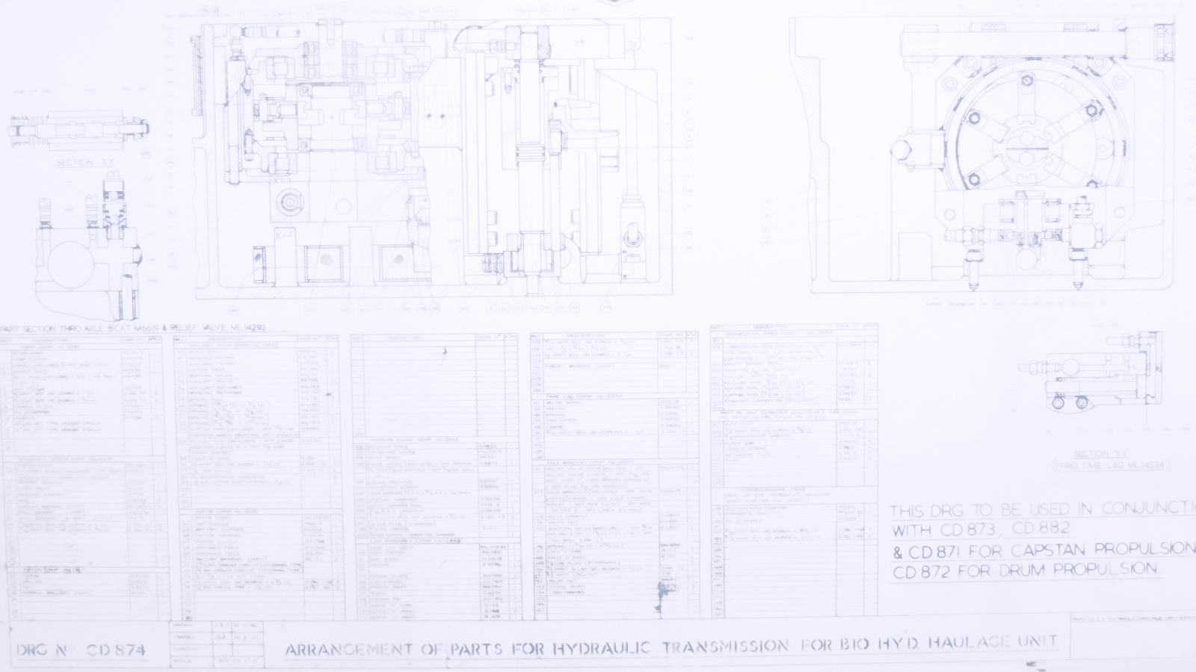
Doing the Right Thing
A quick scamper through serious decision making for the Servant Leader, with a bit of a Benefits slant.
Notes:
Servant Leader / custodian.
Ten minutes’ worth of stuff to consider when you’re in a senior position and are making decisions about other people’s lives and money.

Slide 2
“Benefits Management when it’s appropriate”
There may be situations where, “The popular kids think it’s cool” is sufficient justification to invest.
However, spending public money and messing with people’s lives isn’t one of them.
Notes:
Someone once said in a discussion group that they were in favour of Benefits Management when it’s appropriate.
My view is that it’s always appropriate.

Slide 3
Starting from the top
Behind every business change there are six seemingly naïve questions:
What does ‘good’ look like round here?
What’s the point of this change?
Who is it really for?
What do they actually want?
How do we get this done?
What makes this option better than Plan B?
Notes:
Let’s start from the top, the things to know before you commit.
Behind every business change there are six seemingly naïve questions:
What does ‘good’ look like round here?
What’s the point of this change?
Who is it really for?
What do they actually want?
How do we get this done?
What makes this option better than Plan B?
The questions are simple, so simple that they are rarely asked. There’s that nagging ‘Emperor’s new clothes’ feel to them:
“Am I the only one who doesn’t get this?”
“Are you really that ignorant or just causing mischief?”
“We’re committed now. How much trouble will I cause if I raise my doubts after we’ve invested so much?”
The answers aren’t simple at all though. Your environment is complex and the cost of investigation may be too high. You may have to compromise. That’s fine, don’t let perfection be the enemy of the good. On the other hand, answers like, “It’s priceless” and “How long is a piece of string?” really won’t cut it.
Your colleagues may not know the answers. They may know but not want to tell you. You may learn more about the culture of your organisation than you do about the change you’re planning to make. If asking your own organisation is awkward, asking your customers, suppliers and partners won’t be any easier.
So why ask the questions if they will bring such grief? A few awkward conversations up front will save an awful lot of waste and unpleasantness down the road.

Slide 4
Start with the end in mind
In 1942 why did William Beveridge propose the Welfare State?
A) To address the five “Giant Evils” of squalor, ignorance, want, idleness, and disease
B) To motivate the troops after three hard years of war
C) To ensure his old age was sorted
It’s not only what you do, it’s also why you choose to do it
Answer: A (if you didn’t pick A you are not taking this seriously)
Notes:
The purpose behind any course of action has a direct and significant effect on the way it is undertaken. The reasons why affect the ways we go about things. If Beveridge had just wanted to motivate the troops then it’s unlikely that the Welfare State would still exist today.
A sports analogy, a football manager’s side and tactics will adapt to the objective:
Win at all costs
Put on a show for the fans
Play for the league points
Pace yourselves for the next match
The same applies for any project, the ends affect the means and ways.
Projects talk of acceptance criteria, the things that decide when the project has ended successfully, a sort of, “No-one goes home until…”
Define your acceptance criteria in terms of objectives and benefits before you start. Don’t install the kit and then wonder what to do with it. Too often, projects leave benefits realisation until it’s too late, i.e. at the end of the project. That’s why benefits should be managed from the start.
Some organisations demand a hard financial return.
Some want intangible improvements like satisfaction and image.
Usually, they want both. That’s when conflicting objectives throw a spanner in the works. That’s why clear objectives are crucial.

Slide 5
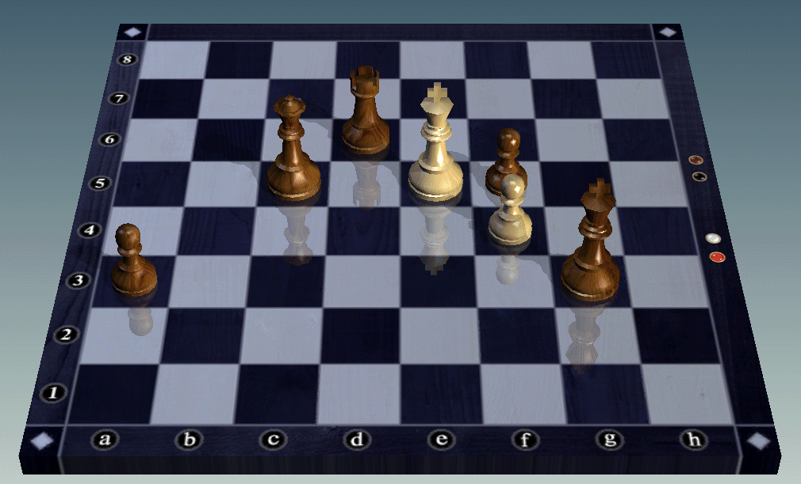
Endgame
The game ends when:
You are checkmated, or
My King is in g3, my Queen is in c5, etc….
Keep it simple, know when you’ve won.
Notes:
In the same way as we can have various reasons for the same outcome and find they affect how it is brought about, we can also affect the process through the way we describe the end state. Only a very confident (or deluded) chess player would describe the endgame in terms of where the pieces will be. Yet we are often very granular in describing our programme objectives. The NPfIT Output Based Specification ran to hundreds of pages with sheets of individual requirements, desires and benefits, a pound here, ten minutes there, etc.
Even if there are dozens of reasons why you need to do something, pick the key one as the purpose behind the objective.
This sort of mass objective twists individual priorities and breaks down any common purpose. In the chess analogy it’s like having a different person responsible for each piece. Each heads for its assigned position and sits there without contributing anything to the whole or supporting its team mates in winning the game.

Slide 6
Which Direction?
ENDS (what we want)
Patients
Partnership
WAYS (what we do)
Clinical Effectiveness
Clinical Efficiency
MEANS (what we have)
Scheduling
Standard Forms
Pride
Performance
Start / Stop / Improve Processes
Record to hand
…
STRATEGIC
Top-down
TACTICAL
Bottom-up
Notes:
Just in case you’re worried that all this ‘end in mind’ stuff comes from an out-dated Command and Control mind-set and we’re all Agile now. Which direction you start from isn’t critical. What’s critical is making feasible connections between means, ways and ends. This slide comes from a pitch to a Trust Clinical Reference Group.
Sitting in a Programme Office, I can offer you the Tactical options: “Here’s something good, what can you use it for?”
I can suggest some strategic stuff from what I’ve learned elsewhere.
However, I don’t do your jobs so I don’t have the obvious and direct experience you have.
There is a risk with this approach that we limit ourselves to the petty stuff, we automate existing tasks and measure our achievements in terms of the stationery budget we’ve saved.
Sitting where you do, you can offer me Strategic opportunities: “Here’s something good we want to do, how can you help us?”
I can’t guarantee results but at least I’ll know where to look.

Slide 7
Features, Outcomes, Benefits
Feature - my car is painted ‘Police Car’ white
Outcome - people move over for me on the motorway so I get home for 6 pm
Benefit - I get to watch The Simpsons on TV, and am happier for it
Notes:
It’s essential that we get a common understanding of what constitutes a benefit.
Here’s a silly example to show the difference between features, outcomes and benefits.
The benefit is what I, the stakeholder get out of the thing. The paint job isn’t a benefit, it’s a feature, a means to my desired end. Getting home for 6pm isn’t a benefit, it’s an outcome, a way to achieve my desired end.
My benefit is the happiness / wellbeing I get from watching The Simpsons.
Remember “Who’s it really for? What do they actually want?” I’m the stakeholder, this is what I perceive to be worthwhile.

Slide 8


Silver Bullets
60-80% of IT related projects don’t deliver benefits
Success = to time & cost
Notes:
5
The Silver Bullet method of project management rarely works. Lots of IT projects just don't seem to deliver the goods. Really successful IT projects happen more by accident than design and are considered a novelty when they should be the norm. Much of this failure can be attributed to the way IT projects come unglued from the business need, processes and people that created them.
Research shows that between 60-80% of IT projects don’t deliver any benefits to the business. When reviews are undertaken project success is usually measured in terms of delivery time and cost. Whether the system is in use or useful is rarely examined. Only something like 20% of projects actually bother to review what benefits were actually delivered.
These figures come from Cranfield research. However, there is a considerable amount of evidence from other sources to support this view most notably Strassmann, P.A. in his report “The business value of computers”.
“The Challenges of Complex IT Projects” a report from the Royal Academy of Engineering and the BCS, April 2004 claims, ‘only around 16% of IT projects can be considered truly successful’. UK spend on IT at the time was forecast at £22.6Bn.
When reviews are undertaken project success is usually measured in terms of delivery time and cost. Is the system in use or useful is rarely examined.
.

Slide 9
Benefits, not Bullets
Lots of activities become unglued from the business need, processes and people that created them.
Benefits Management puts the glue back. It is a structured approach that will:
Make the link between technology and the organisation’s strategic objectives
Build a solid case for investment
Gain buy-in to projects from all participants
Maximise the benefit from the things we do
Notes:
The problem isn’t simply confined to projects. Lots of business activities become unglued from the need, processes and people that created them.
So, how do we escape from this miserable situation? Benefits Management provides a rational framework to enable better decisions to be made and benefits to be delivered.
Benefits Management puts the glue back. It is a structured approach that will:
Make the link between technology and an organisation’s strategic objectives
Build a solid case for investment
Gain buy-in to projects from all participants
Maximise the business benefit from the things we do

Slide 10
Benefits Management
Benefits Management is the best application of scarce resources to select and deliver appropriate benefits to identified stakeholders
“The role of Benefits Management is to lend an element of rationality to the exercise of power.”
Notes:
The purpose behind any Benefits Management methodology is to identify, quantify, prioritise, select and manage business benefits. In essence it is choosing the right things to do, for the right reasons and then doing them.
Benefits Management is the best application of scarce resources to select and deliver appropriate benefits to identified stakeholders.
In the end, we are talking about the exercise of power. That’s always going to be subjective, it’s people making choices. What we can hope to do is add some rationality into the process.

Slide 11
Benefits-led Business
Shared objectives
Stakeholder commitment to the numbers
A few big, genuine benefits
A feasible solution
Rational
Consensus
Compelling
Realistic
Notes:
Done well, Benefits Management provides a rational, consensus set of business decisions. The strength of Benefits Management is that it creates a compelling reason for the project sponsor / champion / stakeholders to act. A benefits-led project will have been chosen because it meets a valid business need with sound, agreed objectives. All the numbers in the business case will have been put there by the stakeholders with evidence to back them up and an owner committed to their delivery. As they are involved in delivery, it will be a manageable amount of change for a few big benefits
The links between the means, ways and ends (enabler to objective) are proved through the BDN. There’s no implicit assumption along the lines of buy kit – get benefit. The cause – effect nets are visible and open to debate and the solution is seen to be feasible.

Slide 12
Psychology of Decisions
Prediction
Optimism Bias
Strategic Misrepresentation
Anchoring
WYSIATI
Delivery
Illusion of Control
Confirmation Bias
Affect Heuristic
Framing
Regression to the Mean
Notes:
Here’s the sort of thing that interferes with rational decision making. We know they exist. We have optimism bias in our business cases. Everyone does unconscious bias training. And yet, we forget about them when making big decisions.
There’s some excellent stuff on the ways that psychology affects economic decision making in Daniel Kahnemann’s book Thinking, Fast and Slow.
Prediction – pre Business Case
Optimism Bias – Expecting too much in terms of results, cost and time despite previous experience. This is now recognised and often included in business cases. Which means people have started gaming with it, claim double .
Strategic Misrepresentation – Flyvberg, conscious deliberate lying to get the business case approved. International analysis of transport infrastructure, just about every business case lied about the potential benefits to be achieved.
Anchoring – Anchor on the first estimate, no matter how inaccurate and then fail to change sufficiently despite knowing it was wrong. It’s why salespeople start on an impossibly high note, “This is the best thing since sliced bread”. It will still feel that way even when the facts have destroyed their argument.
WYSIATI – What You See Is All There Is (Kahnemann), ignoring the existence of other evidence, failing to look for alternatives.
Delivery – work in progress
Illusion of Control – Assuming it all goes to plan… Belief that you have full control of the situation, not mitigating the risks.
Confirmation Bias – Filtering the evidence to fit your expectations, seeing only what you want to see.
Affect Heuristic – Seeing the positive in things (and people) we like, and negative in things we don’t. The halo effect of the singer, not the song.
Framing – Making a choice dependent on the way the options are phrased. “It could be you!”, or “It’s almost certain it won’t be you.” Good news / bad news stories in performance reports.
Regression to the Mean – A knee-jerk reaction to a one-off. Reward and punishment are both usually followed by a more average result, hence we believe punishment motivates.

Slide 13
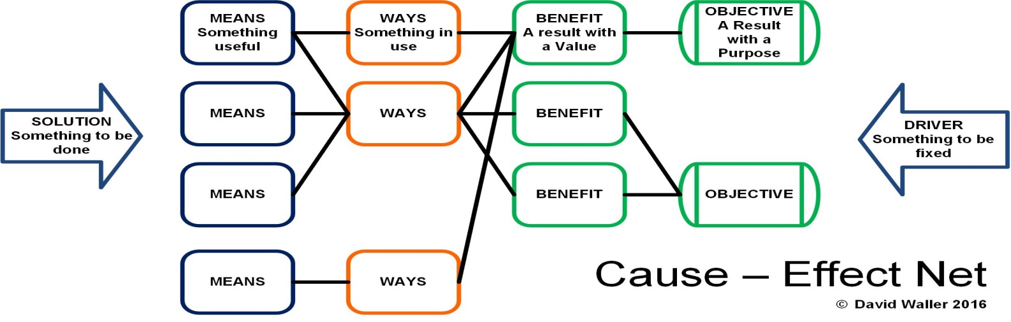
A small heresy
We’re not in it for the benefits
We’re in it for the strategy
Notes:
Benefits Management supports better delivery of strategy. Concentration on benefits is better than what we had before. But it’s only part of the story. Now we’ve got an emphasis on benefits that may not be strategic. Lots of piecemeal rewards that don’t add up to a strategic whole.
It takes leadership commitment to make the move from Benefits to Strategy.

Slide 14
“Benefits Management when it’s appropriate”
“What is becoming clear however is that we have found a robust, rational framework for setting objectives, managing projects, shaping communications and defining success that works for us. Furthermore it is an approach which, once mastered, can be applied to almost any key business decision, giving us the benefit of foresight rather than hindsight.”
Bob Sunley Yorkshire Ambulance Service (HSJ Good Management Oct 07)
Notes:
A reminder that BM works, why it’s always appropriate. Here’s a quote from the YAS testimonial piece.

