Slide 1
The Goal Model
More than Benefits Mapping
“Yet there is the constant desire to find some point in the twisting, knotting, ravelling nets of space-time on which a metaphorical finger can be put to indicate that here, here, is the point where it all began…”
- Terry Pratchett, Hogfather
Notes:
“Everything starts somewhere, although many physicists disagree.
But people have always been dimly aware of the problem with the start of things. They wonder aloud how the snowplough driver gets to work, or how the makers of dictionaries look up the spelling of the words. Yet there is the constant desire to find some point in the twisting, knotting, ravelling nets of space-time on which a metaphorical finger can be put to indicate that here, here, is the point where it all began…”
- Terry Pratchett, Hogfather
Start with the end in mind. I’ve never been totally happy with the focus on benefits over objectives. It’s always felt incomplete. Benefits Realisation / Benefits Management doesn’t provide sufficient emphasis on purpose or strategy. Too often, benefits are rewards promised so people will permit, enable or justify decisions that have already been made. The Benefits Map or Benefits Dependency Network ought to be a serious tool for selecting and delivering value from change. In many cases, it isn’t used at all. In others, it doesn’t produce the quality results that it could because it draws us to small tactical benefits (rewards to keep the users happy) instead of big strategic objectives.
The Goal Model is a type of Benefits Map / Benefits Dependency Network. However, its scope is broader than benefits and it applies to more than projects so I took ‘Benefits’ out of the name. By modelling Goals instead of mapping Benefits, I hope to keep the emphasis on purpose and strategy.
The Goal Model is a picture that shows the net of resources and their cause-effect applications between an initiative (process, project, programme, portfolio) and the strategic objective(s) to which it contributes.

Slide 2
Starting from the top
Behind every business change there are six seemingly naïve questions:
What does ‘good’ look like round here?
What’s the point of this change?
Who is it really for?
What do they actually want?
How do we get this done?
What makes this option better than Plan B?
Notes:
Let’s start from the top, the things to know before you commit.
Behind every business change there are six seemingly naïve questions:
What does ‘good’ look like round here?
What’s the point of this change?
Who is it really for?
What do they actually want?
How do we get this done?
What makes this option better than Plan B?
The questions are simple, so simple that they are rarely asked. There’s that nagging ‘Emperor’s new clothes’ feel to them:
“Am I the only one who doesn’t get this?”
“Are you really that ignorant or just causing mischief?”
“We’re committed now. How much trouble will I cause if I raise my doubts after we’ve invested so much?”
The answers aren’t simple at all though. Your environment is complex and the answers will blend and overlap with each other. One good way to look at your answers is to map them out with the Goal Model.

Slide 3
Mapping – what’s it good for?
Plan on a page / MSP Blueprint – a diagram that describes the enterprise. A summary of Means, Ways and Ends
Project planning chart – like a PERT chart that shows interconnected project activities, the Goal Model shows a detailed rational set of paths from solution to objectives
Solution design – the model is a tool for making rational choices of what’s required and how it will be achieved.
Stakeholder involvement – the activity of creating a Goal Model attracts people to take part and motivates them to contribute to the enterprise.
Notes:
What’s it for?
The purpose(s) of using a Goal Model are:
• Plan on a page / MSP Blueprint – a diagram that describes the enterprise. A summary of Means, Ways and Ends
• Project planning chart – like a PERT chart that shows interconnected project activities, the map shows a detailed rational set of paths from solution to objectives
• Solution design – the map is a tool for making rational choices of what’s required and how it will be achieved.
• Stakeholder involvement – the activity of creating a map attracts people to take part and motivates them to contribute to the enterprise.

Slide 4


Models
Models reflect reality
Scale and detail appropriate to purpose
Notes:
Models reflect reality so adapt the model to reality, don’t squeeze reality to fit the model.
Appropriate scale and detail. These models do very different jobs. The same goes for Goal Models. A simple PowerPoint slide is the balsa and rubber band job that convinces your Board that the project will fly. The Vulcan has sufficient in it to get airborne. The Corsair in the middle has the meticulous detail that some planners may want to see.

Slide 5
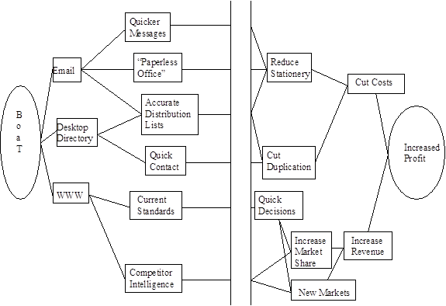

My first map
Notes:
Office Automation in BT (BOAT), from BOAT BM Process May 1996
To show you that skills improve with practice. My map of BT’s intranet (BoaT) features on the left, results on the right, and a gap in the middle for business units to link the two with their business activities.

Slide 6
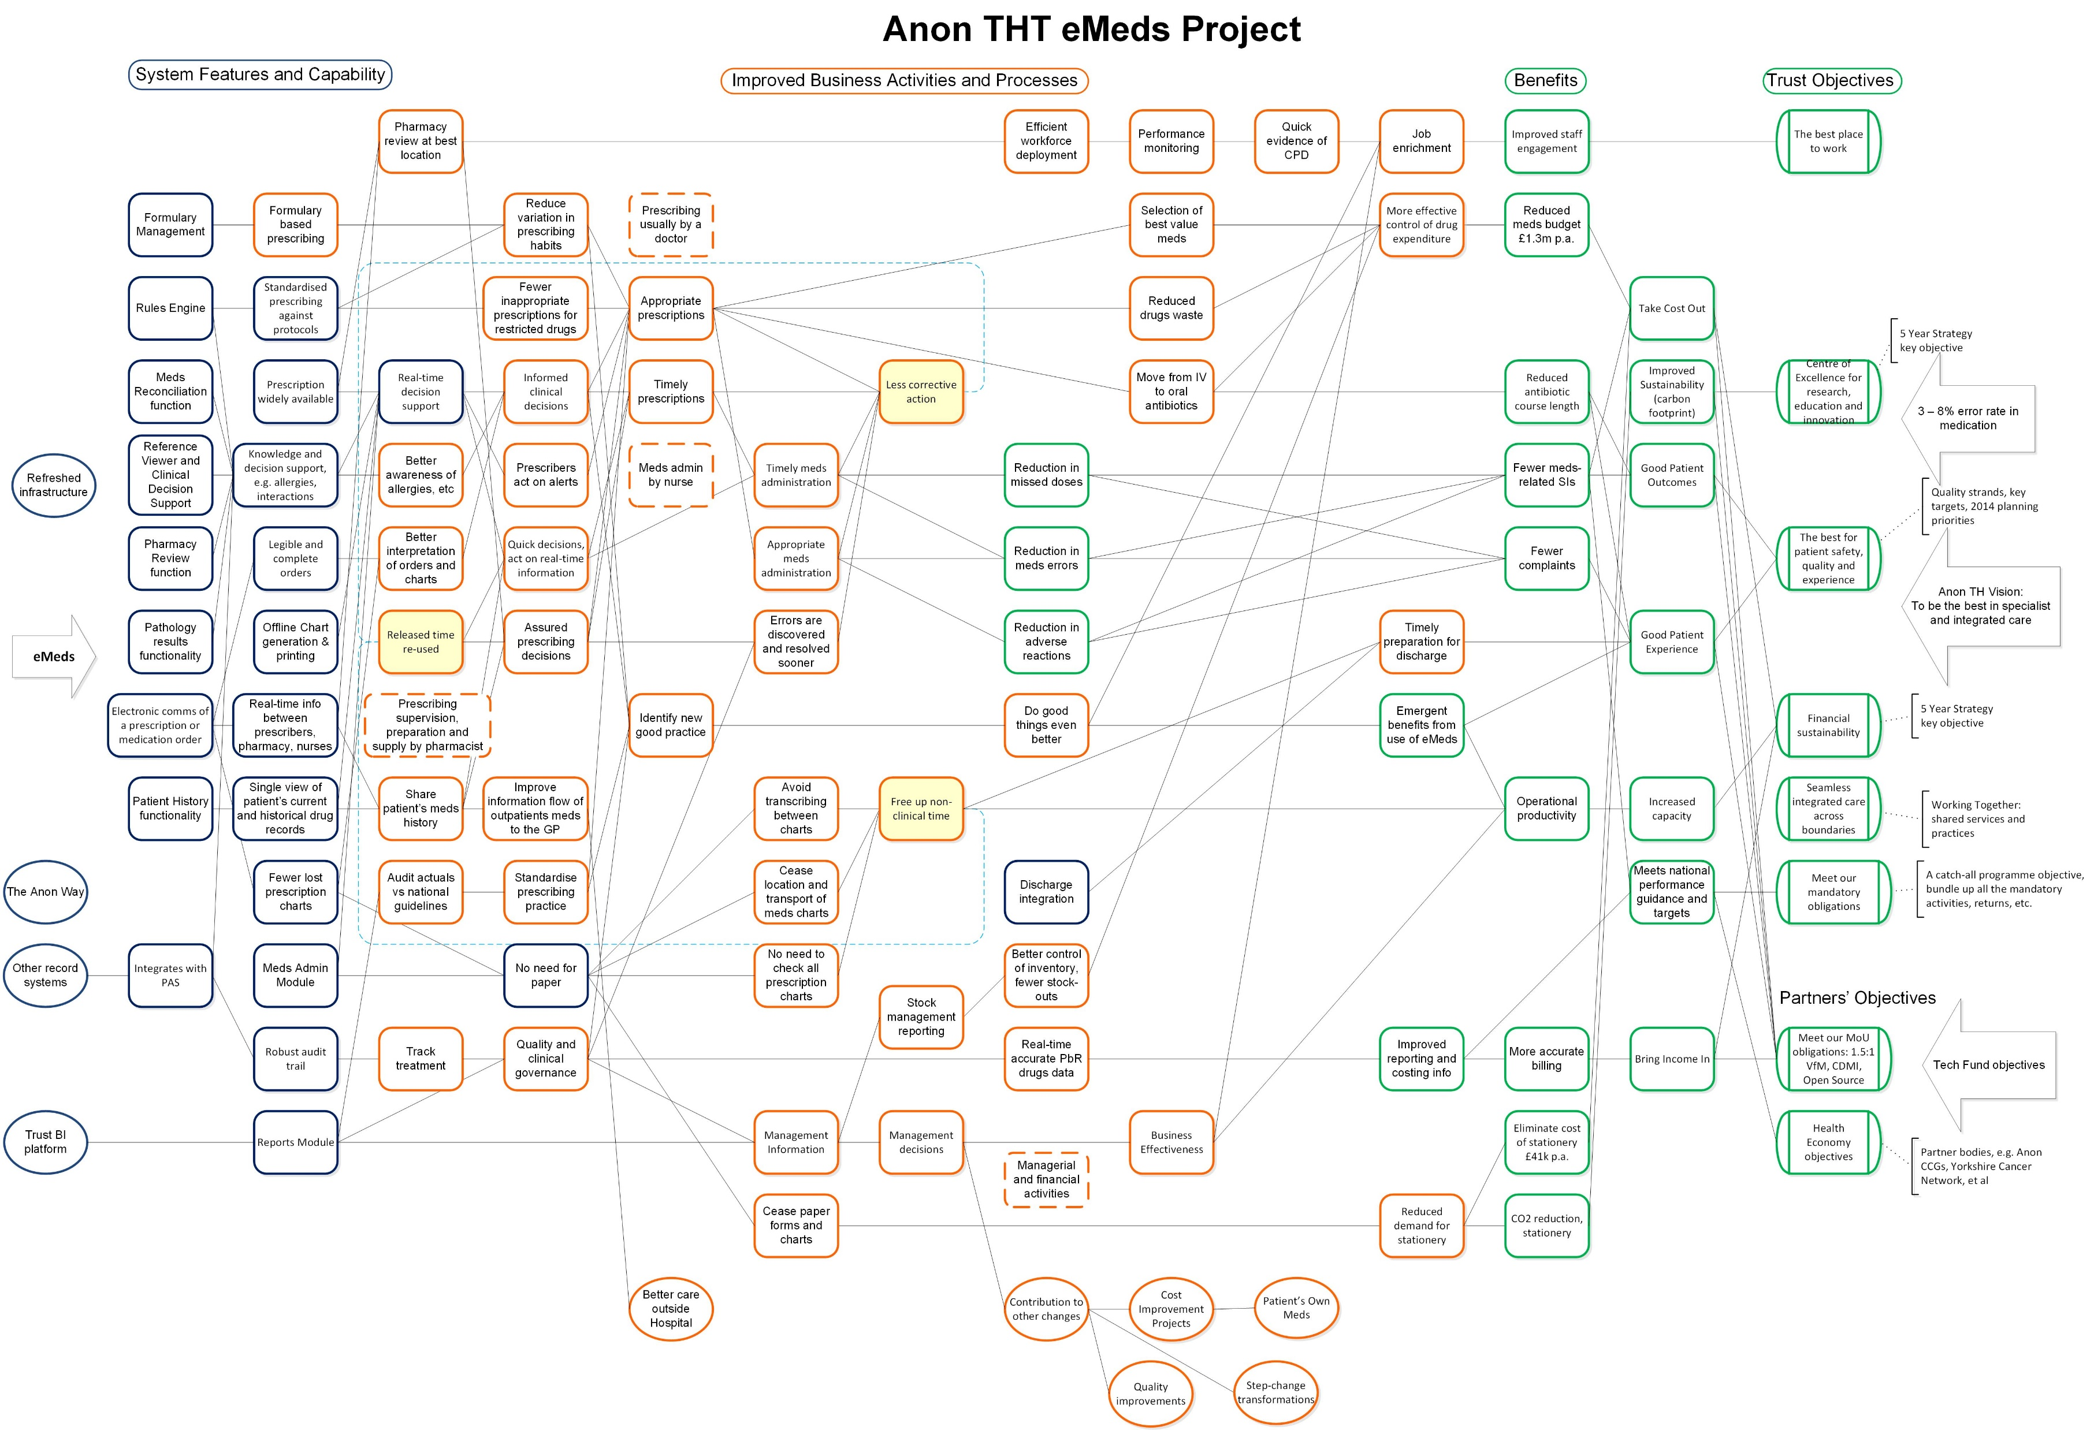
A more up to date one
Notes:
This is one from 20 years after, electronic medicines management in a teaching hospital. I’ve moved on a bit since the days of BoaT.

Slide 7
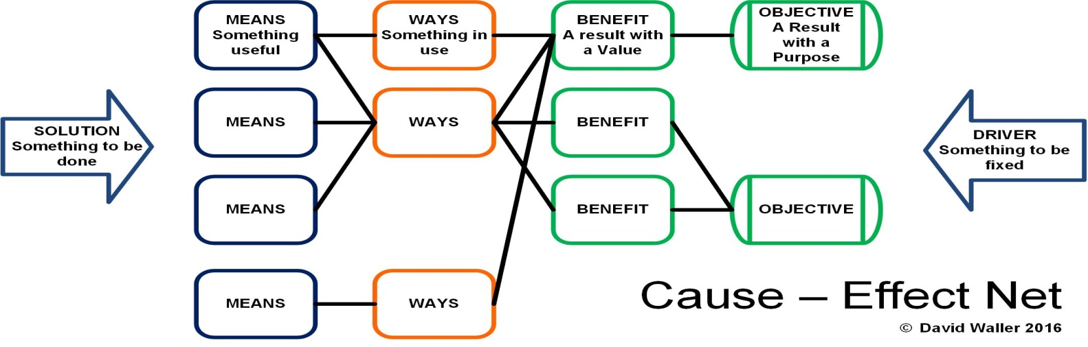
A small heresy
We’re not in it for the benefits
We’re in it for the strategy
Notes:
The Goal Model is a type of Benefits Map. The issue with most Benefits Maps is that the name focuses people on the benefits and not the strategic objectives that those benefits are meant to support. This can lead to poor or irrelevant benefits. Concentration on benefits is better than what we had before. But it’s only part of the story. Now we’ve got an emphasis on benefits that may not be strategic. Lots of piecemeal rewards that don’t add up to a strategic whole.
The emphasis here is on strategy, picking sound objectives and relevant benefits that contribute to them.
It takes leadership commitment to make the move from Benefits to Strategy.

Slide 8
Goal Model
Layout and Contents
Notes:
This is what the generic model looks like, what it contains and some example categories to help sort the content.

Slide 9
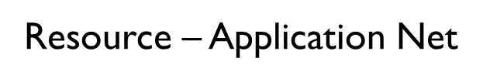
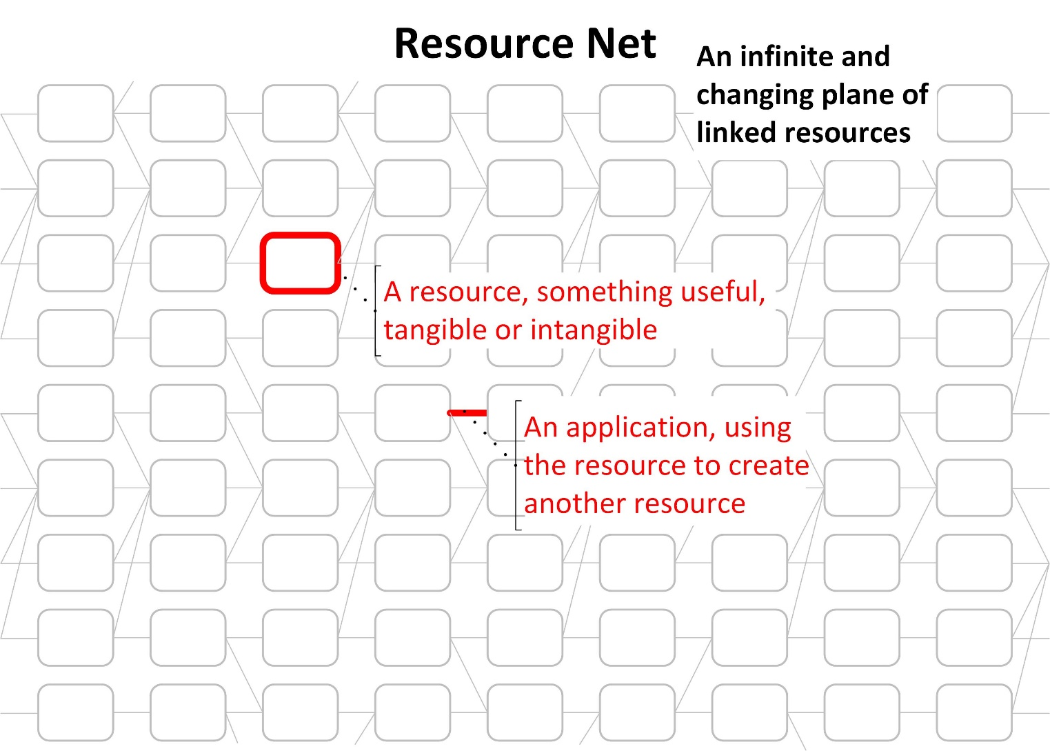
Never-ending links
Notes:
Think of your project’s Goal Model as sitting on an infinite and changing plane of resources connected by how they are applied. The box describes a resource, an asset, something useful. It may be tangible, a physical item or an intangible one, e.g. skills or software. It could be a process.
The connector describes the application of the resource, the way it is converted to the next resources in the model.

Slide 10
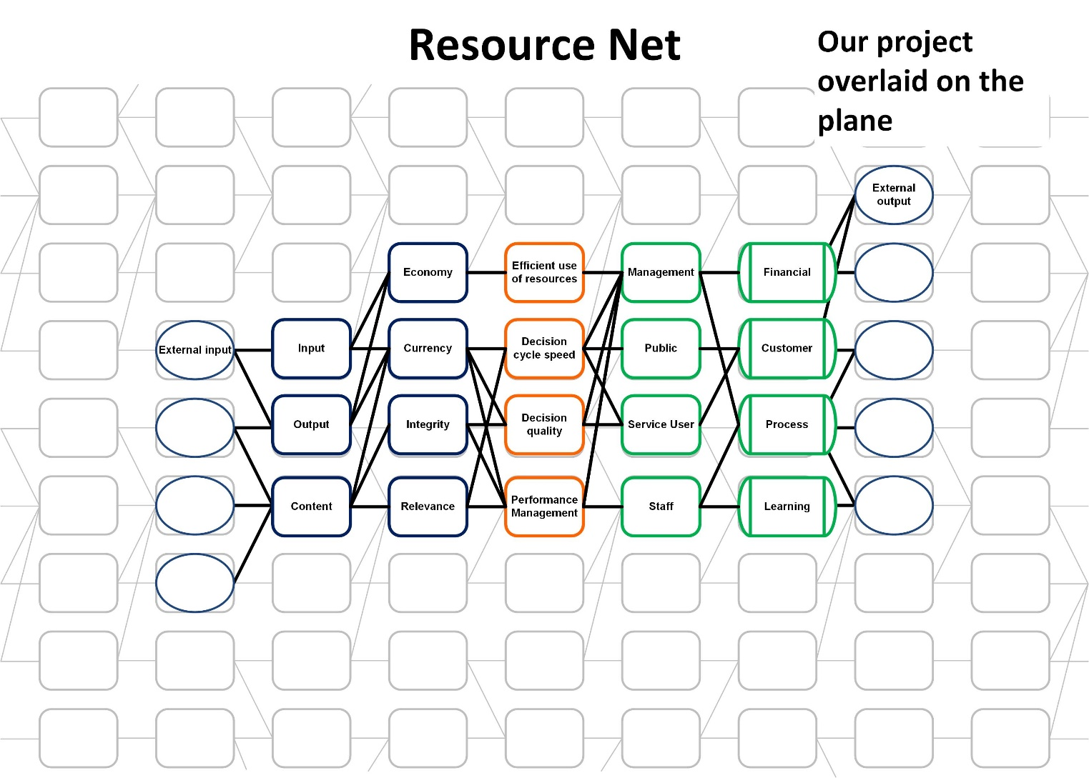
Sitting on the plane
Resource – Application Net
Notes:
The model we build for our initiative (programme / project / service / process) sits on this plane. At some stage we will bring in resources from outside. We can’t use the firm’s van without the resources that made it and sold it to us. We in turn contribute to dependent enterprises. The profit we make will be spent somewhere. The services we provide have customers who use them for their own ends.

Slide 11
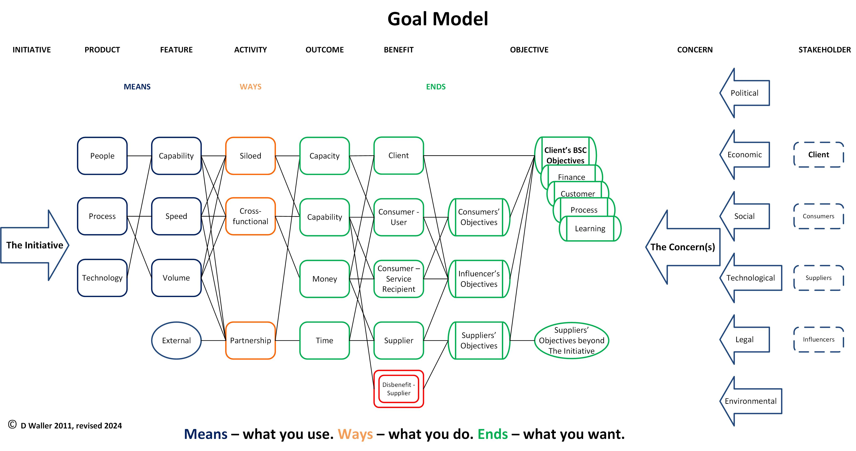
The Goal Model
Notes:
This is a quick summary of what the completed Goal Model will contain. It’s a map of the cause-effect nets between the Concern(s) to be addressed and the Initiative that addresses it.
This one has means to ends flowing left to right. So long as you keep the same order, it doesn’t matter which direction you prefer.

Slide 12
The business environment
What’s happening around you? How do you fit into it all?
Concerns summarise the business environment, the context in which you operate. They can be described as the Problem Statement that triggers a change.
Stakeholders are the people / groups / entities who impact and are impacted by the change
Client
Consumers
Suppliers
Influencers
Externals – resources outside your direct control, dependent projects or the stakeholders’ objectives outside your Initiative
Initiative – the change your client wants, with a feasible scope and clear boundaries
Notes:
The first naïve question we asked at the start, “What does good look like?” The Goal Model sits in the business environment, the context in which you operate. It’s essential to understand where you fit into the overall scheme of things.
There are two categories in the context, Stakeholders and Concerns. Together, they give you the things that need to be addressed, your reasons to act.
Concerns are the things that prompt action to be taken, often described as the Problem Statement that triggers a change.
Stakeholders are the relevant actors, impacting and / or impacted by the initiative
Client
Consumers
Suppliers
Influencers
Some items may be marked as ‘External’, outside inputs and outputs e.g. dependencies, Means and Ways outside the programme’s control, or the suppliers’ objectives beyond The Initiative.
The Initiative is the bounded solution, the overall business change to be made, the programme or project. The Client, the ultimate stakeholder, wants the Initiative for their own objectives and benefits. They permit the objectives and benefits of the consumers, influencers and suppliers.

Slide 13
Concerns
Concerns are the things that prompt action to be taken. They may be straightforward, such as a direct order from above, or more subtle like personal beliefs and mores. PESTLE is one method of categorising Concerns
Notes:
Concerns are the things that prompt action to be taken. They may be straightforward, such as a direct order from above, or more subtle like personal beliefs and mores. PESTLE is one method of categorising Concerns.
The Concerns summarise the business environment, the context in which you operate, often described as the Problem Statement that triggers a change.
For the simplest change there may be only one Concern: “Our client demands that we do X”. You may face many Concerns. They will have to be sifted and prioritised if you are to manage them. Plotting them on the model is a strong visual way of appreciating what’s rational and feasible. The key Concern(s) sits closest to the Objective. The others sit further out, in decreasing importance.

Slide 14







Stakeholders
The relevant actors, impacting and / or impacted by the initiative
Client
Consumers
Suppliers
Influencers
Notes:
Stakeholders are the relevant actors, impacting and / or impacted by the initiative. They may be individual people, groups or entire populations.
Client
There is only one Client. The Client is the stakeholder who wants the initiative and pays for it. Sponsor or SRO are types of Client. They act for themselves, the consumers and influencers.
Consumers
Consumers are the ones using the new initiative and / or receiving its effects, e.g. staff and their customers. They live with the results but they may not have much direct control over it.
Suppliers
Suppliers give the client what they want. Consumers acting in the design and implementation of the initiative are temporary suppliers. The same stakeholder can play more than one role.
Influencers
Influencers is a much broader group of stakeholders, allies, adversaries and indifferents, some of whom play no practical role in the initiative but who affect the client’s decisions. Consumers and suppliers are groups of influencers in that they can directly affect the initiative. Your competitors are major influencers.

Slide 15
The Initiative
A bounded solution, the overall business change to be made, the programme or project.
The Client, the ultimate stakeholder, wants the initiative for their own objectives and benefits. They permit the objectives and benefits of the consumers, influencers and suppliers.
Notes:
The Initiative is a bounded solution, the overall business change to be made, the programme or project. Naming it helps to set the scope and the boundaries. Remember naïve question 2, ‘What’s the point?’ The Initiative is the point. Its description must be concise and meaningful.
The Client, the ultimate stakeholder, wants the initiative for their own objectives and benefits. They permit the objectives and benefits of the consumers, influencers and suppliers.

Slide 16


Ends
Objectives
Benefits
Outcomes
Notes:
Naïve questions 3 and 4, “Who’s it really for and what do they actually want?”
Ends are what you want to achieve. They are Outcomes that lead to Benefits that in turn lead to Objectives.
Objectives
Balanced Scorecard is one way of categorising objectives. Alternatively, you may have specific local categories, e.g. the organisation’s Five Year Plan.
Client’s BSC Objectives
• Finance
• Customer
• Process
• Learning
There may be separate sets of objectives for each stakeholder group but the Client’s take precedence. These may all be shown in the single model or acknowledged and referred out to, e.g. supplier’s profit is their concern and not necessarily a key part of the client’s initiative.
Objectives should be SMART. Concerns might be nebulous, e.g. mission and vision statements, customer wants, etc. but Objectives have to be pretty firm. If you are going to be judged on how well you achieved your Objectives, then you need an agreed way to measure them.
Benefits
Benefits can be split by the stakeholder group that receives them, or by type (cash, non-cash, etc.) A Benefit contributes to an Objective and comes from the Outcomes.
Disbenefits are the negative result or detriment to a stakeholder. Categorise them the same way as Benefits.
Outcomes
Measurable outcomes are produced by the Ways. Outcomes may be resource created / released:
Capacity
Capability
Money
Time

Slide 17
Ways
The Activities that consumers do and how they do them. Business processes that use the Means and produce the Outcomes. They are likely to fall somewhere in this How / What matrix.
How \ What | New | Changed | Stopped | Maintained
Siloed
Cross-functional |  | HR / Finance reviews now in real-time
Partnership
Notes:
Ways are the Activities that consumers do and how they do them. They are business processes or personal actions that use the Means and produce the Outcomes. They are likely to fall somewhere in this How / What matrix. E.G. ‘HR / Finance reviews now in real-time’ is a cross-functional process (HR and Finance) that has been changed from how it used to be done (say, weekly) to how it’s done now (real-time).
They are not business changes. They are business activities in the new ‘to be’ state, after the change has been made. There’s nothing here about how HR/Finance reviews were moved to real-time.

Slide 18
Means
The resources that consumers use. New or changed assets that enable the Ways
Product
Feature
Notes:
Means: the resources that consumers use. They are new or changed assets that enable the Ways.
Means begin with the Product, a tangible or intangible asset provided by the Initiative.
Change Managers may categorise them:
People
Process
Technology
Features are the specific things that make the Product relevant and useful in context. Typically, they may be speed, volume or relevant capability.

Slide 19
Externals
Some items may be marked as ‘External’, e.g. dependencies, Means and Ways outside the projects’ control, or the suppliers’ Objectives outside the Initiative.
Notes:
Some items may be marked as ‘External’, e.g. dependencies, Means and Ways outside the project’s control, or the suppliers’ objectives beyond the Initiative.
They are shown in the model in an ellipse so they stand out from the internal stuff.

Slide 20
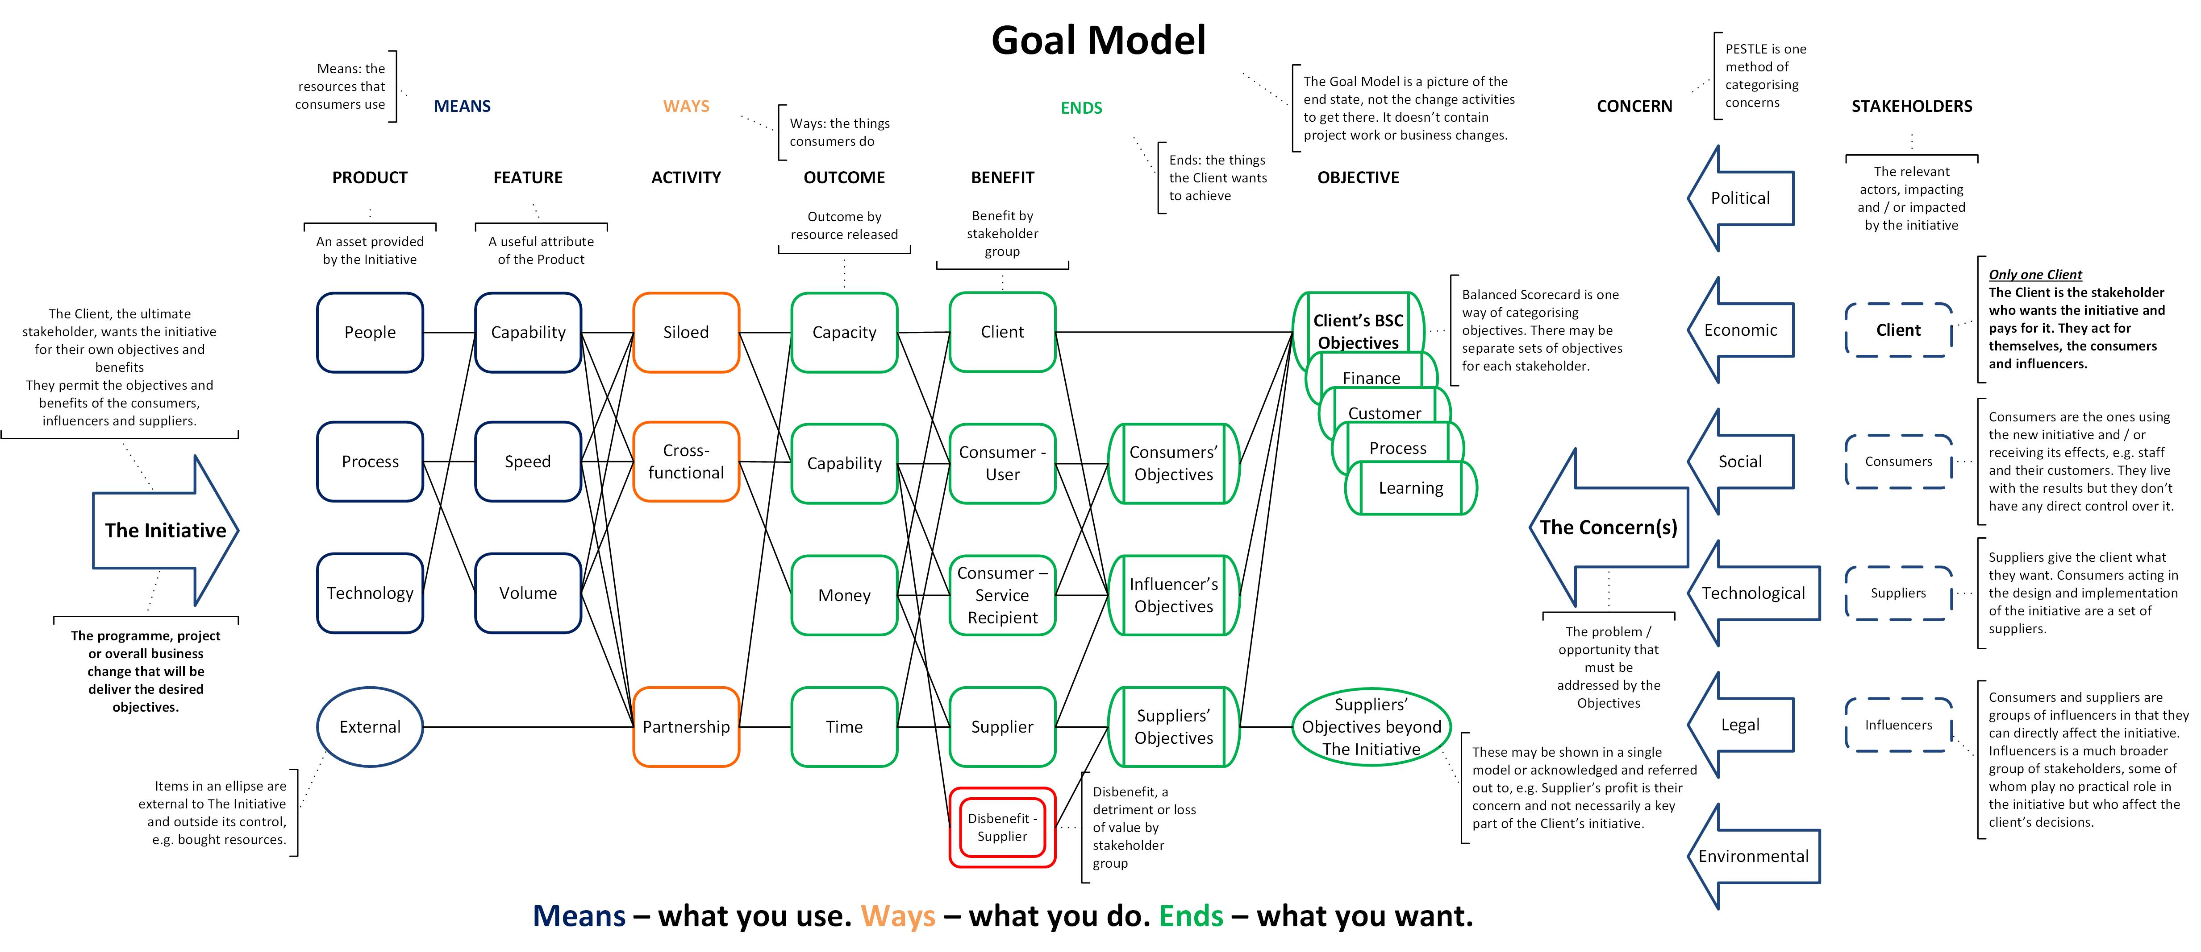
The Goal Model
Notes:
A more detailed summary of what the completed Goal Model will contain. It’s a map of the cause-effect nets between the Concern(s) that has to be addressed and the Initiative that addresses it.

Slide 21
Goal Model
Considerations and approach
Notes:
We’ve covered the layout and content of the Goal Model. Here are some factors to consider when creating one.

Slide 22
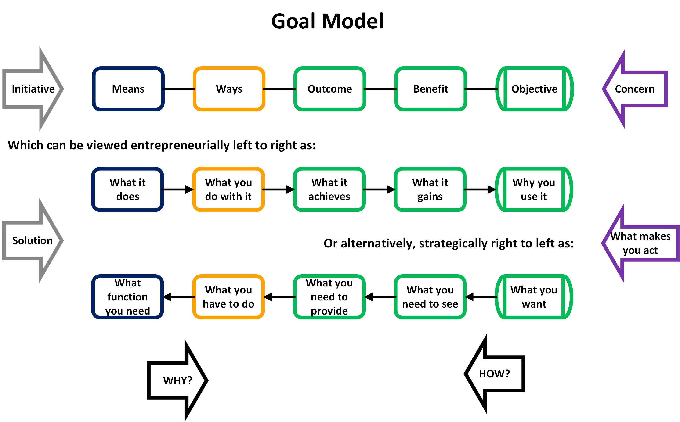
Bi-directional – no arrows
Notes:
The model is bi-directional. You can come at it from either end. We don’t use arrows for the connections as that would influence people’s choices of what to put in it.
However, sometimes you’ve already been given the starting point that sets the direction. You’re going to get a new resource and need to make the most of it, “We’re swapping phones from Android to Apple next month.” That means the left to right tactical / entrepreneurial approach. Entrepreneurial sounds more positive, taking advantage of the new thing. Tactical feels more like making do with it. Starting with what’s useful about the new situation, you work through what you could do with it to what you could get out of it.
Alternatively, you may have been set a new objective, “10% budget cut this year.” Then, you work right to left from the high-level target through the things you’ll have to do differently to the stuff you’ll need in order to do so.
Starting on the left, you ask ‘Why?’ to make the connections, ‘Why use this tool?’
Starting from the right, ask ‘How?’ ‘How will I meet my objective?’

Slide 23
Connections – it’s the bond that counts
The model looks like this, atoms linked together by bonds.
Reality is more like this, there’s no gap, no link. The atoms run into each other to make something that behaves very differently from its separate parts
Notes:
At the start, I talked about the Resource – Application Net. The connector describes the application of the resource, the way it is converted to the next resources in the model.
The application is the important item on the model but it’s difficult to show how important it is in the picture. We end up with descriptions in boxes and assume that there is a valid and important reason behind the thin line that connects them.
In chemistry, it’s the bonds between atoms that make molecules that behave very differently from their constituents. But you don’t appreciate the importance of the bonds from the diagram. Likewise in the Goal Model, it’s not so much the nodes, more the connections, the ‘so what’s between the nodes. Means A allows Way B, or Way B needs Means A. The applications make the model.

Slide 24
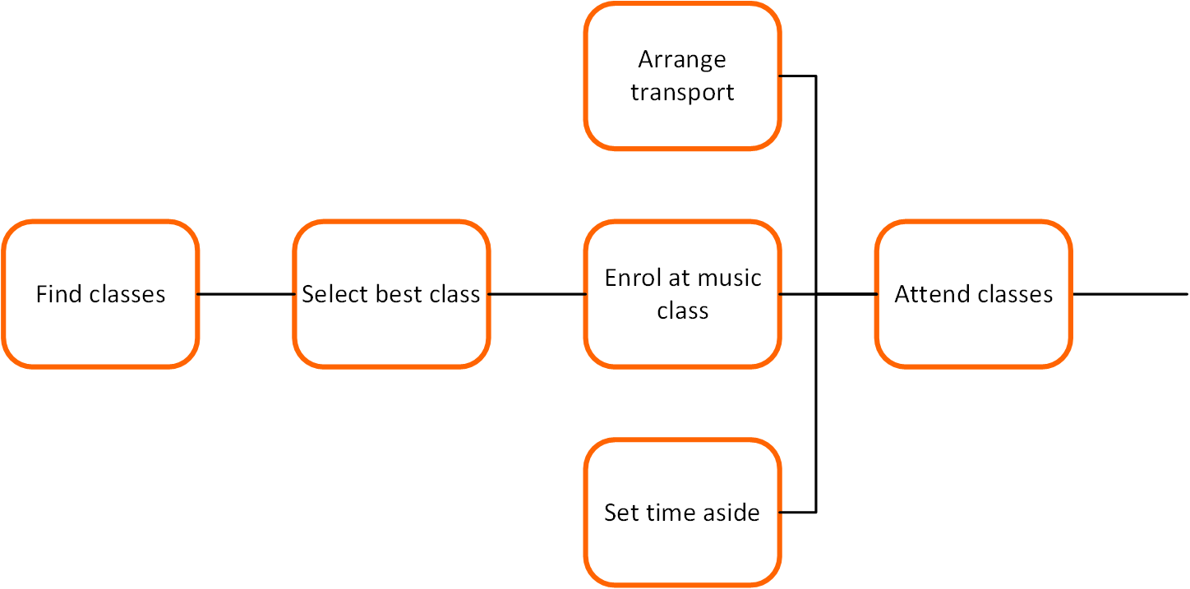
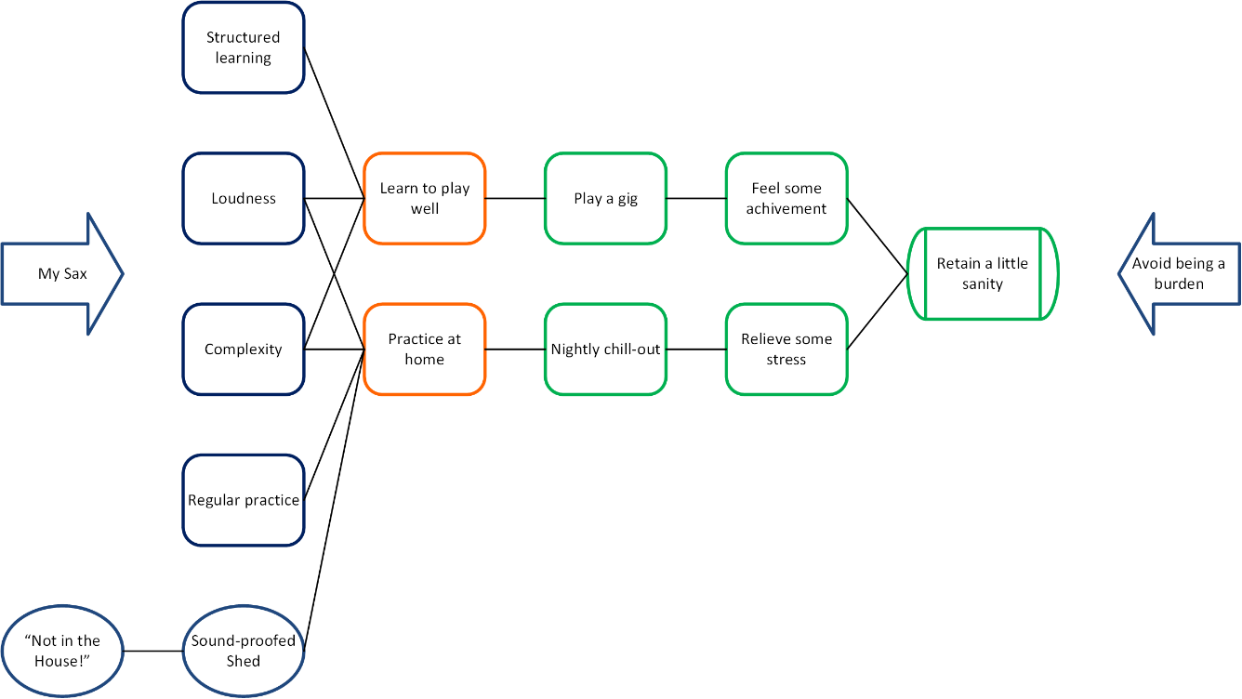
No Work or Change in the Goal Model
Work Breakdown – Attend Classes
Notes:
Unlike some Benefits Maps, project Work and Business Change don’t belong in the Goal Model. The Model is all about the ‘to be’ state and not the stuff that has to happen in order to get there.
This is a simple example Goal Model from a lesson on Benefit Maps and MSP. It’s a silly story about a programme to take up the saxophone as a hobby.
Here’s what happens when Work and Business Change is included. I’ve attached the project activity to deliver the Product of ‘Structured learning. It bulks out the picture, but doesn’t add anything to the means - ways- ends story.
The project activity and business change are obviously important and must be recorded somewhere. But not here.

Slide 25
3D Overlay – Work Breakdown
Notes:
The project activity belongs outside the model. The two diagrams of Work Breakdown and Goal Model intersect at the product / feature of Structured learning. Each Product in the Means will have Product and Work Breakdowns behind it. It’s also likely that activities in the Ways section will also have similar breakdowns for the business changes and assumptions around them. They can’t all fit in the model, but they are important things to consider. Behind each resource and application is a set of assumptions and risks that can’t be ignored. Putting them all in the Model will make it unusable. However, if you have one or two critical items that you can’t afford to ignore, then annotate your Model with some brief comments.

Slide 26
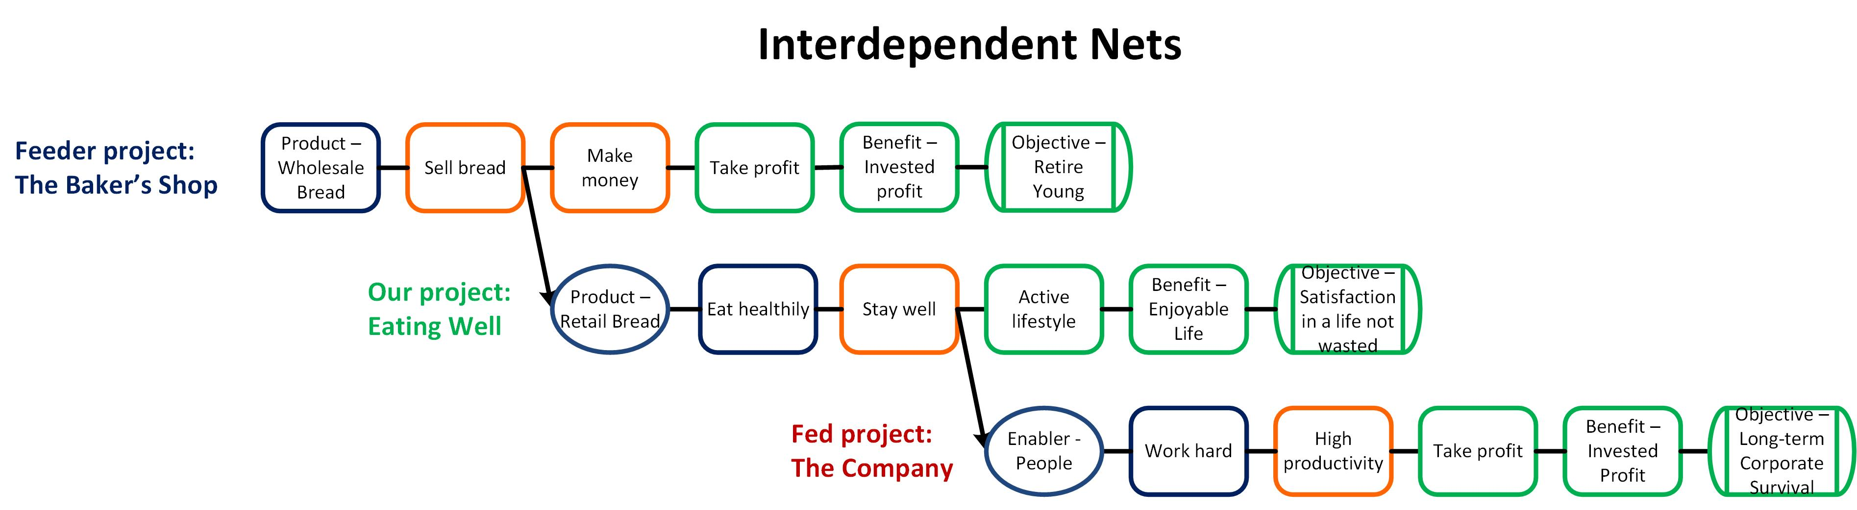
Setting some boundaries
Decide the limits of your responsibility
Notes:
Your Model sits on an infinite Resource – Application Net, so it’s important to draw sensible boundaries around what’s yours to control. Carefully naming the Initiative helps. So does the clear marking of the External factors.
Here’s an example of interdependency, looking at the Goal Model as a chain of resource – application. I take a resource and do something that converts it into new resources that I or others can use in turn. Consider a production line assembling components into a car. One component was itself made on another production line from individual parts, and so on. Even the metal ore it came from had to be extracted with tools that came from yet more production lines.
This is why we have to set boundaries to limit our responsibilities. Take the example above, it’s not our job to see that the shopkeeper retires young. Nor is our life lived in the sole aim of keeping the company going. Duty, moral obligation, friendship, pride may all link our projects so the shop and company drive us to some extent. The skill comes in deciding the limits of this driving influence.

Slide 27
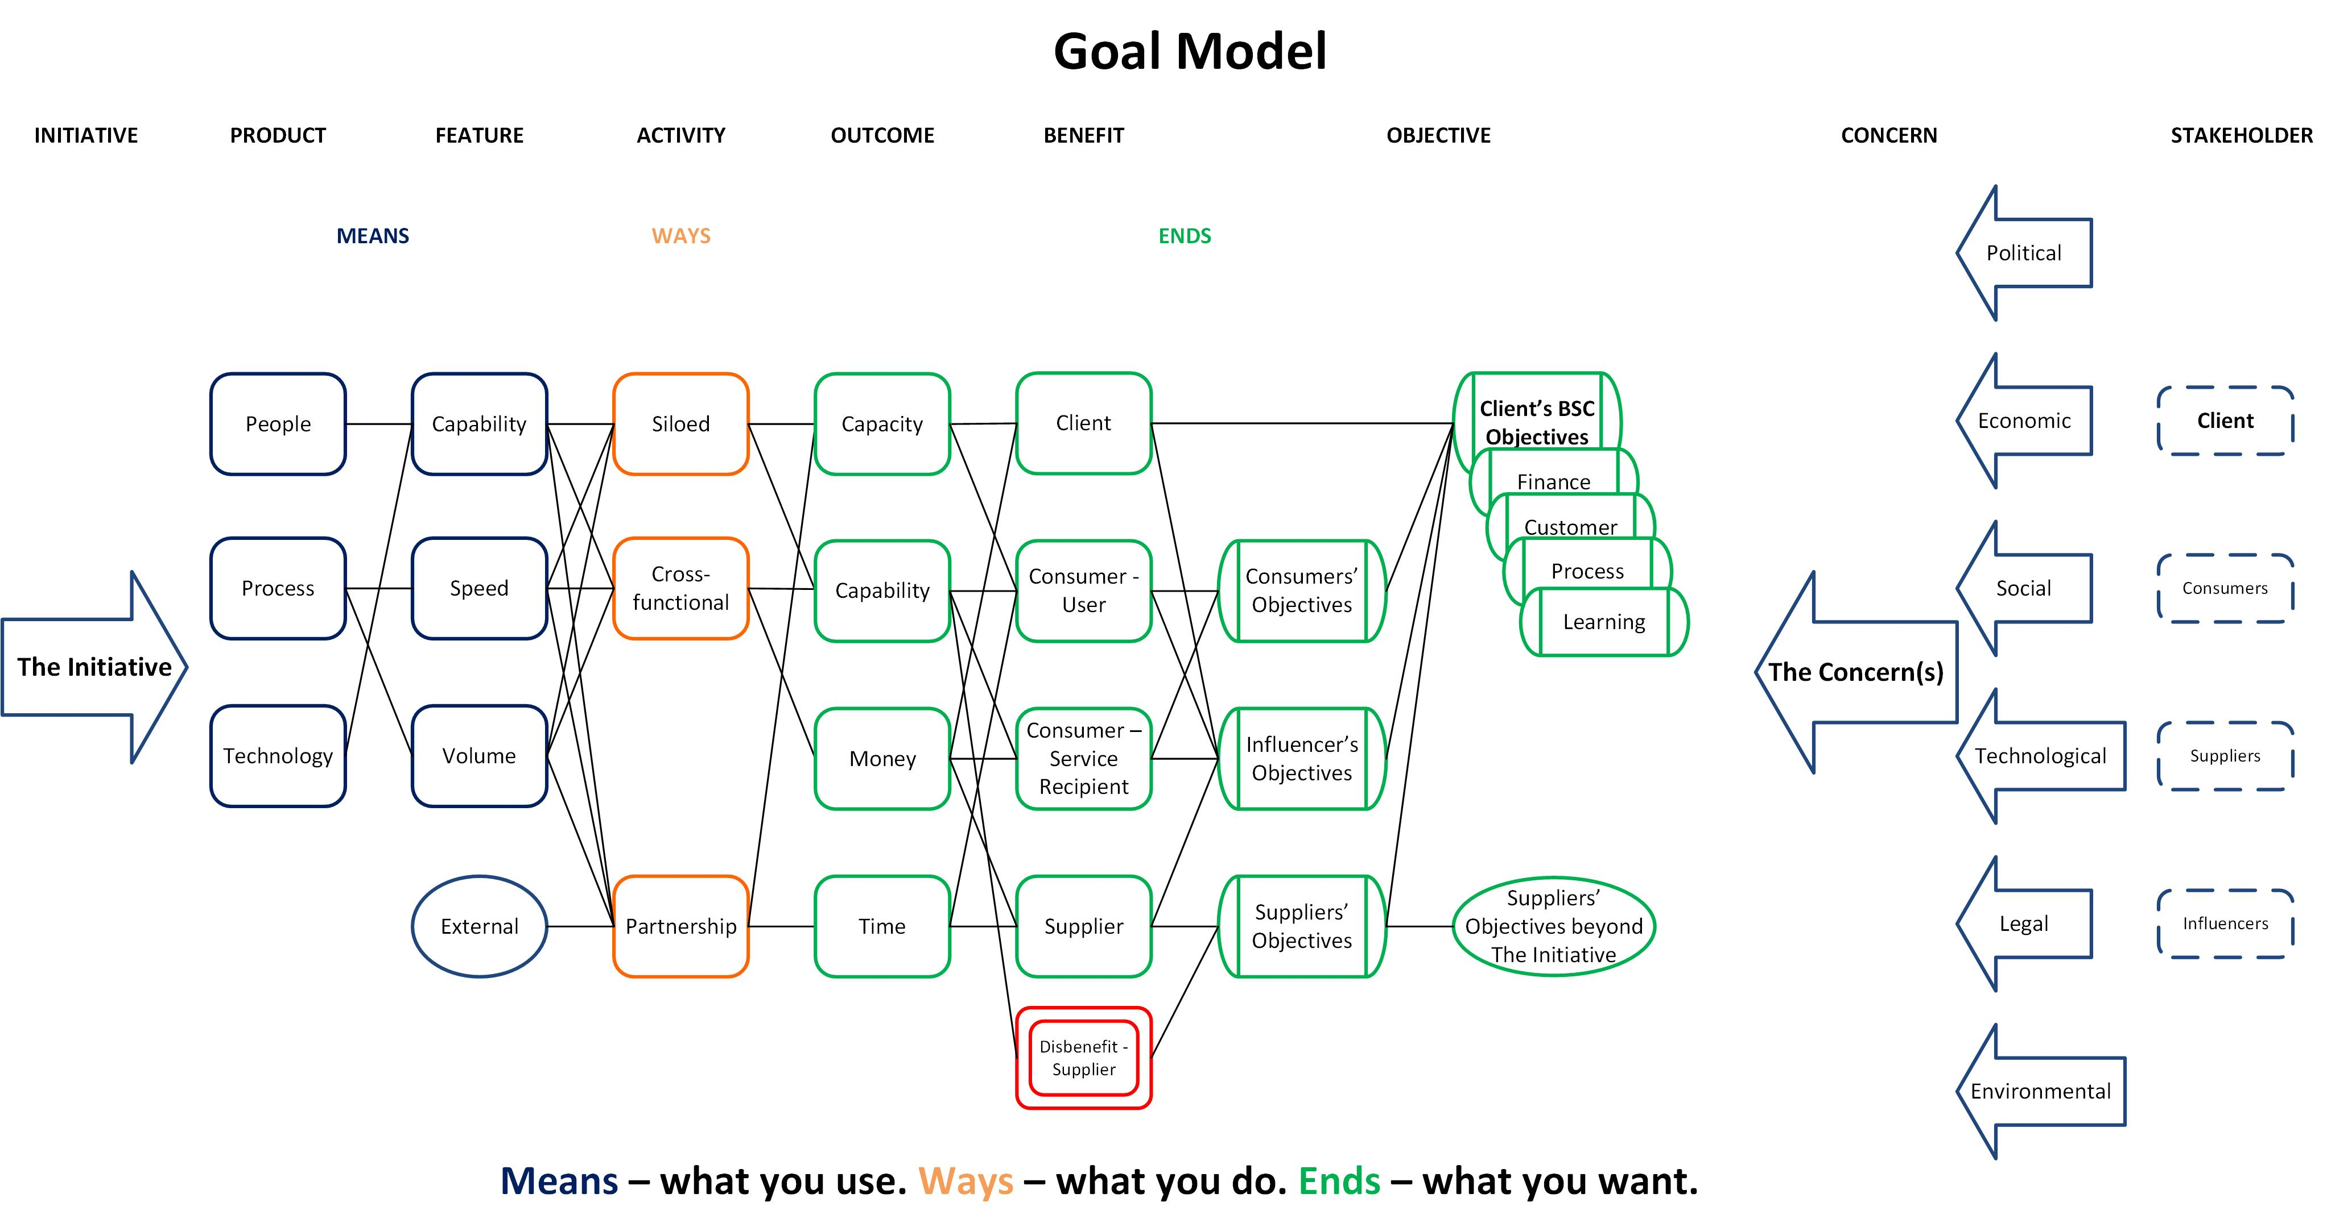
What makes this the best choice?
Six questions answered
What does good look like?
Who’s it for?
What do they want?
How do we do this?
What’s the point?
Notes:
Remember the six naïve questions asked at the start of this lesson? This is how the Model fits with them.
What does ‘good’ look like round here? The Concerns and Stakeholders cover the business context for the Initiative
What’s the point of this change? The Initiative, explained concisely in plain language.
Who is it really for? What do they actually want? Benefits with obvious recipients, linked firmly to sound Objectives.
How do we get this done? The Means are the necessary products. Knowing them helps decide the processes to create them.
What makes this option better than Plan B? The whole Model summarises the Initiative in one picture. It’s a rational description of what will happen and it can be compared with alternative investments.

Slide 28
Observations
Lack of radical change
SMART implies small - strategic objectives get de-scoped
Map to validate / justify existing plans
Inappropriate benefits
Mapping helps rationalisation
The amount of activity required to deliver each benefit
The validity of projects mapped to strategic objectives
Re-defined objectives
Iteration works
Notes:
Things we’ve seen in practice.
One area of confusion was the definition of objective, benefit and outcome. The same item could be phrased to fit any of the three categories so the significance of the differences wasn’t fully grasped. Applying the SMART principle to the objectives encouraged people to narrow them down to tactical outcomes. Just because something should be measurable and timely doesn’t mean it should be a short-term cost saving. This is vital to get right. We do too much without fully grasping the reasons why we are doing it. It opens up whole debates about governance and leadership and the purpose of projects.
Other teams simply used the method to validate or justify their existing plans. One programme came up with 23 plans and connected them to 13 benefits. The first draft of another plan had 35 objectives, all of the nature, implement project 1, project 2, etc.
Sometimes the benefits are inappropriate. There are some ‘usual suspects’ that crop up every time, no matter what the project is about, e.g. improve patient care. Sometimes a limiting factor is turned round into a benefit. A workshop on Junior Doctors’ working hours had a critical success factor of no detriment to patient care. In two sentences of group discussion, this was turned into the benefit of improving patient care, an un-necessary potential burden on the project.
There was some degree of rationalisation though. A great strength of the Model is that it shows just how much change effort is going to be needed to deliver the selected benefits. The more benefits, the much more effort.
It provided evidence to stop projects which didn’t link into priority objectives. One group found essential benefits which did not link into the original objectives so added a new objective. They had started with the wrong end in mind, so they changed it.
Iteration works, the third pass at the Model will look much better than the first one.

Slide 29
Discussion

Slide 30

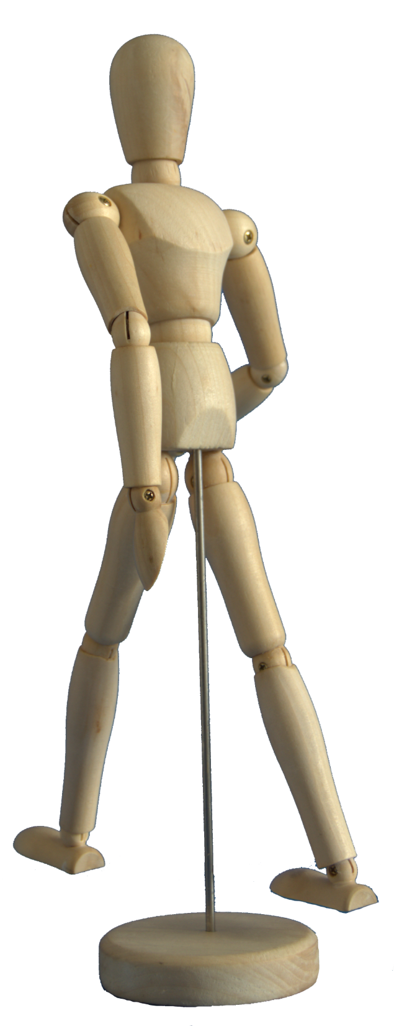
The Goal Model
©Keldale Business Services 2024

