Slide 1




Strategic Choice
Benefits-led questions and answers
Notes:
Six questions sum up strategic thinking and Benefits Management is an excellent method to provide good answers.

Slide 2
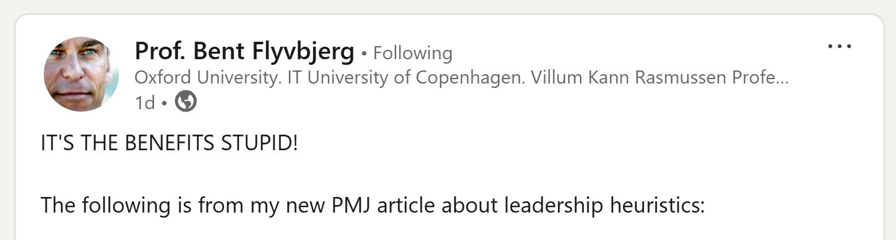
“It’s the Benefits, Stupid!”
"It appears that once project leaders know how to get benefits right, they know how to get everything right. They have graduated to the level of project masterbuilder. Therefore, if you don’t already focus on benefits in your projects, now is a good time to start. You will not truly master project leadership until you do.“
Heuristics for Better Project Leadership: Teasing Out Tacit Knowledge, Prof. Bent Flyvbjerg Project Management Journal Dec 2024
https://journals.sagepub.com/doi/10.1177/87569728241300307
Notes:
Don’t just take my word for it. Here’s what Prof. Bent Flyvbjerg says. And his c.v. is bigger than mine.
Bent Flyvbjerg was the first BT Professor of Major Programme Management at Saïd Business School and a Professorial Fellow of St Anne’s College. He held the post until September 2021.
Bent Flyvbjerg works for better management of megaprojects and cities. He is the most cited scholar in the world on megaprojects. He is #1 on each of Google Scholar’s global-citation ranking lists in: Project Management, Planning, Infrastructure and Cities.
Flyvbjerg is the author or editor of 10 books and 200+ papers, translated into 20 languages.

Slide 3
Testimonial
HSJ readers over the age of 30 may well remember Victor Kayam. He was the silver haired, perma-tanned, American entrepreneur who used to remind us in his TV adverts how he tried the Remington razor just once and “liked it so much…I bought the company!”…
… we adopted a new decision making process known as Benefits Management (BM) which has proved so effective that we have now, like Mr Kayam, bought into it wholesale and use it as the framework for all key business decisions in the Trust.
Bob Sunley Yorkshire Ambulance Service (HSJ Good Management Oct 07)
Notes:
Benefits Management – It’s not new anymore. Other people have been using it for years.

Slide 4
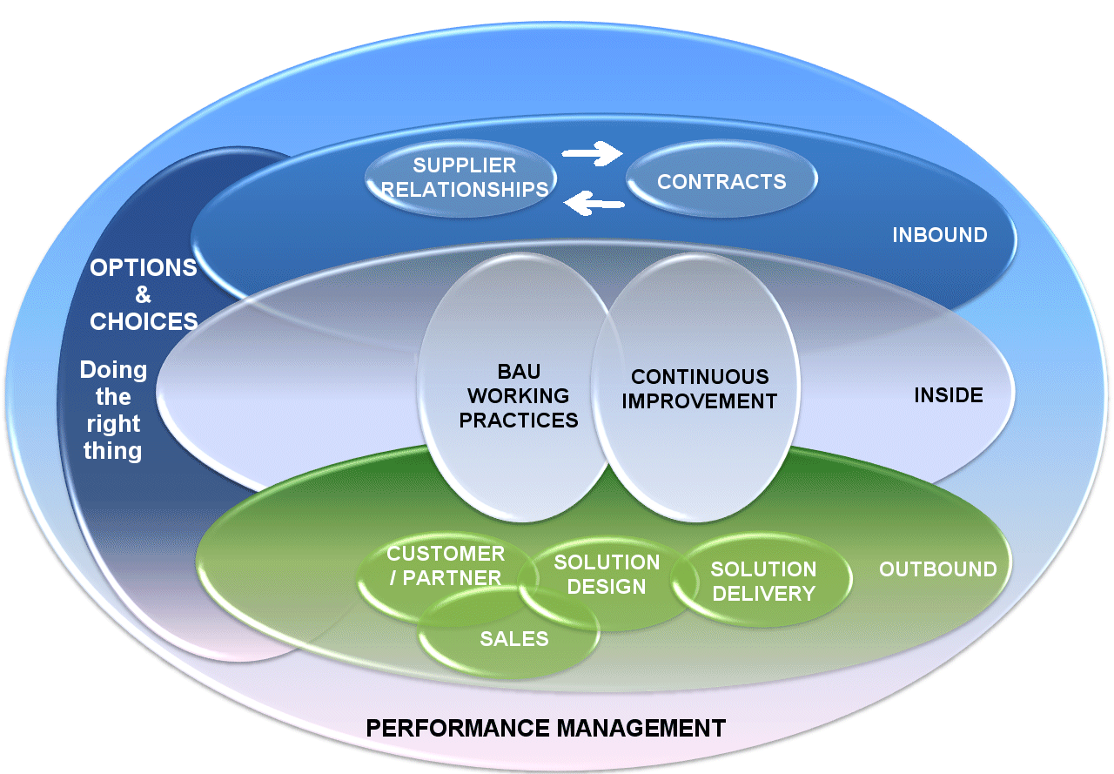
“Benefits Management has its place”
Options & Choices – Benefits Management aids strategy
Notes:
A quote from a health IT discussion forum, a phrase that I’ve heard more than once. The person who said it also reckons that GP Practice wi-fi sits in Maslow’s Hierarchy of Needs because it’s so self-evidently good.
That is why there is always a place for Benefits Management. We spend public money to change people’s lives. We should expect some rigour in the strategic choices we make.
The Venn diagram shows that BM has some usefulness across all business practices. Today, we’ll concentrate on the strategic aspects, options and choices, doing the right thing.

Slide 5
Strategy and Benefits
What
“Our goal is to improve health and social care in England by making better use of technology, data and information.”
NHS Digital, Our Purpose
How
Benefits Management is the best application of scarce resources to select and deliver appropriate benefits to identified stakeholders
Notes:
Where does Benefits Management come into this?
Benefits Management is the best application of scarce resources to select and deliver appropriate benefits to identified stakeholders.
Appropriate and identified are going to feature pretty heavily in what comes next.
If we talk ‘management’ and not ‘realisation’, then we get to appreciate the strategic value of benefits activity. This is how Benefits Management aids strategic choice, how it helps to answer the Six Dumb Questions.
If the goal at NHSD is to make improve care through better use of tech, then BM is tells us what ‘improve’ and ‘better’ should be here.
I looked for NHSE’s vision / mission but couldn’t find anything succinct to fit on a slide.

Slide 6
Six simple questions that deserve smart answers
What does ‘good’ look like round here?
What’s the point of this change?
Who is it really for?
What do they actually want?
How do we get this done?
What makes this option better than Plan B?
Notes:
This is flippant but valid. The questions appear simple but the answers are serious. The typical 100 page business case may contain them all. Its Exec Summary probably won’t though. And they might not be very good answers when you study them.
These six questions sum up strategic thinking and Benefits Management is an excellent method to provide good answers.
Behind every business change there are six seemingly naïve questions:
What does ‘good’ look like round here?
What’s the point of this change?
Who is it really for?
What do they actually want?
How do we get this done?
What makes this option better than Plan B?
The questions are simple, so simple that they are rarely asked. There’s that nagging ‘Emperor’s new clothes’ feel to them:
“Am I the only one who doesn’t get this?”
“Are you really that ignorant or just causing mischief?”
“We’re committed now. How much trouble will I cause if I raise my doubts after we’ve invested so much?”
The answers aren’t simple at all though. Your environment is complex and the cost of investigation may be too high. You may have to compromise. That’s fine, don’t let perfection be the enemy of the good. On the other hand, answers like, “It’s priceless” and “How long is a piece of string?” really won’t cut it.
Your colleagues may not know the answers. They may know but not want to tell you. You may learn more about the culture of your organisation than you do about the change you’re planning to make. If asking your own organisation is awkward, asking your customers, suppliers and partners won’t be any easier.
So why ask the questions if they will bring such grief? A few awkward conversations up front will save an awful lot of waste and unpleasantness down the road.

Slide 7
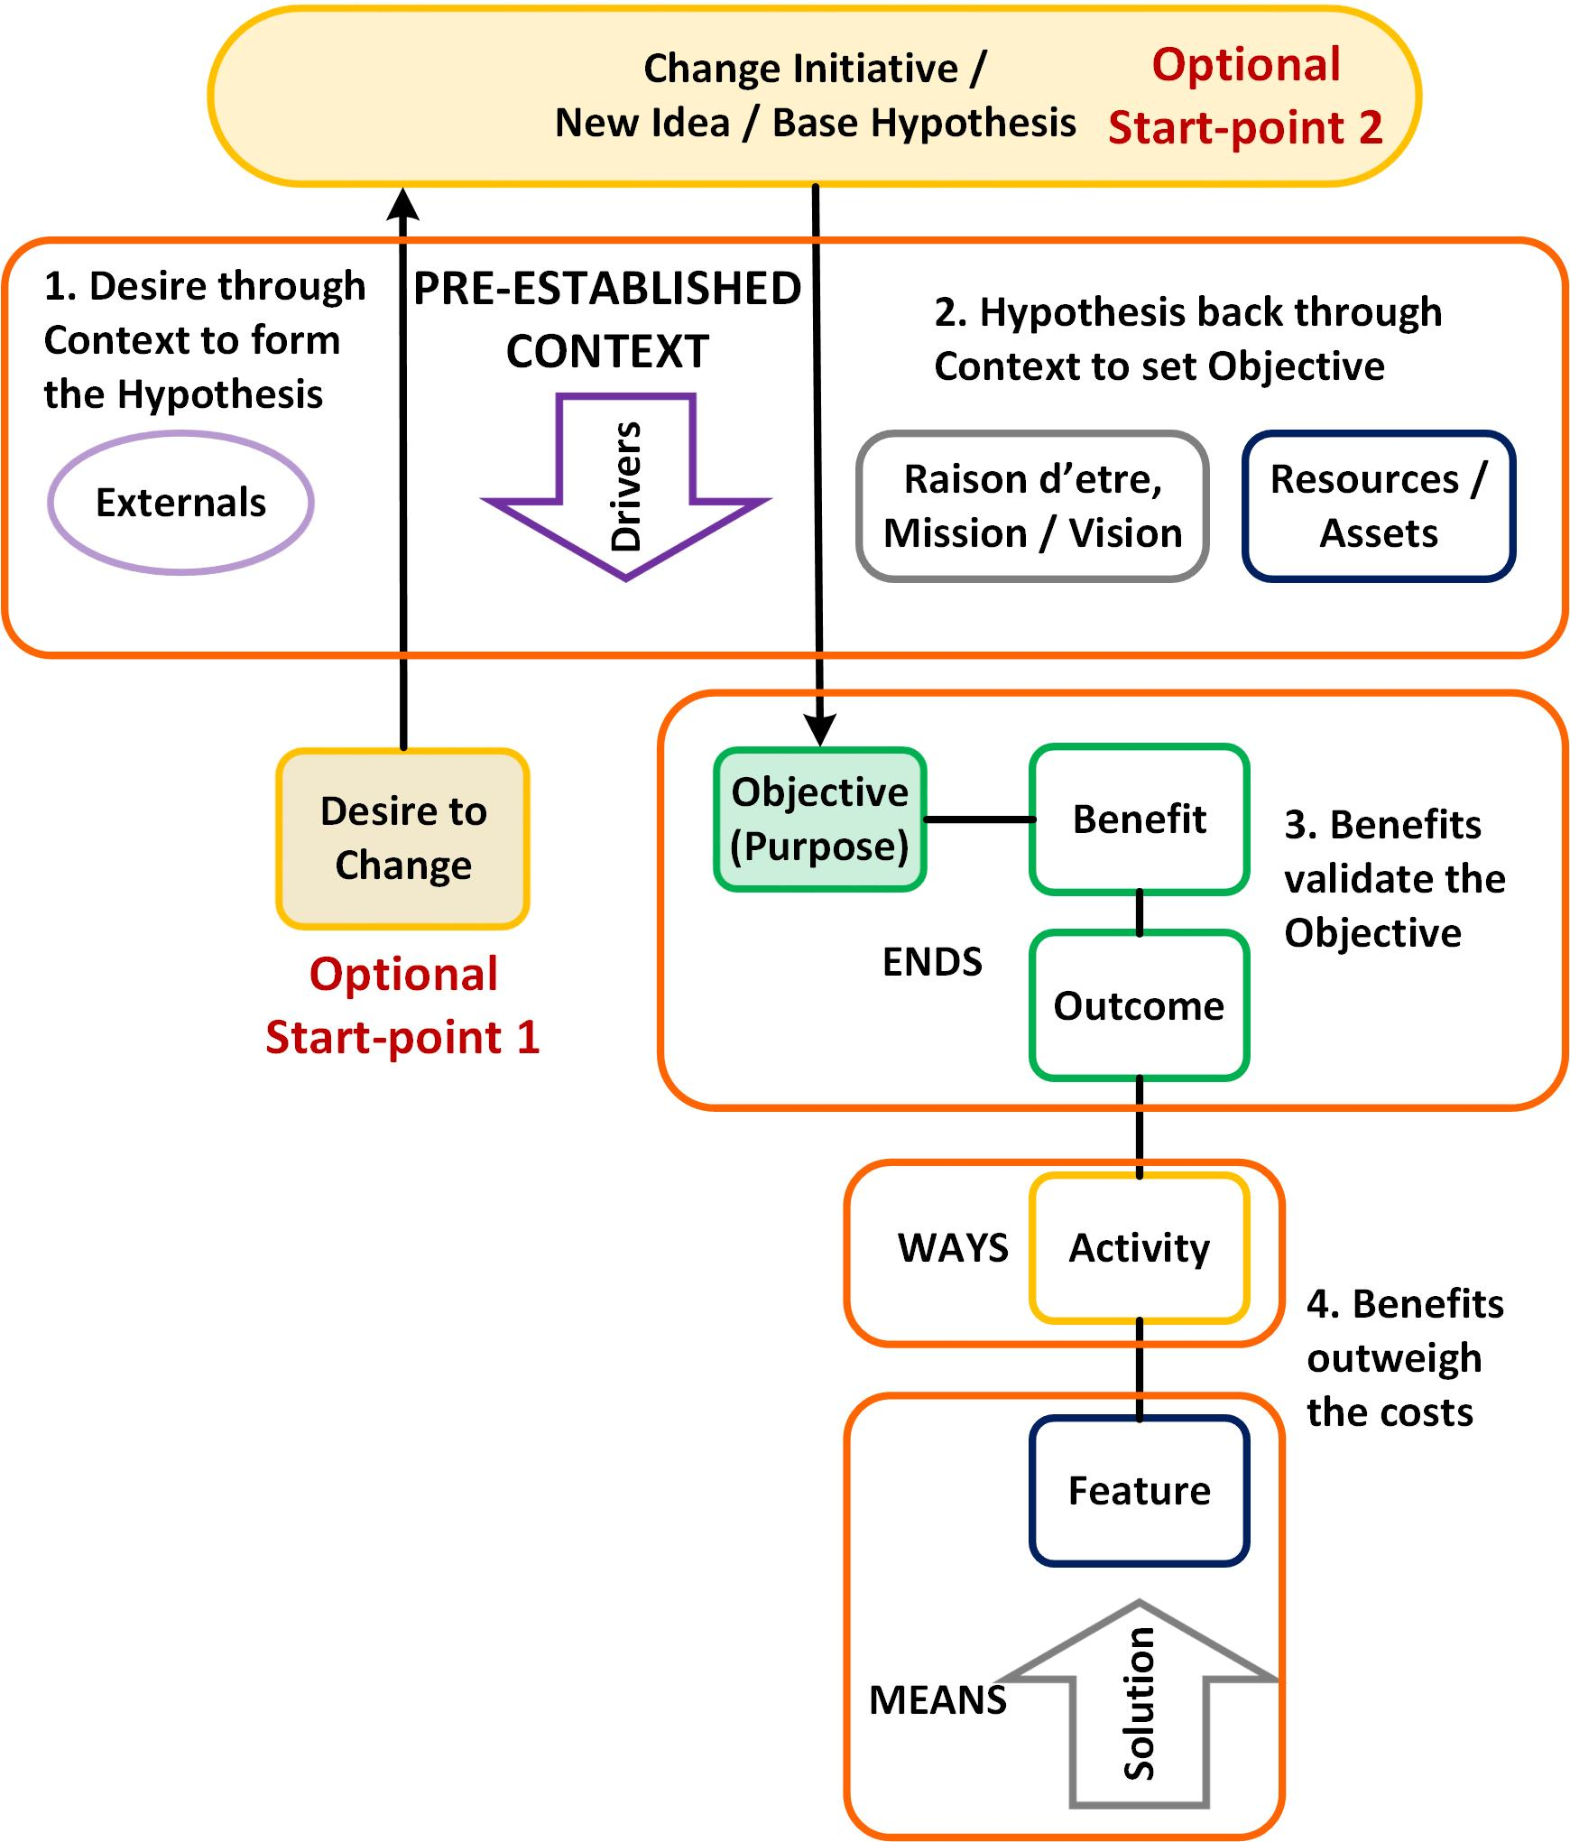
1. What does ‘good’ look like?
Know the context in which you operate
Deeply understand your vision, mission, raison d’être
Know you are doing a better job this week than you did last week
The Idea Test – NHS Change Day 2013
Notes:
What does good look like round here?
This sets the scene for an organisation. Know the context in which you operate. Where are you, who’s there with you and what are you all doing? It’s the ground you are on and the situation you face. It’s the market, its population, competition, market share and resources. Understand your Vision, Mission, raison d’être, the things you must do and how you know when you are doing them well.
What’s the culture here and around us? Do we believe we are ‘product-led’, ‘design-led’, ‘service-led’, ‘user-led’, ‘outcomes led’; ‘value-led’ or ‘benefits-led’? Does everyone agree with this belief? Does behaviour match belief?
The picture is from another lesson on strategic choices, The Idea Test, first drafted for the 2013 NHS Change Day. The pre-established context is a formal version of ‘what does good look like. Filtering the hypothesis through the context is a way to change a rough idea of a change into a SMART objective. You can’t tell that a change initiative is going to be good if you don’t understand its context or consequences. Do we want to do it? Should we do it? What will it do to us?

Slide 8
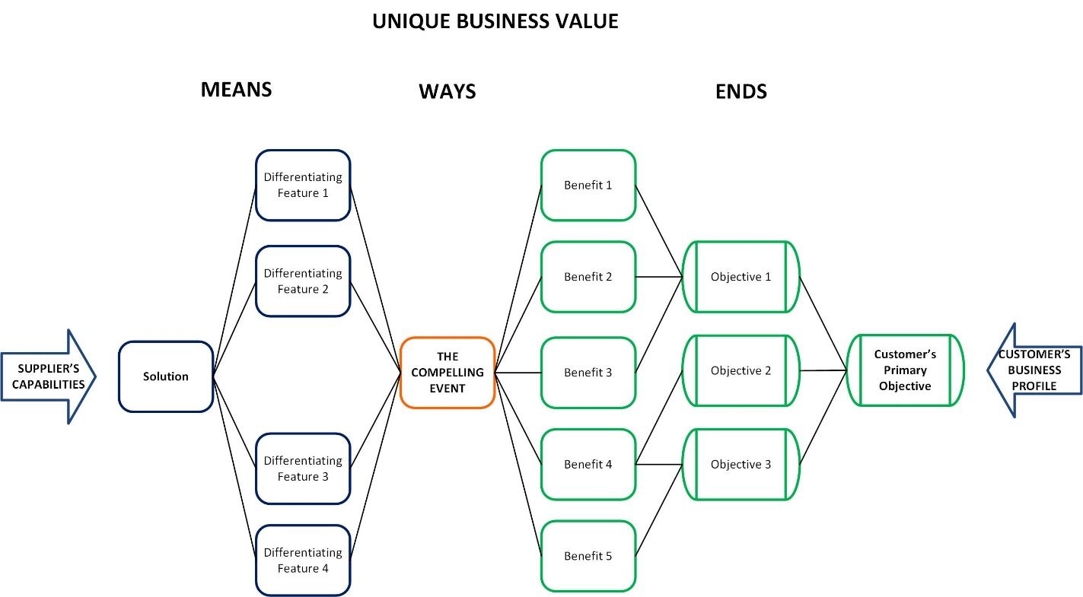
What does ‘good’ look like to our customers?
Relevant, accurate, timely info
Proof of quality services
New, useful information
‘Deliver best quality services’
Info gets used
Notes:
Our customers should take their changes through their own Idea Test and know their own business profile.
Taken from Target Account Selling, this is the context in which we provide goods and services. The customer’s business profile describes who they are and their raison d’être. Our customers have objectives too and want to see benefits. We provide a solution that meets their needs. The compelling event in the middle is that crucial way in which the customer applies our solution to achieve their desired ends.
The customer’s primary object is going to be something like ‘Deliver best quality services’.
In health and care IT our information products are often national, outside the customer’s boundaries. We give them information that they would not otherwise know. Generically, our products are new, useful information.
These products have features that differentiate them from the customer’s other information sources. They will be relevant, accurate, timely, whatever makes them fit for purpose.
The compelling event is that the information gets used. If it’s not fit for purpose, it won’t get used. If it’s not used then there will be no benefits, the proof that the customer is delivering quality services and meeting their objective.
The relationship we have with the customer will determine how we work together to design and implement a solution that delivers optimal benefits. We will rarely control how and when it is used. When we do, we cease to be the supplier and become their partner, with all of a partner’s responsibilities.

Slide 9
2. What’s the point of this change?
You start with the end in mind, with a clear, agreed understanding of what that end will be
You then need a clear, succinct description of what you will do to achieve that end
Notes:
What’s the point of this change?
We’ve understood the desired end-state in what ‘good’ looks like. Now we must understand the product that will get us there. The point of the change initiative (programme, project, whatever) is to make a solution. Can you summarise that solution in a few short sentences in plain language? The classic solution is Digital Transformation. Can you picture what this will look like in practice? Is your picture the same as everyone else’s? Bring it down to a level that people can understand. Show them the architect’s model.
The reasons why we make a change affect the way in which we go about making it. You rent a shop on the High Street for the ‘presence’, to let customers examine the goods before they order online. It will have the space and style to encourage them to stay and browse but it won’t need the storage and logistics to shift large amounts of stock.
Once you have a clear understanding of what needs to be done, the next trick is to say clearly how you will do it.
You need a clear, succinct description of what you will do. “We will rent a small shop in a prime location…” is more straightforward for a project than, “We will immerse our customers in an aspirational, high-tech retail experience…”
How can your people work towards building something they can’t remember, let alone understand?

Slide 10
How not to do it
From a digitalhealth infomercial 09/07/20:
Enter the smart clinical asset
This smart clinical asset is not just a new generation of EPR, or an integration engine, some sort of population health portal, or a slightly better version of what came before…
“Or to simplify Clive, can you please tell us what it does and how?”
Notes:
A sponsored piece on the digitalhealth website. It went on for ages but never said what the product was.
The 20+ feedback comments didn’t find out what it was either, summarised in one comment, “Or to simplify Clive, ‘can you please tell us what it does and how?”

Slide 11
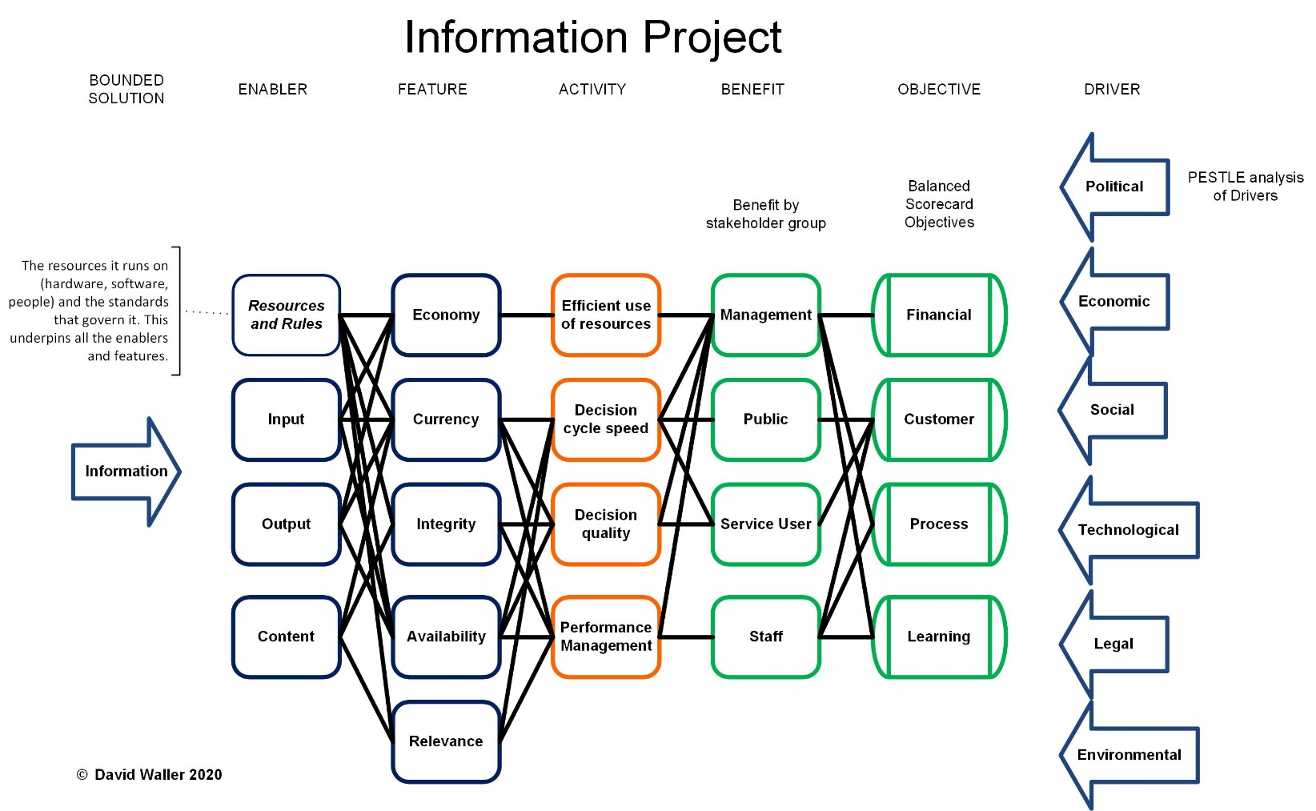

What’s the point? Setting the boundaries.
What does ‘good’ look like?
Our products
Customer’s use of our products
What’s the point?
Notes:
This is a benefits map for a typical information project. There’s a quite a bit of detail here, which I’ll skim over quickly.
The map is the key tool in the BM box. It’s one that we don’t use half as often or as well as I’d like. It’s a ‘plan on a page’ summary of the end state of any initiative, the why, what and how, all in one picture.
On the right are the Drivers why, and the End, what you want. What does ‘good’ look like? It looks like this desirable end-state.
On the left, the Means. What’s the point of the change? It’s a simple expressed solution with its key features, “We rent a shop. It is small and in a prime location.”
In this case, a generic information project, we’ll be clear about what the information is and what we do to it.
Note the boundary of control and responsibility between what we produce and how it gets used.

Slide 12
3. Who’s it really for?
Who are the appropriate stakeholders for your change?
Who it’s really for isn’t as obvious as it looks at first sight
Notes:
Who is it really for?
Who are the appropriate stakeholders for your change? Who wants it? Who controls how it will happen? Who should receive the benefits? When told that it’s for the customers, remember that there are a number of gatekeepers and advocates between you and your actual customers. You may not be giving the patients what they want so much as giving the CCGs what they believe the patients want. This might not be a bad thing but it is something to keep in mind. Who it’s really for isn’t as obvious as it looks at first sight.

Slide 13
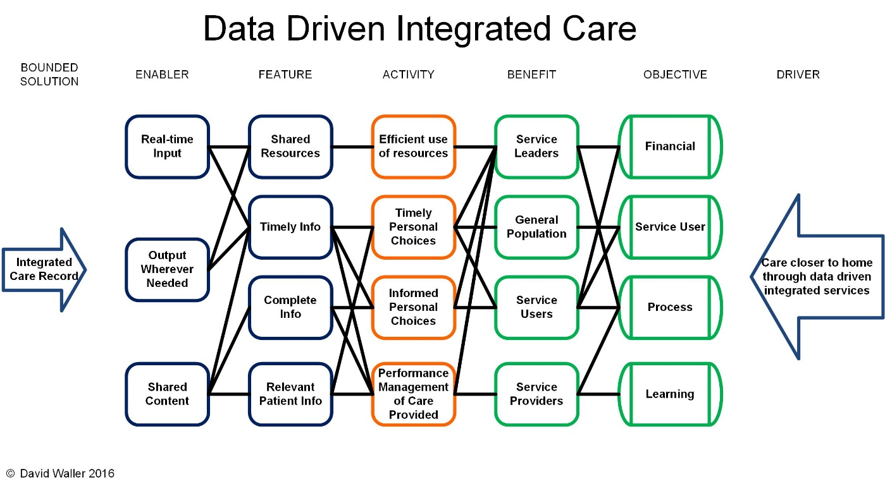

Who’s it really for?
Notes:
Here’s a hypothetical case of an integrated care record. It’s a bit closer to home than the generic information project map. We’ve identified four sets of stakeholders who expect to benefit.
Service Leaders are the people who control the care, e.g. commissioners of services or budget holders. Who they are will depend on the scale of the programme or project in question. Service Providers can be the institutions delivering services, down to individual staff members and again this depends on scale. The Service Users get direct, personal impact from the care provided and the broader societal impact lands on the General Population. They’re often listed as ‘The Community’, ‘The Taxpayer’, or ‘UK plc’.
What happens when we concentrate on one requirement? Someone who commissions care believes an integrated care record can bring more empowerment to service users. The next diagram shows a) why they believe this is a good thing and b) how the record will empower the service user.

Slide 14
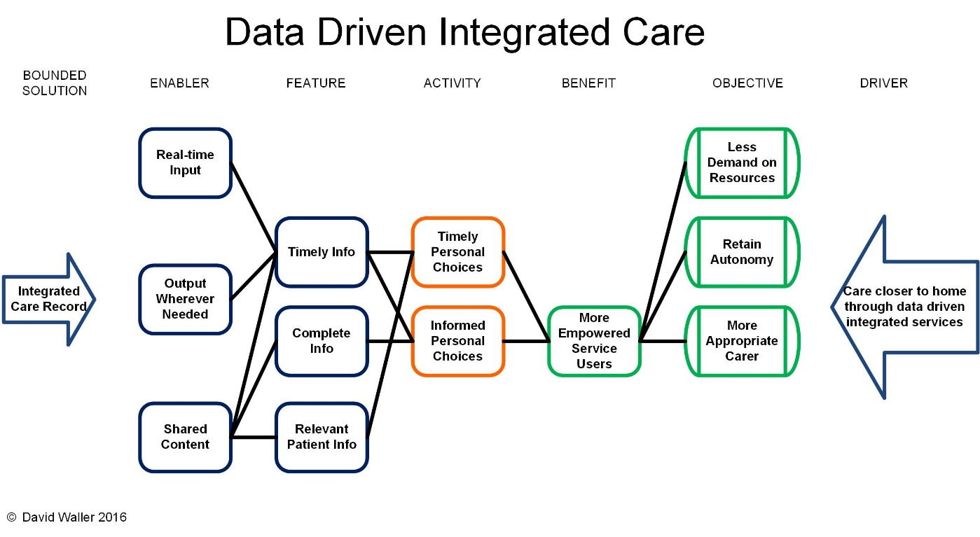
Who’s it really for? Not the users.
Notes:
There’s a whole separate discussion to be had on whom a project’s really for and what they actually want from it. Looking at the objective of ‘Less demand on resources’, it’s pretty clear that the benefit recipient here is the commissioner who’s paying, not the Service Users. We would usually expect Service Users to get some value out of a healthcare related project but they’re not the reason why this particular project is happening. The model shows clearly what end we have in mind. This then tests the reasoning of what a good result is and how we will prove it.

Slide 15
4. What do they actually want?
A benefit is a result that a stakeholder perceives to be of value
Perception beats reality nearly every time
Know your stakeholders, know their perceptions
Notes:
What do they actually want?
A benefit is a result that a stakeholder perceives to be of value. So, having identified the right stakeholders, what do they perceive as being valuable? Perception beats reality nearly every time and perception is subjective. It isn’t easy deciding who the change is for. It’s even harder working out what they genuinely want, whether you can feasibly deliver it and if it’s worth the cost.

Slide 16
Closer to home- data driven integrated care
Notes:
To repeat, the model shows clearly what end we have in mind. This then tests the reasoning of what a good result is and how we will prove it.
In this case, wanting less demand on resources means that we will want the Service Users to be more empowered to look after themselves, not more empowered to band together and demand more out of the NHS. The project will have to be planned and managed to ensure it meets its desired objective. The information product we create will have to be fit for Service Users to use it in a way that empowers them to meet the commissioner’s objectives. The benefit will be measured and proved in terms of self-help or reduced use of services.
Remember the ‘Start with the End in Mind’. Why you choose to do something directly affects the way you go about it.

Slide 17


What are the benefits?
A range of authenticators, now and upcoming.
Use of modern browser technology.
Breaking a Benefit Manager’s heart…again.
Internet facing.
Available anytime and anywhere with internet connectivity.
Based on a user feedback and needs
approach.
Notes:
How not to do it.
This is a slide from a typical Comms piece. It’s safe to assume that any slide labelled ‘Benefits’ will not contain any benefits at all. They will be features, or occasionally measurable outcomes.
Who really wants these ‘benefits’? Who will own them and see that they happen? It’s not likely to be customer or end user. These are more like stuff we want to make, rather than stuff they want to achieve. Benefits Management – appropriate benefits to identified stakeholders – the right things for the right people.
What do they actually want? If we have Benefit Owners who genuinely want these, how will they quantify them to prove that they are worthwhile? Asking the ‘so what’ questions will dig out the genuine value behind them, e.g. ‘Available anytime, anywhere’ enables 24hr care at the right locations, improving clinical outcomes for a particular set of patients.

Slide 18
5. How do we get this done?
How far does your influence extend?
Does everyone involved understand and agree who must do what?
Have you made promises that aren’t yours to keep?
Notes:
How do we get this done?
Up to this point, you’ve got something aspirational, a great idea in theory. So, let’s spoil it all by dragging it back down to reality. “How do we get this done?” moves you on from design to implementation. It reminds you that the results (“What do they actually want?”) will have to be managed in. It’s not just the technology, it’s the objectives and the benefits and all the business change needed to achieve them. This is all Project or Line Management, leadership, not Benefits Management. However, your BM and their map will have set the scene for what needs to be done. Looking at the map, is it rational, feasible and worth the effort?
Do you control the levers, how far does your influence extend?
You’ve found out who it’s really for and what they actually want. What about all the others who will have to take part in delivering it? Will they do what’s needed? Does everyone involved understand and agree where the boundaries of responsibility lie and who must do what? Have you made promises that aren’t yours to keep?
These issues must be resolved before you can worry properly about the time and resources needed and start drawing up plans.

Slide 19
6. What makes this option better than Plan B?
Why is it the best use of your scarce resources?
Unless you own your business, you’re responsible for spending other people’s money
There may be situations where, “The popular kids think it’s cool.” is a sound reason to invest, but spending public money to change peoples’ lives isn’t one of them.
Notes:
What makes this option better than Plan B?
Why is this change the best option to take? Why is it the best use of your / your sponsor’s scarce resources? When you are dealing with profit and finance then the comparison will be relatively (!) straightforward. If you’re looking at Social Return on Investment then life can get just a little more messy. That doesn’t mean that you shouldn’t try though. Unless you own your business, you’re responsible for spending other people’s money so you ought to spend it wisely.
What else could the money be spent on? Have you a sound argument why it should be spent on you? Crudely put, in the NHS we’re competing for funds against nurses and drugs and bandages. We should justify our investments. We need comparative value within our own portfolio. We can’t do that if we don’t know what the benefits are or what they’re worth.
There may be situations where, “The popular kids think it’s cool.” is a sound reason to invest, but spending public money to change peoples’ lives isn’t one of them.

Slide 20
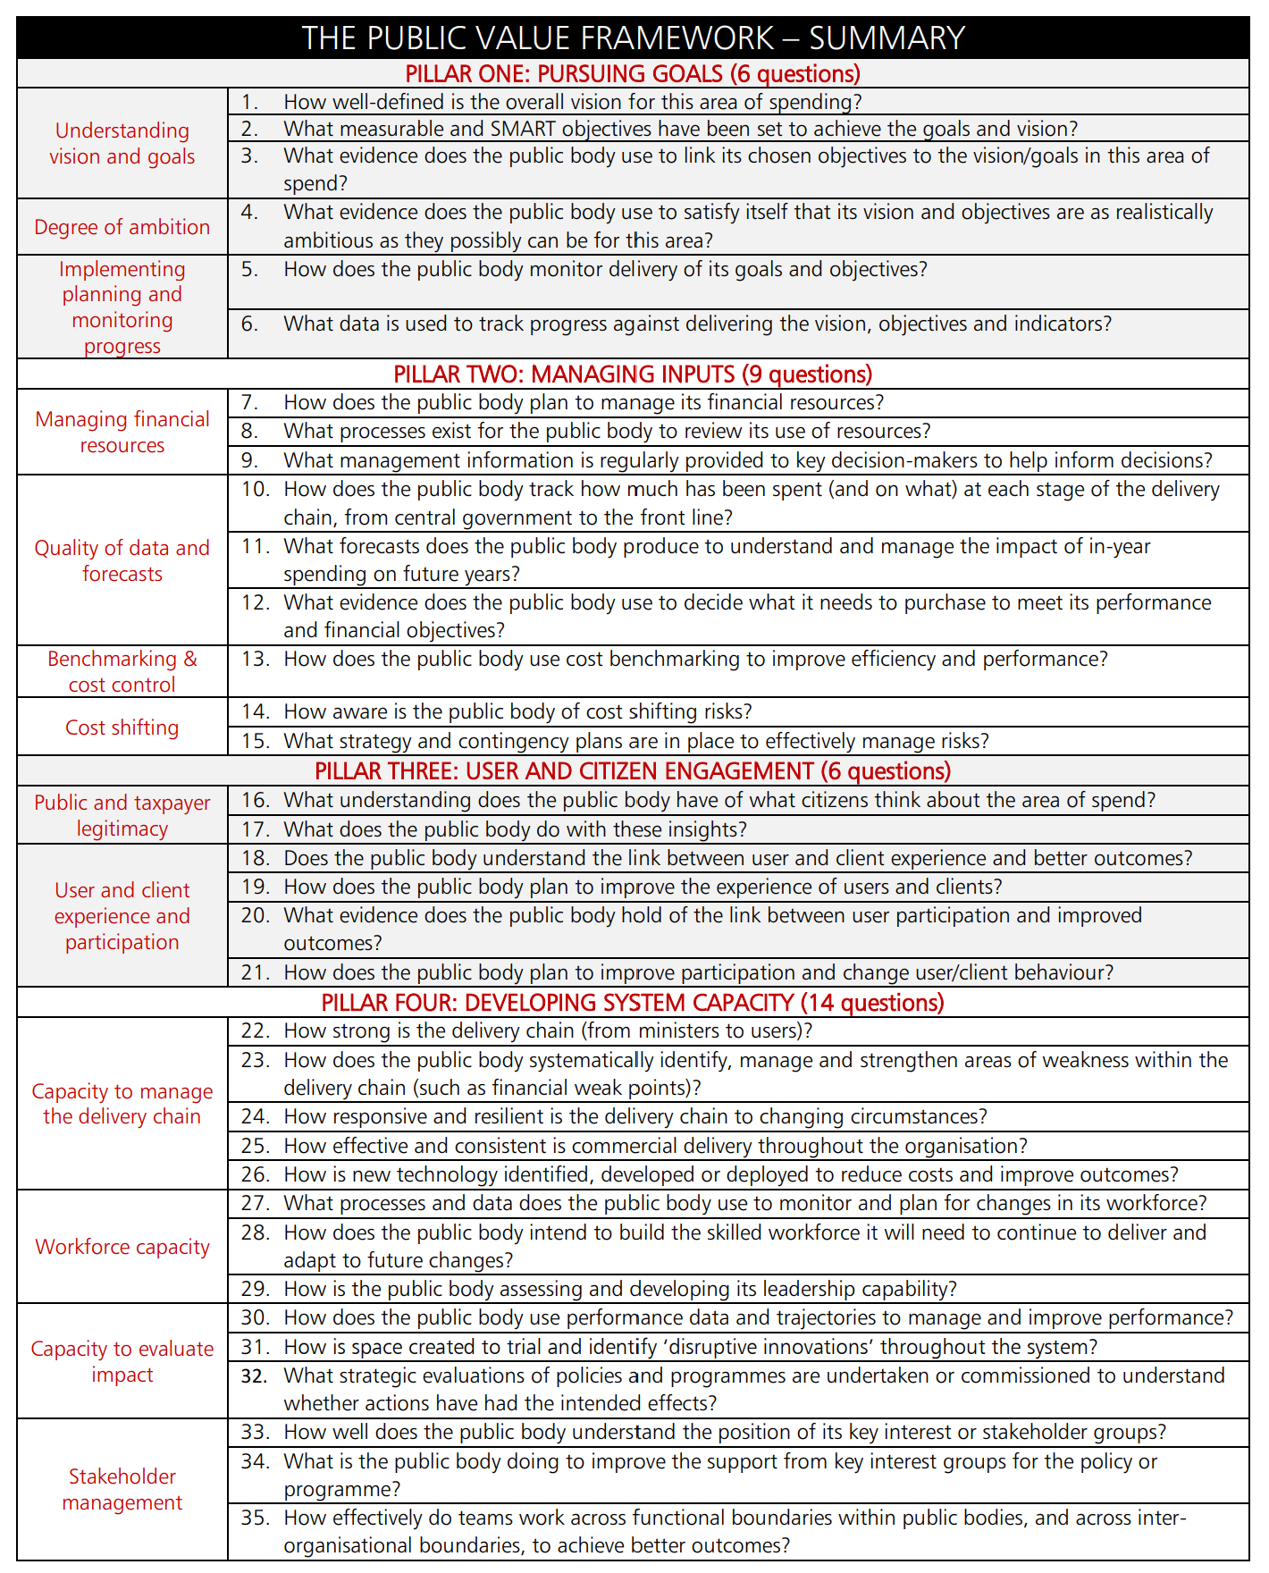
35 Serious questions - The Public Value Framework
“In November 2017, the government published a report led by Sir Michael Barber in to improving the public value delivered by the public sector. The report made a series of recommendations, the central one of which was to implement a new Public Value Framework as a practical tool for maximising the value delivered from public spending and improving outcomes for citizens.”
Public Value Framework and supplementary guidance - GOV.UK (www.gov.uk)
Notes:
If 6 dumb questions looks too flippant to take seriously, here’s a more sober view The Public Value Framework: with supplementary guidance 2019.
In November 2017, the government published a report led by Sir Michael
Barber in to improving the public value delivered by the public sector. The
report made a series of recommendations, the central one of which was to
implement a new Public Value Framework as a practical tool for maximising
the value delivered from public spending and improving outcomes for
citizens.
It covers much of the same ground as we just have. It’s missing the best value question though, ‘better than Plan B’…

Slide 21
Summary
What does ‘good’ look like round here?
What’s the point of this change?
Who is it really for?
What do they actually want?
How do we get this done?
What makes this option better than Plan B?
Up-front planning and analysis, ‘know before you go’
Keep it simple – brief and to the point
Notes:
What have we learned?
Up-front planning and analysis, ‘know before you go’. BM helps you make sound strategic decisions and good choices before you commit to invest.
Keep it simple – you should have a compelling case for the why, what and how of your change initiative in fewer than 6 slides.

Slide 22
Benefits Management has its place
“What is becoming clear however is that we have found a robust, rational framework for setting objectives, managing projects, shaping communications and defining success that works for us. Furthermore it is an approach which, once mastered, can be applied to almost any key business decision, giving us the benefit of foresight rather than hindsight.”
Bob Sunley Yorkshire Ambulance Service (HSJ Good Management Oct 07)
(Presenter’s italics)
Notes:
A reminder that BM works. Here’s a quote from the YAS testimonial piece.

Slide 23
Discussion
Notes:
Naïve questions but complex answers
It’s easy to ask the questions, not so easy to get good answers. Ask them at the start, before you’ve invested too much resource and emotion. Use them to select your projects rather than evaluate them after the event. If you do ask them late into the project, at least try to answer the questions honestly and as best you can. Once you know the answers you can improve the present situation and learn valuable lessons for next time.
Bad answers don’t always mean you should stop anything. You can always change the change, do it differently, do something different. Once you’ve got good answers then you’ll have the satisfaction that you’ve picked the right thing to do and the confidence that you can deliver it.

Slide 24


Strategic Choice
©Keldale Business Services 2026

