Slide 1
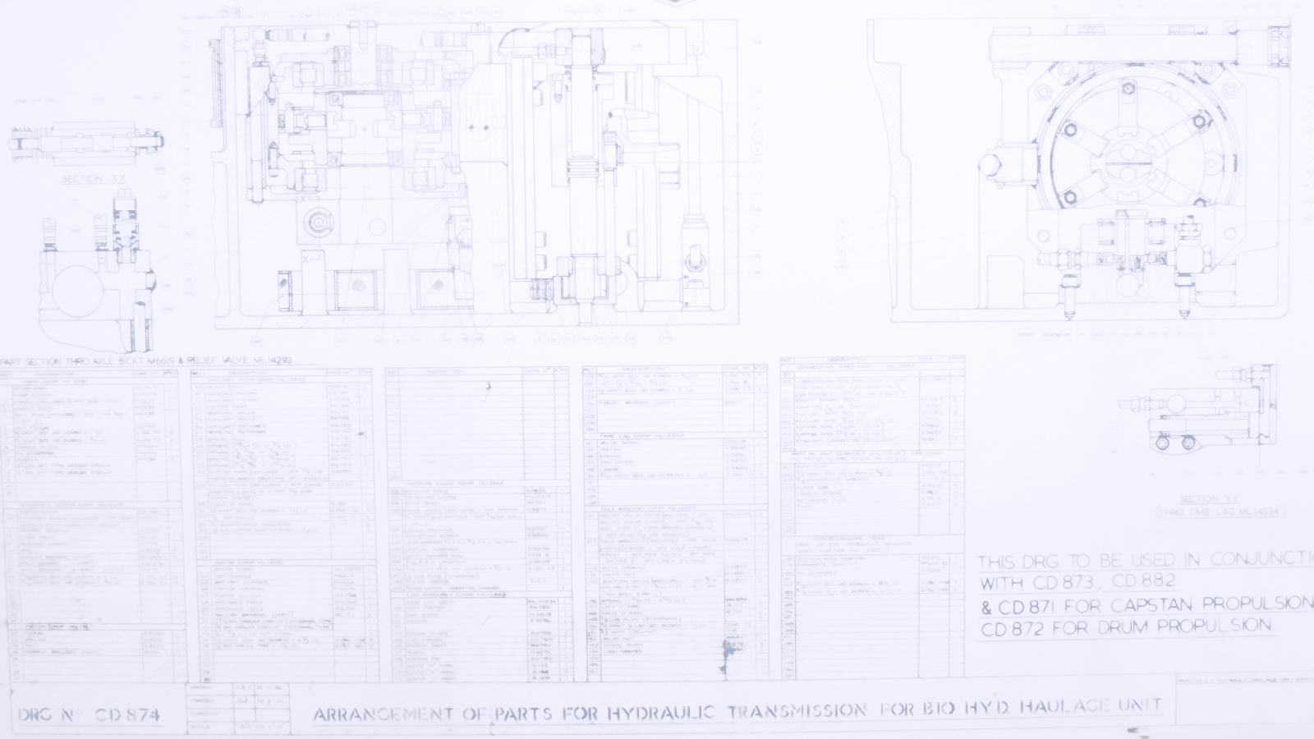
Six Dumb Questions
That deserve smart answers
Notes:
Have you ever read a business case, got to page 10 and still not understood what it was for? Worse, have you scrabbled to realise the benefits when no-one could explain why they bought the kit in the first place? We live in a complex world with no simple answers, but maybe there are some simple questions that could help.

Slide 2
Six dumb questions that deserve smart answers
What does ‘good’ look like round here?
What’s the point of this change?
Who is it really for?
What do they actually want?
How do we get this done?
What makes this option better than Plan B?
Notes:
Behind every business change there are six seemingly naïve questions:
What does ‘good’ look like round here?
What’s the point of this change?
Who is it really for?
What do they actually want?
How do we get this done?
What makes this option better than Plan B?
The questions are simple, so simple that they are rarely asked. There’s that nagging ‘Emperor’s new clothes’ feel to them:
“Am I the only one who doesn’t get this?”
“Are you really that ignorant or just causing mischief?”
“We’re committed now. How much trouble will I cause if I raise my doubts after we’ve invested so much?”
The answers aren’t simple at all though. Your environment is complex and the cost of investigation may be too high. You may have to compromise. That’s fine, don’t let perfection be the enemy of the good. On the other hand, answers like, “It’s priceless” and “How long is a piece of string?” really won’t cut it.
Your colleagues may not know the answers. They may know but not want to tell you. You may learn more about the culture of your organisation than you do about the change you’re planning to make. If asking your own organisation is awkward, asking your customers, suppliers and partners won’t be any easier.
So why ask the questions if they will bring such grief? A few awkward conversations up front will save an awful lot of waste and unpleasantness down the road.

Slide 3
What does ‘good’ look like round here?
What does good look like round here?
How do you know you are doing a better job this week than you did last week?
If you can’t measure the impact of any change, how will you know it’s been worthwhile?
Notes:
What does good look like round here?
This sets the scene. Understand your Vision, Mission, raison d’être, the things you must do and how you know when you are doing them well.
Let’s assume that the general reason for any change is to improve something. You’re not deliberately setting out to make things worse. You need to know the baseline of how things are now. How do you know you are doing a better job this week than you did last week? You must be able to tell if things are getting better or worse and by how much. In other words you have to have KPIs that really indicate how you are performing against the key things that matter. That means knowing what those key things are in the first place. If you can’t measure the impact of any change, how will you know it’s been worthwhile?

Slide 4
What’s the point of this change?
What’s the point of this change?
There should be a ‘because’ statement behind every objective
You start with the end in mind, so you need a clear, agreed understanding of what that end will be
Notes:
What’s the point of this change?
The reasons why we make a change affect the way in which we go about making it. You rent a shop on the High Street for the ‘presence’, to let customers examine the goods before they order online. It will have the space and style to encourage them to stay and browse but it won’t need the storage and logistics to shift large amounts of stock. There should be a ‘because’ statement behind every objective, even if it’s implicit, “We will do this because…”
You start with the end in mind, so you need a clear, agreed understanding of what that end will be.

Slide 5
Who’s it really for?
Who is it really for?
Who are the appropriate stakeholders for your change?
Who it’s really for isn’t as obvious as it looks at first sight
Notes:
Who is it really for?
Who are the appropriate stakeholders for your change? Who wants it? Who controls how it will happen? Who should receive the benefits? When told that it’s for the customers, remember that there are a number of gatekeepers and advocates between you and your actual customers. You may not be giving the customer what they want so much as giving the Marketing Department what they believe the customer wants. This might not be a bad thing but it is something to keep in mind. Who it’s really for isn’t as obvious as it looks at first sight.

Slide 6
What do they actually want?
What do they actually want?
A benefit is a result that a stakeholder perceives to be of value
Perception beats reality nearly every time
Notes:
What do they actually want?
A benefit is a result that a stakeholder perceives to be of value. So, having identified the right stakeholders, what do they perceive as being valuable? Perception beats reality nearly every time and perception is subjective. It isn’t easy deciding who the change is for. It’s even harder working out what they genuinely want, whether you can feasibly deliver it and if it’s worth the cost.

Slide 7
How do we get this done?
How do we get this done?
Up to this point, you’ve got something aspirational, a great idea in theory
How far does your influence extend?
Does everyone involved understand and agree who must do what?
Have you made promises that aren’t yours to keep?
Notes:
How do we get this done?
I used to think that feasibility was part of the next question, ‘Better than Plan B’. If you couldn’t do it efficiently and effectively then you didn’t have the right option. I’ve now decided that feasibility needs more leadership and this has to be looked at separately.
Up to this point, you’ve got something aspirational, a great idea in theory. So, let’s spoil it all by dragging it back down to reality. “How do we get this done?” moves you on from design to implementation. It reminds you that the results (“What do they actually want?”) will have to be managed in. It’s not just the technology, it’s the objectives and the benefits and all the business change needed to achieve them. Do you control the levers, how far does your influence extend?
You’ve found out who it’s really for and what they actually want. What about all the others who will have to take part in delivering it? Will they do what’s needed? Does everyone involved understand and agree where the boundaries of responsibility lie and who must do what? Have you made promises that aren’t yours to keep?
These issues must be resolved before you can worry properly about the time and resources needed and start drawing up plans.

Slide 8
What makes this option better than Plan B?
What makes this option better than Plan B?
Why is it the best use of your scarce resources?
Unless you own your business, you’re responsible for spending other people’s money
Notes:
What makes this option better than Plan B?
Feasibility brings us to our last question, why is this change the best option to take? Why is it the best use of your scarce resources? When you are dealing with profit and finance then the comparison will be relatively (!) straightforward. If you’re looking at Social Return on Investment then life can get just a little more messy. That doesn’t mean that you shouldn’t try though. Unless you own your business, you’re responsible for spending other people’s money so you ought to spend it wisely.

Slide 9
Six dumb questions that deserve smart answers
What does ‘good’ look like round here?
What’s the point of this change?
Who is it really for?
What do they actually want?
How do we get this done?
What makes this option better than Plan B?
Notes:
So, to recap, behind every business change there are six seemingly naïve questions:
What does ‘good’ look like round here?
What’s the point of this change?
Who is it really for?
What do they actually want?
How do we get this done?
What makes this option better than Plan B?
It’s easy to ask the questions, not so easy to get good answers. Ask them at the start, before you’ve invested too much resource and emotion. Use them to select your projects rather than evaluate them after the event. If you do ask them late into the project, at least try to answer the questions honestly and as best you can. Once you know the answers you can improve the present situation and learn valuable lessons for next time.
Bad answers don’t always mean you should stop anything. You can always change the change, do it differently, do something different. Once you’ve got good answers then you’ll have the satisfaction that you’ve picked the right thing to do and the confidence that you can deliver it.

Slide 10
Discussion

