Slide 1

BENEFIT OF EXPERIENCE
Red Team
Notes:
Strategic decision making is a cerebral activity. It uses brains as its prime resource. We may apply time, money, people and machines to help us form our decisions but all the hardware and software in the world will count for nothing if the 'wetware' gets the final connection wrong.
Once a decision is taken, we have many tools and methods to see it is made concrete. These tools are often seen as prescriptive and controlling. We set tasks, milestones and deadlines to ensure the right activities are done at the right time. But what tools and methods do we use to create and evaluate the decision in the first place? Western leadership style expects these decisions to come from flair, imagination and creativity and we are reluctant to tie them down with process.

Slide 2
The Red Team
A red team is a team that is formed with the objective of subjecting an organisation’s plans, programmes, ideas and assumptions to rigorous analysis and challenge. Red teaming is the work performed by the red team in identifying and assessing, inter alia, assumptions, alternative options, vulnerabilities, limitations and risks for that organisation.
Red Teaming Guide (2nd Edition)
The Development, Concepts and Doctrine Centre
Notes:
A red team is a team that is formed with the objective of subjecting an organisation’s plans, programmes, ideas and assumptions to rigorous analysis and challenge. Red teaming is the work performed by the red team in identifying and assessing, inter alia, assumptions, alternative options, vulnerabilities, limitations and risks for that organisation.
Red Teaming Guide (2nd Edition)
The Development, Concepts and Doctrine Centre Shrivenham
E-mail: DCDC-DocEds@mod.uk

Slide 3
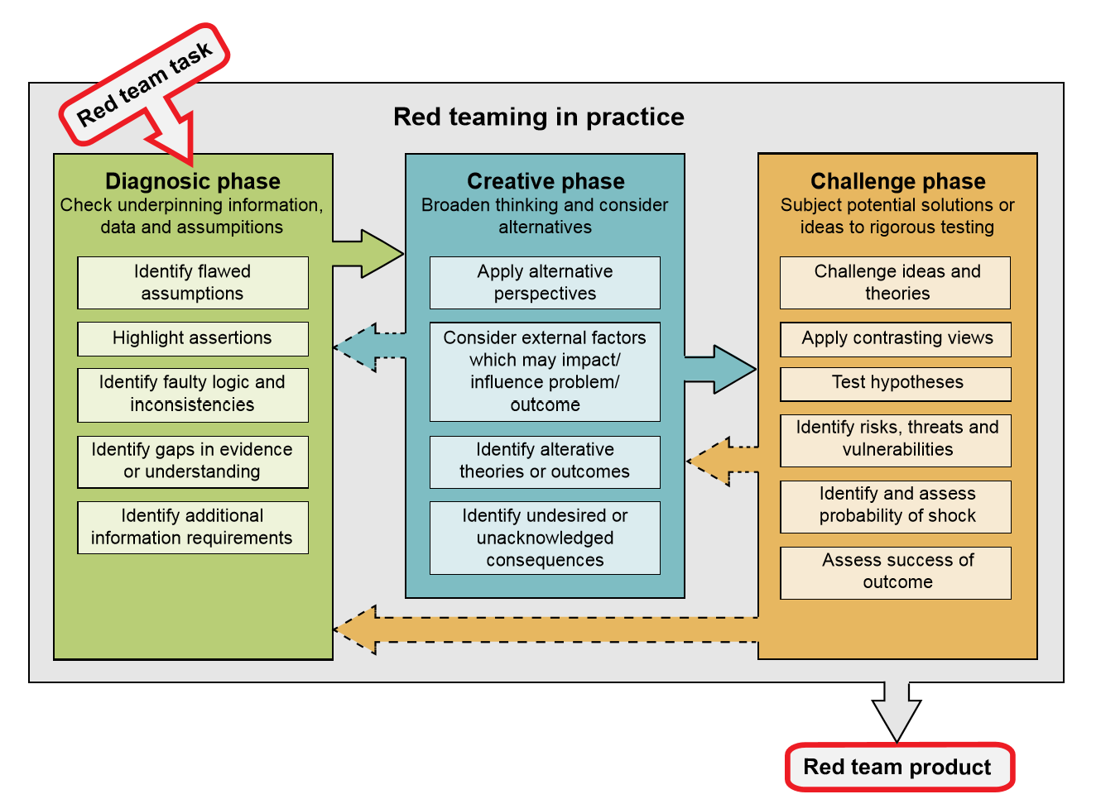

Red Team framework
Notes:
The framework starts with diagnostics. It needs some diagnostic tools.

Slide 4
Structure and creativity
Red teaming is the independent application of a range of structured, creative and critical thinking techniques to assist the end user make a better informed decision or produce a more robust product.
Red Teaming Guide (2nd Edition)
The Development, Concepts and Doctrine Centre
Notes:
Another quote from the manual - Red teaming is the independent application of a range of structured, creative and critical thinking techniques to assist the end user make a better informed decision or produce a more robust product.
Structure and creativity, this is where Benefits Management comes in.

Slide 5

Six dumb questions that deserve smart answers
What does ‘good’ look like round here?
What’s the point of this change?
Who is it really for?
What do they actually want?
How do we get this done?
What makes this option better than Plan B?
Notes:
Six Dumb Questions is a great method for internal analysis. The awkwardness of asking these questions within the team may make it more appealing to get someone from outside to ask, i.e. the Red Team.
It’s good for a quick test, an early sanity check before too much is invested.
Behind every business change there are six seemingly naïve questions:
What does ‘good’ look like round here?
What’s the point of this change?
Who is it really for?
What do they actually want?
How do we get this done?
What makes this option better than Plan B?
The questions are simple, so simple that they are rarely asked. There’s that nagging ‘Emperor’s new clothes’ feel to them:
“Am I the only one who doesn’t get this?”
“Are you really that ignorant or just causing mischief?”
“We’re committed now. How much trouble will I cause if I raise my doubts after we’ve invested so much?”
The answers aren’t simple at all though. Your environment is complex and the cost of investigation may be too high. You may have to compromise. That’s fine, don’t let perfection be the enemy of the good. On the other hand, answers like, “It’s priceless” and “How long is a piece of string?” really won’t cut it.
Your colleagues may not know the answers. They may know but not want to tell you. You may learn more about the culture of your organisation than you do about the change you’re planning to make. If asking your own organisation is awkward, asking your customers, suppliers and partners won’t be any easier.
So why ask the questions if they will bring such grief? A few awkward conversations up front will save an awful lot of waste and unpleasantness down the road.

Slide 6
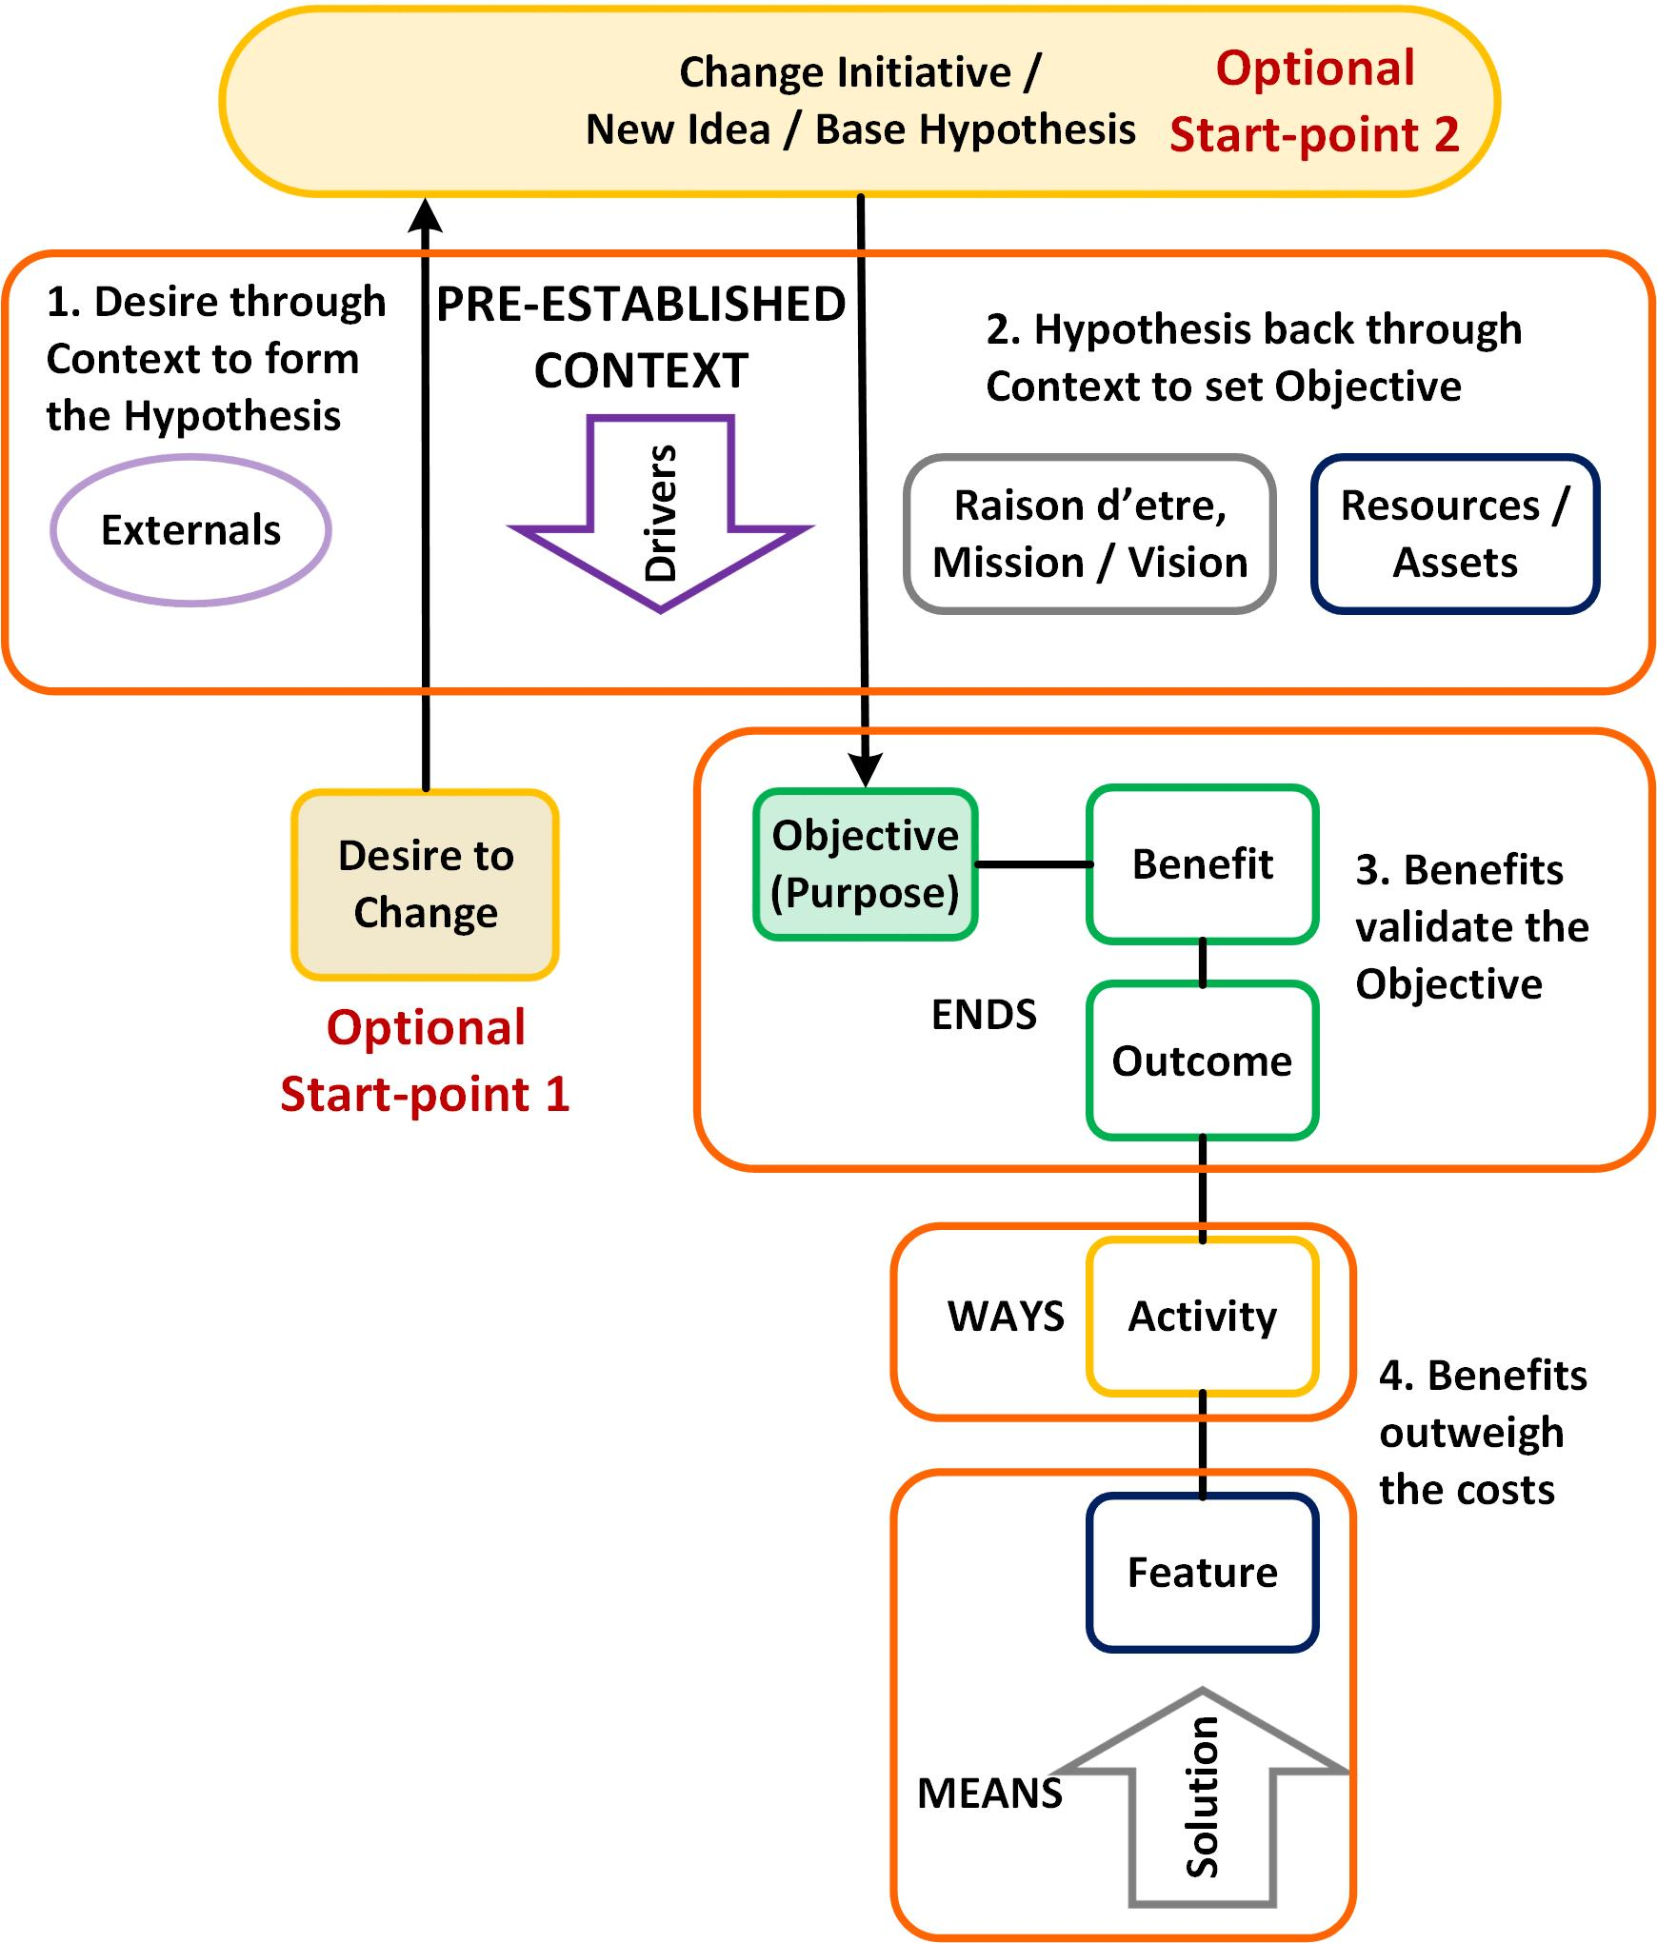
Idea Test
Set the scene
Choose to change
First filter – focus the desire to change
Second filter – test the Hypothesis
Turn the Hypothesis into an Objective
Optimise the value of the Objective
Third filter - test the Objective
Plan to realise the Ends
Fourth filter - test the Benefits
Notes:
The Idea Test is another method. It’s a bit more detailed and thorough than Six Dumb Questions.
Hypothesis testing is a way of testing new ideas against your strategy, goals and context. Before running away with a brilliant new idea, it needs to be checked to see how good it really is and how well it fits with who we are and what we do. It contains three checks to take us from hypotheticals to practicality.
First, we have to understand the context in which we operate.
1. Set the scene – the pre-established context. Who are we, what do we do, what do we think? Understand the purpose and culture of the organisation (Vision, raison d’etre) . What drives us from outside? Know the externals we work with (customers suppliers partners society)
2. Choose to change – At this point, you may not have a particular change in mind. You just know that you can’t stand still, something must be done. Start at Optional Start-point 1 if you’re looking for inspiration.
3. First filter – pass your desire to change through the context to see where the opportunities or gaps lie. Use the Context for some horizon scanning. “What’s happening out there?” “What could be better…?” “What should we fix…?” Try some SWOT analysis. If you don’t already have a Problem Statement, this is where you can create one.
This gives you the new idea or base hypothesis if you don’t already have one.
If you do, start here at Start-point 2, a new idea, Base Hypothesis. At this stage, this is probably a loose statement of, “Why don’t we…?”
4. Second filter - test the Hypothesis against the context to see if it's relevant and feasible. Should we do it, can we do it?
Silly example – you’re the local Temperance Lodge and you need to raise funds. Someone suggests opening a members’ bar.
More sensible example – Tesco supermarkets is a giant grocer. Someone suggests selling financial services. At first sight there’s no connection but thinking about it, Tesco has a huge customer base and knows a lot about their financial state. Its purpose is to make profit. The idea works.
5. Turn the Hypothesis into an Objective. “Why don’t we do X?” becomes, “We will do X, because…”
An Objective is something with purpose. Start with the end in mind.
Is the Objective big enough to bother?
6. Optimise the value of the Objective - analyse the benefits. Too often we do projects without a clear up-front understanding of what benefits they will deliver. ‘Build it and they will come’ is a gamble that maybe we ought not take.
7. Third filter - test the Goal against the optimised package of benefits and detriments to see if it is desirable. “If we do X, we will get Y, and we really want Y.”
This brings us to what benefits and who benefits?
8. Plan to realise the Ends (Objective, Benefits, Outcomes) through the best use of Ways and Means.
9. Fourth filter - test the Objective against the Benefits Realisation Plan. Test the benefits it delivers against the costs involved to prove it is a worthwhile use of resources. You know the chains of cause – effect from Means to Ends. The benefits you have selected are feasible and properly quantified. You’ve accounted for optimism bias (and all the other psychology that affects what we think we can achieve) so the chances of success are reasonable.
If it fits at this point then you’ve got the makings of a good idea and the start of a successful business case.
Then all you have to do is plan, implement, manage, etc… No-one said it was going to be easy.

Slide 7
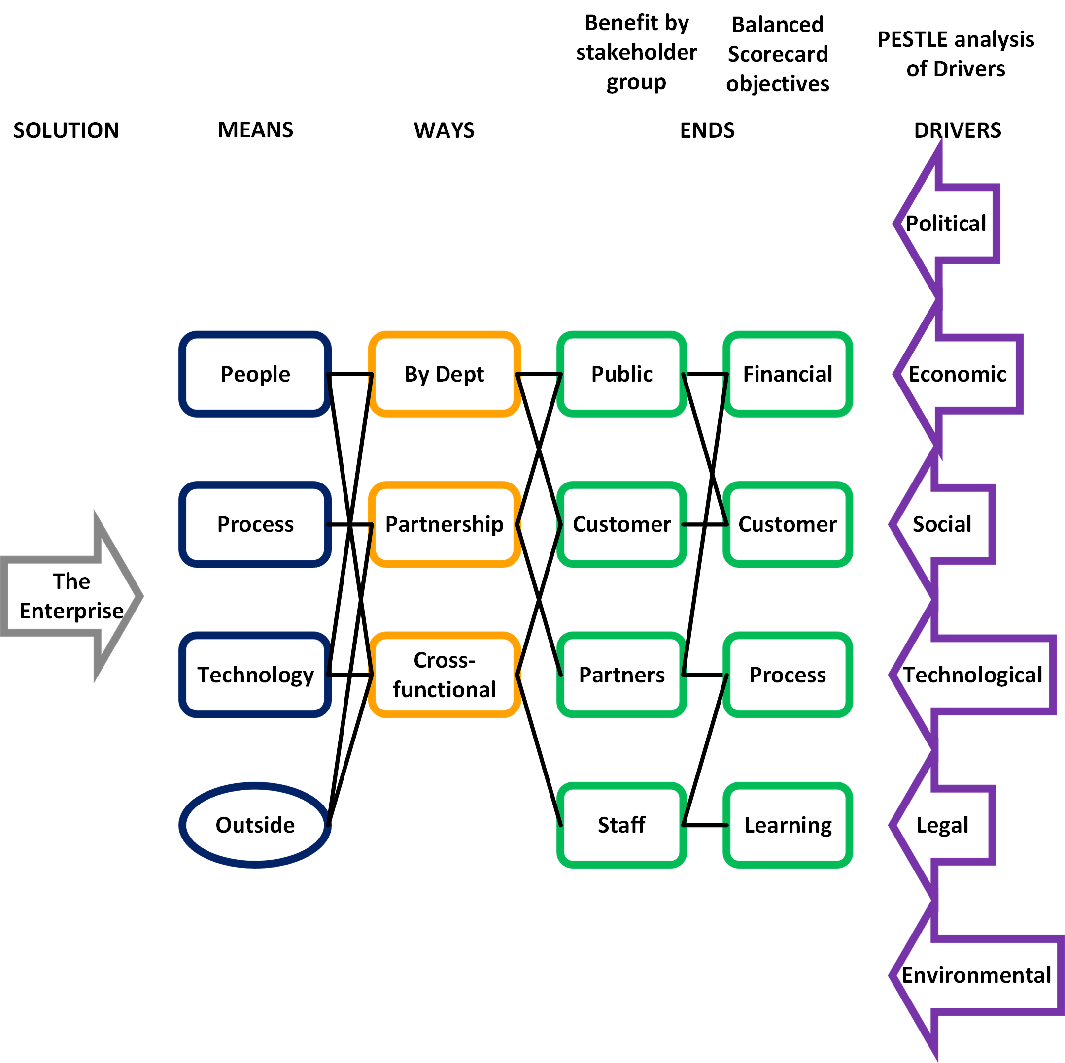
Benefits Dependency
Means – what you use
Ways – what you do
Ends – What you want
Notes:
This is for when all the hard work has been done and solution has been designed. Now’s the time to mark the homework.
Ideally, the planners will present the Red Team with their own Benefits Dependency Network that they created as part of their standard project management processes. In reality, the Red Team will have to draw it by deconstructing the project documentation they’ve been given.
This is a generic Enterprise-level BDN.
The Benefits Dependency Network is one of the key tools in the Benefits / Value arena. It shows the nets of cause and effect between what you want, do and use. In this generic example the Drivers, the outside influences that make you act, fall into PESTLE categories. They don’t have to. It’s just a good way of analysing the context in which you have to operate.
Likewise, Objectives are split as per the Balanced Scorecard. Most objectives fit into quality of service, quantity of service, customer experience and finance.
Benefits are split by stakeholder. There is one stakeholder per benefit. If X is a benefit to customers and staff then X is two benefits. More likely, X isn’t a benefit at all but an enabler or outcome, something to be used to deliver benefits.
Ask ‘so what’ questions to decide where something fits in the chain.
People often confuse outcomes with objectives. “The new clinic is opened”. So what? You can do lots of things with it. It treats more people, better and quicker. Then the objectives are to do with clinical outcome and efficiency. The clinic is not an end in itself.
The distinction between benefits and objectives may not be so clear-cut. Sometimes the benefit is proof that the objective is being met, e.g. individual cost savings to meet an overall budget reduction. Sometimes the objective is to deliver benefits, e.g. raise average survival period for terminal patients by 6 months.
By thinking about the phraseology we become clearer about what we are going to do and why it is important to us.
Activities may be in silos or multi-agent. They can be as simple as one step in a process or as complex as public-private partnerships.
Change managers split enablers into people, process, technology. Economists may use land, labour, capital, enterprise.
You don’t work in a vacuum so there’s bound to be some outside dependencies to consider as well.
These are all just tidy ways to help you break down your organisation in a logical manner. They are not mandatory but they do help.

Slide 8
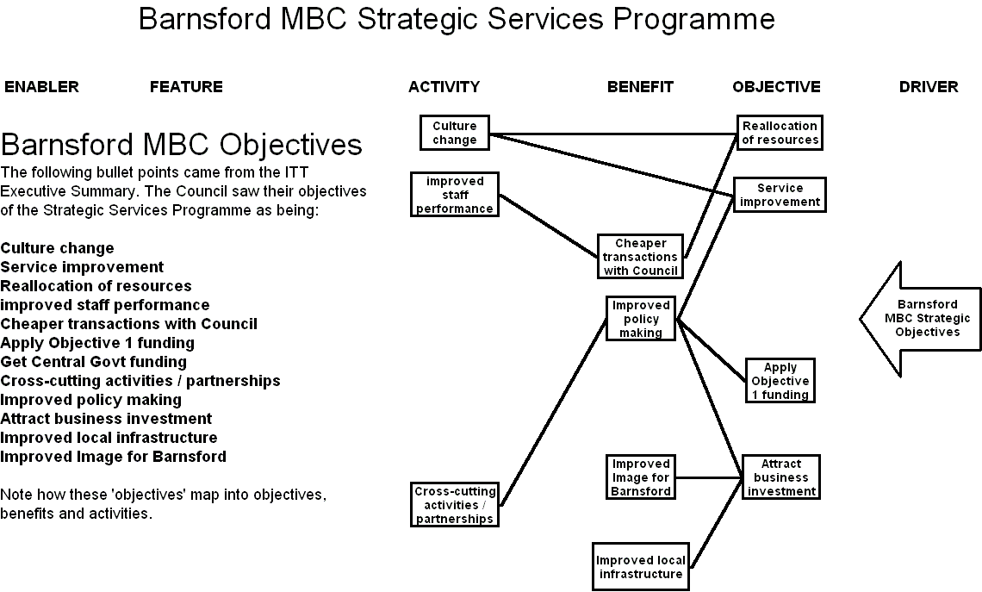
Notes:
An example deconstruction BDN, a Local Authority invitation to tender for a strategic services joint venture.
The un-prioritised bullet points were split up to make the right hand side of the BDN and tested with the LA client before being passed to the supplier to design a solution to fit.

Slide 9
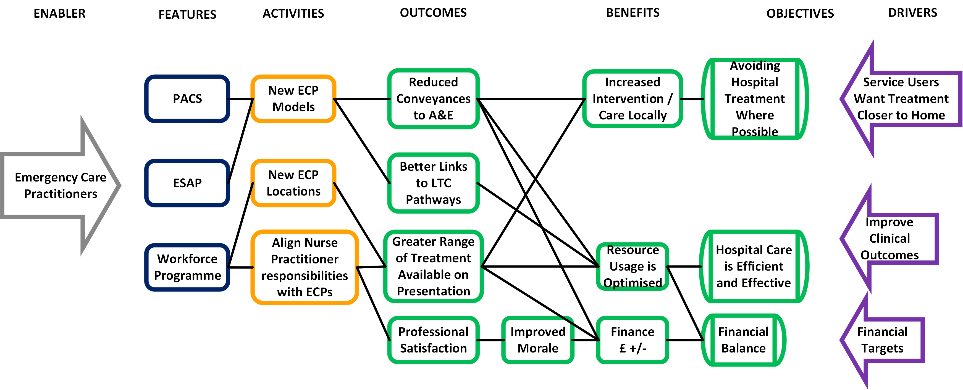
Rational nets of cause - effect
Notes:
A simple example.
Note the links. The links are the crucial part of this diagram.
Sensible connections.
No gaps.
Benefits link to objectives.
Multiple links – killer apps or choke points?

Slide 10

Six Dumb Questions again
What makes this the best choice?
Who’s it for?
What do they want?
How do we do this?
What does good look like?
What’s the point?
Notes:
See how the six dumb questions overlay the BDN.
What does ‘good’ look like round here? - Drivers
What’s the point of this change? – Enabler, Features
Who is it really for? What do they actually want? – Objectives and Benefits
How do we get this done? What makes this option better than Plan B? – The whole BDN

Slide 11
This is manageable
Notes:
Scale and scope
Here’s a hypothetical example, based on an ISIP transformational change programme, March 06.
The objectives are pretty generic and represent the high-level stakeholder groups of patients, policy makers and the organisation itself. All the connections are made. There are no dead-ends in the diagram so everything has a purpose and contributes to the objective to some extent. The diagram starts the discussion about the relative contributions and allows decisions to be made about priorities and allocating resources.
This is manageable, a feasible amount of activity delivers selected benefits that are directly connected to the organisation’s objectives.

Slide 12
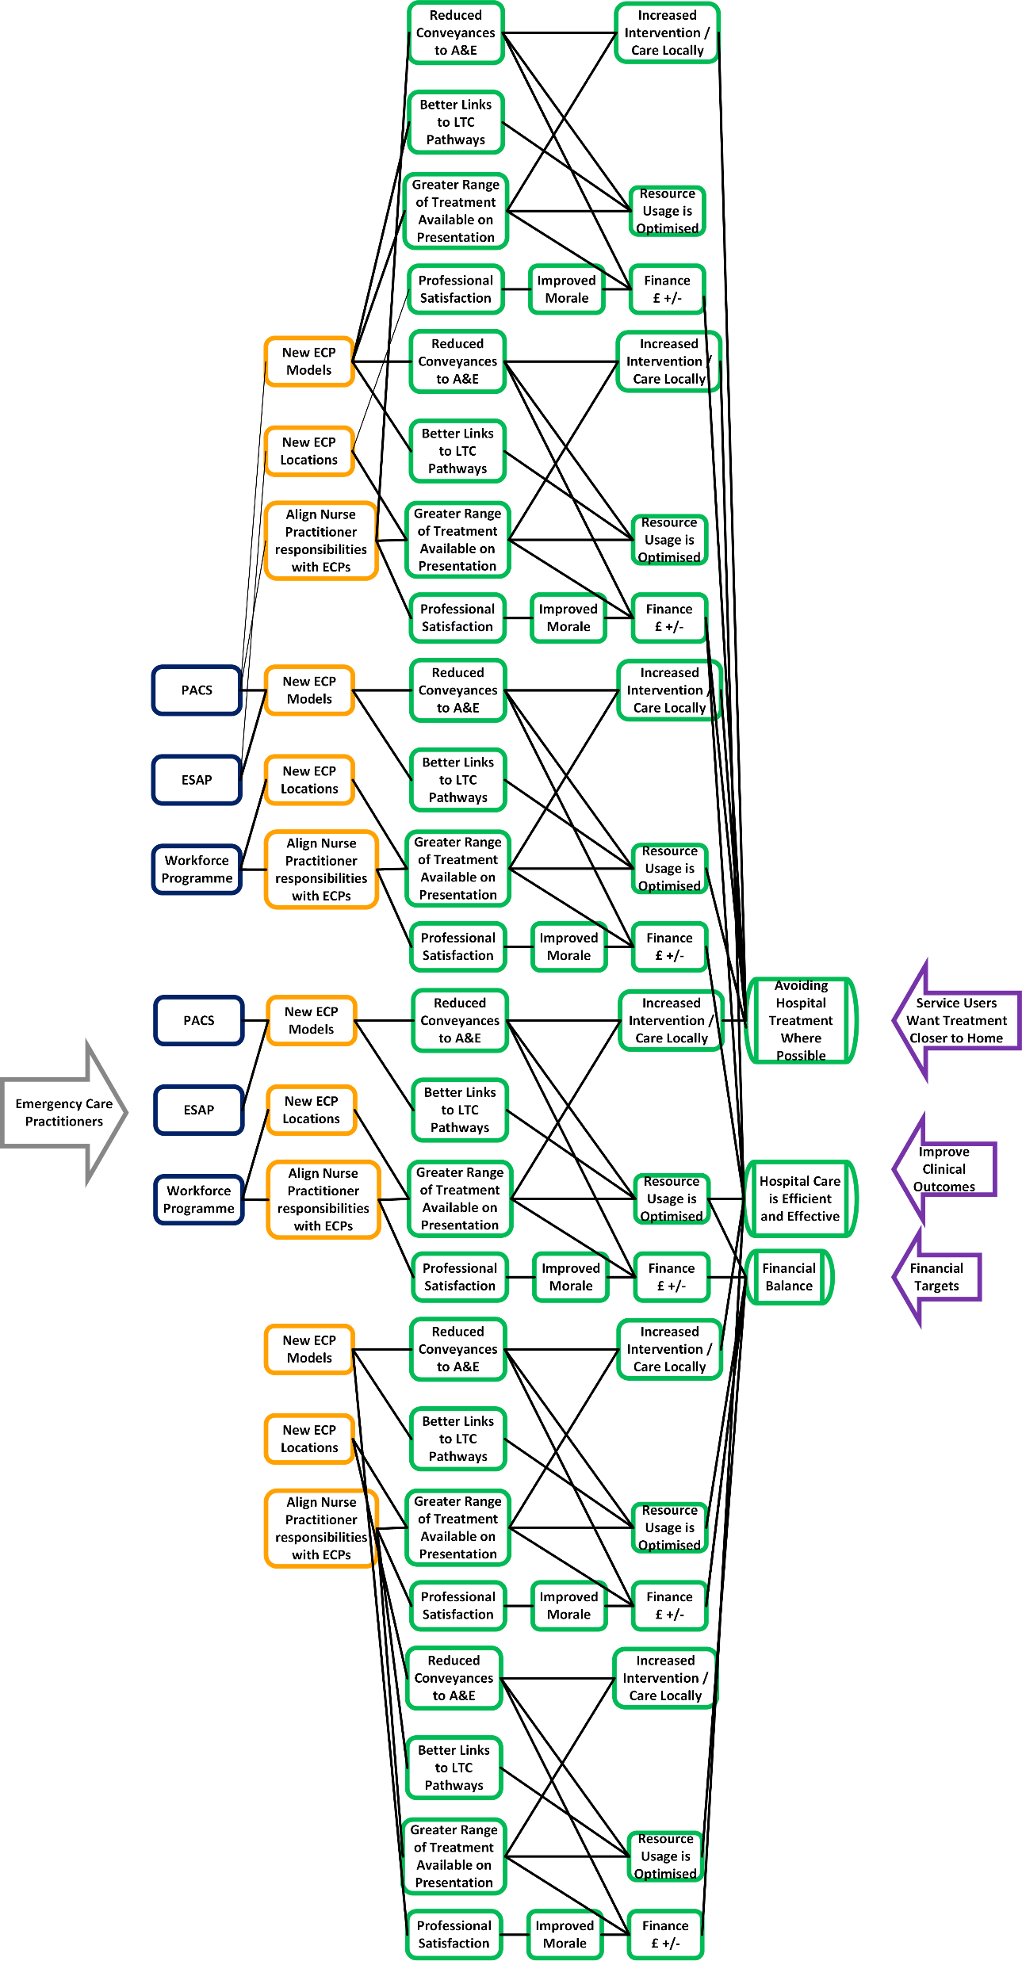
This is not
Notes:
Imagine that the programme had chosen 50 benefits instead of 3. Life gets much more complex here. Many business cases get drafted on the basis of quantity, not quality. The more benefits you put in, the more likely you are to be picked from the pack of competing business cases. Delivery is another matter though. Once you take the table of benefits out of the business case and map it you begin to see how impractical your project is.

Slide 13
Pre-Mortem
A way to assess your risks
Set the scene, “It’s a year from now, we ran the project and it all went wrong”.
Describe how and why it went wrong
See what you can do now to prevent this happening.
Original idea by Gary Klein, quoted in Thinking Fast and Slow, Daniel Kahneman
Notes:
Once you’ve tested your idea and you think it’s sound, this is a way to assess your risks so you can prepare for the things that will spoil it.
Set the scene, “It’s a year from now, we ran the project and it all went wrong”.
Describe how and why it went wrong. Brainstorm all the potential crises, e.g. workforce, skills, competition, economy.
See what you can do now to prevent this happening. What can you control, what can’t you? What are your reasonable chances of success?
Is it still worth doing?
If so, what mitigation can you apply to your risks?

Slide 14
Pre-Mortem
Too little reduction, no savings
Staff shortage crisis
Target doubled
Objective missed
Notes:
Show the risks and assumptions of the pre-mortem scenario on the BDN.
Which links broke?
Which items changed?
What survived?

Slide 15
Comments?

Slide 16

BENEFIT OF
EXPERIENCE
Red Team
david.waller@keldale.com

