Slide 1
Quantifying the Social Stuff
Where to go once you’ve counted all the stationery
www.keldale.com
www.goalmodelling.com
www.hivemindnetwork.com
Notes:
This was originally presented to the HSCIC LSP group and Lorenzo Benefit Leads in Nov 2015. The Lost QALY diagram was added for the Yorks BM Network, Jan 2016.

Slide 2
Disclaimer
The ideas and numbers offered here are suggestions to start the conversation.
I think they are reasonable.
No-one has formally agreed them.
Notes:
The ideas and numbers offered here are suggestions to start the conversation.
I think they are reasonable.
No-one has formally agreed them.
You may use them at your own discretion

Slide 3
Our Job
Benefits Management is the best application of scarce resources to select and deliver appropriate benefits to identified stakeholders
Notes:
This is our job.
Benefits Management is the best application of scarce resources to select and deliver appropriate benefits to identified stakeholders.
This seems like a good thing to do.
Today, the identified stakeholders are the consumers of health and social care services, i.e. patients, carers and the UK tax-payers. The tricky bit is measuring what’s appropriate to them.

Slide 4
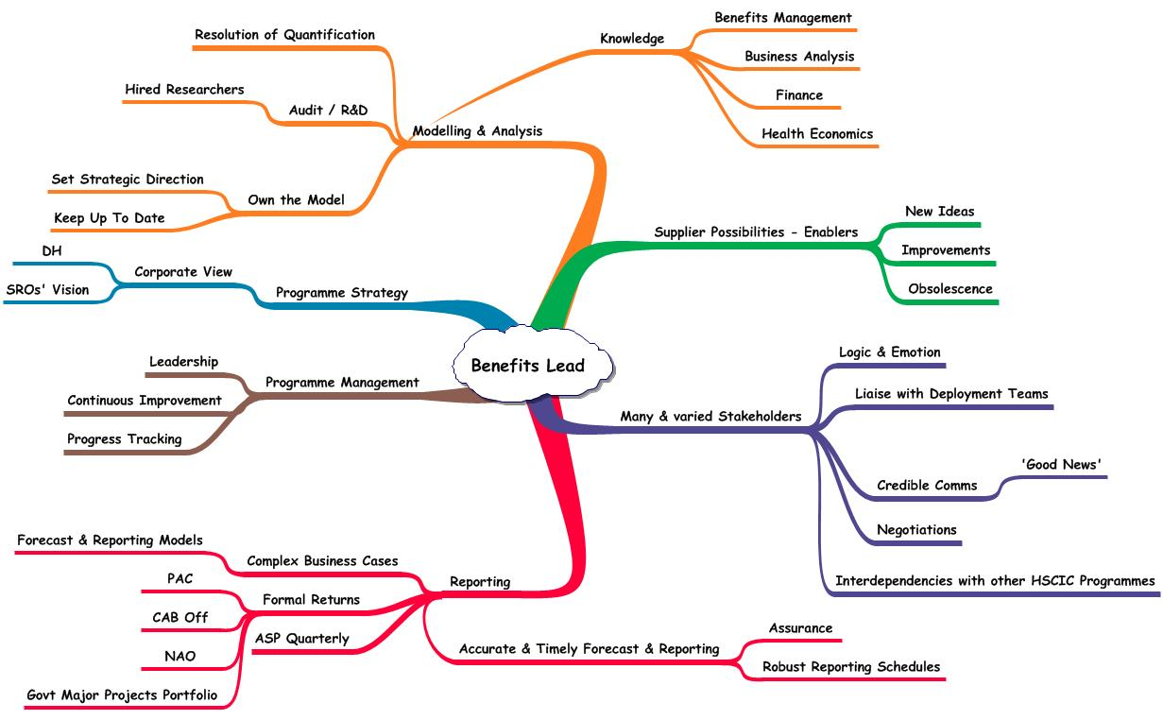
“It’s not rocket science…”
Notes:
A common view of Benefits Management is that it’s not rocket science. True, but it’s nearer rocket engineering. It requires proper planning, meticulous effort, an understanding of the materials and careful tracking of performance if it’s to be done well.
In order to model the true value of technology enabled business change we first have to look at the environment in which we operate. Here’s a job spec for a Benefits Lead who understands the ‘true’ value of Health Informatics drawn to show how many things influence ‘true’ value. It gives us some elements to consider and puts things in context:
Many & Varied Stakeholders – too many to list. There are an awful lot of people from an awful lot of different backgrounds here. It makes ‘true’ value an interesting topic, stakeholder perceptions and all that...
SRO’s vision – probably not quite as inspiring as we’d hope. E.g. Kelsey’s farewell to EHI Live (Nov 15) – Transparency, Collaboration, Participation. These aren’t objectives, they’re CSFs, more means than ends. They say how ‘it’ will be done, not why. He’s far from being alone in poorly defining his objectives.
Modelling & Analysis – strategic direction and resolution of quantification, the meat of today’s talk.

Slide 5
Starting from the top
Behind every business change there are five seemingly naïve questions:
What does ‘good’ look like?
What’s the point of this change?
Who is it really for?
What do they actually want?
What makes this option better than Plan B?
Notes:
Let’s start from the top, the things to know before you commit.
The questions are simple, so simple that they are rarely asked. There’s that nagging ‘Emperor’s new clothes’ feel to them:
“Am I the only one who doesn’t get this?”
“Are you really that ignorant or just causing mischief?”
“We’re committed now. How much trouble will I cause if I raise my doubts after we’ve invested so much?”
The answers aren’t simple at all though. Your environment is complex and the cost of investigation may be too high. You may have to compromise. That’s fine, don’t let perfection be the enemy of the good. On the other hand, answers like, “It’s priceless” and “How long is a piece of string?” really won’t cut it.

Slide 6
The baseline
What does ‘good’ look like?
KPIs that really indicate how you are performing against the key things that matter
Easy on the production-line
Not so easy for the professional knowledge worker
http://himss.eu/sites/default/files/EMRAM%20Performance%20Report%20HM3.pdf
Notes:
What does ‘good’ look like? How do you know you are doing a better job this week than you did last week?
This sets the scene. Let’s assume that the general reason for any change is to improve something. You’re not deliberately setting out to make things worse. You need to know the baseline of how things are now. You must be able to tell if things are getting better or worse and by how much. In other words you have to have KPIs that really indicate how you are performing against the key things that matter. If you can’t measure the impact of any change, how will you know it’s been worthwhile?
HIMSS made a correlation between EMRAM score and SHMI, see http://himss.eu/sites/default/files/EMRAM%20Performance%20Report%20HM3.pdf
It’s not a clear-cut straight-line 100% correlation. Not being a stats expert, I think they are stretching things a bit. However, as at Nov 2015 it’s the nearest evidence I’ve found to “Hospitals with EPR are better for patients than hospitals without.”
If healthcare is all about improving health and well-being then we ought to measure that. Which brings us to QALYs.

Slide 7
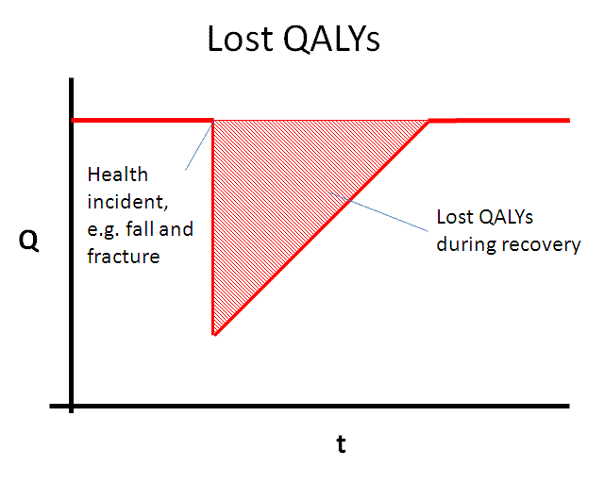
What’s the cost?
Notes:
Check that everyone has heard of QALYs. Quickly explain EQ-5D if nec.
This is a very simple graph of lost quality of life. It suggests a dramatic incident causing an instant drop. Here, the incident is immediately treated and the patient steadily recovers to their original state. You could also imagine a slow deterioration over time, the effect of long patient waiting lists, courses of treatment and persistent conditions. All would complicate the shape of the shaded area.
The lost QALYs are the red shaded area. PROMs gives us two snapshots but we don’t know exactly where on they sit on the curve so we can’t really use them to value an accurate increase in QoL.

Slide 8
How many QALYs to the pound?
QALY value |  | Apr 2015 prices
£60,000 | Public value of a QALY, taken from DH/HSCIC VfM ratio, standard DH Impact Assessment guidance
£15,000 | NICE value of a QALY, taken from DH/HSCIC VfM ratio
£70,765 | EuroVaQ discounted QALY (Approach 1, acute incidents) 2007 | £87,023
£34,925 | EuroVaQ discounted QALY (Approach 2a, long-term conditions age 18+) | £42,949
£53,838 | EuroVaQ discounted QALY (Approach 2b, long-term conditions age 40+) | £66,207
Notes:
DH Impact Assessment £60k
The Department of Health must assess all of its policies in terms of opportunity costs. The Impact Assessment Guidance, paragraph 209, states:
"Thus for all public spending required for an option, whether from the DH budget, from local authorities or from other Government Departments, the opportunity cost is calculated first by working out how many extra QALYs could have been purchased with that sum (currently at £25,000 per QALY), and then how much those QALYs are valued by the recipients (currently at £60,000 per QALY). In short, the opportunity cost of a £1 of public funding is currently estimated to be £2.40p."
There is general guidance on impact assessments at DH Interim Technical Guidance on Impact Assessments. 24 Sep 2009, Donald Franklin, http://www.berr.gov.uk/whatwedo/bre/policy/scrutinising-new-regulations/preparing-impact-assessments/page44077.html but I can’t find the original 60 : 25 explanation.
NICE £15k (recently reduced from £25k to £15k in the Benefits Eligibility Framework for the VfM ratio)
EuroVaQ an EU multi-national research project 2007 gave half a dozen options but wouldn’t choose it’s favourite. Note, accidents trump illness £70k to £53k and the young think life is cheap. As we get old and see our own mortality we begin to put the price up.
Apart from NICE, which is all about managing budgets, they’re roughly similar in size.
I am of the opinion that if £60k is good enough for DH to set VfM hurdles then it’s good enough for me to quantify my benefits. Let’s be consistent here.

Slide 9
Fear of falling
Australian study found fear of falling scored 0.5 QALY
Pro-active falls prevention:
Stops some people falling
Stops some people worrying about falling
Everyone in b) is worth £30k Societal benefit
Notes:
Here’s an example of applying QALY value to a societal benefit.
Quality of life related to fear of falling and hip fracture in older women: a time trade off study, BMJ. 2000 Feb 5; 320(7231): 341–346.
The relevant study group had EQ-5D drop by 0.1 for an average 5 years, i.e. 0.5 QALY worth £30k.
We’d probably cost up the cash / non-cash benefits around the forecast number of prevented falls using the incremental cost of care for fallers in the relevant patient cohort. According to a Torbay case study, it’s around £7k. http://www.kingsfund.org.uk/sites/files/kf/field/field_publication_file/exploring-system-wide-costs-of-falls-in-torbay-kingsfund-aug13.pdf
What’s a reasonable assumption on the impact of a falls prevention service, 20% of users don’t worry about falling, 10%? Even that’s worth an average of £3k / user.

Slide 10
However…
 | Procs | Average Pre-Op Q Score | Average Post-Op Q Score | Health Gain | Improved | Unchanged | Worsened
Groin hernia | 109 | 0.799 | 0.894 | 0.095 | 59 | 33 | 17
Hip Primary | 107 | 0.293 | 0.771 | 0.478 | 98 | 5 | 4
Hip Revision | 6 | 0.36 | 0.673 | 0.313 | 6 | 0 | 0
Knee Primary | 205 | 0.345 | 0.656 | 0.311 | 156 | 22 | 27
Knee Revision | 10 | 0.376 | 0.438 | 0.063 | 6 | 1 | 3
Varicose Veins | 24 | 0.805 | 0.897 | 0.093 | 14 | 7 | 3
Notes:
Pricing the QALY is one thing. Counting the QALYs is another. That’s when we get into ‘length of string’ territory.
One Trust’s PROMs scores, to Nov 14. The patient reported EQ-5D scores vary widely by the type of procedure. Note how many actually make things worse.
PROMs is a major exercise. The patient’s form requires some effort so not all of them fill it in. It’s also two snapshots. It doesn’t explain how long the QoL improvement lasts.
PROMs gets consolidated into one measure in 2015-16 which suggests that it’s not universally loved.
EQ-5D is someone’s IP and they charge people to use it. The academics prefer to make their own topic-specific measures for their research projects.
Academic excellence is the enemy of the good – “There is no ‘neutral’, or ‘objective’ way of summarising EQ-5D data (or data from any PRO measure, for that matter!)” - See more at: https://www.ohe.org/news/5-things-you-should-do-eq-5d-data#sthash.98bTDnsP.dpuf
I still think there’s scope here for rounded estimates and common comparisons if we can gather enough examples and come to a consensus. We don’t have to be perfect, we just have to do something a bit better than arbitrary 4:1 VfM targets.

Slide 11
Life isn’t cheap
Prevented Fatality |  | Apr 2015 prices
£1,400,000 | EuroVaQ Value of Preventing Fatality (VPF) based on 40 yrs life expectancy DfT 2007 | £1,721,640
£56,098 | EuroVaQ discounted value per life year (Approach 1) | £68,986
£29,691 | EuroVaQ discounted value per life year (Approach 2a, long-term conditions age 18+) | £36,512
£56,746 | EuroVaQ discounted value per life year (Approach 2b, long-term conditions age 40+) | £69,782
£1,639,166 | DoT Transport Appraisal and Strategic Modelling Division (lost output + human costs) 2010 | £1,916,198
Notes:
The usual value of preventing fatality figure comes from Dept of Transport who did a lot of research around traffic accidents and how much it’s worth investing in prevention measures.
The number got checked by EuroVaQ and stands up. The 2010 number has gone up beyond RPI inflation but it’s still similar.
The big issue here is SRO acceptance. If we were to focus EPR on mortality reduction projects (patient obs, NEWS, etc) and apply these numbers then VfM would be more than sorted.

Slide 12
Impact of mortality
1422.5 | Observed deaths forecast at average SHMI for the period
1395.6 | Observed deaths forecast at target SHMI
27 | Potential deaths avoided per year shown by reduced SHMI
£1,721,640 | EuroVaQ Value of Preventing Fatality (VPF)
£46,243,241 | Annual Value of Preventing Fatality
Notes:
Just to put things in some sort of context.
Taking a modest sized hospital with a SHMI target reduction of 0.02.
Meeting the target means an average 27 fewer deaths per year, a Societal value of £46m.
The Trust’s forecast benefits of its entire EPR programme over 10 years is £46m.

Slide 13
Cost of harm
Mitigating incident risk
Incidents | Degree | Cost / incident (HSE indexed to 2015 prices) | Cost p.a.
8,652 | None | £0 | £0
1058 | Low | £423 | £447,727
142 | Moderate | £28,917 | £4,106,277
25 | Severe | £292,277 | £7,306,944
18 | Death | £1,885,699 | £33,942,587
9,895 | Total incidents |  | £45,803,534
 | Average incident cost |  | £4,629
Notes:
Lots of patient safety benefits (especially meds management) cover mitigation of risk, e.g. reducing serious incidents. We will harm fewer patients. These are often described in productivity terms though, an adverse drug reaction is worth an extra 2 days LoS.
How big a deal is it to the patient? They don’t all take us to court and win compensation so we can’t just wrap this up in litigation costs. We need some way to express its seriousness though.
The Health and Safety Executive have priced up categories of harm. Like DoT, they wanted to value their risk mitigation measures. The categories are similar to the way Serious Incidents are reported to National Reporting and Learning System (NRLS). Putting the costs to the numbers gives an average cost of harm of £4.6k. The vast majority cause no or little harm so there’s a risk of complacency and deep shock when the rare catastrophe happens. Maybe an average cost may change behaviour here.

Slide 14
Price of comfort
A good patient experience is worth 5% QALY for 10 days = 0.5 QAL Day.
Happy patient = £82 / time
Notes:
That’s what it ‘costs’ the patient when we harm them. What’s the up-side of this? What’s it worth to do more than just not harm them? NHS Outcomes Framework 2011/12 Impact Assessment pg 39 Patient Experience says a good patient experience is worth 5% QALY for 10 days = 0.5 QAL Day. At £60k / QALY this is £82.
If basic 'customer care' can achieve this, what can improved treatment do?

Slide 15
Logic
“Logic can be defined as the study of consistent sets of beliefs” – Logic, Wilfred Hodges
In other words:
If £60k is good enough for DH then it’s good enough for us, every time.
If £1.4m is good enough for DoT then it’s good enough for us, every time.
Notes:
We’ve already looked at the various QALY values and how it would be sensible to pick one and stick with it.
What we also need is a consistent approach. It must be rational. I accept that we need a hurdle rate for opportunity cost so that Health Informatics pulls its weight compared to other healthcare investments. I don’t see the DH VfM argument as rational though. It’s just two groups valuing the same thing differently. When we value our societal benefits we must come up with a better argument than this.
However, if we are going to use an £x / QALY then it has to be the same £x. We can’t use DH £60k for one benefit and NICE £15k for another.
If we do have a better argument then it has to be applied consistently, even when the numbers look alarming. There are some potentially big numbers here, especially where prevented fatality is concerned. Big numbers scare Boards so we are encouraged to tweak the numbers down into their comfort-zone.
For example, if IPPMA saves say, a hypothetical 10 lives / year and we accept that each is worth £1.7m then it’s a Big Deal (£17m / year societal benefit) and we should treat it seriously. We don’t say, “The Board won’t believe this number.” and fiddle the attribution to some trivial percentage that drags it down to a comfortable level. No-one will remember later that we lied (in a good way) about the RoI to get approval to proceed. They’ll just see IPPMA as a mediocre project and resource it accordingly, with all the risk and delay that will follow.

Slide 16
Better than Plan B?
Why is this change the best option to take?
Why is it the best use of your scarce resources?
Does counting the stationery give you the best answer?
Notes:
The final naïve question.
What makes this option better than Plan B?
Why is this change the best option to take? Why is it the best use of your scarce resources? When you are dealing with profit and finance then the comparison will be relatively (!) straightforward. If you’re looking at Social Return on Investment then life can get just a little more messy. That doesn’t mean that you shouldn’t try though. You’re responsible for spending other people’s money so you ought to spend it wisely.

Slide 17
Discussion
David Waller
david.waller@keldale.com
07780 533876
www.keldale.com
www.goalmodelling.com
www.hivemindnetwork.com
Notes:
I hope you have found this presentation useful and that it’s given you something to think about. Obviously, there is only so much we can cover in a short session. I’d be delighted to discuss things in more detail with you. You can contact me at
david.waller@keldale.com

Slide 18
Sources
NHS Outcomes Framework 2011/12 Impact assessment pg 39 - QALY social value £60k
Dot Transport Appraisal and Strategic Modelling Div https://www.gov.uk/government/publications/webtag-tag-data-book-november-2014
EuroVaQ final report 2007 – 10 http://research.ncl.ac.uk/eurovaq/EuroVaQ_Final_Publishable_Report_and_Appendices.pdf
Quality of life related to fear of falling and hip fracture in older women: a time trade off study, BMJ. 2000 Feb 5; 320(7231): 341–346.
Serious Incidents reported to NRLS https://report.nrls.nhs.uk/explorerTool/default.aspx
Cost of falls in Torbay http://www.kingsfund.org.uk/sites/files/kf/field/field_publication_file/exploring-system-wide-costs-of-falls-in-torbay-kingsfund-aug13.pdf

