Slide 1
Objective Setting - what to do
The solution, and how not to leap to it

Slide 2
Where to start
Before you rush into building stuff

Slide 3
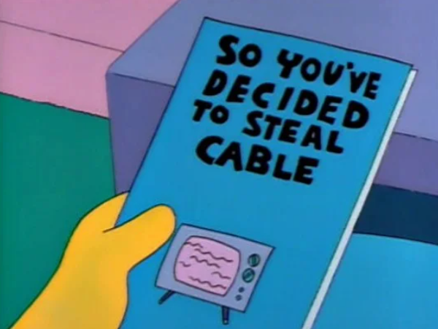
Inception - Discovery
HOMER VS. LISA AND THE 8TH COMMANDMENT
The Simpsons Episode 26, Season 2
Notes:
By the time that most people involved in a project get to hear about it, the decision has already been made. The job is then to implement it as painlessly as possible.
Even in an Agile setup, the Discovery phase is there to prove that the desired result can / should be done.
It is a well-known generalisation that we all dive straight into solutions without thinking properly about what we want to solve. Programme and Project Management tend to start from a (hopefully reasonably) defined need, e.g. the Sponsor’s Programme Mandate, “Build me X…”.
What’s not been explained well is how that need is selected in the first place.

Slide 4
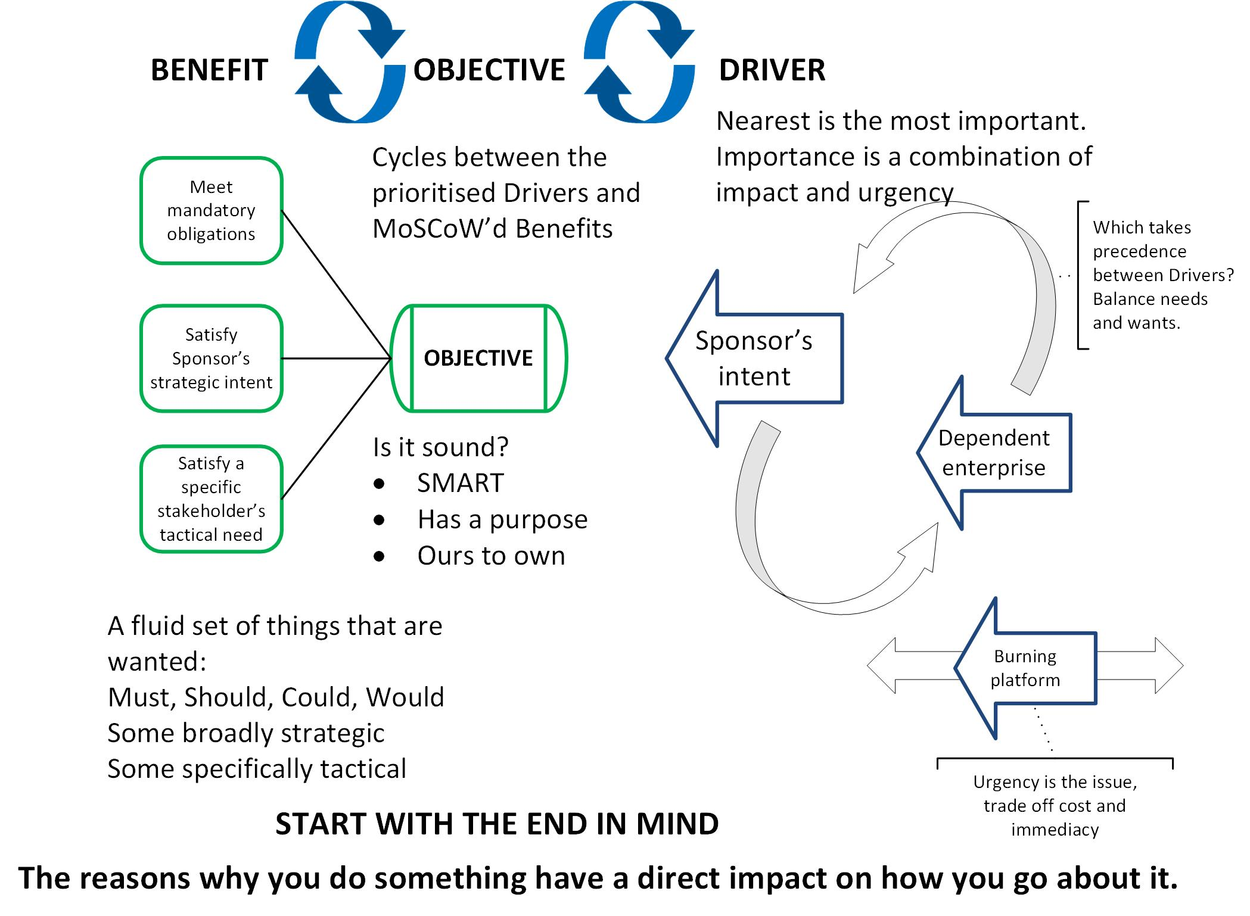
Selecting the Objective
Notes:
This diagram sums up the presentation. It’s a bit fussy, so don’t try to take it all in now. We’ll come back to it later. The things to note for now are that there is a process to all this and that the process is iterative, wheels within wheels, rinse and repeat.

Slide 5
The Objective
You should start with the end in mind, so what end do you have in mind?
Notes:
Benefits Managers keep plugging the mantra, “Start with the end in mind”. As it said on the diagram, the reasons why we do something have a direct impact on how we go about doing it.
We must put sufficient thought and effort into selecting the objective(s).

Slide 6
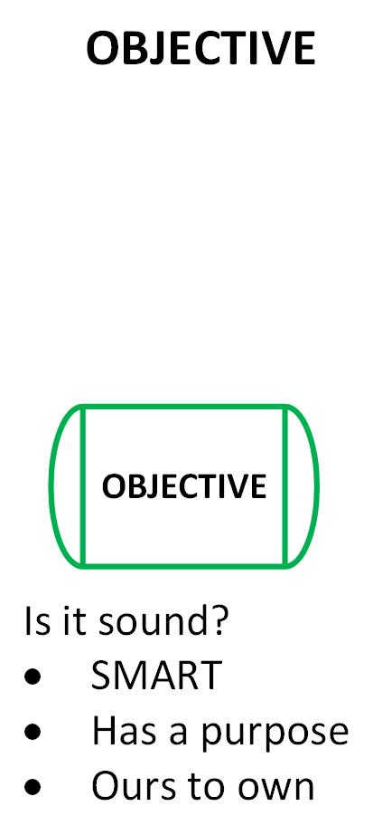
A sound Objective
An objective is a result with a purpose
“We will do X because…”
We require an objective(s) that is sound:
SMART
Has a purpose
Is ours to own
To get there, we need to understand what Drivers prompt our Objective and what Benefits validate it
Notes:
BCS members survey ‘IT in the Org 2022’ reports that over 50% of leaders and professionals blame project failure on unclear goals and objectives.
What makes a good Objective?
It’s got to be strategic, not spending. The objective is not to install kit by deadline. It is to install kit because it will deliver desired results. There has to be a ‘because’ in it, even if it’s implicit.
The Objective must be sound:
SMART (Specific, Measurable, etc.) so we understand what it is and what it’s not. We can see that it has feasible scope and boundaries. We will have something against which we can measure our progress and achievement.
It will have a purpose so we can see why it is important. The ‘because’ is in there that makes it compelling, or at least tells us how much effort is worth putting in.
And it must be ours to own. It fits in our remit and competence, not too big, not too small. We can see that it needs doing, but are we the right people to do it?
That’s a general description of any sound Objective. So what about our specific one? We shouldn’t just pull it out of thin air. There’s a lot to be said for creative and imaginative leadership, the leader’s leap of faith and all that. However, some rationality has to be included. We risk too much (of ourselves, of public / investors’ money, of our stakeholders) to trust simply to luck.
One single, compelling Objective is a good thing. You may have more than one, e.g. four Balanced Scorecard corporate Objectives. Do what works for you. However, do not create a shopping list. Too many Objectives will clash with each other. No-one can hold them all in their head at the same time.

Slide 7
The Drivers
What makes you need to act?
Notes:
Something is going to trigger the need to act. How well is it understood?

Slide 8
Yet there is the constant desire to find some point in the twisting, knotting, ravelling nets of space-time on which a metaphorical finger can be put to indicate that here, here, is the point where it all began…
- Terry Pratchett, Hogfather

Slide 9
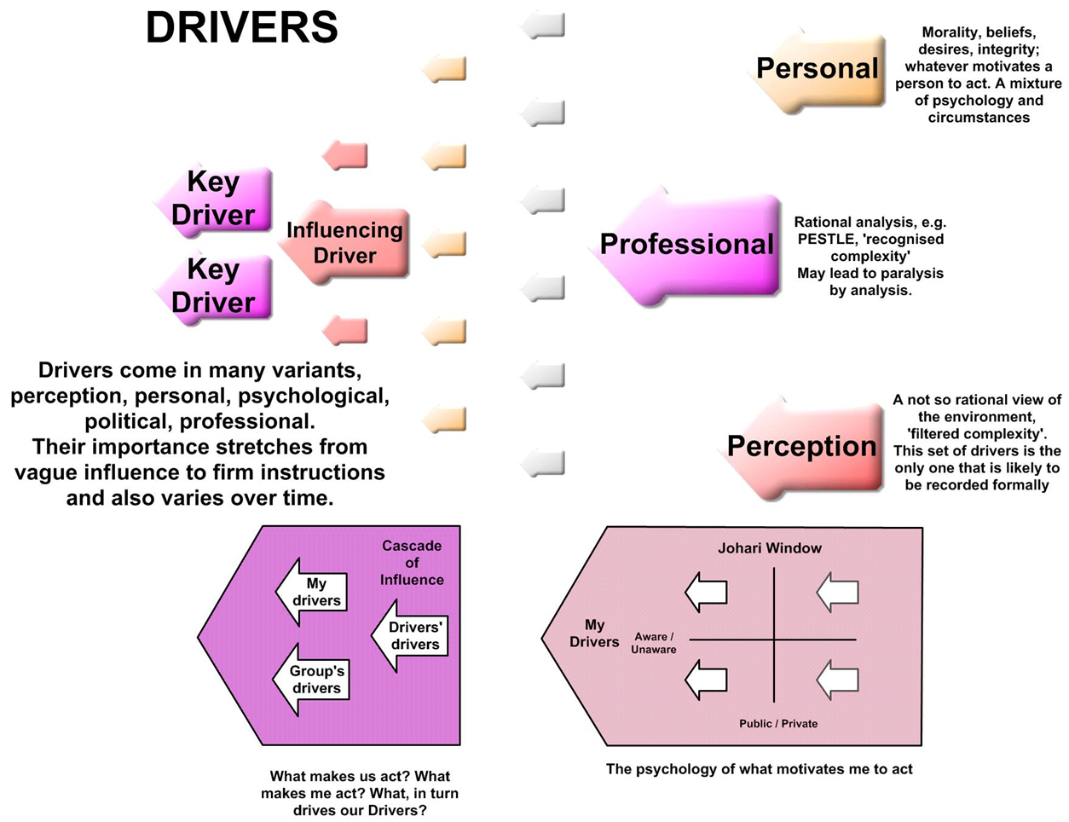
Drivers - understand the context
Drivers are the external influences that cause you to act
They must be selected and prioritised
The Driver’s importance is determined by:
Impact
Urgency
Notes:
How well do we understand the context in which we operate?
Drivers are the external influences that cause you to act. They can be problems, opportunities, instructions from above, personal beliefs or mores.
If we don’t understand them then we risk reacting to the latest, or the most visible, or the easiest.
They must be selected and prioritised. Pick the relevant Drivers, don’t boil the ocean, don’t concern yourself with trivia. Sort them by importance. Pick the key ones.
The Driver’s importance is determined by:
Impact, how big it is
Urgency, how soon it must be addressed
Sometimes drivers are few and clear; mandatory obligations, set targets, JFDI.
However, in multi-agency programmes with an element of free will things get much more complex. Behind the recorded professional drivers will be a number of personal and perceived ones. Morality, beliefs, personal needs are tinged with perception of the world around us. We can only take in so much and we filter it to fit ourselves. Personal psychology plays a part and the Johari window is one example of how this may play out.
Drivers are in turn driven. The service target set by DHSC will have been influenced by expert opinion and political needs, political needs come from politicians’ beliefs about public beliefs based on public perceptions of the care they want and need.
They are the reasons why you chose the Objective. They determine what you will do and if used transparently, they justify why you’re doing it. They are the basis for your Strategic section in the Business Case. When someone asks why you are doing it, the Drivers are your answer. So, how good does the answer sound?
Pick the few, crucial Drivers, not a shopping list. The more you choose, the more likely that they will conflict and you’ll end up satisfying no-one.
In your documentation, explain the rationale and assumptions behind your choice, “Though X is bigger than Y, Y is happening now and we can save up for X in the next five years.” Show the priorities on the diagram, the most important Drivers go nearest to the Objective and are shown bigger than the others. Show the influencing ones for transparency’s sake, “We considered X, but it’s not the thing that really motivates us.”

Slide 10
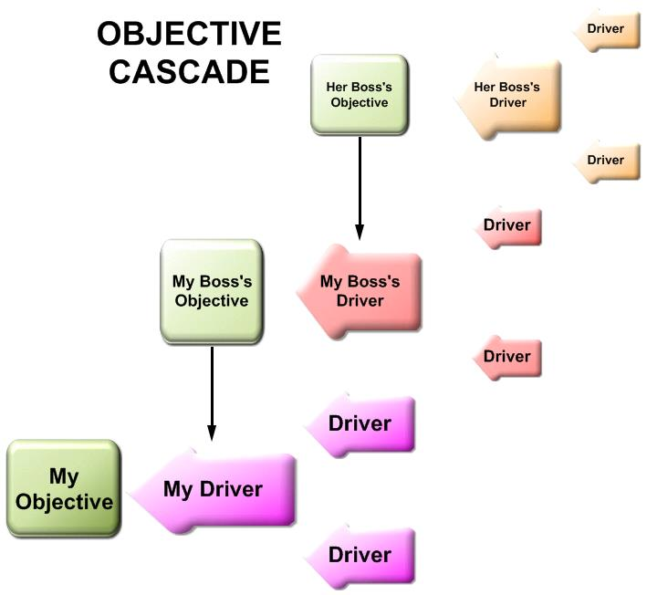
Driver cascade
Programme objective becomes project driver
Project objective becomes workstream driver
Notes:
Where there is a culture of control these drivers can be converted directly into objectives. The army calls this extraction of orders and it is a required procedure. Any unit commander giving formal orders must connect their mission to their commander’s objective.
Even in less formal cultures, one of the drivers that influences my objective comes from my boss. What she wants to achieve drives what I want to achieve. And so it goes up and down the hierarchy.
The picture also shows that you could face many Drivers of decreasing (but still present) influence. That’s why it’s important to sort, prioritise and select the ones that really matter.

Slide 11
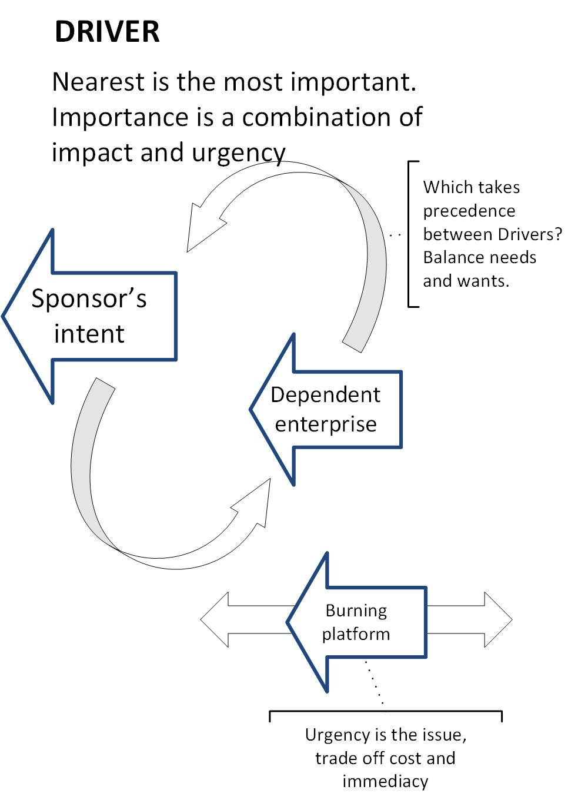
Prioritise the Drivers
Shuffle them
Argue about them
Talk until you reach a consensus
Understand what drives you
Notes:
Some typical project Drivers:
Sponsor’s intent, e.g. political decision - the Minister says do it, a legal obligation
Dependent enterprise, other projects and activities need your products
Burning platform, obsolete kit, a window of opportunity
They’re going to jostle for position, some will clearly trump others. Satisfying a paying customer may come top, unless you need to stop breaking the law. Balance the things that are wanted against the things that are needed.
Time will determine the importance of the burning platform, trading off cost against urgency and impact.
Put them on Post-its and shuffle them around. Argue about them. The visual stuff works better than a list of bullet points.

Slide 12
The Objective – first pass
Addressing the Drivers
Notes:
We’ve got the Drivers, now use them.

Slide 13
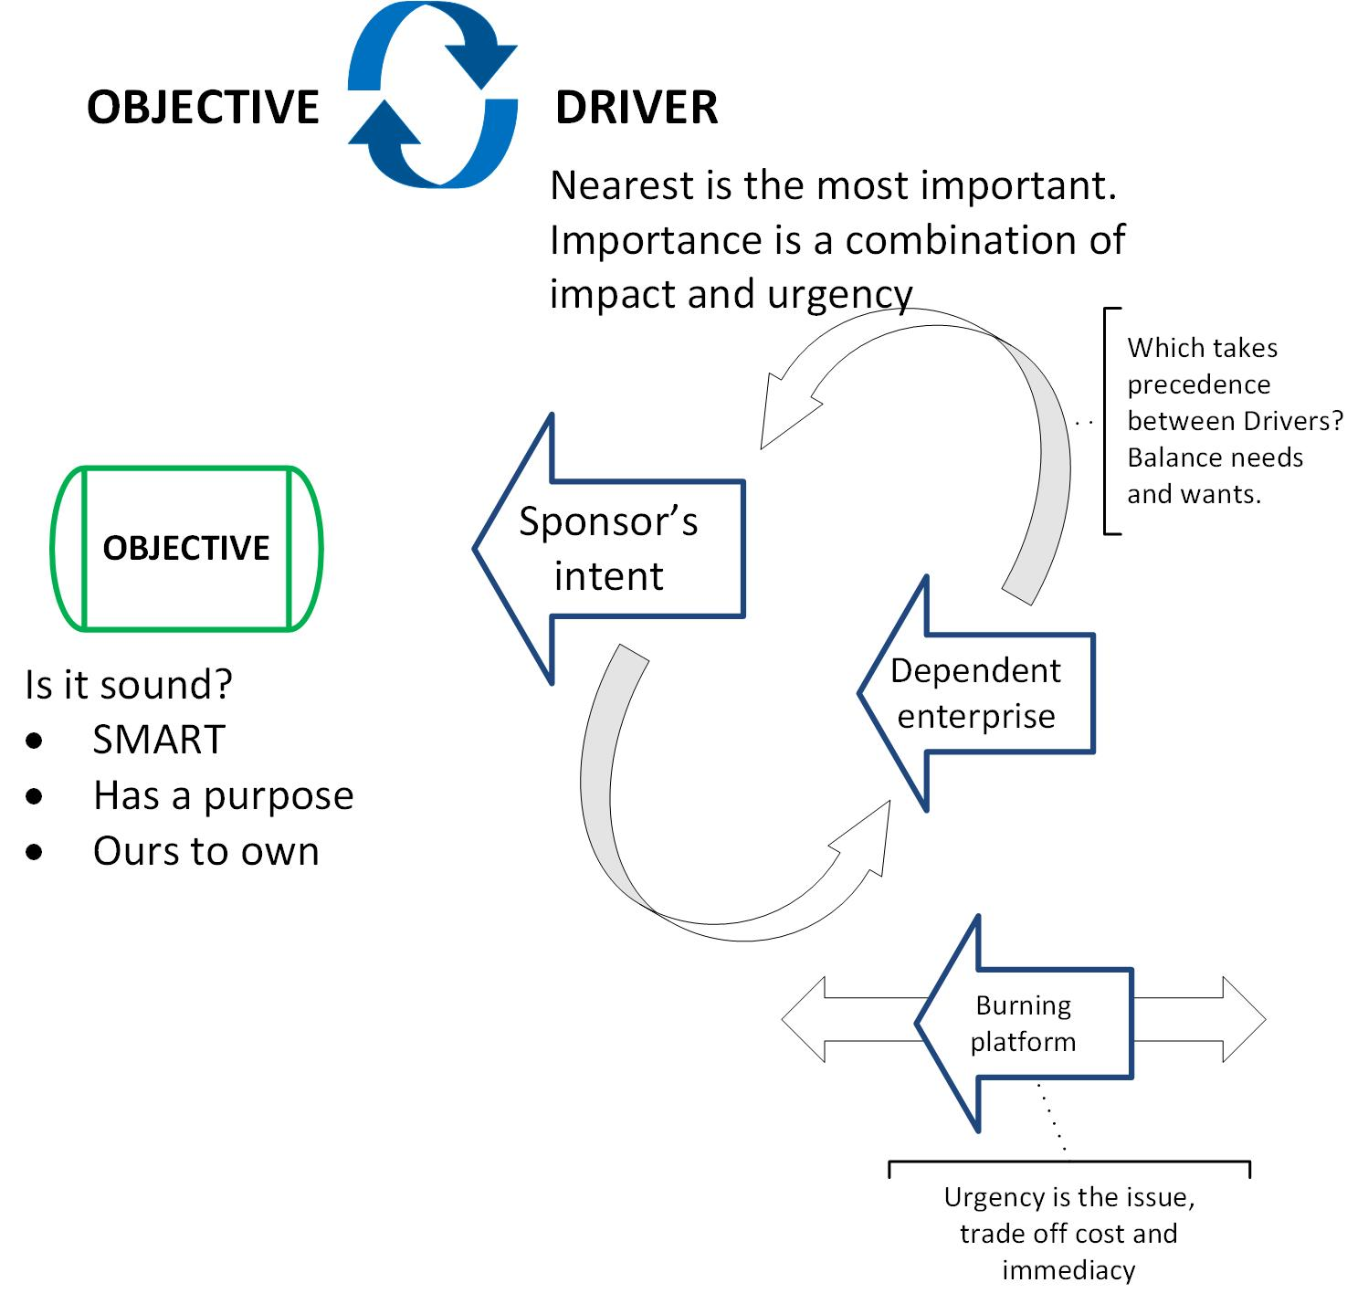
Our sound Objective – first pass
An objective is a result with a purpose
“We will do X because it addresses our Drivers…”
We require an objective(s) that is sound:
SMART
Has a purpose
Is ours to own
Notes:
Remembering the general aspects of a sound Objective, Let’s feed our Objective from our Drivers.
Drivers give us the ‘because’ statement, the purpose behind our Objective. That’s the start.
Now we start solutionising a bit and draft an Objective that:
Is SMART – concrete, not necessarily physical but we’ll know when we’ve done it, that feels feasible
Has a compelling purpose, a mission statement, will motivate
Belongs to us, falls in our remit and competence, not micro-managing, not ruling the world
And we test it against the Drivers. Will it achieve what it ought? Does it change the Drivers? Have we just discovered another (valid) reason to do something?

Slide 14
The Benefits
What makes the Objective worthwhile?
Notes:
“What’s in it for me?”, what’s the ‘what’ and who’s the ‘who’?

Slide 15
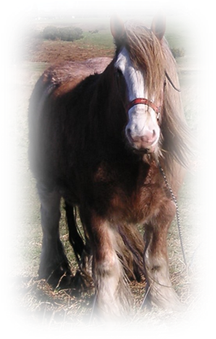
Typical Benefits Management
Benefits Management – not so much shutting the stable door as trying to describe someone else’s horse on the insurance claim.
“How big was it? Really big, cart-horse sized, ok…”
“And the colour? Horse coloured, right…”
Notes:
The cynical and yet typical observation of Benefits Management in practice.
However, this time we’re going to try it in the right time and place, at the start, testing the first-pass Objective.

Slide 16
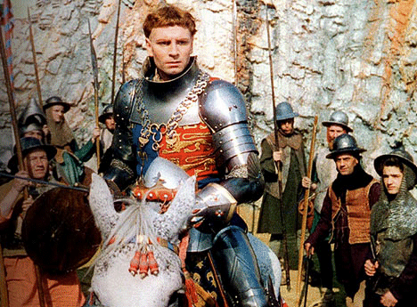
Key stakeholders’ benefits
POWER, CONTROL!
LOOT, DRINK!
Same project, different intentions
Notes:
We have our first-pass Objective. What’s going to come out of it? Drivers set the strategic intent, Benefits give it a sense of scale to see if it’s proportionate and worthwhile. So let’s examine the Benefits and see if the Objective has merit.
Two key questions of any project are: “Who’s it really for? What do they actually want?”
Different stakeholders want different things. Hence the need to work out who we are doing it for and what they perceive as being valuable.
Henry V at the walls of Harfleur, his reasons to get into the castle are very different from the soldier behind him.

Slide 17
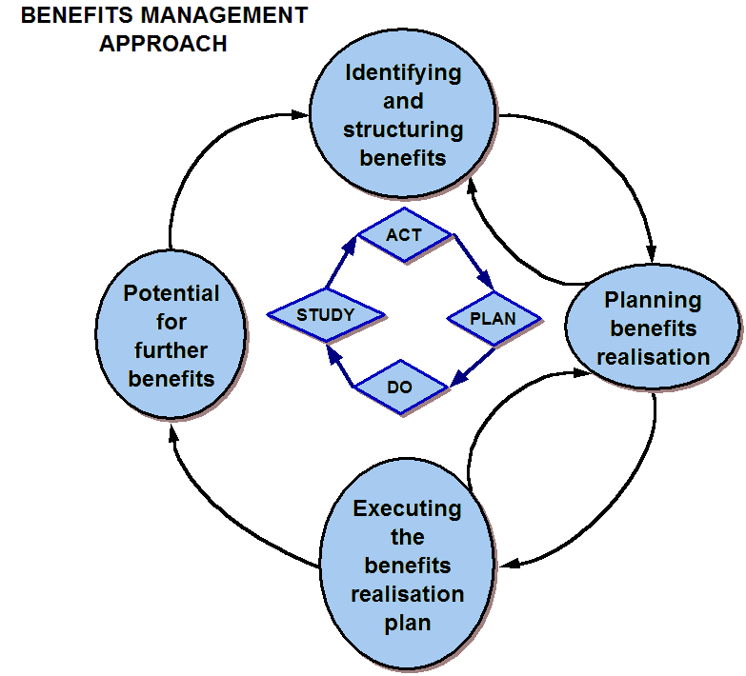
Benefits
A Benefit is a measurable result, seen as valuable to a stakeholder, that contributes to an objective
We create a set of Benefits that is:
Fluid
MoSCoW’d
Broadly strategic, or
Specifically tactical
Notes:
The ‘official’ definition - A Benefit is a measurable result, seen as valuable to a stakeholder, that contributes to an objective. It is important to be firm about this. Otherwise we will end up with features and outcomes that pretend to be Benefits, lots of shiny stuff with no proof of value.
So what Benefits will we want to see from our draft Objective?
At this point, everything is speculative, ill-defined and poorly understood. We are not setting targets or demanding guarantees.
We create a set of Benefits that is:
Fluid, they will change as we go along, vague Benefits will firm up, some will be dropped, others will emerge. The Approach diagram is usually applied after the Objective has been chosen. I’ve put it here to emphasise the iterative fluidity of our benefits. Look at the Deming Loop in the centre and how it starts with Act, not Plan. At this stage in the project, we’ll be spinning through the cycle so quickly that it doesn’t really matter where we started.
MoSCoW’d, prioritised as Must haves, Should, Could have and Would like. We aim for quality, not quantity and a few significant Benefits is far better that bucket-loads of petty stuff. Valuation uses science (objective measurement, etc.). Selection uses art, knowing what to keep, what to drop (e.g. utility vs equality).
Benefits will be broadly strategic, e.g. corporate cost reduction, or specifically tactical, a treat for a particular stakeholder (art of selection…).
Check that the Benefits do contribute to the draft Objective. Otherwise, they are good stuff to have that are nothing to do with our project. Don’t add un-necessary work. E.g. adapting to the Working Time Directive reducing junior doctors’ hours, “And it will improve patient care…” The aim was to stop things getting worse, not to improve them.
These are the reasons why our Objective is worth the effort. They confirm our choice.
Does the Objective still look attractive now we’ve attached some Benefits to it? Do we now have a second-pass Objective?
If we change it, go back and check the Drivers and repeat the whole process again.

Slide 18
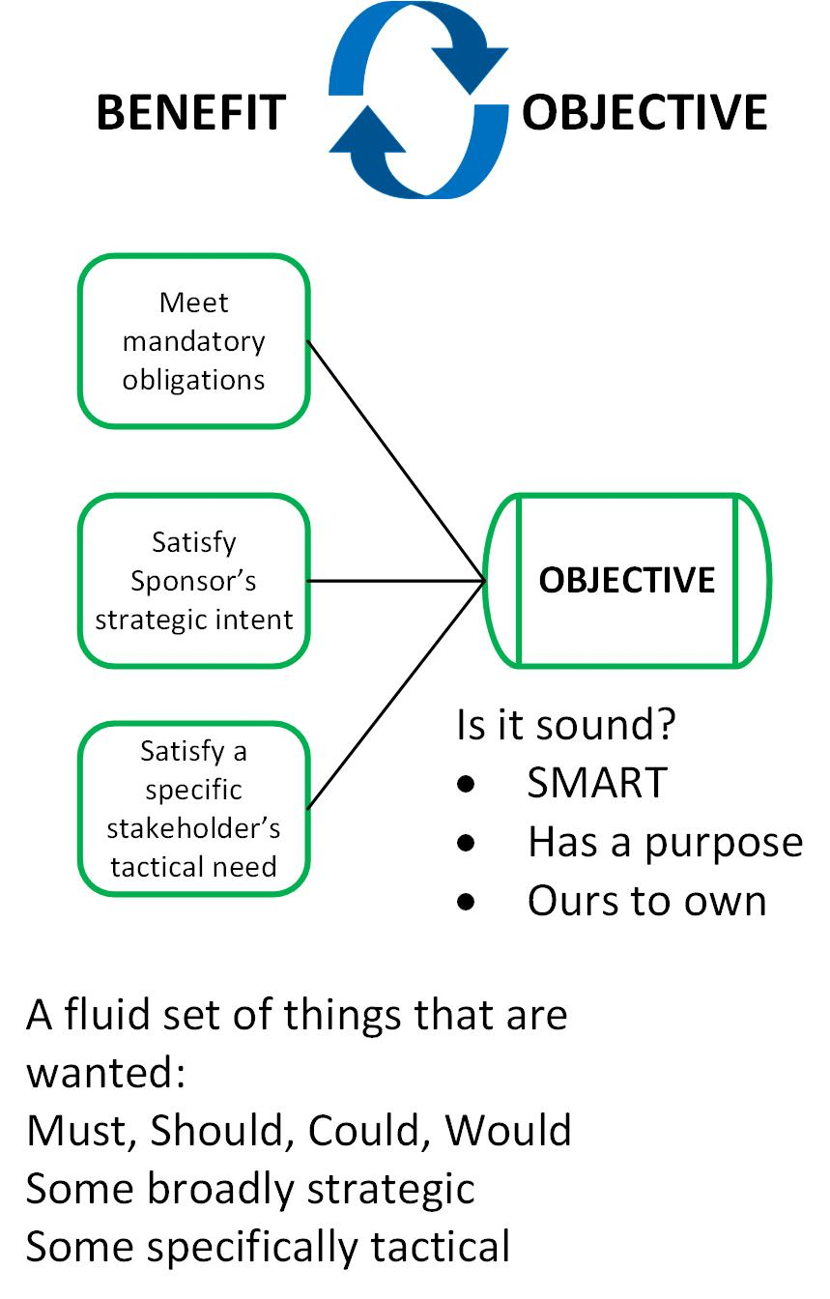
Prioritise the Benefits
Shuffle them
Argue about them
Talk until you reach a consensus
Understand who it’s really for and what they actually want
Notes:
Benefits prove (as in test) our Objective.
Like the Drivers, shuffle them, argue, get consensus.
Benefits will be evidence that we have achieved our Objective, so have we got the right ones?
A few, substantial, significant Benefits for the right stakeholders, that contribute to our Objective. A thing to watch here is the contribution. We often get vague strategic Objectives (digital transformation) and penny-packet treats for stakeholders to bribe them to play nicely but that have nothing to do with the Objective.

Slide 19
The Objective – second pass
Proved by the Benefits, confirmed against the Drivers
Notes:
Are we getting close to a sound Objective now?

Slide 20
Our sound Objective – second pass, and more
Notes:
The complete picture. This diagram sums up the presentation.
We now have an Objective that addresses our Drivers and promises the Benefits we desire.
It’s iterative, wheels within wheels. We cycle the Objective between the prioritised Drivers and the MoSCoW’d Benefits. Benefit, Objective and Driver all influence each other. That’s why we have to go round again and again until they settle into some sort of equilibrium.
In summary:
Work out the Drivers, what are the relevant ones, prioritise them
Draft an Objective that addresses them
Work out the Benefits
Revise the Objective
Test the new Objective against the Drivers
And repeat until satisfied…

Slide 21
Discussion
david.waller@keldale.com

Slide 22


Objective Setting
©Keldale Business Services 2024

Slide 23
Ways and Means
Much further down the line
Notes:
In case anyone asks, this is for another day.

Slide 24
Ways – what you will do. Means – what you will use
Don’t worry about these until you’ve chosen your objective.
They confirm that your objective is feasible and a sound investment. They tell you ‘how’, but not ‘what’ or ‘why’.
Other things to consider:
Constraints
CSFs
Notes:
It will be tempting to slip into solution mode. At some point, you will have to work out how to do it all, but not yet. Let’s get the Objective selected and agreed first. The Ways and Means that create the Benefits will test our plans. They will show how feasible the Objective is (“Land on the Moon next week”, not going to happen).
They will show how attractive it is, cost / benefit comparison.
Also, think about the constraints – resources, restrictions, and Critical Success Factors – things that have to be present to enable success, not acceptance criteria that describe a quality result. Find the trade-off or compromise necessary to keep some sort of satisfactory Objective.
You shouldn’t have time to include them at this point. If you do then you’re probably haven’t taken enough time to think through the Driver – Objective – Benefit cycle. Go back and do it again.

