Slide 1
Introducing Benefits Management
Lessons learned(?) so far
Notes:
We expect strategy and policy to add value so it should be open to two simple questions:
Who’s it for?
What’s it worth?
All too often, the answers aren’t simple, or even forthcoming.
The selection and delivery of benefits from Health Informatics is an on-going issue. It is not, and will never be a ‘done deal’ and anyone who says they’ve got Benefits Realisation sorted doesn’t understand the situation. There are people in the NHS (possibly in the audience) with 20 years’ experience of the subject. We assign people to Benefits and Change roles. HC2011 ran an entire workstream on Benefits Management. And yet on the whole we continue to re-invent the wheel, or worse dismiss wheels as unnecessary drag that slows our project vehicles.
This session is offered as an example of lessons learned and not learned so far. Benefits Managers can take away some practical suggestions for their own projects. Leaders can take away a better understanding of their programme value, a way to have good answers to, “Who’s it for? What’s it worth?”
This is the story of NHS Connecting for Health’s ISIP (Integrated Service Improvement Programme). NHS CfH at that time was in the early stage of the National Programme for IT and was facing criticism for being IT-focused and lacking clinical stakeholder engagement. ISIP was CfH’s attempt to fix this by taking an active interest in improving healthcare services.
I’ll be talking about things that happened some years ago so you may question its relevance. However, I have a couple of good reasons why I’ve chosen this example. First, it’s long enough ago that I’m unlikely to embarrass anyone in the audience. Second, though it’s years ago, I believe the lessons to be learned are still valid. Sadly because they haven’t been learned already.

Slide 2
My job
Benefits Management is the best application of scarce resources to select and deliver appropriate benefits to identified stakeholders
Notes:
This is my job.
Benefits Management is the best application of scarce resources to select and deliver appropriate benefits to identified stakeholders.
This seems like a good thing to do.
Crudely put, it means working out who your project is really for and what they actually want. Often, that’s not as obvious and straightforward as it would appear at first glance.

Slide 3
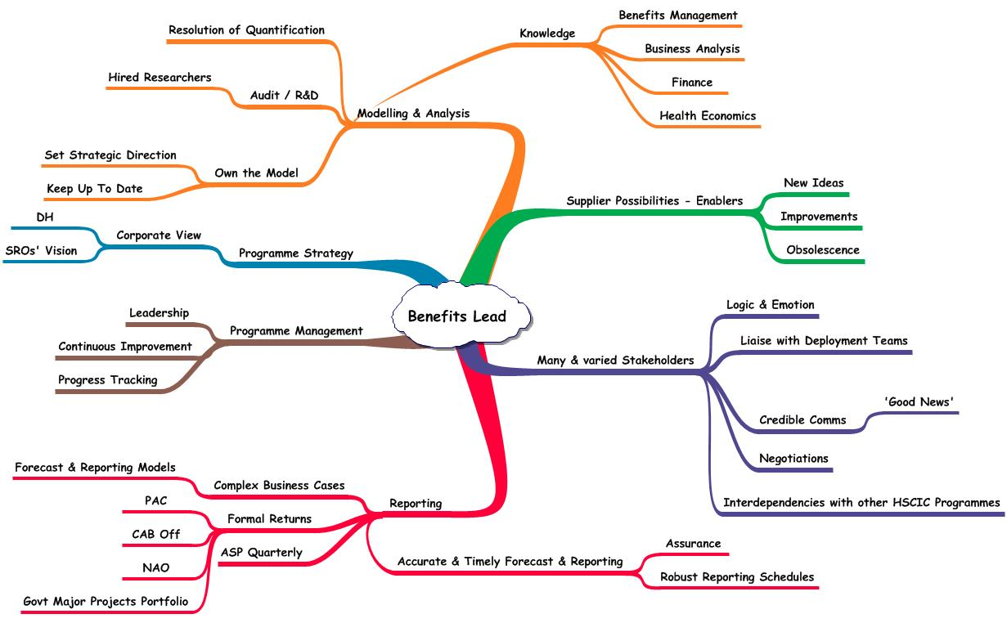
“It’s not rocket science…”
Notes:
A common view of Benefits Management is that it’s not rocket science. True, but it’s nearer rocket engineering. It requires proper planning, meticulous effort, an understanding of the materials and careful tracking of performance if it’s to be done well.
I deconstructed a job spec for a Benefits Lead. The advert wanted someone who understood the ‘true’ value of Health Informatics so I drew this to show how many things influence true value. I suspect I was a bit too clever for my own good.
In order to model the true value of technology enabled business change we first have to look at the environment in which we operate. The Benefits Lead Job Spec gives us some elements to consider and puts things in context.
Many & Varied Stakeholders – too many to list. There are an awful lot of people from an awful lot of different backgrounds here. It’s going to make ‘true’ value an interesting topic.

Slide 4
Rule No.1
Strategic decision making starts and ends with subjective events chosen by people
Notes:
Rule Number One
Strategic decision making starts and ends with subjective events chosen by people. It’s a matter of knowing where to start and when to stop.
Given that strategic decision making is a human activity, we can never entirely eliminate human weaknesses and strengths. There is no workable production line that churns out good decisions. We are faced with human subjectivity throughout the decision project lifecycle. This is where the 'in-flight magazine' school of portfolio selection often appears. The CEO reads something that strikes a chord; 'Everyone who's anyone has a Portal', ‘Open source is the ultimate Free Good', ‘Every CEO needs SEO'. Everyone then jumps to deliver this vision without analysing how valid it was in the first place.
ISIP was the NHS’s attempt to avoid the ‘in-flight magazine’.

Slide 5
Thoughts to take away
You are not alone
You can do something about it
Notes:
My aim today is to give you some lessons to take away. Even if you are a well established BM practitioner, it’s nice to know that other people have hit the same snags that you have and that the snags are not insurmountable.
If you are new to BM then the bad news is that it isn’t always easy. The good news is that it isn’t always impossible.

Slide 6
Psychology of Decisions
Prediction
Optimism Bias
Strategic Misrepresentation
Anchoring
WYSIATI
Delivery
Illusion of Control
Confirmation Bias
Affect Heuristic
Framing
Regression to the Mean
Notes:
Here’s the sort of thing that interferes with rational decision making. There’s some excellent stuff on the ways that psychology affects economic decision making in Daniel Kahnemann’s book Thinking, Fast and Slow.
Prediction – pre Business Case
Optimism Bias – Expecting too much in terms of results, cost and time despite previous experience. This is now recognised and often included in business cases. Which means people have started gaming with it, claim double .
Strategic Misrepresentation – Flyvbjerg, conscious deliberate lying to get the business case approved. International analysis of transport infrastructure, just about every business case lied about the potential benefits to be achieved.
Anchoring – Anchor on the first estimate, no matter how inaccurate and then fail to change sufficiently despite knowing it was wrong. It’s why salespeople start on an impossibly high note, “This is the best thing since sliced bread”. It will still feel that way even when the facts have destroyed their argument.
WYSIATI – What You See Is All There Is (Kahnemann), ignoring the existence of other evidence, failing to look for alternatives.
Delivery – work in progress
Illusion of Control – Assuming it all goes to plan… Belief that you have full control of the situation, not mitigating the risks.
Confirmation Bias – Filtering the evidence to fit your expectations, seeing only what you want to see.
Affect Heuristic – Seeing the positive in things (and people) we like, and negative in things we don’t. The halo effect of the singer, not the song.
Framing – Making a choice dependent on the way the options are phrased. “It could be you!”, or “It’s almost certain it won’t be you.” Good news / bad news stories in performance reports.
Regression to the Mean – A knee-jerk reaction to a one-off. Reward and punishment are both usually followed by a more average result, hence we believe punishment motivates.

Slide 7
Integrated Service Improvement Programme
Notes:
Setting the Scene
The NHS Integrated Service Improvement Programme (ISIP) was leading a fresh approach to transformational change to deliver quality and value.
Local Health Communities (LHCs) were collaborations of bodies with an interest in healthcare, Primary Care Trust (now CCGs) who commission or buy the services, Hospitals and Community Care providers, GPs and Local Authorities.
The ISIP planning process consisted of ‘As is’ baseline, future state and gap analysis. Priority objectives were then set and change programmes established that used the new (CfH provided) IT in conjunction with the Community’s other resources.
Of course, setting objectives by itself didn’t achieve anything. To make sure things happen so that the objectives were reached the LHC had to commit itself to a number of actions to change itself. The planners were to identify a small number of programmes. These programmes would:
Involve all the organisations in the LHC working together across boundaries
Improve the care experienced by the patient
Produce lasting change in the health and care delivery system
Produce measurable benefits
Each programme would have a Benefits Realisation Plan as would all its constituent projects.

Slide 8
ISIP Organisation
ISIP Leadership
Top-Team sponsorship, SRO within the Service Improvement community. Workforce, National Institute and CfH involved (people, process and technology)
ISIP Central Team
Production of guidance, senior stakeholder management and communications
ISIP Field Support
One person / SHA to support local planners and implementers as they learn the method and apply it.
Notes:
ISIP had commitment from the top. It was driven by Directors of Service Improvement and had senior input from Workforce Development, the National Institute for Innovation and Improvement and Connecting for Health.
The Central Team produced guidance, managed the senior stakeholders (stalked the corridors of power) and controlled communications
ISIP Field Support, one person / Strategic Health Authority supported local planners and implementers as they learned the method and applied it. We liaised between LHCs and the Central team, interpreting central guidance to local circumstances. We were the people who had to introduce the concept of Benefits Management (in an ISIP setting) to the people who would actually have to use it.
Our tasks were to assist LHCs in reviewing their original ISI Plan and producing their first Benefits Realisation Plans for their Integrated Change Programmes.

Slide 9
Roles & Personalities
Execs
Planners
Managers
Clinicians
Nerds
Creatives
Notes:
Like most national instructions and guidance, ISIP hit the NHS via letters to SHA Chief Executives for them to cascade down their organisations until they eventually landed on the right desk. This meant that the ‘right desk’ wasn’t quite as high up the organisation as we might have liked. Because ISIP talked of plans, it ended with the planners.
Governance was a significant issue. LHCs were not legal entities but groups of care providers working together to deliver ‘joined up’ care within a geographical boundary. Some were more firmly established than others. Most lacked common objectives, clear terms of reference and corporate responsibility. There was a significant element of bottom-up planning instead of top-down vision.
The typical audience of people we met was a mix of sad BM fans, the woolly types who couldn’t grasp the concept of measurable benefits and most of all people who planned rather than people who did.
10% became BM converts. They had been waiting for something to improve their decision making and felt this was it. They read around the subject and made constructive criticisms of the guidance.
20% remained sceptical. Even when they accepted the value of BM, they really weren’t keen on the admin. The logic and rationality of BM puts off some of the more creative types who prefer a leap of faith to a decent cost/benefit analysis.
The middle 70% saw value in the method. They would leave workshops thanking us for a useful session. The follow-up was a bit lacking though. Like any other project, there are people who do their action points and then wait to be told what to do next.
The functional breakdown of the planning teams was biased towards the planners. The LHCs were multi-agency bodies but the teams didn’t get full representation. The hospitals who were busy worrying about getting Foundation status (a degree of autonomy) and financial deficit didn’t take the opportunity to work in close partnership with their customers.

Slide 10
Examples
Lack of health-specific examples
Not invented here
Worked example in a multi-agency environment missed the right balance
Notes:
ISIP was new to the NHS. We had no health-specific examples and few non-health ones either.
Non-health examples turned people off. Some people just don’t work with analogies. They can’t take examples from outside their own experience and adapt them to fit.
ISIP required LHCs to submit their plans to the Central team for assessment of the ISIP process (not performance management of their programmes). Like any exam, everybody wanted model answers, how long an essay should they write, how many marks for each section? We tried a worked example with little success. A worked example in a multi-agency environment is hard to draft with the right balance (too simple, too complex, not relevant, benefits weren’t benefits). So many inputs and interested parties made it a spoilt broth served too late.

Slide 11
Benefits
What’s a benefit?
How many iterations to get them
2 workshops for a weak set
12 workshops for a good set
More 2s than 12s
A benefit is a result that a stakeholder perceives to be of value
Notes:
The BIG issue, what constitutes a benefit.
A sweeping generalisation - everybody gets it wrong to begin with.
The simple definition we applied was: “A benefit is a result that a stakeholder perceives to be of value.”
People accept the definition but still come up with system features or outcomes when asked for benefits. There is great value in Post-it notes when constructing a benefits dependency network. It enables you to reassign the ‘benefits’ into their proper place.
How much effort should you put into benefits selection? Some teams held two workshops before producing their draft plans. The benefits were generally ill-defined and occasionally plain wrong, e.g. benefit = recruit 10 more staff. Another team ran 12 separate workshops amongst a wide set of stakeholder representatives and came up with a set of feasible, prioritised, measurable benefits. Unfortunately, they were the exception.

Slide 12
Squeezing old plans to fit
Lack of radical change
Poor grasp of strategic objectives
BM to validate / justify existing plans
Some degree of rationalisation
Notes:
Learning as we went along
The first set of plans didn’t deliver the radical transformational change that was hoped for. People were uncertain of ISIP’s survival. If it was just a short-lived management fad then there was no point in sweating too much over it.
The newness of the method didn’t help. Most people treated their first plans as a learning exercise.
One area of confusion was the definition of objective, benefit and outcome. The same item could be phrased to fit any of the three categories so the significance of the differences wasn’t fully grasped. Applying SMART principles to the objectives encouraged people to narrow them down to tactical outcomes. Just because something should be measurable and timely doesn’t mean it should be a short-term cost saving. It’s like Nelson setting off for Trafalgar with the objective of:
Destroying the French fleet and removing Napoleon’s threat of invasion or
Using up his old gunpowder stock before it gets damp
This is vital to get right. We do too much without fully grasping the reasons why we are doing it. It opens up whole debates about governance and leadership.
Other teams simply used the method to validate or justify their existing plans. One programme came up with 23 pre-existing plans and connected them to 13 benefits. The first draft of another plan had 35 objectives, all of the nature, implement project 1, project 2, etc.
There was some degree of rationalisation though. A great strength of the BDN is that it shows just how much change effort is going to be needed to deliver the selected benefits. The more benefits, the much more effort.

Slide 13
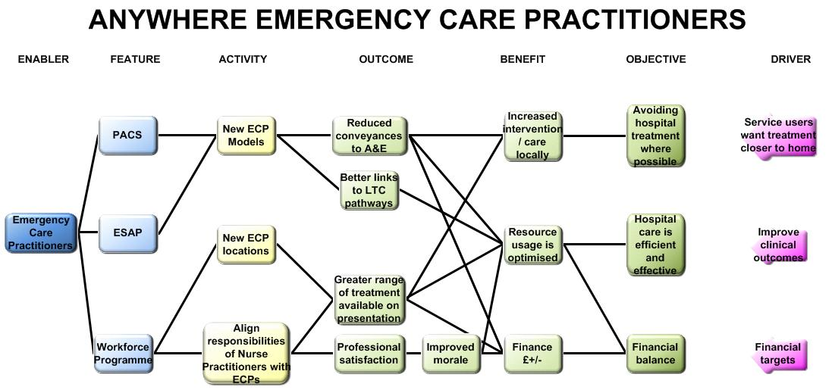
This is manageable
Notes:
As an example of rationalisation, this is a Benefits Dependency Network for one of ISIP’s programmes, Emergency Care Practitioners.
The objectives are pretty generic and represent the high-level stakeholder groups of patients, policy makers and the organisation itself. All the connections are made. There are no dead-ends in the diagram so everything has a purpose and contributes to the objective to some extent. The diagram starts the discussion about the relative contributions and allows decisions to be made about priorities and allocating resources.
This is manageable, a feasible amount of activity delivers selected benefits that are directly connected to the organisation’s objectives.

Slide 14
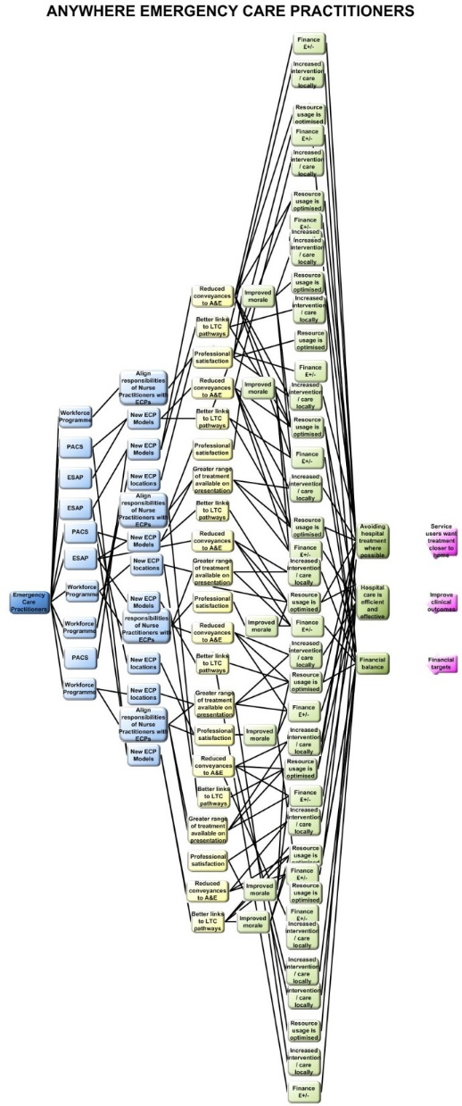
This is not
Notes:
Imagine that the programme had chosen 50 benefits instead of 3. Life gets much more complex here.
Many business cases get drafted on the basis of quantity, not quality. The more benefits you put in, the more likely you are to be picked from the pack of competing business cases. Delivery is another matter though. Once you take the table of benefits out of the business case and map it you begin to see how impractical your project could be.

Slide 15
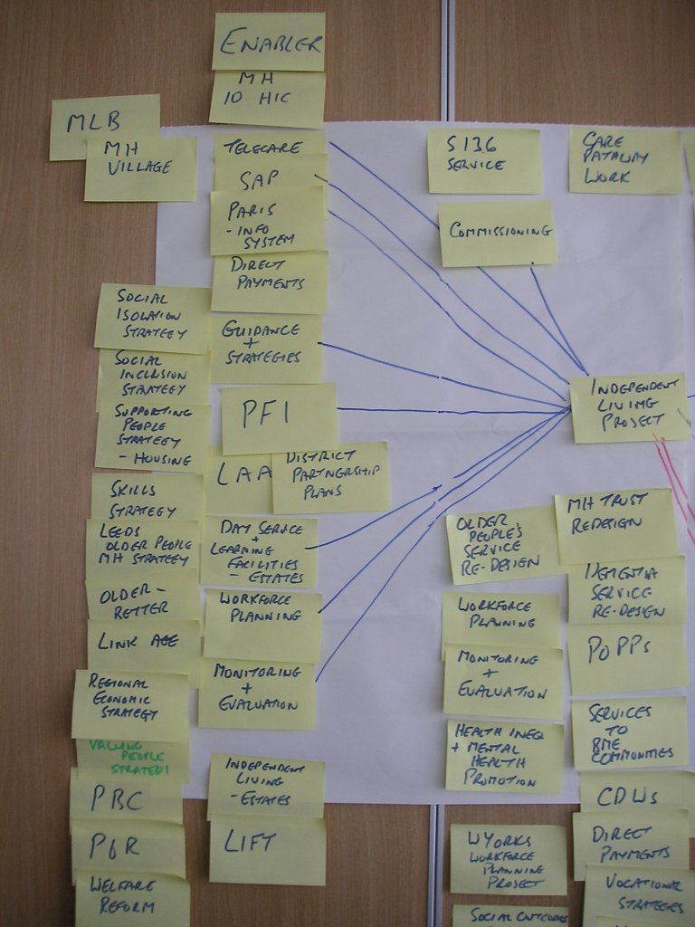
Poor Enablers
Enablers without resources are really limiting factors.
Notes:
Mental Health has a tremendous number of strategy papers. Initially these were listed as enablers to the project. Then it was realised that they brought no resources. The many MH strategies were enablers without resources. They were really limiting factors. They told people how the job should be done but gave no tools to help do it.
In the second draft BDN they were removed from the Enablers and included as limiting factors in the Activities, i.e. business processes designed to meet DH strategy requirements.
It shows how the 1st draft is a learning exercise. These things need practice.

Slide 16
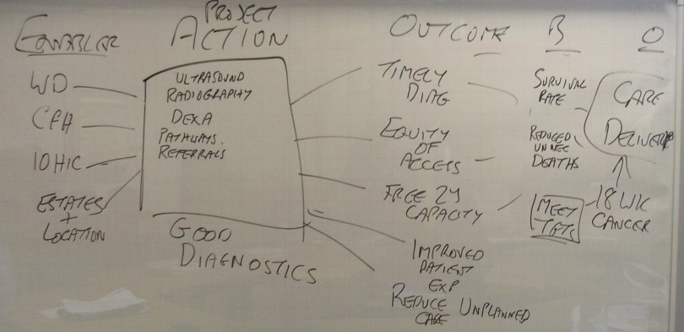
Lip service
This is the output of 30 mins management team discussion
Notes:
Sometimes people just don’t want to take part. This workshop was 30 mins reluctantly tagged onto the end of another meeting.

Slide 17
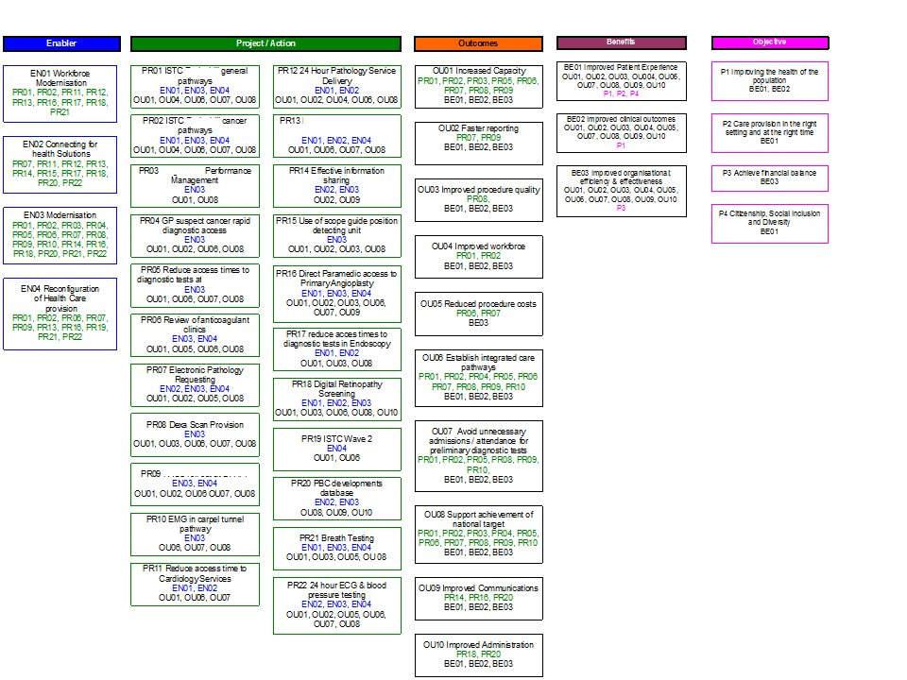
Lip service
This is what the project manager brought to the next meeting
Notes:
The Project Manager took away the previous diagram and produced this from his existing plans. It met his requirement of taking part in ISIP but bore little resemblance to what his management colleagues had discussed (which may have been a good thing).

Slide 18
Cancer & Palliative Care Integrated Change Programme Benefits Dependency Network
Enablers
Projects
Outcomes
Benefits
Priority Objectives
Effective use of capacity
1. Commissioning & practice based commissioning
Cancer & palliative care NICE guidance implementation
Achievement of key waiting times
Improving access & choice
Increased diagnostic capacity
Increased number of diagnosed cancers referred via the USC route
2. Modernising information management & technology
Primary care service improvement initiatives
Delivering high quality managed care
Improved primary care engagement in cancer & palliative care agenda
Improvement in patient satisfaction
3. Workforce modernisation
Improved care pathways
Secondary & tertiary care service initiatives
Reduction of cancer mortality 20% by 2010
Year on year % reduction in incidence of cancer in identified areas of deprivation
4. High impact changes
Increased participation in screening, prevention and education programmes for target population
Partnership forum initiatives
Improving patient experience
5. Integrated care pathways
Achievement of prevention/ screening targets for specific target population
All patients better informed about choices
6. Estates & facilities modernisation
Prevention & screening initiatives
Consistent approach to management of cancer & palliative care in all GP practices
Improved communication along whole care pathway
Improving prevention & screening
Notes:
Here’s one of the best BDNs from ISIP. It was developed from the 12 workshops mentioned earlier.

Slide 19
Primary Care Service Improvement Benefits Dependency Network
Enablers
Projects
Outcomes
Benefits
Priority Objectives
Effective use of capacity
1. Commissioning & practice based commissioning
Achievement of key waiting times
Improving access & choice
Increased diagnostic capacity
Increased number of diagnosed cancers referred via the USC route
2. Modernising information management & technology
Improved primary care engagement in cancer & palliative care agenda
Delivering high quality managed care
Primary care service improvement initiatives
Improvement in patient satisfaction
3. Workforce modernisation
Improved care pathways
Workstreams:
1. Primary care toolkit
2. End of life initiative (gold standards)
3. Prostate injection therapy
4. Breath testing
5. Mainstream primary care service improvement workforce
6. Cancer referral directory
Reduction of cancer mortality 20% by 2010
Year on year % reduction in incidence of cancer in identified areas of deprivation
4. High impact changes
Increased participation in screening, prevention and education programmes for target population
Improving patient experience
5. Integrated care pathways
Achievement of prevention/ screening targets for specific target population
All patients better informed about choices
6. Estates & facilities modernisation
Consistent approach to management of cancer & palliative care in all GP practices
Improved communication along whole care pathway
Improving prevention & screening
Notes:
This BDN is a sub-set of the previous one and concentrates on one project, the Primary Care Service Improvement Initiatives. There are six workstreams within this project. As far as the BDN is concerned, the cause-effect links come via the completed project, i.e. the end state where these primary care initiatives have taken place. The project to do this is separate from the BDN.
Note that the project’s benefits are a sub-set of the programme’s benefits. The purpose of the project is to support the programme.

Slide 20
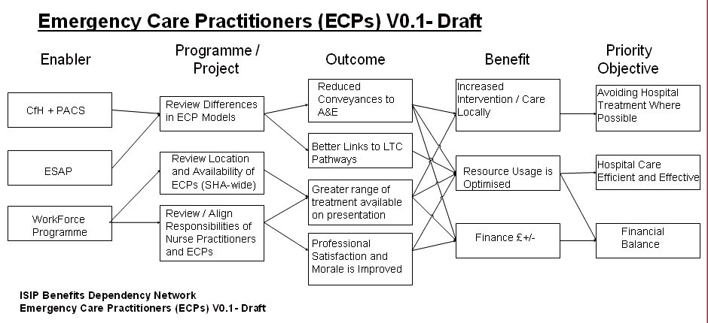
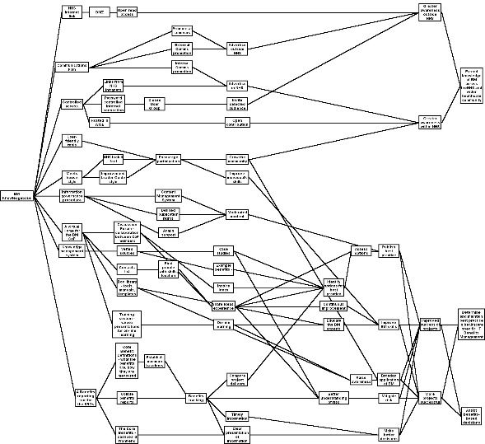
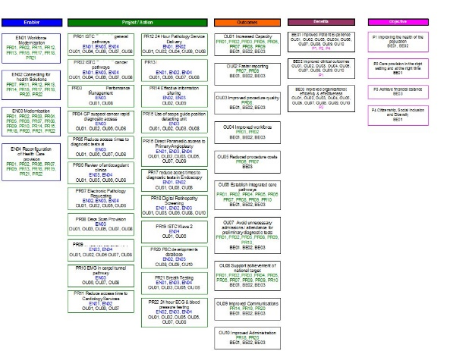
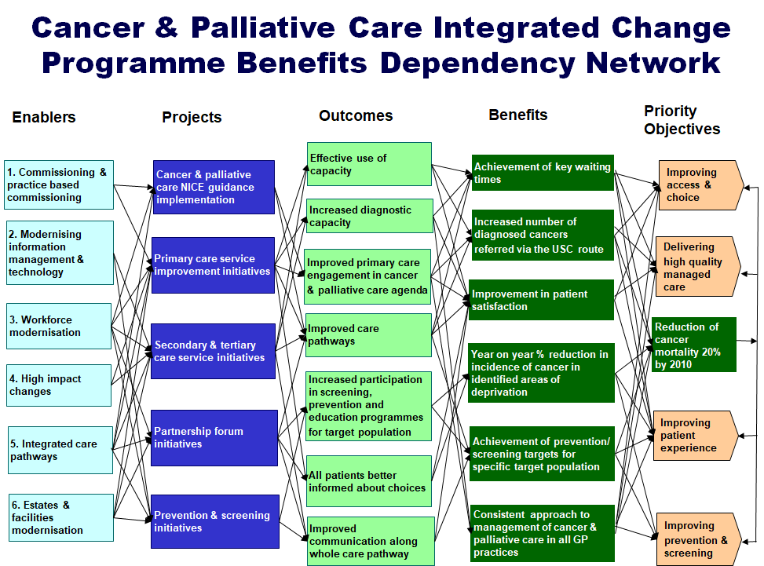
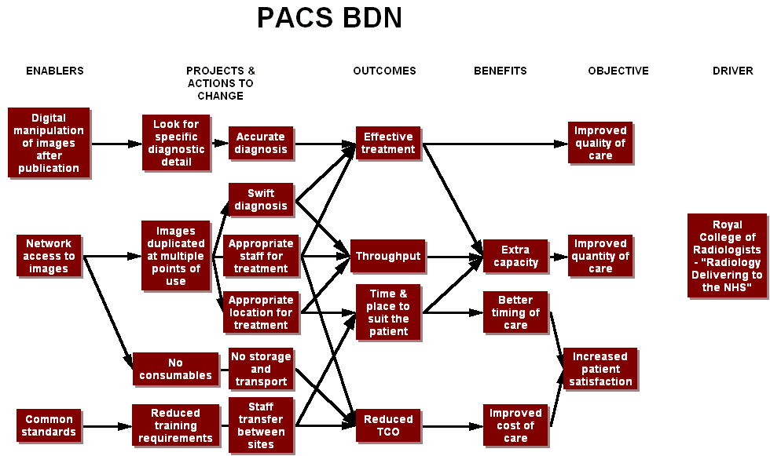
Dialects
Within three months people had adapted the tools to suit themselves
Five flavours of BDN
Notes:
Within three months people had adapted the tools and techniques. Some forms were discarded, others changed. We didn’t have one consistent BDN drawing tool. Some were drawn on PowerPoint slides, others using Visio, one on a spreadsheet.

Slide 21
Resourcing and selling
Small groups of local experts
Capable of doing but not capable of training others
Selling the concept within organisations was hard.
Seen as Management School BS
Notes:
After three months we had small groups (2-3 people) in each LHC who felt they were competent in benefits-led planning. They weren’t so confident in their ability to train their colleagues.
Selling the concept within organisations was hard. It needs a simple example that convinces and doesn’t confuse. The BDN was seen by some people as a single page exec summary, a very powerful tool to get the message of your programme across. Unfortunately, more people were confused or intimidated by it. Striking the balance is difficult. You can either condense the BDN to fit it on a slide and be accused of over-simplifying the programme or you can show the detail and be shouted down for your baffling complexity.
At worst, BM was seen as management school BS, usually by clinicians who were too busy fire-fighting to recognise an extinguisher when it’s offered to them.

Slide 22
After ISIP
Some positive examples
Notes:
ISIP was 10 years ago.
Things moved on a bit, probably not enough though.

Slide 23
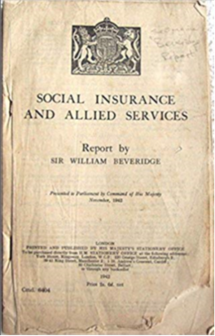
Start with the end in mind
Why did William Beveridge propose the Welfare State?
A) To address the five “Giant Evils” of squalor, ignorance, want, idleness, and disease
B) To motivate the troops after three hard years of war
C) To ensure his old age was sorted
It’s not only what you do, it’s also why you choose to do it
Answer: A (if you didn’t pick A you are not taking this seriously)
Notes:
The purpose behind any course of action has a direct and significant effect on the way it is undertaken. The reasons why affect the ways we go about things. If Beveridge had just written something for the troops then the Welfare State probably wouldn’t exist today.
A sports analogy, you would think that in playing football, the objective is to win the match. Not necessarily, a football manager’s side and tactics will adapt to the objective:
Win at all costs
Put on a show for the fans
Play for the league points
Pace themselves for the next match
They’re all still playing football but for different reasons and in different ways. The same applies for any project, the ends you want to achieve will affect the means and ways you use to get there.
Projects talk of acceptance criteria, the things that decide when the project has ended successfully, a sort of, “No-one goes home until…”
Define your acceptance criteria in terms of objectives and benefits before you start. Don’t install the kit and then wonder what to do with it. Too often, projects leave benefits realisation until it’s too late, i.e. at the end of the project. That’s why benefits should be managed from the start.
Some organisations demand a hard financial return.
Some want intangible improvements like satisfaction and image.
Usually, they want both. That’s when conflicting objectives throw a spanner in the works. That’s why clear objectives are crucial.

Slide 24
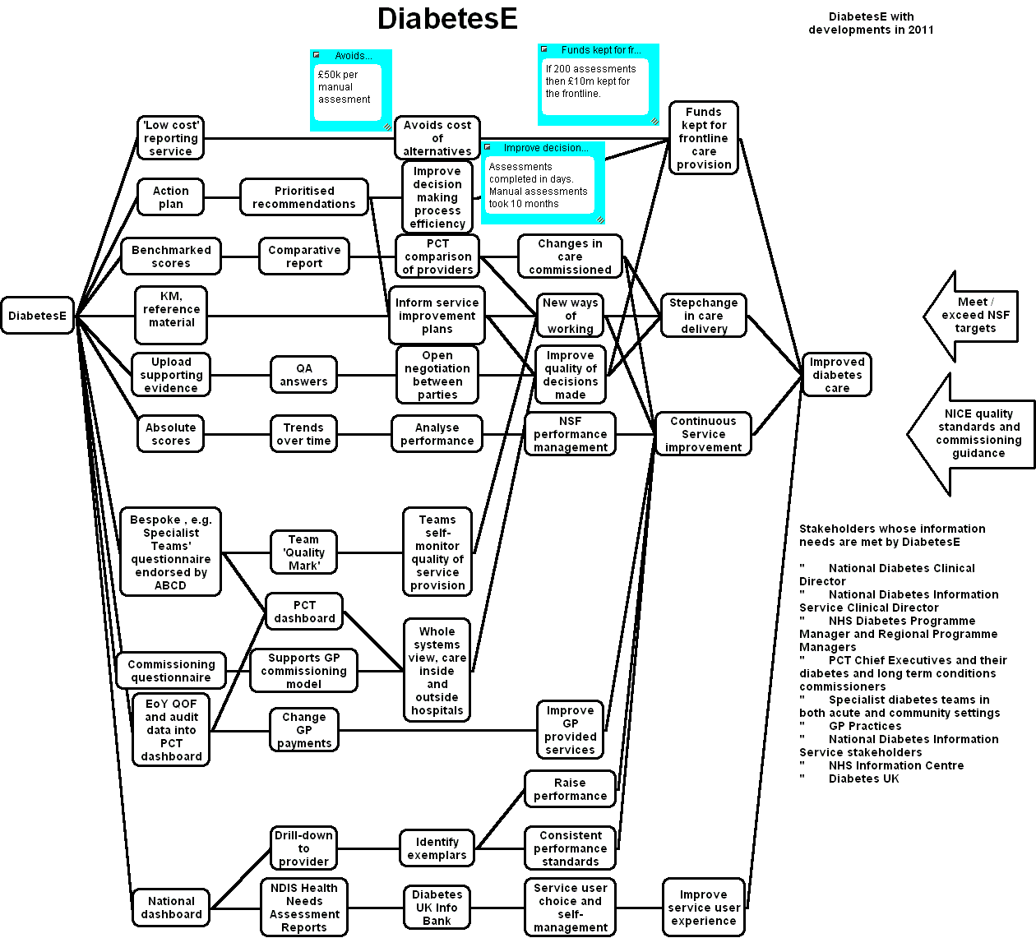
Notes:
This was drawn up for the business case to extend the DiabetesE contract. It was relatively easy to draw up as it described an existing service with one straightforward objective. DiabetesE came out of Performance I, an online workbook for European Foundation for Quality Management (EFQM) so a lot of the preliminary analysis had already been done before the BDN.

Slide 25
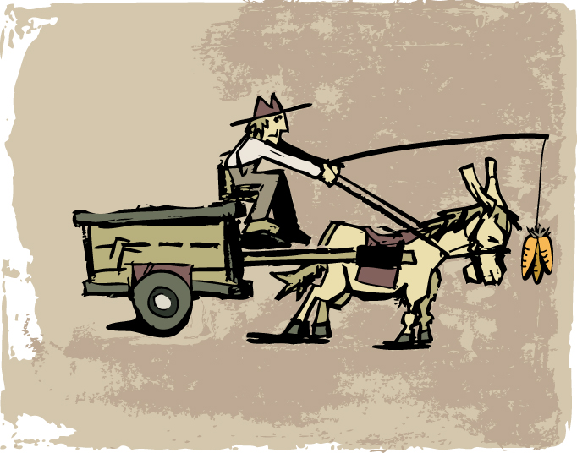
Picking the right benefits
Tactical benefits – getting the donkey to move
Notes:
All too often we concentrate on the carrots, the treats we offer all the stakeholders to encourage them to take part in the project. We neglect the cargo, what the project is all about.

Slide 26
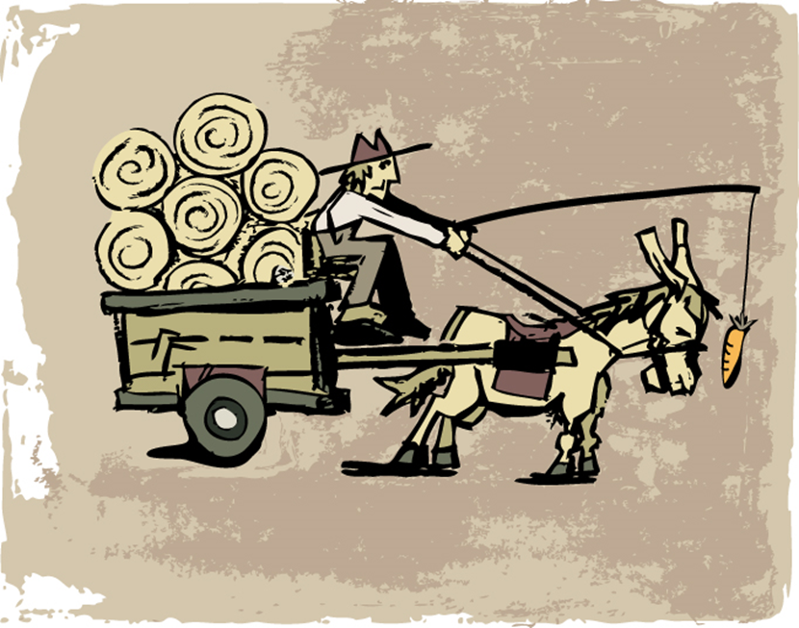
Picking the right benefits
Strategic benefits – a cart full of valuable cargo
Notes:
The cargo is what it’s all about.

Slide 27
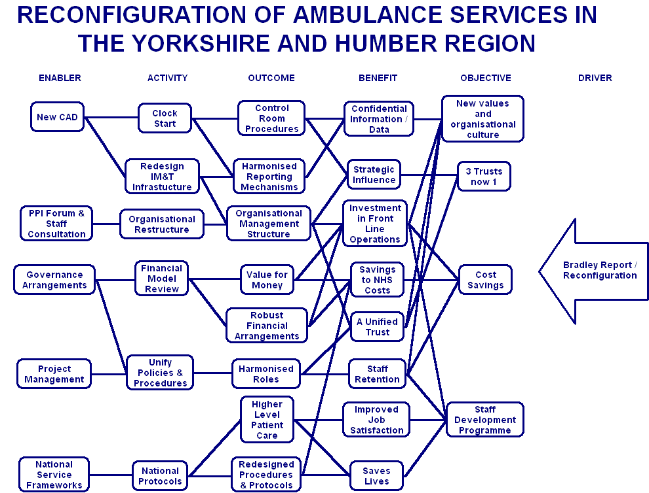
Notes:
Here’s an example of strategic benefits, the 2007 Ambulance Service Reconfiguration. They’re big, Service-wide and firmly connected to objectives. At this level there’s no trivia about ambulance crews using new kit or shaving seconds off call centre response times.
Note that it was all about reorganisation. ‘Saves lives’ had to be tied to the objective of staff development as it’s not a significant concern of this programme.

Slide 28
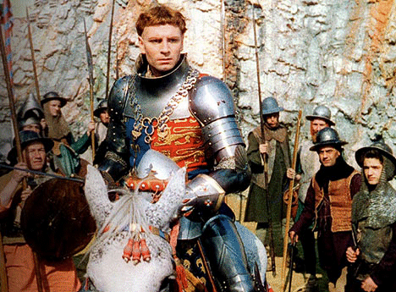
Key stakeholders’ benefits
POWER, CONTROL!
LOOT, DRINK!
Same project, different intentions
Notes:
Different stakeholders want different things. Hence the need to work out who you are doing it for and what they perceive as being valuable

Slide 29
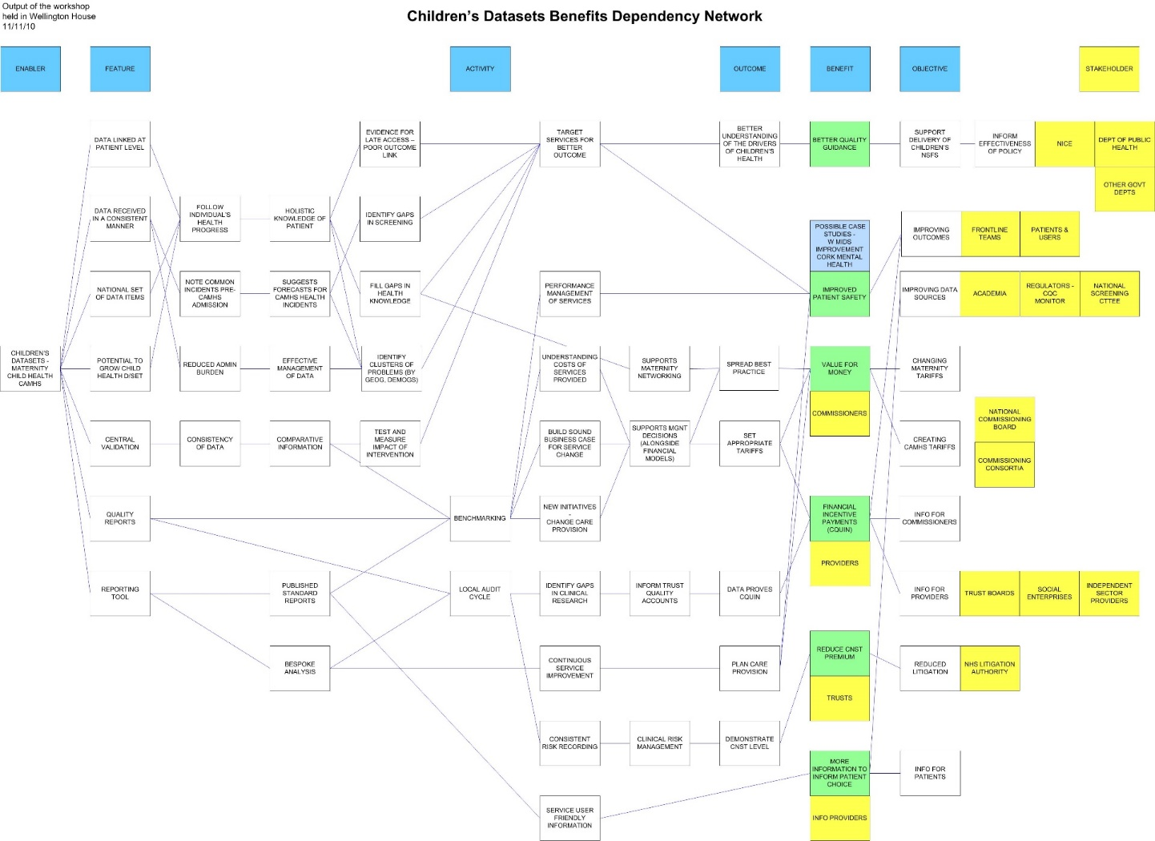
Notes:
Note the variety of stakeholders here. Note also that the stakeholder may not be who you think it ought to be at first glance. Info for patients is wanted here by the info providers, not the patients themselves.

Slide 30
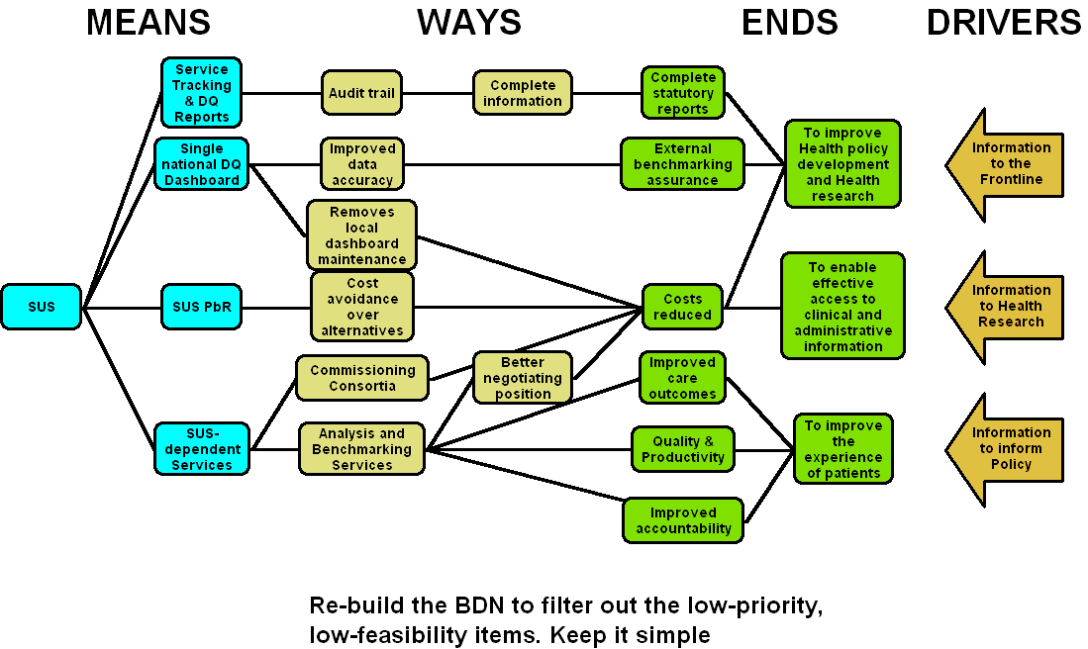
A suitable picture
Notes:
This is the condensed version of Secondary Uses Service from a benefits review of the live service 2010 to prove it was a worthwhile use of resources. It fits on a PowerPoint slide and is legible in a report. It’s simplified into means, ways and ends and summarises what Secondary Uses Service (SUS) achieves.

Slide 31
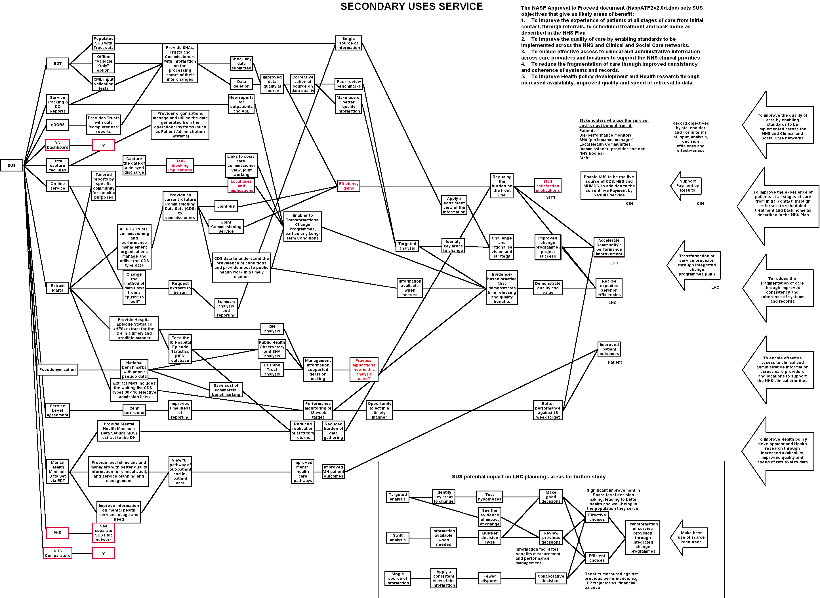
Notes:
This is the uncondensed version just to show that the real story behind the summary wasn’t quite so simple.

Slide 32
Rule No.1
Strategic decision making starts and ends with subjective events chosen by people
Notes:
Strategic decision making starts and ends with subjective events chosen by people. In applying Benefits Management, we have a framework to give us confidence that the final decision was the best we could do. Though driven by the subjective, it contains a bit more logic than gut feeling or simply tossing a coin.
Between the Subjective Start and the Subjective Stop we have in Benefits Management a method to improve the choices made and the results delivered.

Slide 33
Comments
Notes:
1

Slide 34


Introducing Benefits Management
©Keldale Business Services 2024

