Slide 1
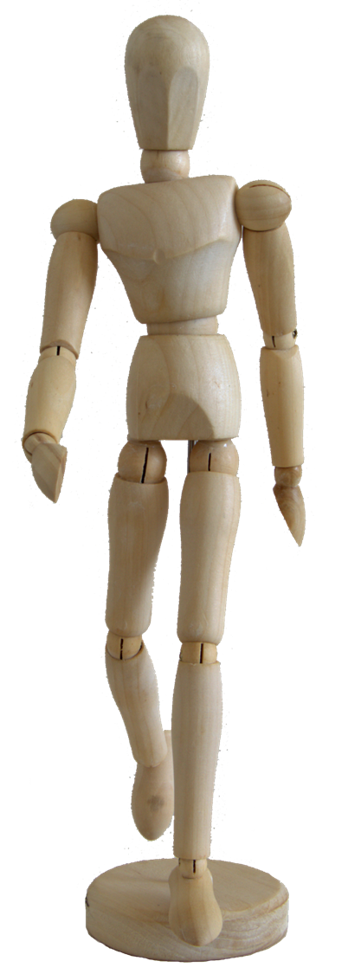
BENEFIT OF EXPERIENCE
EFQM Excellence Model 2013
Notes:
Something from my distant past.
BT got into Quality Management in the late 80’s and were one of the originators of EFQM in 1988. I did the assessor’s course in 2001, intending to use it as thought leadership pre-sales consultancy. Raise the client’s interest in improving quality, sell them PerformanceI, our online EFQM workbook.
N.B. the model changed radically in 2020 and this means – ways – ends linkage doesn’t fit so well.

Slide 2
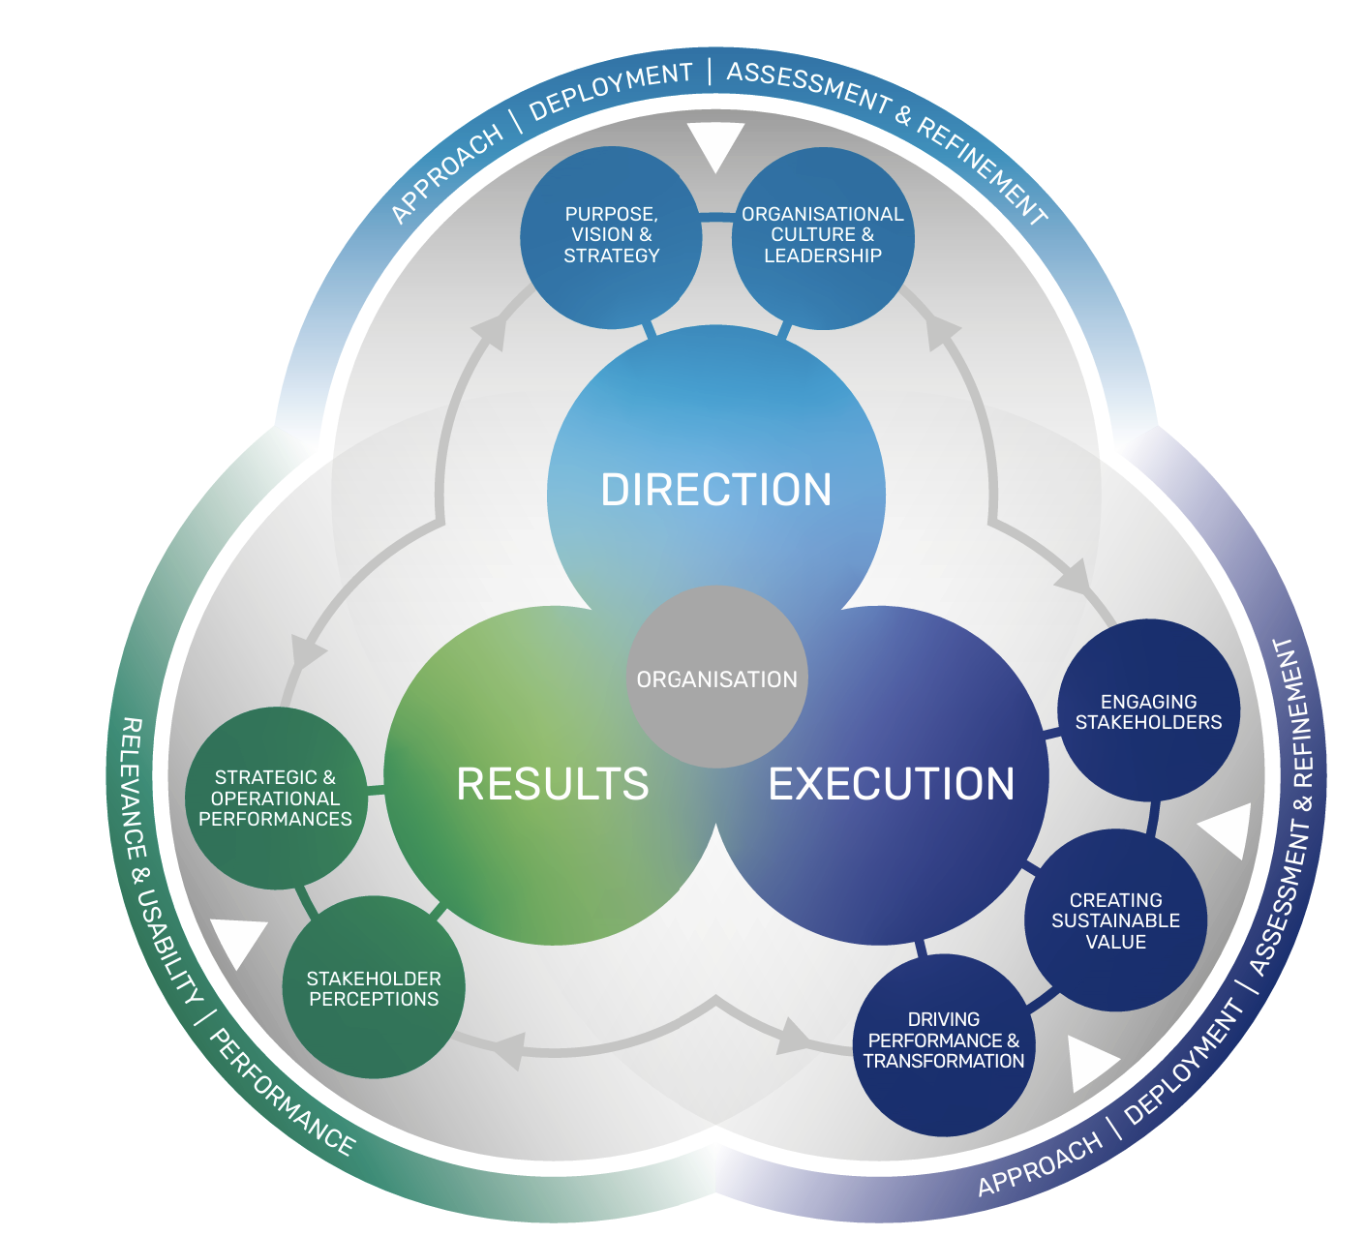
2020 EFQM Model
This isn’t as linear as the old model
Notes:
Break this down into something benefits map / Goal Model appropriate.

Slide 3
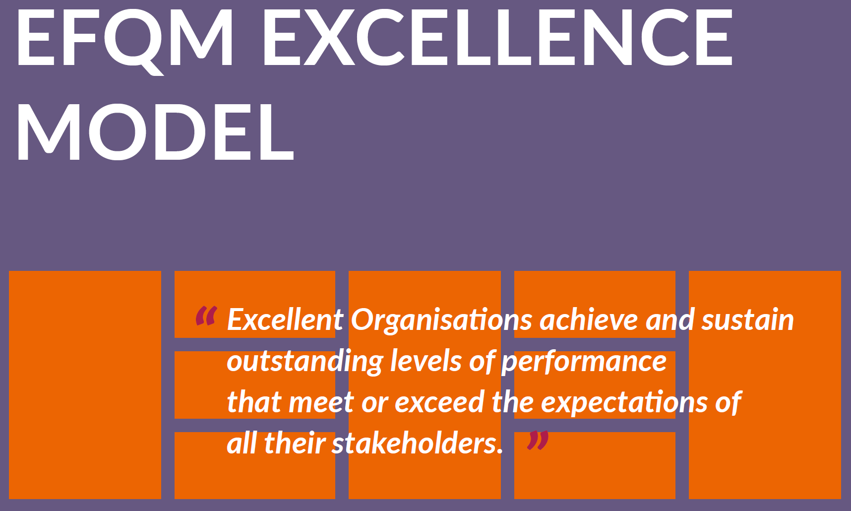
Notes:
Where are you on the path to excellence?
Understand strengths and gaps
A basic structure for your management system
The EFQM Excellence Model is a practical, non-prescriptive framework that enables organisations to:
Assess where they are on the path to excellence; helping them to understand their key strengths and potential gaps in relation to their stated Vision and Mission.
Provide a common vocabulary and way of thinking about the organisation that facilitates the effective communication of ideas, both within and outside the organisation.
Integrate existing and planned initiatives, removing duplication and identifying gaps.
Provide a basic structure for the organisation’s management system.
The EFQM Foundation was formed to recognise and promote sustainable success and to provide guidance to those seeking to achieve it. This is realised through a set of three integrated components which comprise the EFQM Excellence Model:
The Fundamental Concepts of Excellence: The underlying principles which are the essential foundation of achieving sustainable excellence for any organisation.
The EFQM Excellence Model: A framework to help organisations convert the Fundamental Concepts and RADAR logic into practice.
RADAR logic: A dynamic assessment framework and powerful management tool that provides the backbone to support an organisation as it addresses the challenges it must overcome if it is to realise its aspiration to achieve sustainable excellence.

Slide 4
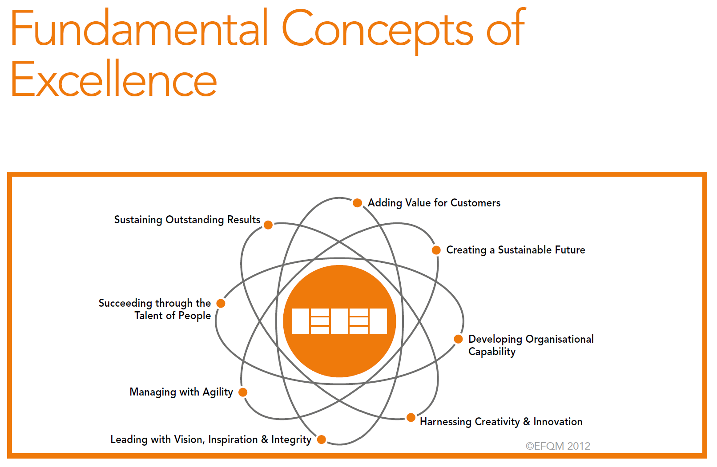
Notes:
Excellent organisations consistently add value for customers by understanding, anticipating and fulfilling needs, expectations and opportunities.
In practice, we find that excellent organisations:
Know who their different customers groups are, both existing and potential, and anticipate their different needs and expectations.
Transform needs, expectations and potential requirements into attractive and sustainable value propositions for both existing and potential customers.
Build and maintain a dialogue with customers, based on openness and transparency.
Strive to innovate and create value for their customers, involving them, where appropriate, in the development of new and innovative products, services and experiences.
Ensure people have the necessary resources, competencies and empowerment to maximise the customer experience.
Continually monitor and review the experiences and perceptions of their customers and respond appropriately to any feedback.
Compare their performance with relevant benchmarks and learn from their strengths and opportunities for improvement in order to maximise the value generated for customers.

Slide 5
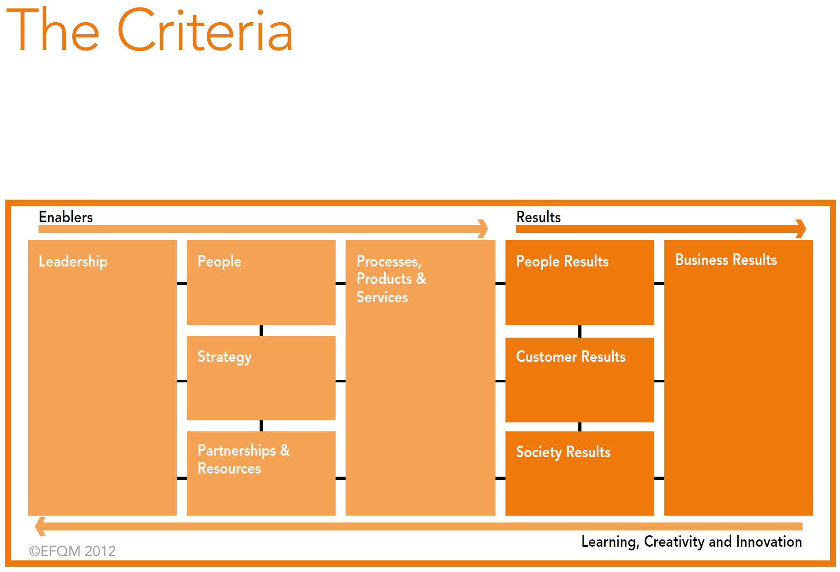
Notes:
Enablers – what you do
Results – what you achieve
The EFQM Excellence Model represented in the diagram above is a non-prescriptive framework based on nine criteria. Five of these are ‘Enablers’ and four are ‘Results’. The ‘Enabler’ criteria cover what an organisation does and how it does it. The ‘Results’ criteria cover what an organisation achieves. ‘Results’ are caused by ‘Enablers’ and ‘Enablers’ are improved using feedback from ‘Results’.
The arrows emphasise the dynamic nature of the Model, showing learning, creativity and innovation helping to improve the Enablers that in turn lead to improved
Results.

Slide 6
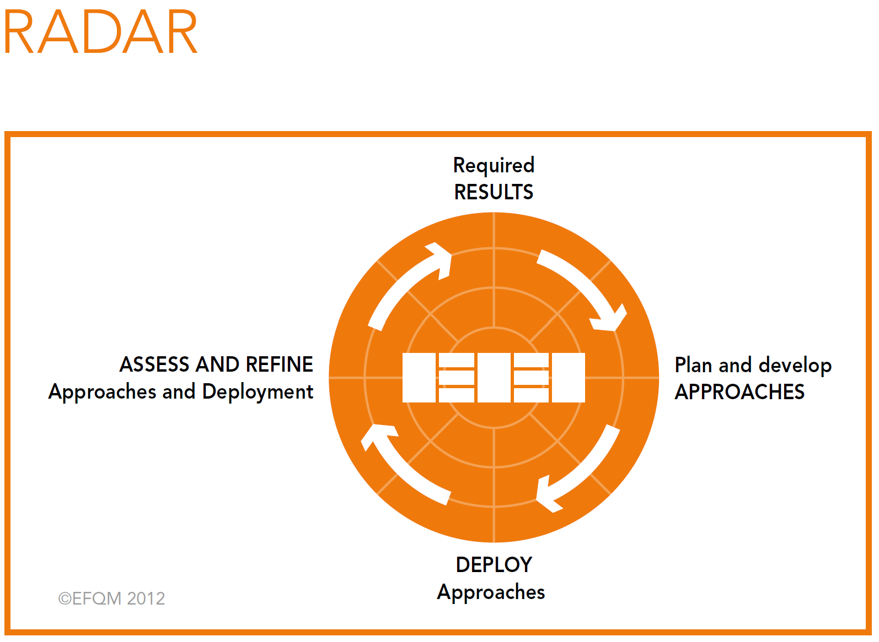
Notes:
Note that it’s similar to Deming PDCA and BM Select, Plan, Realise, Review.
The RADAR logic is a dynamic assessment framework and powerful management tool that provides a structured approach to questioning the performance of an organisation.
At the highest level, RADAR logic states that an organisation needs to:
Determine the Results it is aiming to achieve as part of its strategy.
Plan and develop an integrated set of sound Approaches to deliver the required results both now and in the future.
Deploy the approaches in a structured way to ensure implementation.
Assess and refine the deployed approaches based on monitoring and analysis of the results achieved and ongoing learning activities.

Slide 7

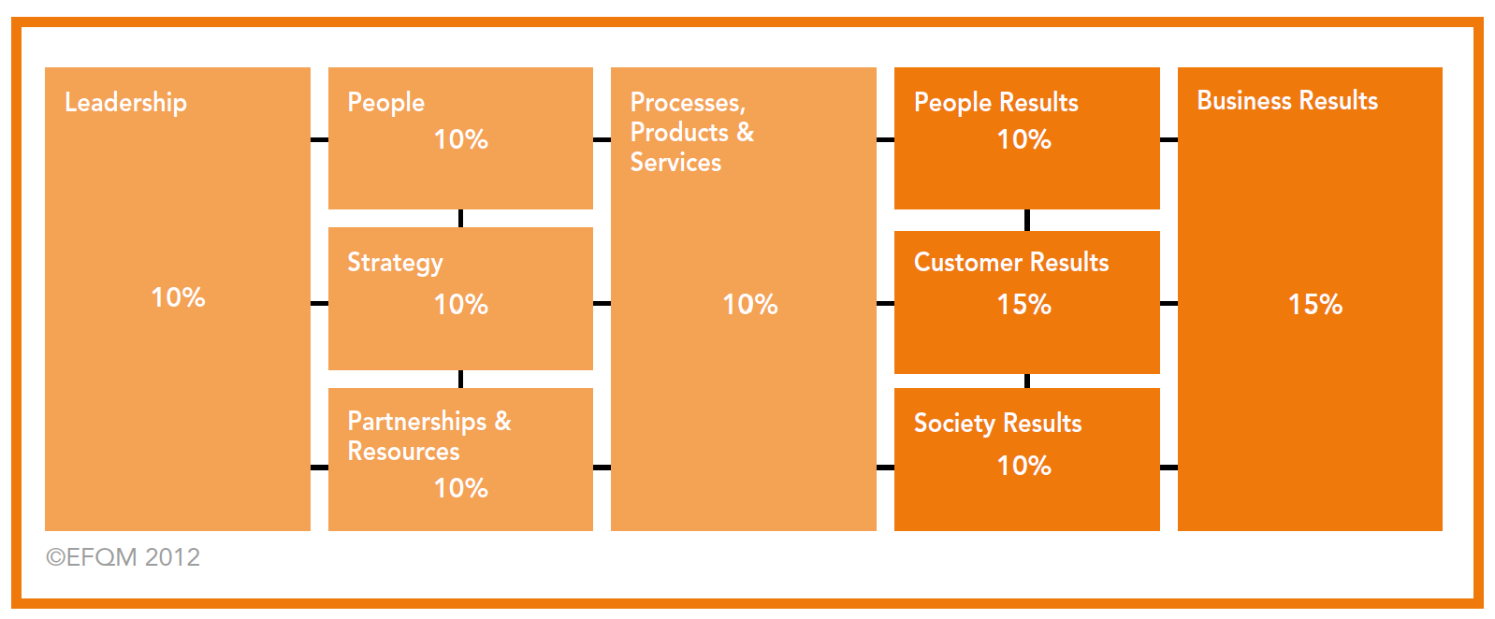
Notes:
Scoring out of 1000 points
The RADAR Assessment and Management tool is the evaluation method used to score organisations applying for the EFQM Excellence Award and most national Excellence awards in Europe. It can also be used by organisations carrying out Self-Assessment and wishing to use a score for benchmarking or other purposes.
The underlying principle for scoring using the RADAR is that when an organisation’s performance improves over time, their score against the Model will increase. 50%
of the points available are allocated to the Enablers and 50% are allocated to the results. This is to ensure the organisation has the capability to sustain this performance into the future.
When an organisation is scored using the RADAR matrix, weights are given to each of the nine criteria to calculate the number of points awarded. These weights were established in 1991 as the result of a wide consultation exercise across Europe. They have been periodically reviewed by EFQM and the diagram above illustrates the current weightings.
Generally each criterion part is allocated equal weight within that criterion; for example, each of the 5 criterion parts for Leadership contributes 20% of the 100 points
allocated to criterion 1.
There are however two exceptions:
Criterion part 6a Customer Results perception takes 75% of the points allocated to criterion 6, whilst criterion part 6b Customer Results performance indicators takes 25%;
Criterion part 7a People Results perception takes 75% of the points allocated to criterion 7, whilst criterion part 7b People Results performance indicators takes 25%.
Each criterion part is assessed using the RADAR matrix and a score agreed. These scores are then combined to give a score for that criterion. The weighting is then applied to give an overall score from 0 to 1000 points.

Slide 8
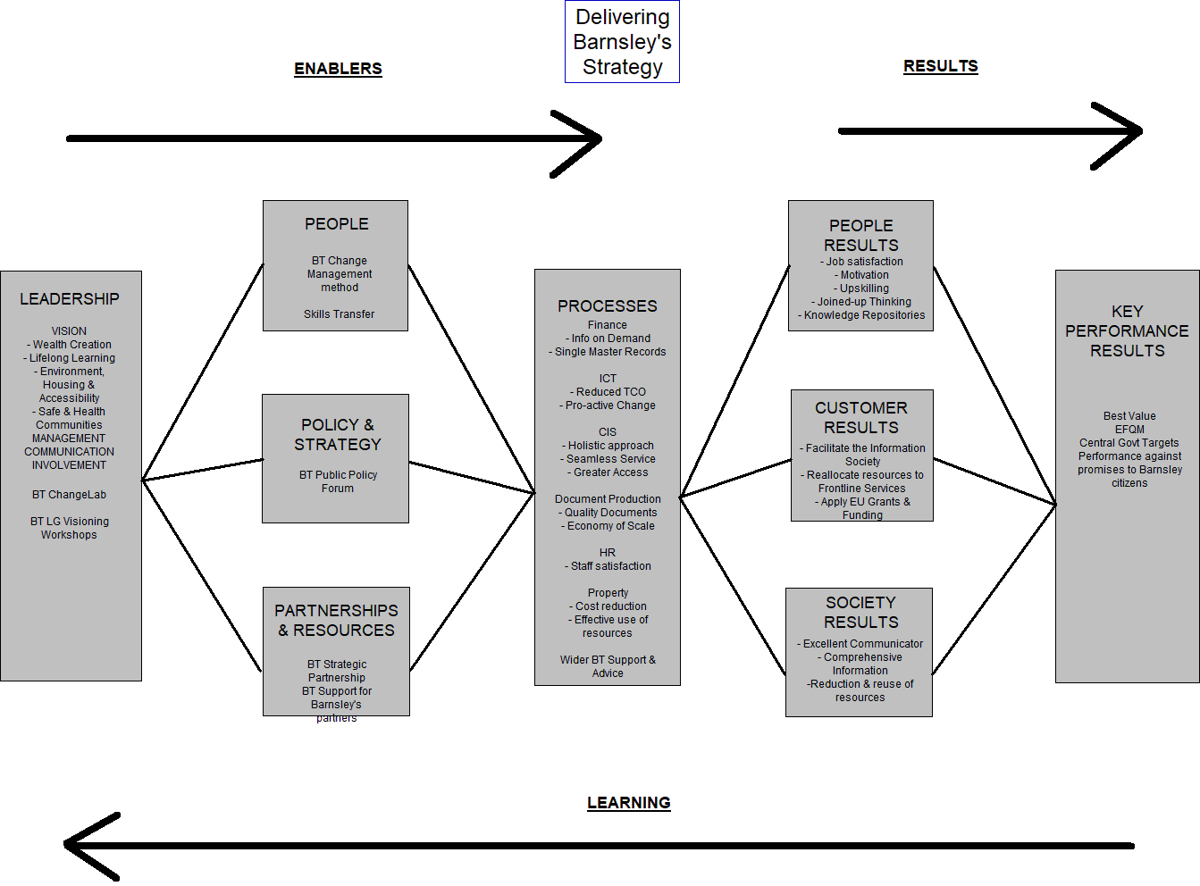
Barnsley – an example
Notes:
This is an example from the late 90’s. BT bid to provide a Joint Venture service with Barnsley MBC in the early days of e-government. In the end, Barnsley backed out of the plan for political reasons.

Slide 9
Barnsley – an example
MEANS:
PEOPLE PROCESSES ASSETS
WAYS:
STOPPED,
STARTED,
ALTERED PRACTICES
ENDS:
OUTCOMES AND BENEFITS
SOLUTION:
LEADERS’ CHOICES
STRATEGIC OBJECTIVES
Notes:
Overlay the generic BDN onto the EFQM Model.

Slide 10
Comments?
https://www.efqm.org/

Slide 11
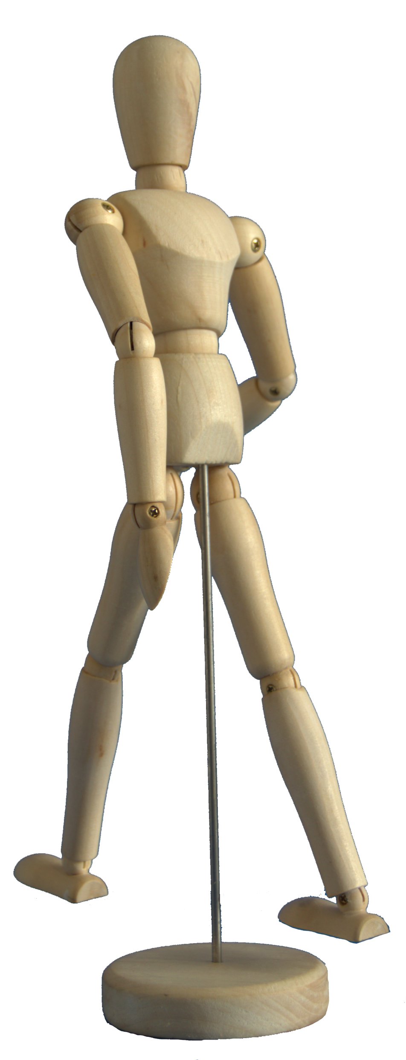
BENEFIT OF EXPERIENCE
EFQM Excellence Model
david.waller@keldale.com

