Slide 1
Campaign Map
Using the Benefits Dependency Network to connect projects to strategic objectives
Notes:
The Benefits Dependency Network is the key tool from the Benefits Management methodology. It shows the cause / effect linkages between a project and the organisation’s strategic objectives. In one image it shows the reasons why your project is valuable to the organisation.
The definition of Benefits Management is:
a process of organising and managing such that potential benefits are actually realised.
Benefits Management is a rational framework for decision making and a way of prioritising investment, bringing clarity of purpose and intent. The method includes a number of tools and techniques such as facilitated workshops, stakeholder analysis and benefit categories to enable you to make good decisions based on sound reasons.

Slide 2
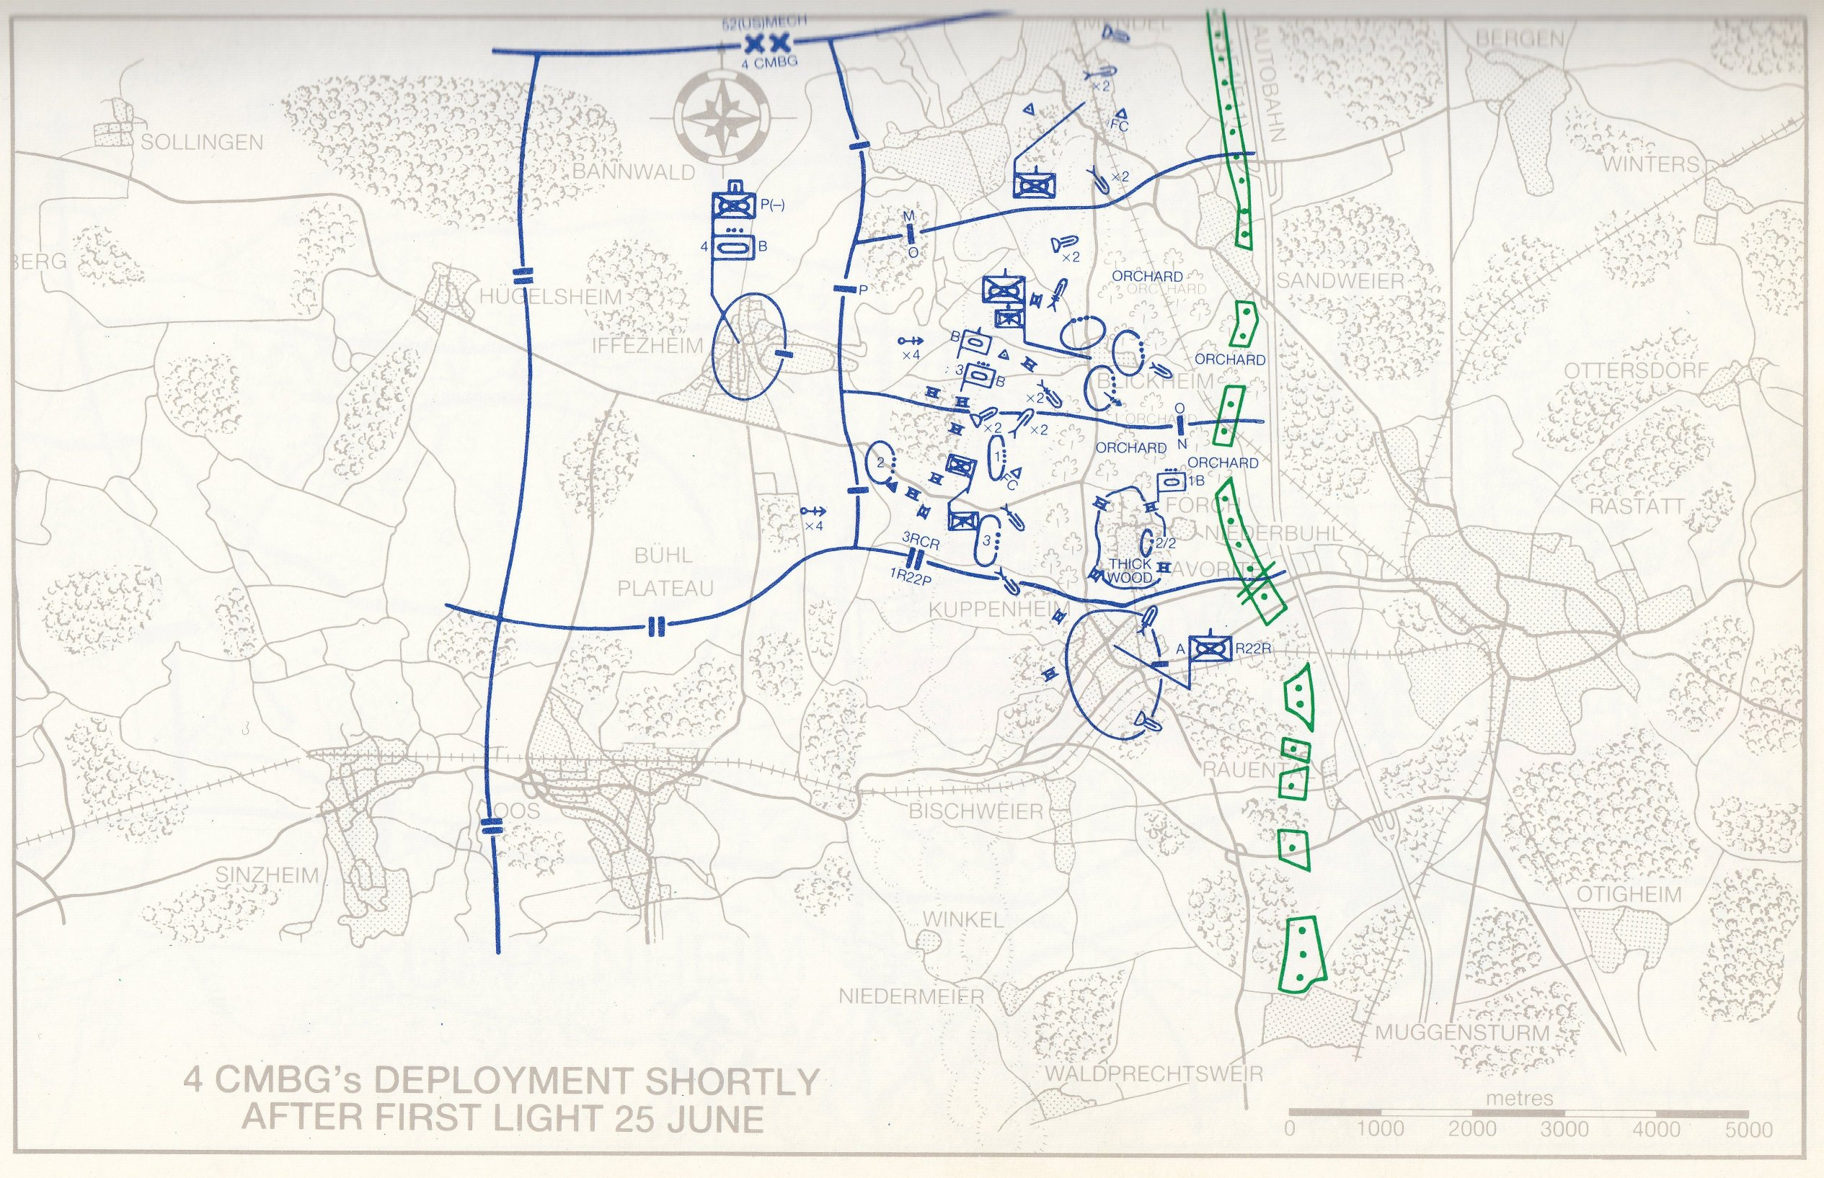
Campaign Map
This is a pictorial plan. It shows where everyone is supposed to be.
Map - Kenneth Macksey, First Clash 1990
Notes:
This is a pictorial plan. It shows where everyone is supposed to be.

Slide 3
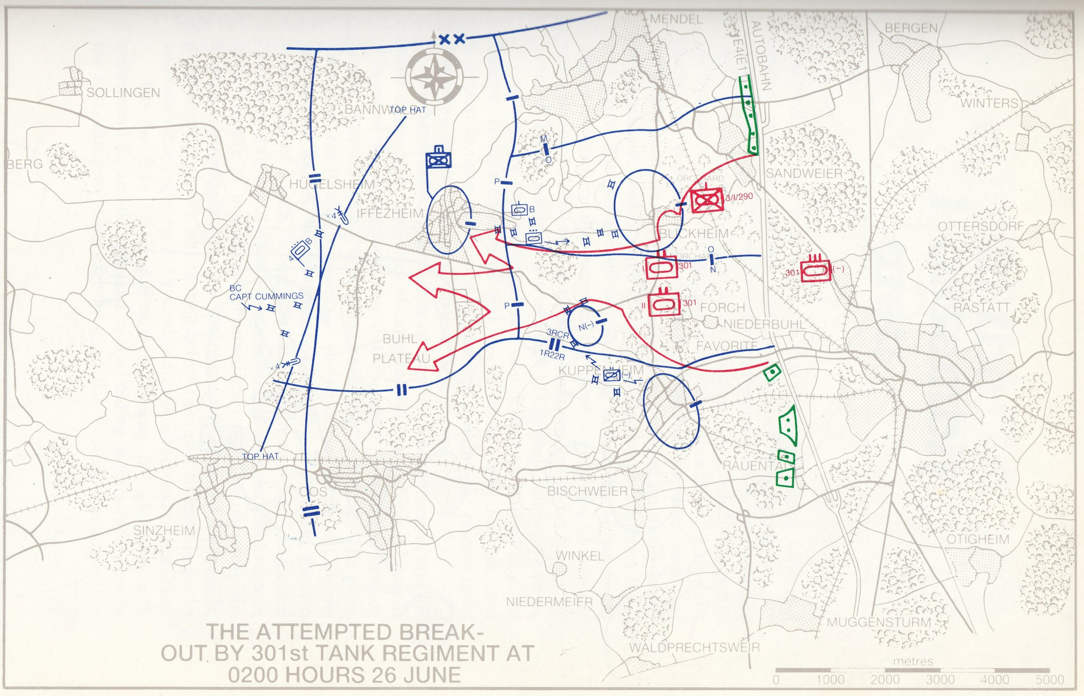
Campaign Map
The map is a snapshot and must be updated as events change.
Map - Kenneth Macksey, First Clash 1990
Notes:
The map is a snapshot and must be updated as events change.

Slide 4
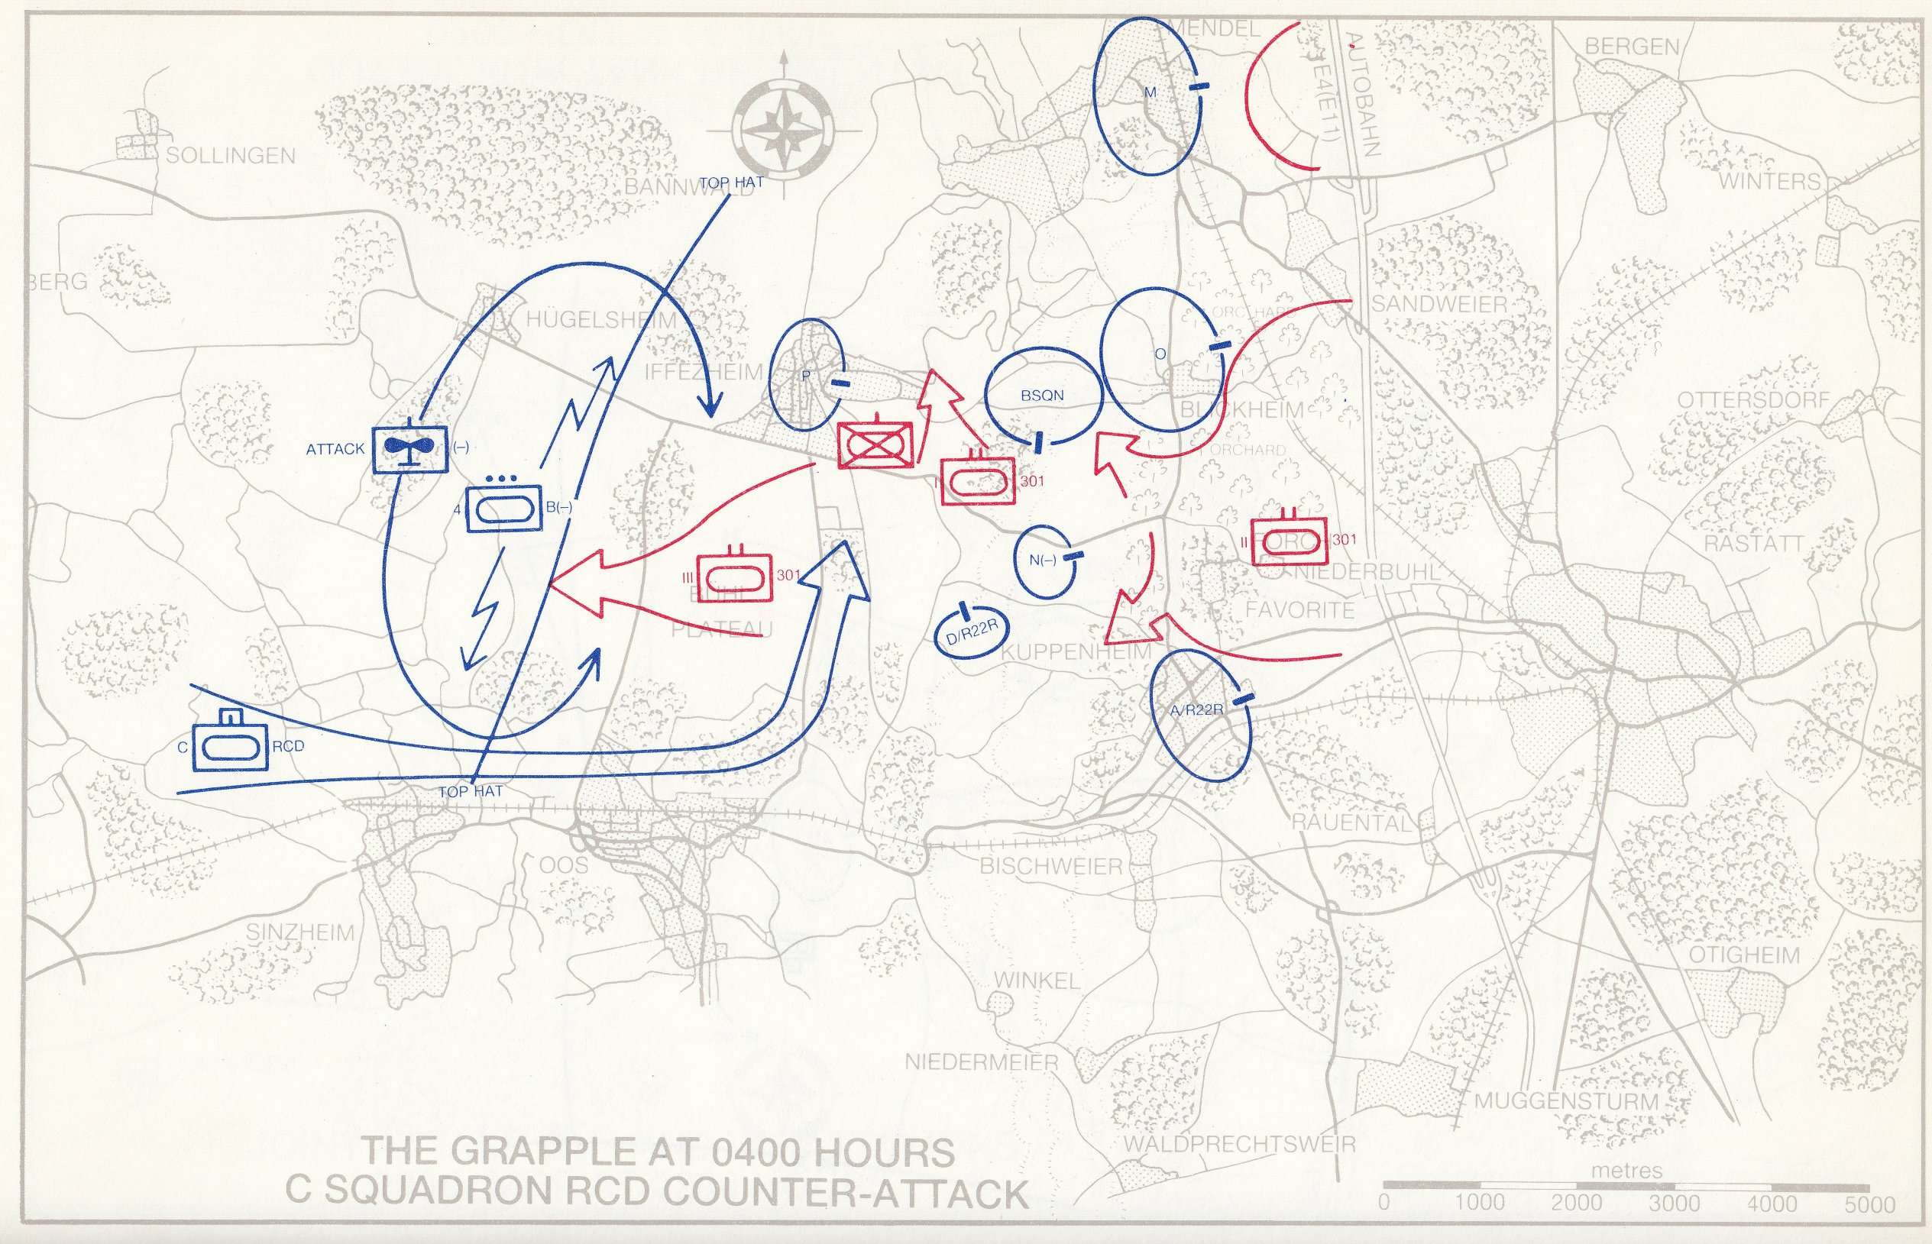
Campaign Map
This one shows the movement to a desired end state.
Map overlays aren’t the most appropriate way of displaying business decisions so we need an alternative blueprint.
Map - Kenneth Macksey, First Clash 1990
Notes:
This one shows the movement to a desired end state.
Map overlays aren’t the most appropriate way of displaying business decisions so we need an alternative blueprint.

Slide 5
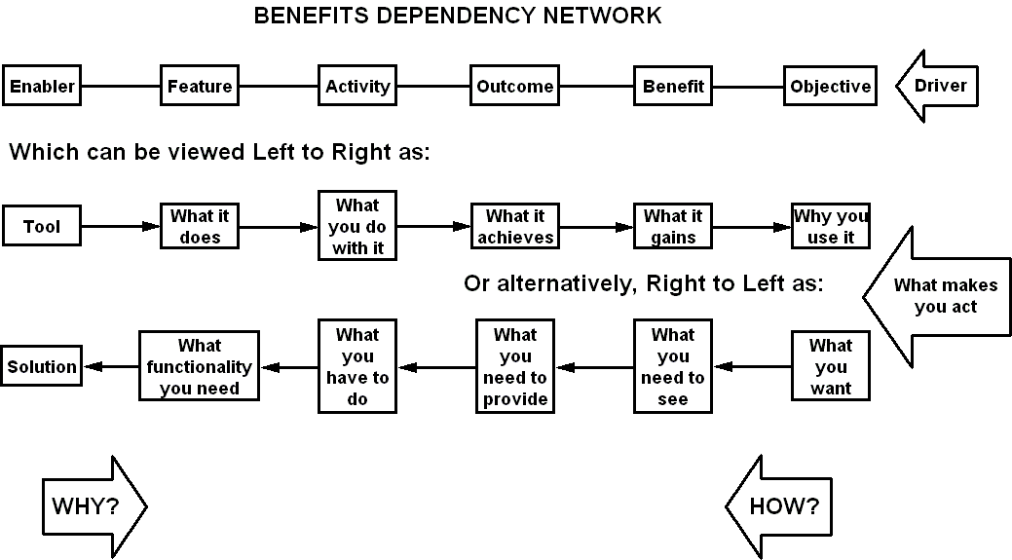
Benefits Dependency Network
Notes:
The benefits dependency network consists of relevant project factors categorised into seven loose columns, linked by the connections between them. It is a tool that shows the linkage from the ICT solution, through business processes and major desirables to the organisation's overall aim. It confirms that the system you intend to introduce will actually provide the results the customer is seeking. Any feature that isn’t linked to a benefit is obviously of doubtful value. Features with many or vital links can be picked out for special attention.
This is the core to any project justification, this is the tool from the Benefits Management method. You add it to the Executive Summary where it shows in one picture how our solution is intimately connected to the customer’s business objectives.
Like any other management tool, it requires effort if it is to be used correctly. You can dash out a quick diagram in ten minutes but it’s likely to be worthless. A full Benefits Management exercise with proper sponsorship and stakeholder involvement that shares ideas between customer and supplier is far more likely to give you some constructive output.

Slide 6
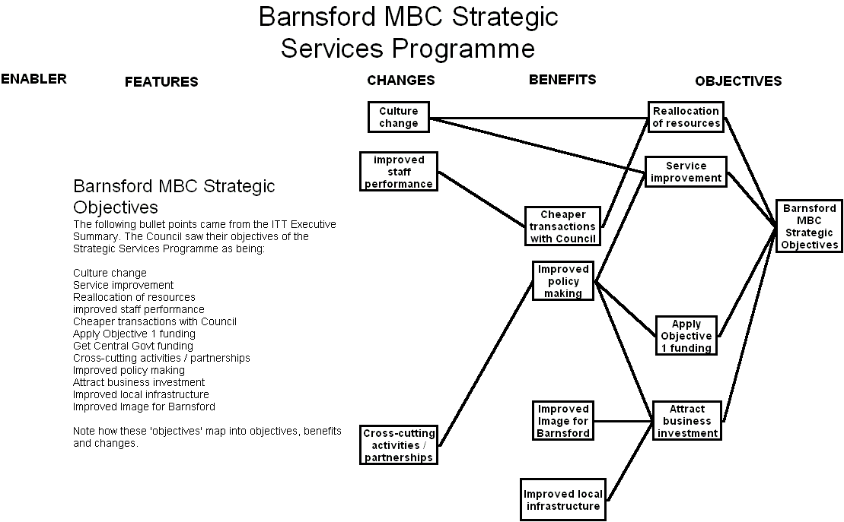
Required Objectives
Notes:
This example comes from a Local Government Partnership programme in the late 90s when ‘Barnsford’ Metropolitan Borough Council sought an international ICT supplier as a partner to help them provide services to the people of the borough.
The high-level strategic objectives are taken from the Council’s Invitation to Tender Executive Summary. The ITT listed them as concise bullet points in no particular order or prioritisation.
When put into the BDN it became obvious that the original ‘objectives’ were a mixture of strategic objectives, benefits and business changes.

Slide 7
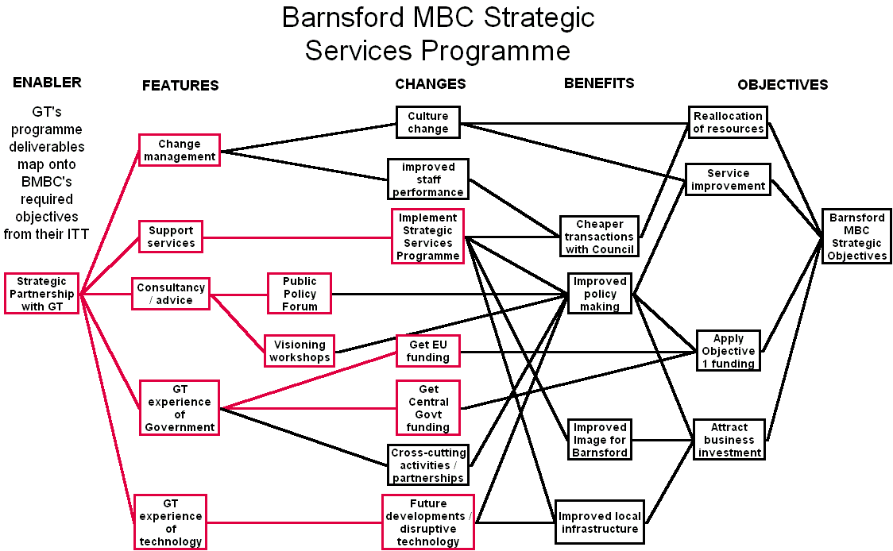
Programme Deliverables
Notes:
Global Telecom was one of the international suppliers who responded to the Council’s ITT.
At the high-level, GT’s partnership would deliver a variety of features; consultancy, support, etc. The bid response to the ITT showed graphically how the parts of the solution were connected to BMBC’s requirements. For the sake of a commercial bid it was vital that there were no dead-ends in the diagram. All the features delivered value that the customer would recognise and no requirements were left un-fulfilled. On this diagram GT’s deliverables are outlined in red to separate them from the Council’s requirements.

Slide 8
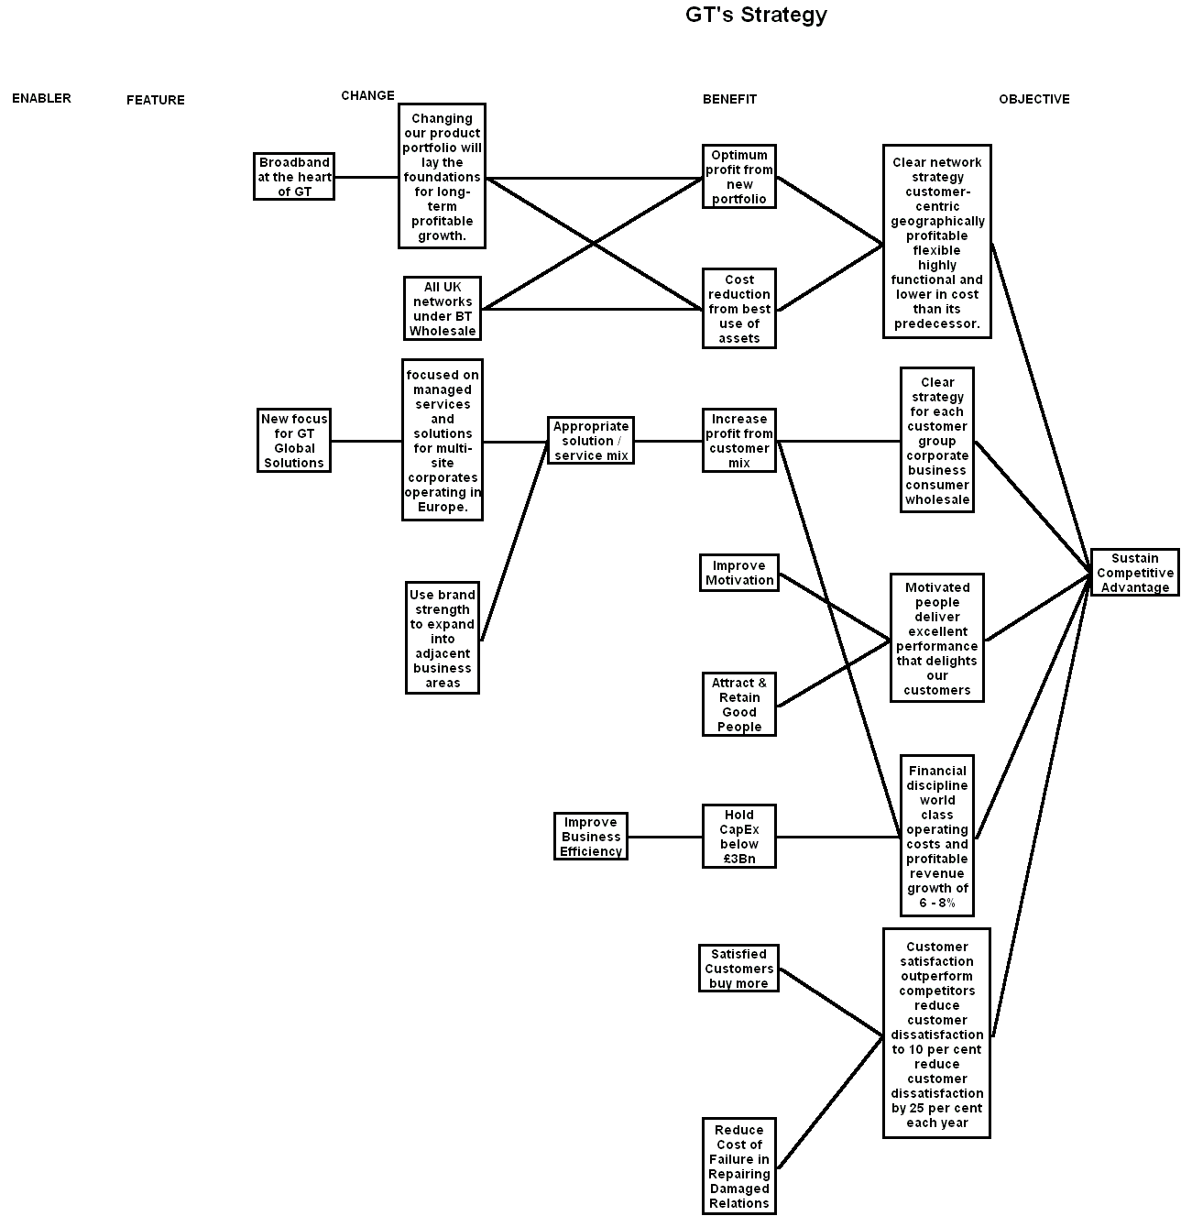
GT’s own Strategy Map
Notes:
Global Telecom’s strategy mapped into a Benefits Dependency Network.
Here’s where a BDN can put over the organisation’s strategy far more clearly than a simple statement.
GT’s Strategy
Global Telecom announced a three-year strategy to help GT become the best provider of communications services and solutions for everybody in the UK, for corporate customers in Europe and with global reach through partnerships.
Their seven priorities were:
A relentless focus on customer satisfaction 2. Financial discipline 3. Broadband at the heart of GT 4. New focus for GT Global Services 5. Clear network strategy 6. Clear strategy for each customer group 7. Motivated people
Like the BMBC example, strategic objectives came mixed in with benefits and changes. This half diagram forms the start for project selection and business case assessment. If the project makes no connection with this right hand side of the BDN then serious questions have to be asked about its value.

Slide 9
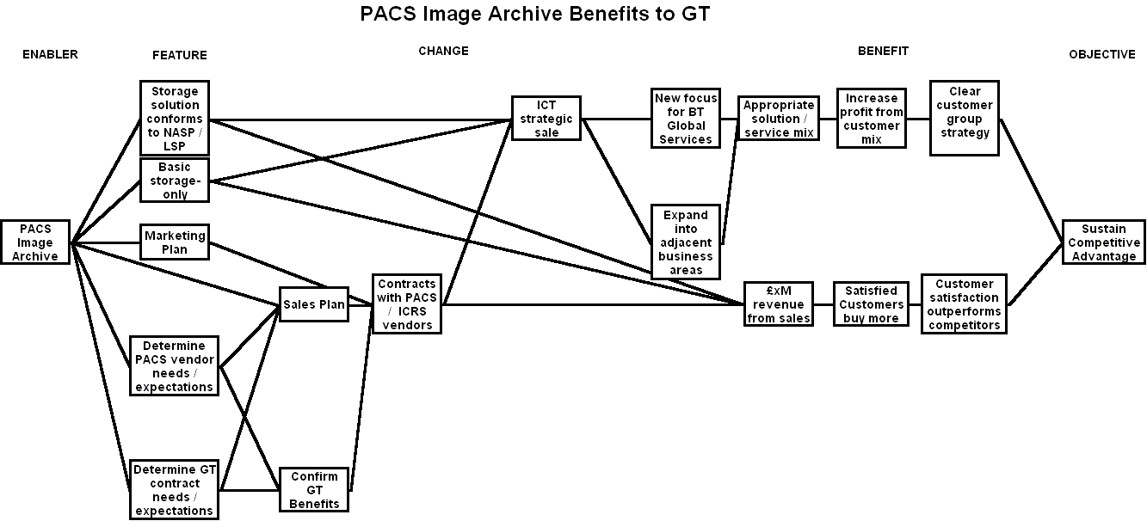
Project Mapped to Strategy
Notes:
Here, in very simple terms is the connection between a business development project, PACS Image Archive (a central store of digital medical images, x-rays, MRI scans, etc) and GT’s strategic objectives of:
A new focus for Global Services
Use the brand to expand into adjacent business areas
Customer satisfaction out performs the competition
In this example there may be tenuous links to other objectives like employee motivation and Wholesale control of networks but they are left out for simplicity.
The strength of the BDN is that it forces people to explain the connection between their project and the organisation’s objectives. It’s not good enough to say something like, “Project X will facilitate the improvement of customer satisfaction.” By working through a complete Benefits Management exercise to create the network we can explain in detail the business changes that will come from Project X, the extent of the benefits to be gained and the impact on strategy.
We will know that Project X is worth doing. And if it’s worth doing, it’s worth the commitment and resources to do it right.

