Slide 1
Bidding with Benefits
Matching solutions to your customers’ needs
Notes:
“…but where’s the convincing argument?”
The bidding process is horribly complex and the opportunities for misunderstanding are immense.
The customer sends us 100 pages written by a dozen different authors to tell us what they think they want.
We reply with 1000 pages telling them what we think they want and what we think we are going to give them.
They decide to buy based on their interpretation of our interpretation of their perceived needs.
Is it any wonder that customers try to simplify the whole thing by choosing a solution for themselves, “Just give me the big one in blue, never you mind what I want it for.”
There is a way to improve on this situation though, apply some Benefits Management.

Slide 2
The Benefits-driven Bid
Benefits Management creates a compelling reason for the customer to act in our favour
A BM bid will be chosen because it clearly shows how it meets the customer’s valid business needs
It proves our willingness to be their partner as they see us take an active part in delivering worthwhile business change.
Notes:
Basing the bid on customer benefits puts it in a context they will appreciate.
It shows the connection between our solution and their primary objectives, business drivers or aims.
It highlights the benefits they want to see in terms they recognise.
It forms a solid base on which to build collaborative partnership.

Slide 3
Benefits Management
Benefits Management is the best application of scarce resources to select and deliver appropriate benefits to identified stakeholders
To optimise the benefits from business change
Notes:
6
But before we get too involved in the process, a few explanations.
Benefits Management according to Cranfield University is ‘a process of organising and managing such that potential benefits are actually realised.’ I say that it’s the best application of scarce resources to select and deliver appropriate benefits to identified stakeholders. ‘Best use’ is basically management, it’s the ‘appropriate’ and ‘identified’ that makes BM special.
It means optimising the benefits from business change, not kit installation.
Though it started as an additional work package to any old IT project, the concept has grown into a very strong business strategy tool. It helps you do the right things for the right reasons.

Slide 4
What is a benefit?
An advantageous change realised from the transformation of resources to deliver new or improved value adding activity
Improve
Increase
Reduce
Eliminate
Stop
A result that a stakeholder perceives to be of value
Notes:
7
What’s meant by the word benefit?
Here, it’s defined as ‘an advantageous change realised from the transformation of resources to deliver new or improved value adding activity.’
More simply, it’s whatever a stakeholder perceives to be of value. Two key points here, the stakeholder is a key player with influence and perception wins over facts every time.
In simple terms, it is expressed in ‘doing words’. Note the careful use of words. Make sure there is a clear statement of the benefit, i.e. what makes it worthwhile. Get away from features and outcomes.

Slide 5
Features, Outcomes and Benefits
Feature - my car is painted ‘Police Car’ white
Outcome - people move over for me on the motorway so I get home for 6 pm
Benefit - I get to watch The Simpsons on TV and so improve the quality of my otherwise dull existence
Notes:
Here’s a silly example to show the difference between features, outcomes and benefits.
Less silly, take an improved network:
Feature - more bandwidth
Outcome - faster file downloads, less time wasted over the day
Benefit - Whatever the customer wants from faster downloads and saved time.
This is the customer’s choice. They make the management decision about what the will do with this free time. If they need to save costs then it may go into headcount reductions. They may choose to use this extra resource to improve customer service. The choice is theirs and they should make it on what brings them most value.

Slide 6
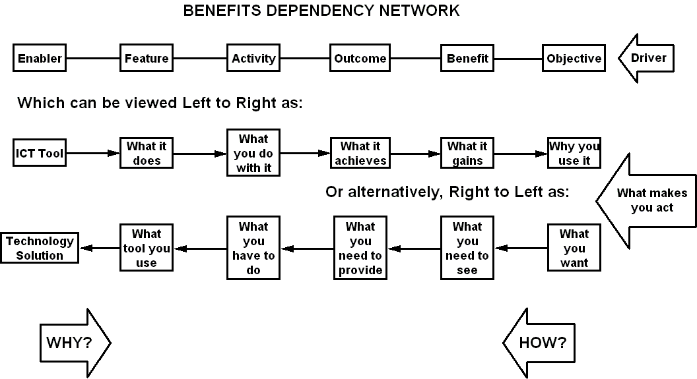
Mapping the benefits
Notes:
As far as bid submissions are concerned, this is the tool from the Benefits Management method. You add it to the Executive Summary where it shows in one picture how our solution is intimately connected to the customer’s business objectives.
The benefits dependency network is one of the key elements of the benefits management method. It is a tool that shows the linkage from the ICT solution, through business processes and major desirables to the organisation's overall aim. It confirms that the system you intend to introduce will actually provide the results the customer is seeking. Any function that isn’t linked to a benefit is obviously of doubtful value. Functions with many or vital links can be picked out for special attention.
This is the core to the bid.

Slide 7
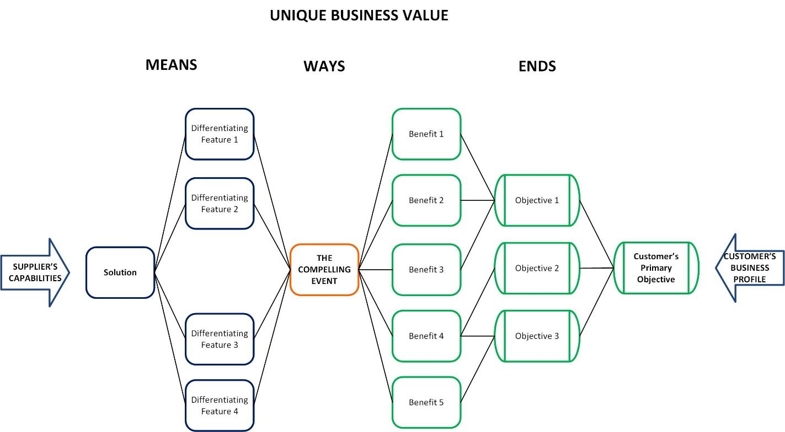
Mapping for a sale
Notes:
Taken from Target Account Selling, this is the context in which we provide goods and services. The customer’s business profile describes who they are and their raison d’etre. Our customers have objectives too and want to see benefits. We provide a solution that meets their needs. The compelling event in the middle is that crucial way in which the customer applies our solution to achieve their desired ends.

Slide 8
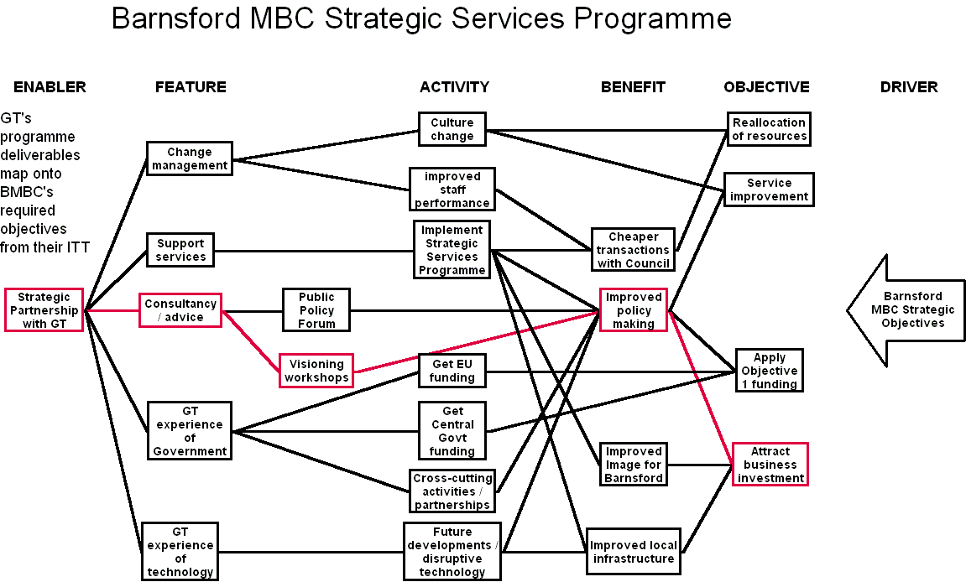
An Example
Notes:
This is an actual example from a Local Govt Partnership bid.
The benefits diagram was included in the Executive Summary to show how the vendor has linked its proposed solutions to the Council’s strategic objectives.
The diagram shows the features that the vendor will deliver, how they enable business changes that create benefits that help deliver strategic objectives. One of the linkages is shown in red as an example. The proposed consultancy / advice includes visioning workshops. A benefit of visioning workshops is that they improve policy making. This creates the benefit of attract business investment, enabling the Council to meet one of its Strategic Objectives.
Working through the diagram from left to right shows the specific business reasons for action, why things should be done. In this case, it shows why consultancy / advice is necessary to attract business investment. Taking the diagram from right to left shows how objectives will be achieved, how Strategic Objectives will be facilitated through the provision of consultancy / advice.

Slide 9
The Method
Cut & Paste from the ITT
From the ITT document
4.1 The Council's Priorities and Core Values
With these factors as a backdrop there is a shared agenda to concentrate much of the Council’s work around: -
Increasing educational attainment at all levels and increasing basic skills in order to give our population a better chance of sharing in the town's economic prosperity;
Working to alleviate the effects of poverty and discrimination through our housing, benefits, regeneration, family support, crime reduction, community and partnership work;
Notes:
So how do you build the diagram in practice?
Most of your time will be taken up in filtering the information provided by the customer.
Start with the ITT and associated documents. As you work your way through them, cut and paste the important paragraphs into a set of notes. Leave the paragraph headings on so you can refer back to the original documents later if you have to.
Look for the ‘X implies Y’ statements where the customer has identified their own connections. These may help you build the diagram. Beware of the tenuous connections though. If the statement is along the lines of, “A new LAN will give us huge savings”, then you have identified a huge gap that needs to be filled. The customer wants the benefit of huge savings (define huge…), has decided on a new LAN as the solution but doesn’t say how the solution delivers the benefits.

Slide 10
The Method
Cut & Paste from the ITT
Condense to bullets
From the ITT document
4.1 The Council's Priorities and Core Values
With these factors as a backdrop there is a shared agenda to concentrate much of the Council’s work around: -
Increased educational attainment
Sharing prosperity
Alleviate poverty
Notes:
Condense the notes into brief bullet points.

Slide 11
The Method
Cut & Paste from the ITT
Condense to bullets
Categorise the bullets
Enabler
Service Provision Partnership
Features
Bring expertise
BPR
ICT
Notes:
Split your notes into the categories on the Benefits Dependency Network:
Enabler
Feature
Activity
Outcome
Benefit
Objective
Then sort the bullet points into the categories. Ideally, your customer will have provided you with some clearly stated objectives, specific, measurable benefits and some recognised business changes that will enable them.
If they’ve listed features and the solution to be delivered then questions need to be asked. Is the requirement so simple that it doesn’t warrant the full bid effort or do we have the relationship to query the customer’s competence?
This will build up the right hand side of the diagram.
Meanwhile, your colleagues in the supplier units will be giving you the information to build up the left hand side, the recommended solution, its features and some likely business changes that the features will enable. This information also needs to be categorised.

Slide 12
The Method
Cut & Paste from the ITT
Condense to bullets
Categorise the bullets
Cull to a manageable number
Notes:
Once the bullet points have been sorted they will have to be whittled down to a manageable number. The final diagram is designed to add clarity to the text, not confuse everyone or give them eye-strain trying to read it. Tidy up the duplicates then look to prioritise the requirements. Within the ITT it may not be obvious which objectives and benefits are the most important. You may have to use the supporting documents. Better still, if possible, go ask the customer.

Slide 13
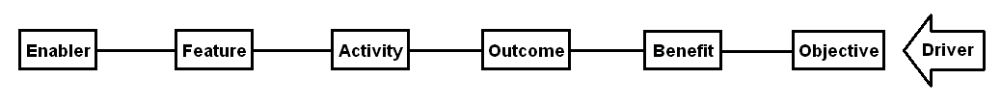
The Method
Cut & Paste from the ITT
Condense to bullets
Categorise the bullets
Cull to a manageable number
Connect the items
Notes:
Finally, it’s time to start building up the diagram. You need to be able to drag items around so choose your drawing package accordingly. You can even start with post-its on a white board if you like.
A software package that has been used successfully is Inspiration (available online from http://www.pmi.co.uk). It’s a mind mapping tool that retains connections as you move the boxes around. It also saves its diagrams as gif image files for inclusion in your documents.
You can also use Visio.
Start by putting all the bullets into their relevant column, Enabler, Feature, Activity, Outcome, Benefit, Objective, Driver.
Then look for groups, e.g. put the financial benefits together. Shuffle them into groups and start making the connections. Link the benefits to the objectives, the changes to the benefits and so on.

Slide 14
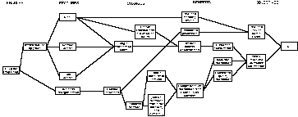
The Method
Cut & Paste from the ITT
Condense to bullets
Categorise the bullets
Cull to a manageable number
Connect the items
Construct the diagram
Notes:
When you’ve made all the obvious connections, step back and look at what you’ve got. Chances are, there will be a number of dead-ends and gaps where the business changes are missing that ought to connect our features to the customer’s benefits.
If you have a feature that goes nowhere then you have to ask why we are trying to sell it. It apparently doesn’t deliver any business benefit so the customer is unlikely to want to buy it.
A benefit that hangs in the air is a missed opportunity. It’s something they want but our solution doesn’t deliver it. Go back to your supplier colleagues and see what they’ve got that will fulfil this need.
Look for the strong connections. Many links into a benefit or objective suggest that these are the things the customer really wants to see. It gives a hint to priorities that may not have been explicitly expressed. If one feature leads to many benefits or the key benefits the customer has chosen then it may be the ‘killer app’ in this case. It’s delivery needs to be recognised as very important and treated with the respect it deserves.
Choose one set of connections from solution to objective and highlight them in a different colour. Write some narrative to walk the customer through this path as an example of how the diagram works. Start from the right, explaining HOW they get their objective.

Slide 15
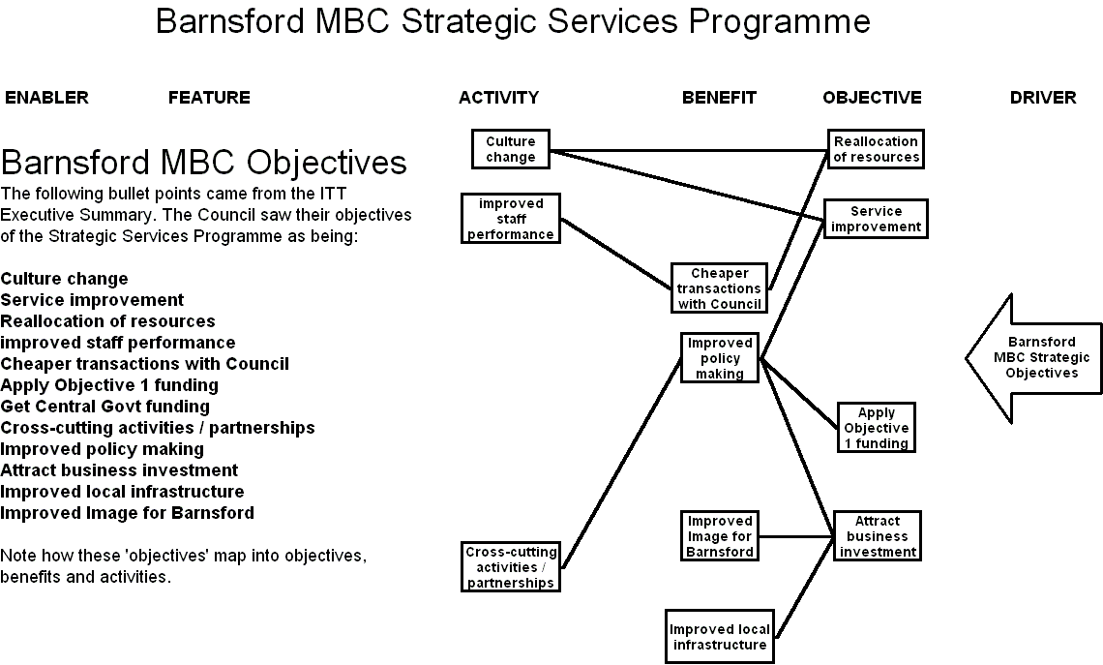
Notes:
This example comes from a Local Government Partnership programme in the late 90s when ‘Barnsford’ Metropolitan Borough Council sought an international ICT supplier as a partner to help them provide services to the people of the borough.
The high-level strategic objectives are taken from the Council’s Invitation to Tender Executive Summary. The ITT listed them as concise bullet points in no particular order or prioritisation.
When put into the BDN it became obvious that the original ‘objectives’ were a mixture of strategic objectives, benefits and business changes.

Slide 16
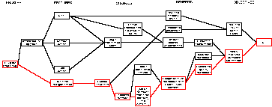
The Method
Cut & Paste from the ITT
Condense to bullets
Categorise the bullets
Cull to a manageable number
Connect the items
Construct the diagram
Confirm
Notes:
Confirm the diagram within the bid team. Have you got a fair and attractive representation of the solution and its impact.
If you have the relationship then confirm the whole thing with the customer.
Make sure the diagram fits with the text you’ve written.

Slide 17
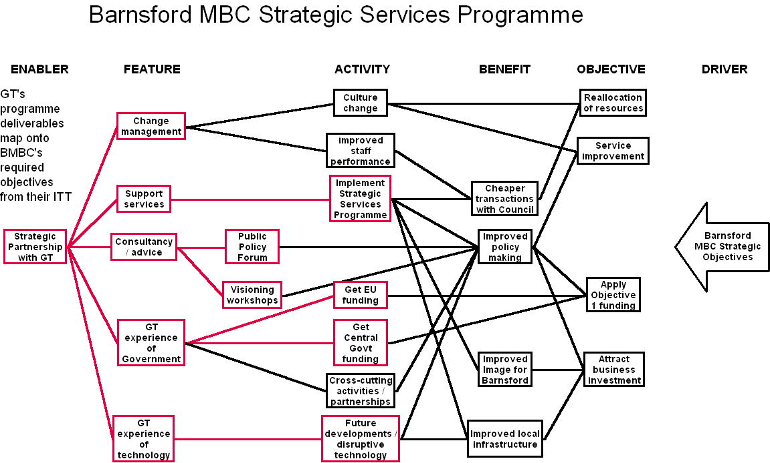
Notes:
Global Telecom was one of the international suppliers who responded to the Council’s ITT.
At the high-level, GT’s partnership would deliver a variety of features; consultancy, support, etc. The bid response to the ITT showed graphically how the parts of the solution were connected to BMBC’s requirements. For the sake of a commercial bid it was vital that there were no dead-ends in the diagram. All the features delivered value that the customer would recognise and no requirements were left un-fulfilled. On this diagram GT’s deliverables are outlined in red to separate them from the Council’s requirements.

Slide 18
Making it happen - fundamentals
Sponsorship
Strategy
Benefits management
‘Killer’ applications
Focus on business change
Infrastructure
A commitment to action
Notes:
42
Don’t forget the people aspects. Make sure you haven’t invented your bid while sitting alone in your ivory tower.
Also make sure the customer understands that this isn’t a silver bullet remedy to all their problems. They’ve got a bit of work to do too if the project is to be successful.

Slide 19
Comments
Notes:
1

Slide 20


Bidding with Benefits
©Keldale Business Services 2024

