Slide 1

BENEFIT OF EXPERIENCE
The Benefits of Benefits Management
Notes:
If Benefits Management can’t explain its own benefits then it’s not much good, is it.

Slide 2
David Waller BSc MBA CMgr FCMI CEng MBCS CITP
Managing Director, Keldale Business Services Ltd
BCS Member since 1992
Benefits Management Specialist since 1996
Previously with BT, government and major customers internet programmes
Currently with NHS, health and social care informatics
A benefit is a result that a stakeholder perceives to be worthwhile.
Notes:
David Waller
Managing Director, Keldale Business Services Ltd
Benefits Management Specialist
A benefit is a result that a stakeholder perceives to be worthwhile.
And behind that simple statement lies all the complexity in health and social care that comes from many, differing stakeholders and what they believe is valuable to them.
Benefits Management (BM) is all about the decisions, processes and activities that make the best use of scarce resources to deliver the right benefits to the right stakeholders.
David was active in Cranfield University's Benefits Management research, applying the method in the rollout of BT's intranet, one of the first, largest and most successful corporate intranets. He then took this experience to customers in finance, utilities and central government.
David was recruited into the NHS to establish a public sector focused benefits management toolset. Since he moved into health, he has covered a range of topics from telecare to service re-structuring and helped hospitals achieve strategic benefits from electronic patient records. He has led on Benefits, writing business cases and guiding teams for national IT programmes on topics from data standards and interoperability to adult social care and child protection.
The national learning group he mentors for Benefits Managers enables him to keep the methodology fresh and at the forefront of service improvement.

Slide 3
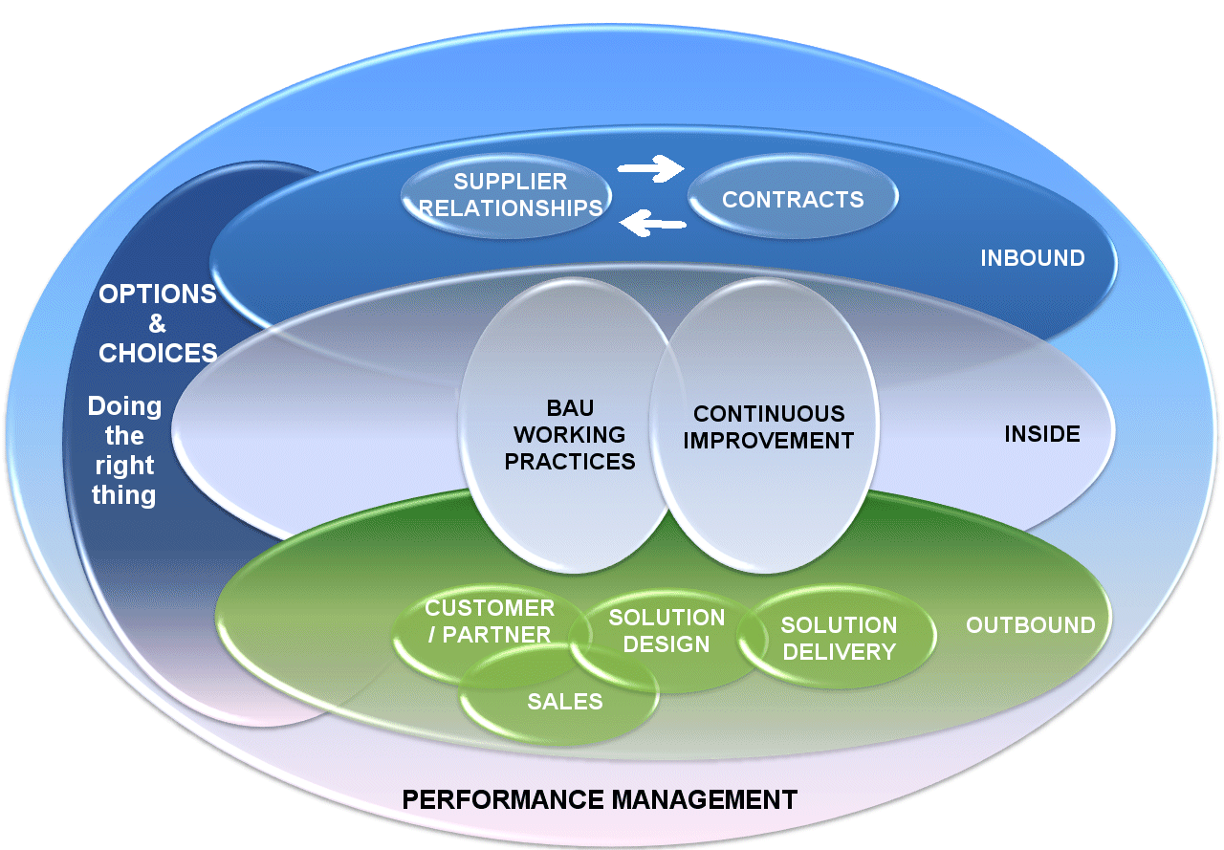
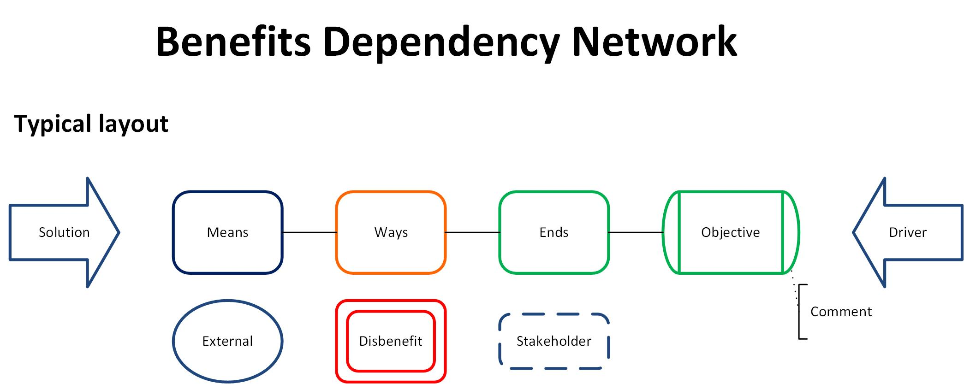
Benefits-Led Enterprise
Notes:
I believe that BM is a broadly applicable method that works well outside the confines of IT projects, it’s usual habitat.
Within any enterprise we have a number of activities that can be improved by the application of BM tools and principles.
Though Cranfield started with deriving benefits from a single IT project, the method has expanded its relevance across the entire business. This diagram tries to show this by overlaying BM on the Inbound / Inside / Outbound (Buy Side / Inside / Sell Side) model that some of you will recognise. I’ve drawn it as a Venn diagram because these items are rarely isolated from each other, there’s always a fair amount of overlapping between them.
Even deep within the Public Sector we have internal customer / supplier relationships. The Buy Side / Inside / Sell Side model is appropriate to all business units and local service systems.
I’ve left a little diagram in the bottom corner as a reminder of the linkages between enabler and objective. It’s a BDN and we’ll get to it in a few minutes.
Just picking out a few examples:
Options and Choices – developing strategy and policy
Advanced benefits management is a strategic business planning tool that enables senior managers to use a rational methodology for selecting and delivering successful business strategies and ICT application portfolios. The Benefits Drivers here are the organisation’s strategy, objectives, raison d’être. The context can be the who, what, where of the health economy. The Realisation Plan for the new strategy comes from Benefits, not pet projects, fair shares or face saving.
It is using BM to decide the best course of action to take, doing the right thing.
Inbound
Supplier Relationships
Open dialogue with a clear understanding of agreed joint aims and mutual benefits will build a solid working relationship with key suppliers. As the customer, the enterprise creates the right hand side, the objectives and benefits half of the benefits dependency network. The supplier can then map their offered solution as the left hand side. Working together, the diagram can be improved to develop the optimum solution and a strong working relationship into the bargain.
Outbound
Though I will refer to external ‘customers’ here, remember this applies just as well within the organisation where some of us have to ‘sell’ our services to our colleagues.
Solution Development
As we deal with innovation and disruptive technology we are faced with recurring questions about how it is to be used. Working through the left hand side of the benefits dependency network builds reasons for why you should want to use a particular technology. Creating solutions in search of problems is bad if we try to force the solution onto any problem that comes our way. However, the benefits network provides a set of potential problems we can solve.
For later reference if the class asks:
Options and Choices – developing strategy and policy
Advanced benefits management is a strategic business planning tool that enables senior managers to use a rational methodology for selecting and delivering successful business strategies and ICT application portfolios. The Benefits Drivers here are the organisation’s strategy, objectives, raison d’être. The context can be the who, what, where of the health economy. The Realisation Plan for the new strategy comes from Benefits, not pet projects, fair shares or face saving.
It is using BM to decide the best course of action to take, doing the right thing.
Inbound
Supplier Relationships
Open dialogue with a clear understanding of agreed joint aims and mutual benefits will build a solid working relationship with key suppliers. As the customer, the enterprise creates the right hand side, the objectives and benefits half of the benefits dependency network. The supplier can then map their offered solution as the left hand side. Working together, the diagram can be improved to develop the optimum solution and a strong working relationship into the bargain.
SLAs & Contracts’ Acceptance Criteria
Acceptance Criteria are defined and contracts phrased in terms of the benefits to be delivered rather than the resources input to the system. Agreements can be made on the basis of reward for results.
Relationships influence the ‘paperwork’, performance against paperwork in turn influences the relationships.
Inside
Business As Usual Working Practices
Processes should be viewed from the value they add to the business. This value may not necessarily be in hard financial terms but must be expressed as a benefit that managers feel is worth having. Once established, the aim of any practice must be documented in its works instructions. Stating the ‘ends’ as well as the ‘means’ reminds people why they are doing what they do. If it’s your job to give orders then JFDI is out. You have to be prepared to explain why an action is necessary and how it connects to the desired result. And the first person you have to explain it to is yourself.
Continuous Improvement
All the old folk out there will remember TQM. Existing working practices should be subject to continuous improvement. Quality improvement exercises must remember to consider the ‘why’ as much as the ‘how’. Benefits management defines the ‘why’ in clear terms.
Outbound
Though I will refer to external ‘customers’ here, remember this applies just as well within the organisation where some of us have to ‘sell’ our services to our colleagues.
Partner Relationships
Open dialogue with a clear understanding of agreed joint aims and mutual benefits will build a solid working relationship with our key partners. The same processes can be applied here as above in the supplier relationship.
Customer Relationships
BM is a pre-sales tool to build a solid relationship with your customer. Together you work to determine their objectives and develop a solution that meets them. Shared objectives and open discussion help build a partnering relationship as described above in the supplier relationship.
Cost / benefit analysis is difficult in many government projects because the less tangible benefits to society do not lend themselves to easy measurement. Building a grounding in experience and case studies with various agencies grows our intellectual capital and will enable us to save our customers the effort of re-inventing the wheel with each new project.
Within the commercial arena our customers are not all the same. Even if they all want to make a profit, the ways they go about doing it vary enormously.
The two sides of the benefits dependency network can be constructed in a reasonably straightforward and logical manner. The brainpower comes in making the connections from one side to the other. Having identified the customer's needs, which alternative solutions can we offer? Having identified a feature of a new disruptive technology, which problem could it solve? If nothing more, the network can act as a conversation piece to start a dialogue between customer and supplier.
Solution Design
Having started the dialogue, BM provides a good base on which to develop solutions with customers. Before work goes out to tender, we can be actively involved in defining the customer’s needs as we work with them to map solutions to objectives. This can take significant time and effort if done properly and the customer is unlikely to have the resource to duplicate this sort of exercise with our competitors. The required solution is going to have our imprint simply by our involvement in its definition. However, it will still be expressed in terms of customer benefits, meeting their objectives. It will be the solution they want to buy, not the one we want to sell. We should be at an advantage when the Invitation to Tender is issued.
The best way to use the BDN in developing solutions is in partnership with the customer, working through a series of iterations back and forth across the network until both sides have their optimum solution.
Solution Development
As we deal with innovation and disruptive technology we are faced with recurring questions about how it is to be used. Working through the left hand side of the benefits dependency network builds reasons for why you should want to use a particular technology. Creating solutions in search of problems is bad if we try to force the solution onto any problem that comes our way. However, the benefits network provides a set of potential problems we can solve.
Starting with Central Government we can chart their objectives from various sources, e.g. PM's Office, Treasury, etc. The Treasury is a good place to start as we see what the government's actual priorities are from the money they are prepared to spend. The targets they set define the benefits they want delivered.
We can do this for any customer group, NHS, EU, Central Government and Departments, Local Govt, partnership bodies, right the way down to an individual with a project and some money to spend. In a commercial context, this means everyone from the CEO to the budget holder.
This builds up the right hand side of the diagram. We know what they want to achieve so now we can look at propositions to fit their needs.
Knowing the customer side of the Benefits Dependency Network will prompt for enablers and features that will connect. Features that lead to dead-ends can be dropped. A feature linked to many or major benefits is likely to be the ‘killer app’ and should be resourced accordingly.
Again, the best way to use the BDN in developing solutions is in partnership with the customer, working through a series of iterations back and forth across the network until both sides have their optimum solution.
Bid Summary
Invitations to Tender are often large, complex documents written by a number of authors. Bid submissions responding to them are much larger and more complex. The opportunity for poor communication and misunderstanding is tremendous. We may miss the customer’s key drivers. They may miss how our solution meets their needs better than our competitors.
The Benefits Dependency Network is a very strong tool for displaying graphically how our proposed solution will meet the customer’s requirements. At a glance you have the Executive Summary on one page. Obviously, you need the narrative to back-up the boxes on the diagram but the customer can wade through that for the specifics of what we will deliver, not to answer the simple question, “Will this do what I want?”
Again, it is best built in collaboration with the customer. This not only creates the optimal solution, it helps build the relationship.
Project Management (Solution Delivery)
Project management is the ‘home’ of BM. We can use it as a differentiator between ourselves and other PM providers.
It is much more than a benefits realisation work package. The project is a benefits delivery project and the ICT is one of its work packages.
This area shows that we can deliver the promises made by our selling colleagues. Its practical application extends through the project life-span into live service though and our expertise in the subject can be applied to deliver customers’ business improvements and maintain our credibility as a provider of good service.
Performance Management
A rational scheme of performance management underpins the entire system. If you can’t measure the benefit, how do you know it’s occurred? This means having baseline figures before you make the business change and on-going measures to show the impact of the change. We need to measure the right things for the right reasons and prove that the benefits are as valuable as we expected and are actually being delivered.
We often make our targets and measurements so granular that we forget their original purpose. Customer contribution to profit becomes customer satisfaction which in turn becomes number of rings to answer or sales visits per week.
Benefits management helps us choose the appropriate performance to measure, not the easy one. As mentioned earlier in the SLAs bit, we measure what we get out of the system, not just what we put in. Performance management shows how well the benefits are being delivered and enables us to act appropriately to improve the situation.

Slide 4
The preoccupation with the “How” diminishes the “What”
Ask someone what they are doing and chances are they’ll tell you how they are doing it.
“What are you doing?”
“We are working as one enthusiastic team to deliver our project on time and in budget.”
“What is it?”
“It’s a relational database of millions of records, accessed by hundreds of concurrent users in milli-second response time.”
“What does it do?”
“It records transactions between suppliers and purchasers across the region.”
“What’s it for?”
“Dunno”
Notes:
Have you ever read a business case, got to page 15 and still don’t know what it’s about?
This is why I like BM.

Slide 5
What is it all for? What is a benefit?
Simple definitions:
A benefit is a result that a stakeholder perceives to be of value
Benefits Management is the best application of scarce resources to select and deliver appropriate benefits to identified stakeholders
Simple questions:
Who is it all actually for?
What do they really want?
What makes this choice better than Plan B?
Notes:
7
We use benefits as an aid to setting good objectives. It’s reasonable to expect that our objective will be something to do with bringing benefit to someone, even if it’s purely selfishly to ourselves. The moral and ethical issues can keep for another lecture. The key points here are a benefit needs a stakeholder, someone has to see its merit and perception is crucial. “What’s in it for me?” is a subjective judgement. Like morality, issues of relative value, altruism and perverse choices can be left for another day.
However, the definition of benefit helps us define the things around it like outcome and objective.
Benefits Management is about best use of scarce resources.
All this gives us answers to three pretty basic but important questions. If we can’t answer these sensibly, how do we know that we’re doing the right thing?

Slide 6

Start with the End in Mind
Why did Wellington fight at Waterloo?
A) Defeat Napoleon convincingly and remove France as a threat to European peace
B) Use up the old gunpowder before its sell-by date
C) A failed insurance scam to get a new horse
It’s not only what you do, it’s also why you choose to do it
Answer: A (if you didn’t pick A you are not taking this seriously)
Notes:
Before getting to the BDN here are a couple of key points to cover, where to start and when to stop.
Let’s start with the Objectives. An objective is a result with a purpose. There has to be a ‘because…’ in it somewhere, even if it’s implicit. The objective is not ‘Open a shop’ but ‘Open a shop because it will be where we sell our products and make a profit.
The purpose behind any course of action has a direct and significant effect on the way it is undertaken. The reasons why affect the ways we go about things. If Wellington had gone off to Waterloo simply with the intent of using up his budgeted stock of gunpowder then he would have fought a very different battle from the one that actually took place.
A football manager’s side and tactics will adapt to the objective:
Win at all costs
Put on a show for the fans
Get promoted
Avoid relegation
The same applies for any project, the ends affect the means and ways.
Projects talk of acceptance criteria, the things that decide when the project has ended successfully, a sort of, “No-one goes home until…”
Define your acceptance criteria in terms of objectives and benefits before you start. Don’t install the kit and then wonder what to do with it. Too often, projects leave benefits realisation until it’s too late, i.e. at the end of the project. That’s why benefits should be managed from the start.
Some organisations demand a hard financial return.
Some want intangible improvements like satisfaction and image.
Usually, they want both. That’s when conflicting objectives throw a spanner in the works. That’s why clear objectives are crucial.

Slide 7
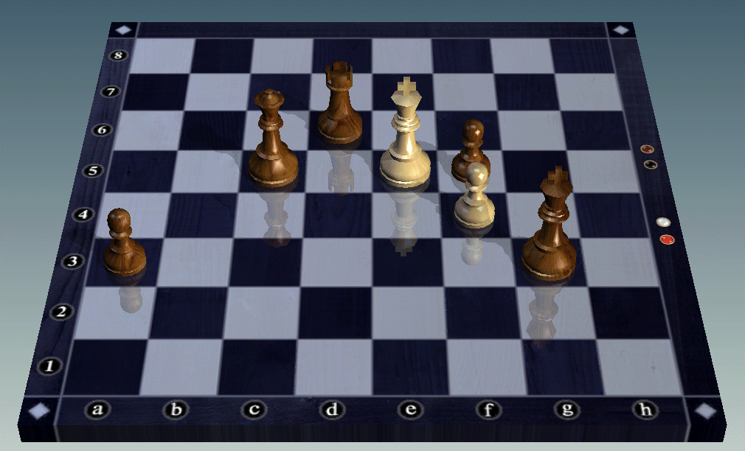
Blueprint - Endgame
The game ends when:
You are checkmated, or
My King is in g3, my Queen is in c5, etc….
Notes:
In the same way as we can have various reasons for the same outcome and find they affect how it is brought about, we can also affect the process through the way we describe the end state. Only a very confident (or deluded) chess player would describe the endgame in terms of where the pieces will be. Yet we are often very granular in describing our programme objectives. The NPfIT Output Based Specification ran to hundreds of pages with sheets of individual requirements, desires and benefits, a pound here, ten minutes there, etc.
This sort of mass objective twists individual priorities and breaks down any common purpose. In the chess analogy it’s like having a different person responsible for each piece. Each heads for its assigned position and sits there without contributing anything to the whole or supporting its team mates in winning the game.

Slide 8
Features, Outcomes and Benefits
Feature - my car is painted ‘Police Car’ white
Outcome - people move over for me on the motorway so I get home for 6:30 pm
Benefit - I get to watch The Simpsons on TV
Notes:
it’s essential that we get a common understanding of what constitutes a benefit.
Here’s a silly example to show the difference between features, outcomes and benefits.
When you come to brainstorm benefits you will get a number of features and outcomes that will have to be weeded out as you go through the list.

Slide 9
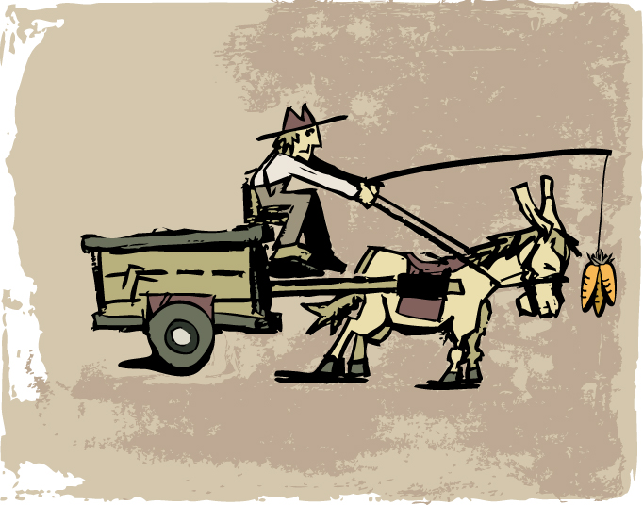
Picking the right benefits
Tactical benefits – getting the donkey to move
Notes:
All too often we concentrate on the carrots, the treats we offer all the stakeholders to encourage them to take part in the project. We neglect the cargo, what the project is all about.

Slide 10
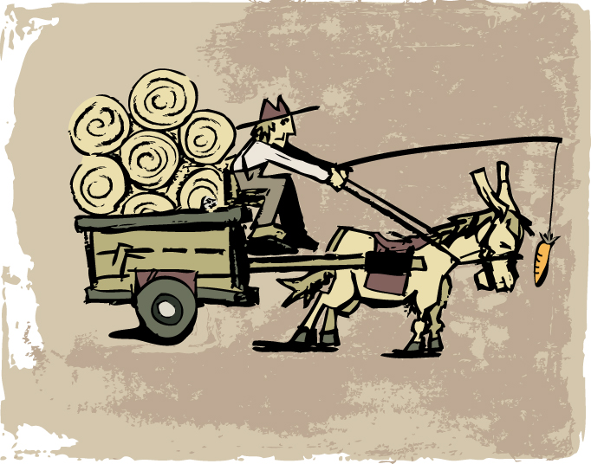
Picking the right benefits
Strategic benefits – a cart full of valuable cargo
Notes:
The cargo is what it’s all about.

Slide 11
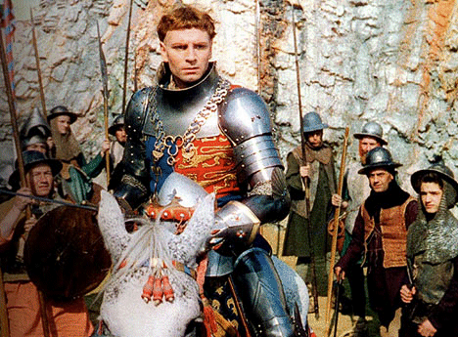
Key stakeholders’ benefits
POWER, CONTROL!
LOOT, DRINK!
Same project, different intentions
Notes:
Different stakeholders want different things. Hence the need to work out who you are doing it for and what they perceive as being valuable

Slide 12
Stakeholder Analysis
Sponsor
Client
Consumer
Supplier
Influencer
Who are the key stakeholders?
What will they gain/lose?
What impact will they have upon your objectives?
Notes:
Stakeholder Analysis:
Think of all the people / groups that will be affected by the change.
Who are the key ones who have a significant influence on the project?
What business changes will they make for the project to be successful?
What benefits and disbenefits will they get, “What’s in it for them?”
How committed to success will they be? Where do they sit currently in terms of commitment and where do we want them to be?
What would you (more correctly, their responsible manager) do to manage them to a more positive position?
Use the Benjamin & Levinson grid.
I use these categories of stakeholder. The Sponsor is the person / entity who wants the project, the ultimate customer. They permit it to happen so everyone else’s benefits depend on them. Clients pay for the project. They may not be the Consumers who use it, e.g. parents buying for their children, hospitals buying for their patients. Suppliers produce the goods and Influencers affect the project through the other stakeholders. They may have no active involvement in it at all.
A common mistake going from no stakeholder analysis, giving people what’s good for them, “The man in Whitehall knows best…” to the other extreme of forgetting / ignoring the Man in Whitehall and concentrating on the benefits recipients. Two key groups of stakeholders who get lost in this approach are the project sponsors and the project team. Both have critical roles to play. Project X is not for ‘the patients’. Project X is for the commissioning body who pays for it so they can expect to have some influence over what their money is being spent on.

Slide 13
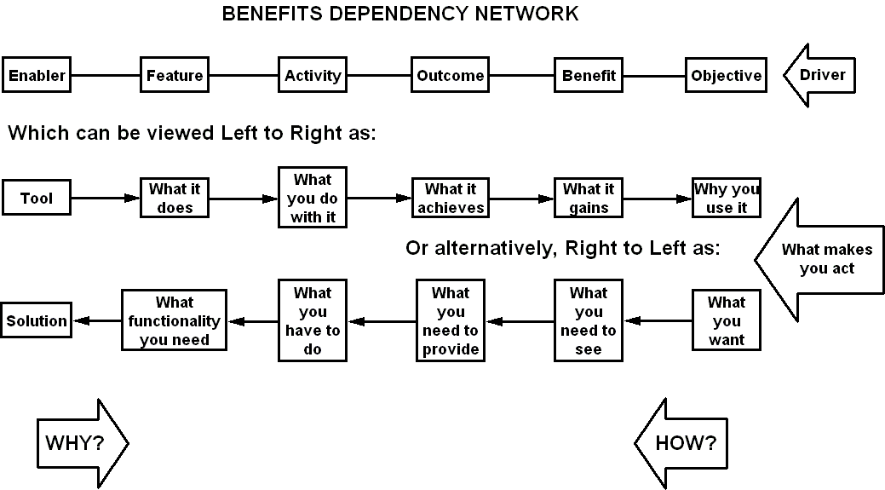
The Benefits Dependency Network
MEANS
WAYS
ENDS
Notes:
The benefits dependency network is one of the key elements of the benefits management method. It is a tool that shows the linkage from the solution, through business activities, outcomes and benefits to the organisation's overall drivers. It confirms that the system you intend to introduce will actually provide the results you are seeking. Any function that isn’t linked to a benefit is obviously of doubtful value. Functions with many or vital links can be picked out for special attention.
Starting on the left, you ask ‘Why?’ to make the connections, ‘Why use this ICT tool?’
Starting from the right, ask ‘How?’ ‘How will I meet my objective?’
There’s a general flow from Means through Ways to Ends, what you use, what you do, what you get. Treat the labels more as a continuum than a rigid set of columns. This is a model of your actual situation so don’t try to force reality into the model, let the model resemble your reality.
How to build it
We need teamwork to make the most of this, the right people with the right knowledge and experience to build the diagrams objectively. A lot of the preliminary study can be done individually and the results passed around between colleagues. The diagram will be created in a group workshop though. It's better for everyone to talk and build the diagram with post-its on a wall than try to draw the thing on a PC. The agreed post-it diagram can then be copied onto a drawing application for further review before it is put into words for the proposition, plan, etc.

Slide 14
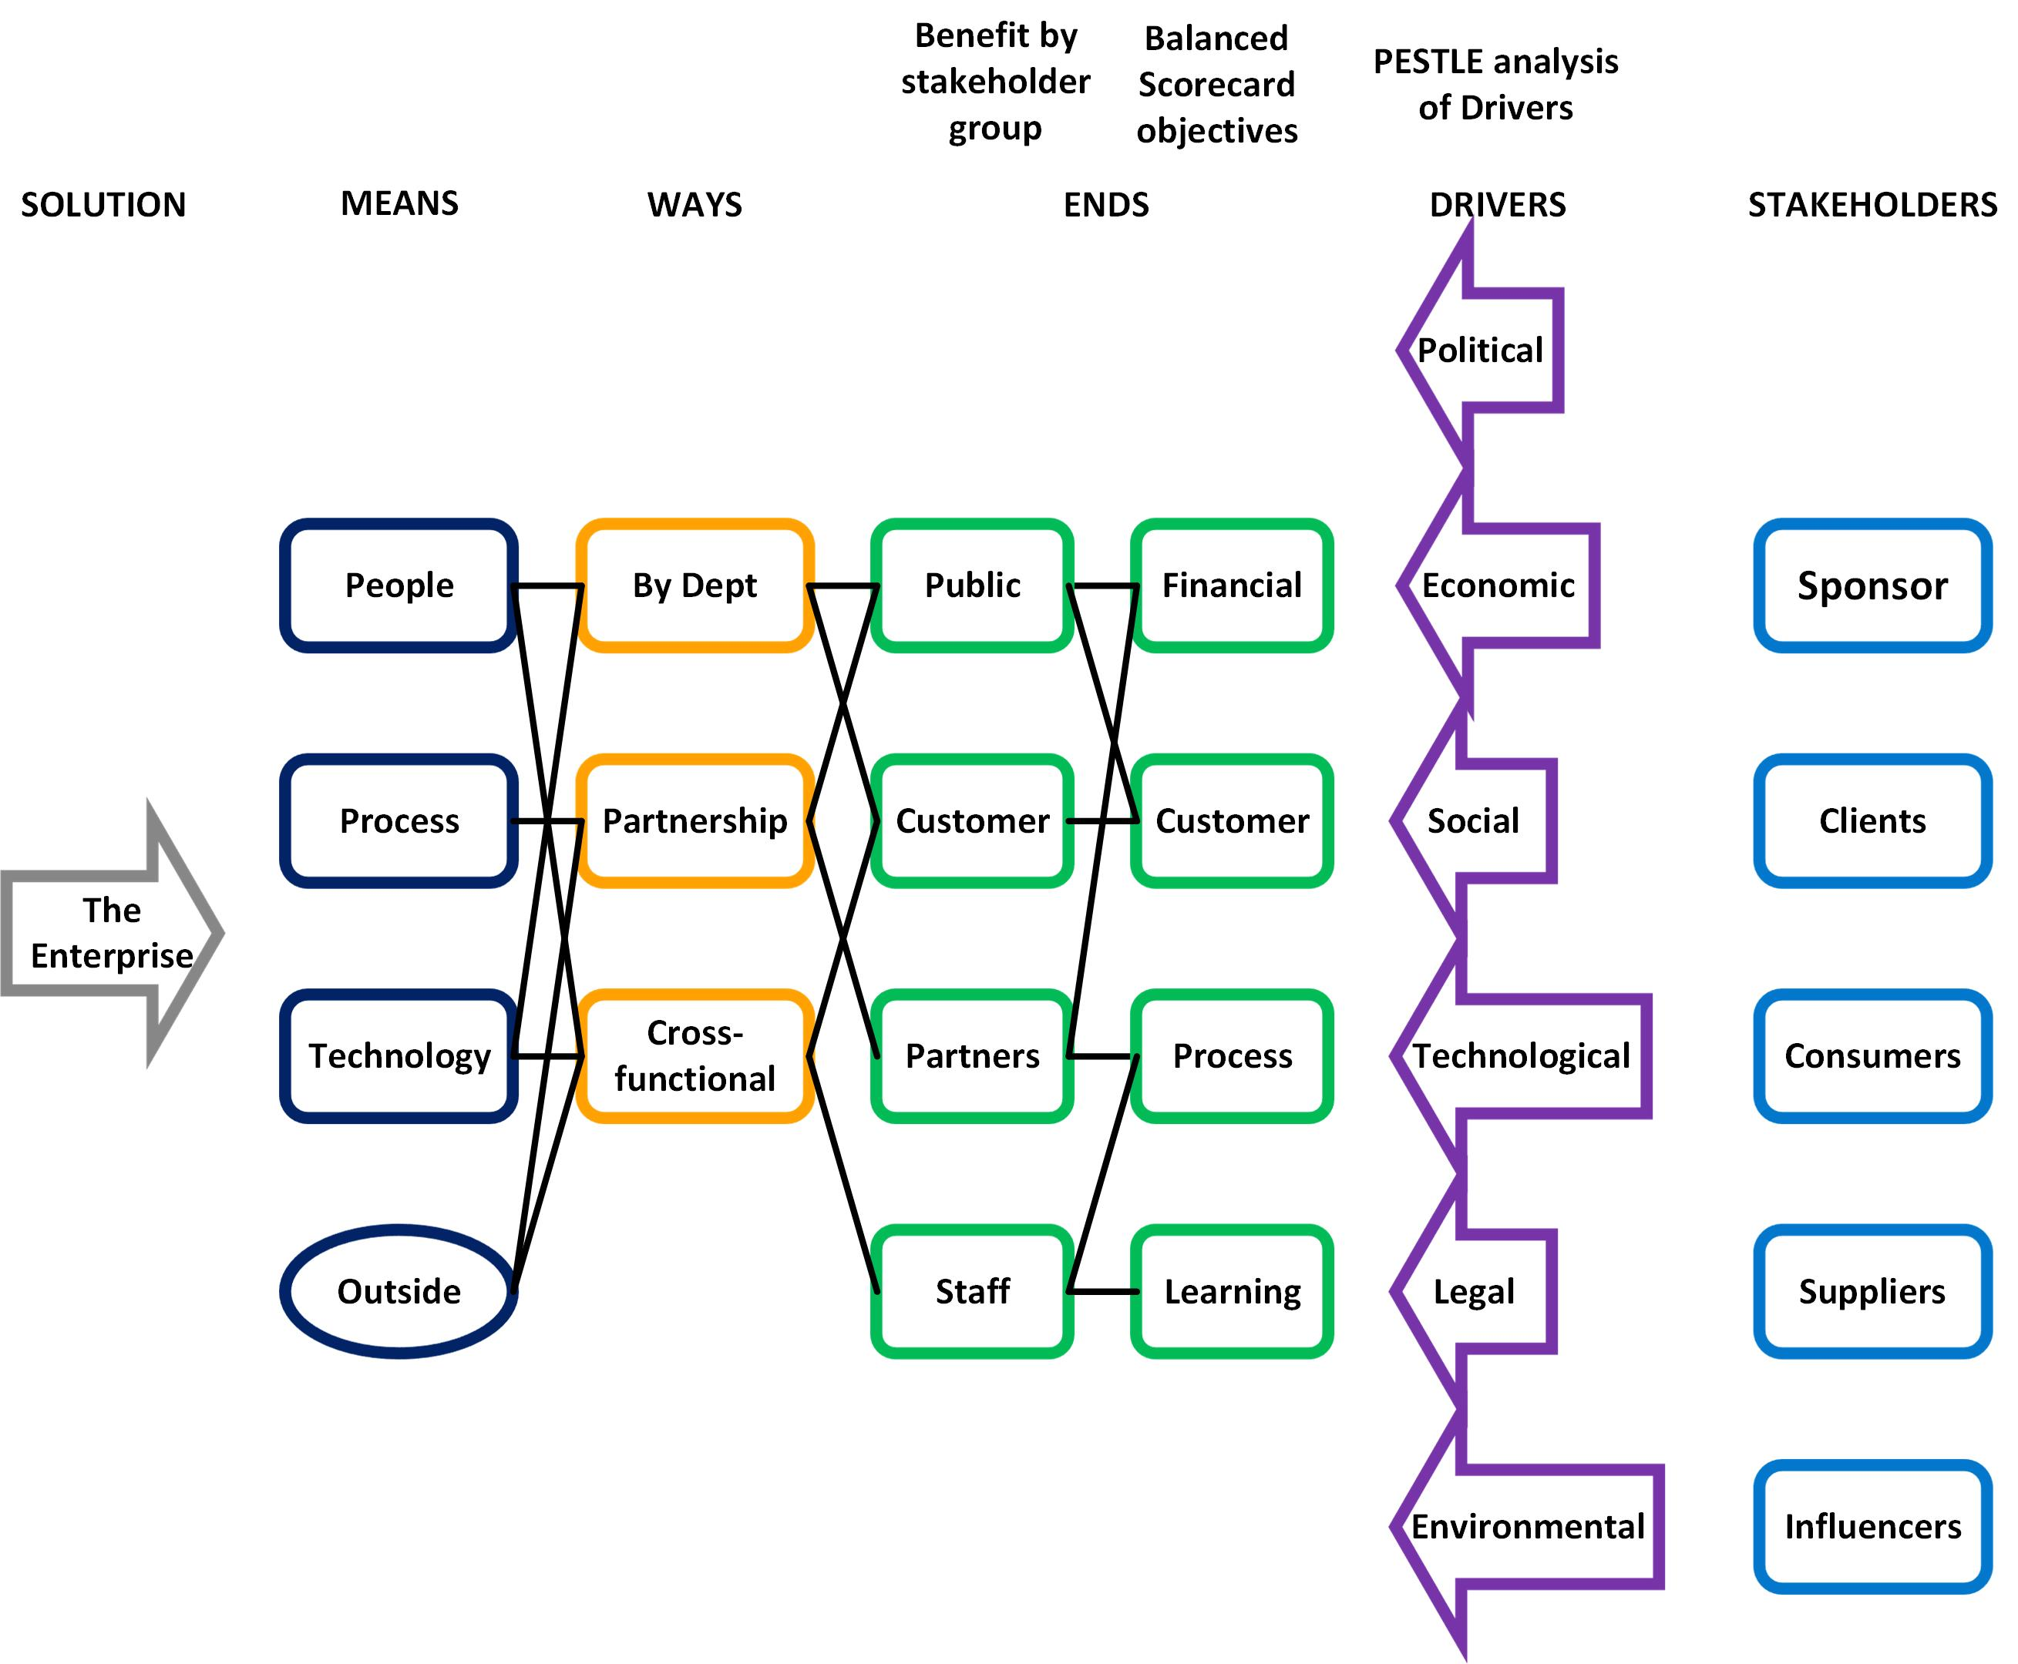
What is the business environment?
What does the organisation want?
Who gets the benefits?
What resources are used?
Notes:
In this generic example we have categories of stakeholder The Sponsor is the person / entity who wants the project, the ultimate customer. They permit it to happen so everyone else’s benefits depend on them. Clients pay for the project. They may not be the Consumers who use it, e.g. parents buying for their children, hospitals buying for their patients. Suppliers produce the goods and Influencers affect the project through the other stakeholders. They may have no active involvement in it at all.
The Drivers, the outside influences that make you act, fall into PESTLE categories. They don’t have to. It’s just a good way of analysing the context in which you have to operate.
Likewise, Objectives are split as per the Balanced Scorecard. Most objectives fit into quality of service, quantity of service, customer experience and finance.
Benefits are split by stakeholder. There is one stakeholder per benefit. If X is a benefit to customers and staff then X is two benefits. More likely, X isn’t a benefit at all but an enabler or outcome, something to be used to deliver benefits.
Activities may be in silos or multi-agent. They can be as simple as one step in a process or as complex as public-private partnerships.
Change managers split enablers into people, process, technology. Economists may use land, labour, capital, enterprise.
You don’t work in a vacuum so there’s bound to be some outside dependencies to consider as well.
These are all just tidy ways to help you break down your organisation in a logical manner. They are not mandatory but they do help.
Have a try at one of these for your own organisation. They are much more fun to play with than just look at.

Slide 15
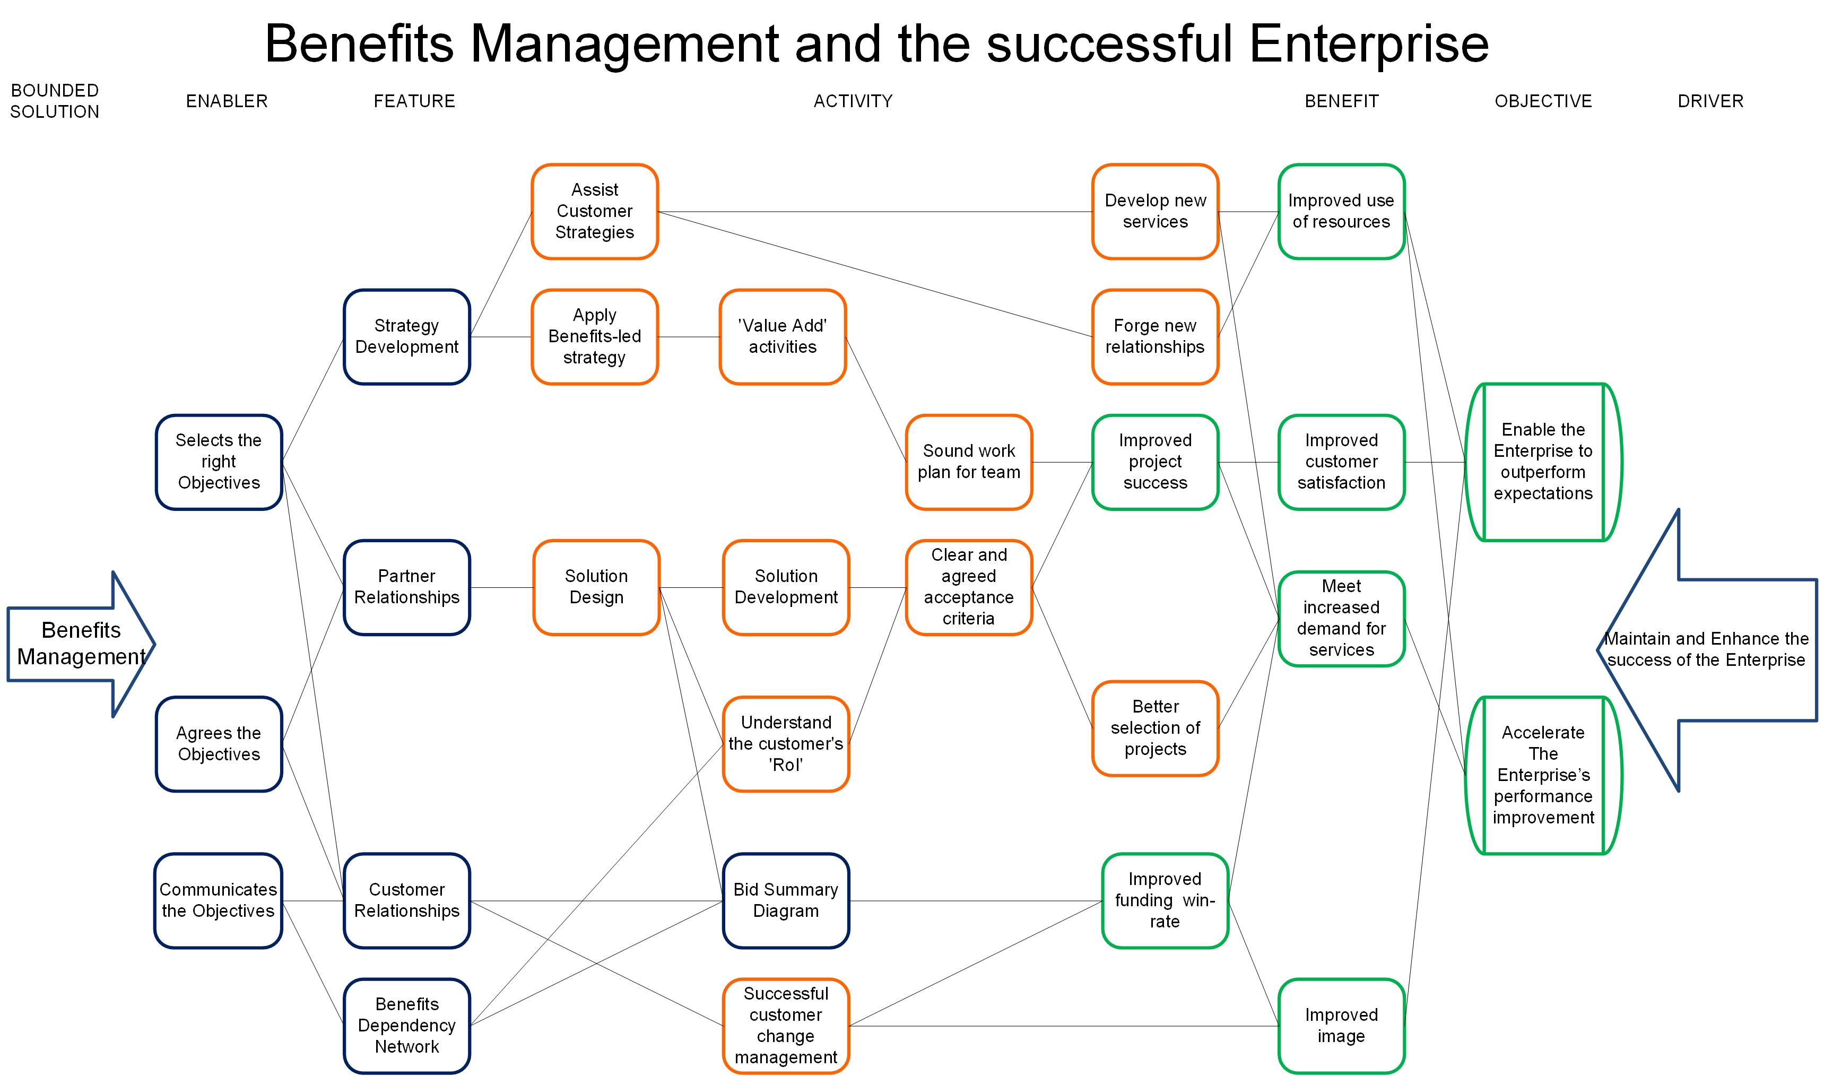
Notes:
Remember the Venn diagram at the start? Here’s how it looks as a BDN for a generic enterprise.

Slide 16
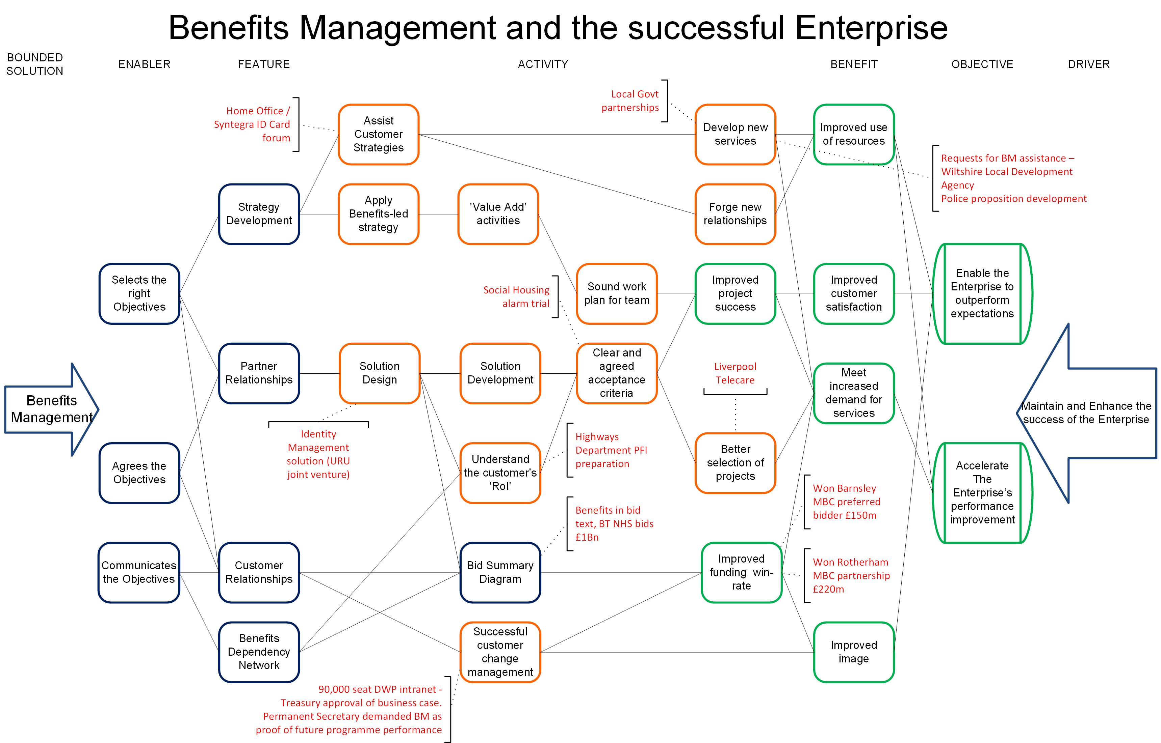
Notes:
And here are some practical examples of how it worked. Most of the examples are from jobs in the public sector. The principles apply just as well in the private sector.

Slide 17
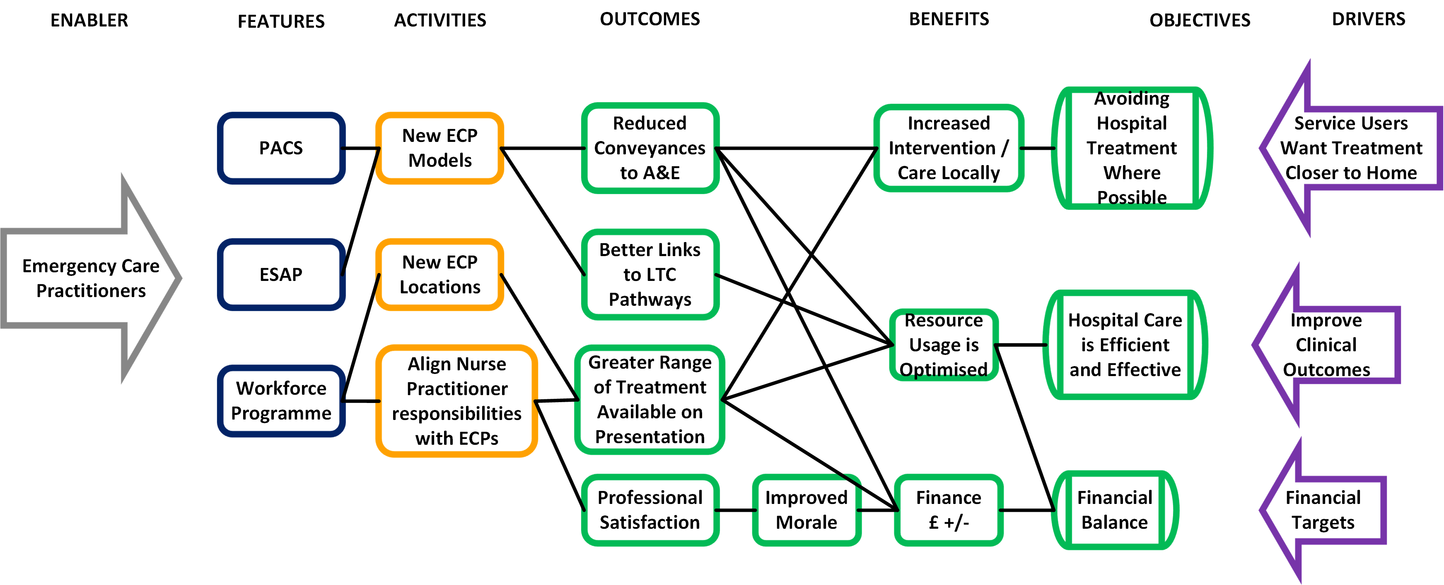
This is manageable
Notes:
If time allows, a little more detail on the practical BDN.
Here’s a hypothetical example, based on an NHS transformational change programme, March 06.
The objectives are pretty generic and represent the high-level stakeholder groups of patients, policy makers and the organisation itself. All the connections are made. There are no dead-ends in the diagram so everything has a purpose and contributes to the objective to some extent. The diagram starts the discussion about the relative contributions and allows decisions to be made about priorities and allocating resources.
This is manageable, a feasible amount of activity delivers selected benefits that are directly connected to the organisation’s objectives.

Slide 18
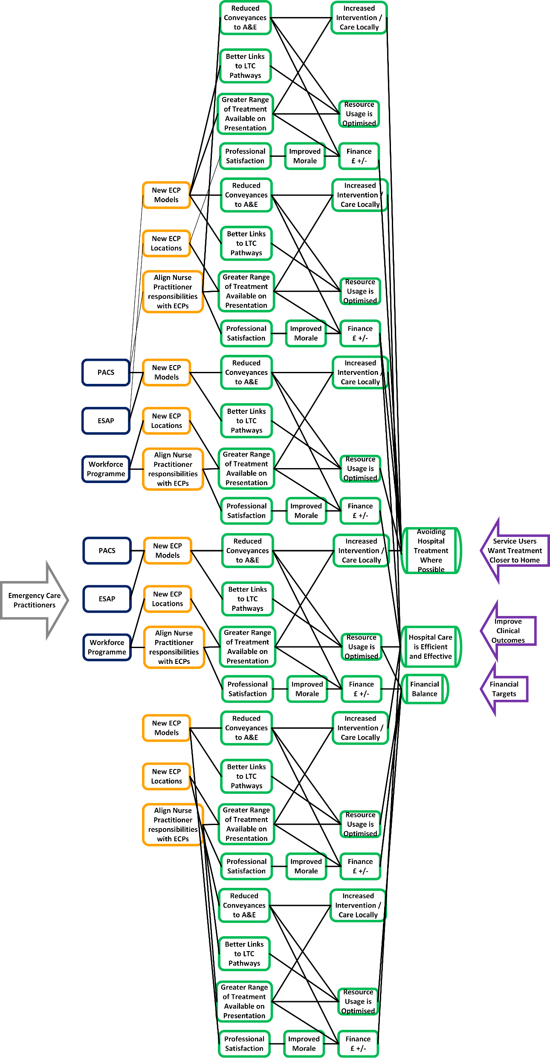
This is not
Notes:
Imagine that the programme had chosen 50 benefits instead of 3. Life gets much more complex here. Many business cases get drafted on the basis of quantity, not quality. The more benefits you put in, the more likely you are to be picked from the pack of competing business cases. Delivery is another matter though. Once you take the table of benefits out of the business case and map it you begin to see how impractical your project is.

Slide 19
Observations
Lack of radical change
SMART implies small - strategic objectives get de-scoped
BM to validate / justify existing plans
Inappropriate benefits
BDN helps rationalisation
The amount of activity required to deliver each benefit
The validity of projects mapped to strategic objectives
Re-defined objectives
Iteration works
Notes:
Things we’ve seen before.
1. Specific – Objectives should specify what they want to achieve.
2. Measurable – You should be able to measure whether you are meeting the objectives or not.
3. Achievable - Are the objectives you set, achievable and attainable?
4. Realistic – Can you realistically achieve the objectives with the resources you have?
5. Time – When do you want to achieve the set objectives?
One area of confusion was the definition of objective, benefit and outcome. The same item could be phrased to fit any of the three categories so the significance of the differences wasn’t fully grasped. Applying SMART principle to the objectives encouraged people to narrow them down to tactical outcomes. Just because something should be measurable and timely doesn’t mean it should be a short-term cost saving.
This is vital to get right. We do too much without fully grasping the reasons why we are doing it. It opens up whole debates about governance and leadership.
Other teams simply used the method to validate or justify their existing plans. One programme came up with 23 plans and connected them to 13 benefits. The first draft of another plan had 35 objectives, all of the nature, implement project 1, project 2, etc.
Sometimes the benefits are inappropriate. There are some ‘usual suspects’ that crop up every time, no matter what the project is about, e.g. improve patient care. Sometimes a limiting factor is turned round into a benefit. A workshop on Junior doctors’ working hours had a factor of no detriment to patient care. In two sentences this had become a benefit of improving patient care, an un-necessary potential burden on the project.
There was some degree of rationalisation though. A great strength of the BDN is that it shows just how much change effort is going to be needed to deliver the selected benefits. The more benefits, the much more effort.
It provided evidence to stop the projects which didn’t link into priority objectives and indeed one LHC had benefits which did not link into the objective, this was a very powerful message.
Iteration works, the third pass will look much better than the first one.

Slide 20
Comments?

Slide 21

BENEFIT OF
EXPERIENCE
david.waller@keldale.com
@benexperience

