Slide 1
After the dust has settled
Managing benefits in the long-term

Slide 2
How it was – Tech Fund Drugs Cabinets
Short window to bid for funds
2.4 :1VfM ratio promised
Short window to spend
Long-term reporting to a standard template
Notes:
Here’s a hypothetical example Bruddersford intelligent drugs cabinets.
A national IT investment exercise. Trusts bid for matched funding from a central pot. Though people knew it was coming, the details weren’t known until shortly before the deadline. “What’s that project we couldn’t afford? Quick, knock up a business case.”
Pitched to the Approvals Cttee, promised to meet RoI target. Got selected as one of around 200 winners.
Had to spend the cash by FY end.
Benefits to be reported quarterly from Day One to the national fund. Central team with regional patches to manage. Assess benefits forecast, assure benefits realised. Limited numbers, limited influence, very limited sanctions (could hardly ask for the money back, maybe threaten to turn you down next time). No-one at the Trust was interested, too busy with their day-jobs.

Slide 3
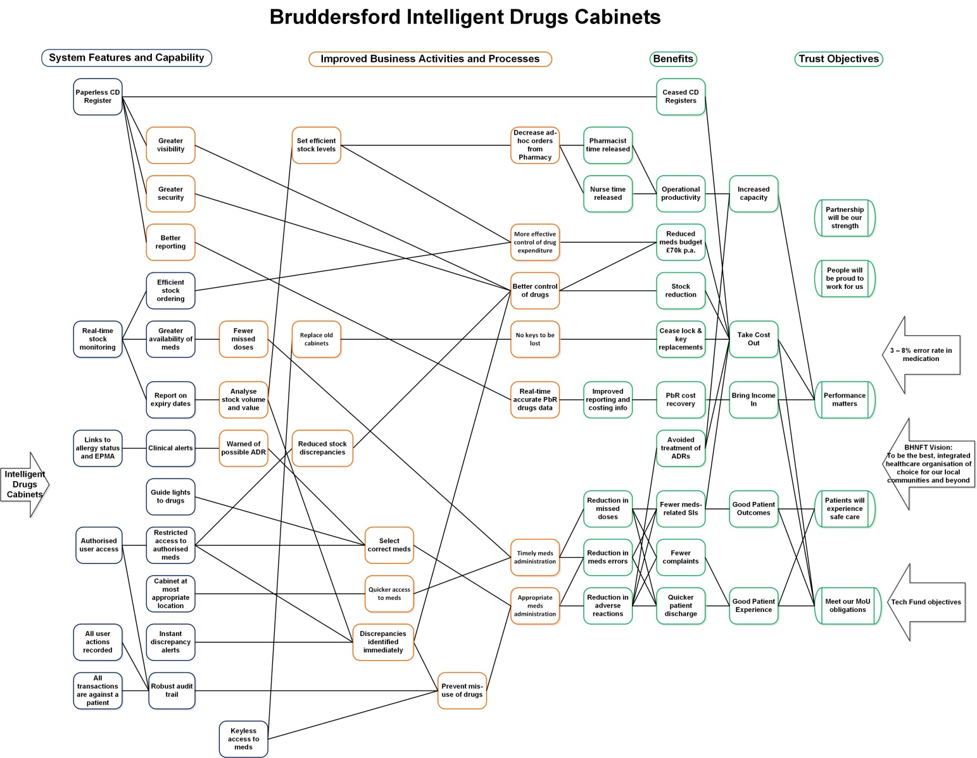
Notes:
BDN drawn up after the event. Show the image for detail.
This was done because the central team were chasing progress 6 mths after proposed go-live. The original business case wasn’t quite so detailed or logical. “It will save 667 hrs/ ward which is £100k”, suggests that the £100k came first.
Casual meeting, “You’re doing benefits at Bruddersford, what’s happening with the drugs cabinets?”, led to me reviewing it from scratch.

Slide 4
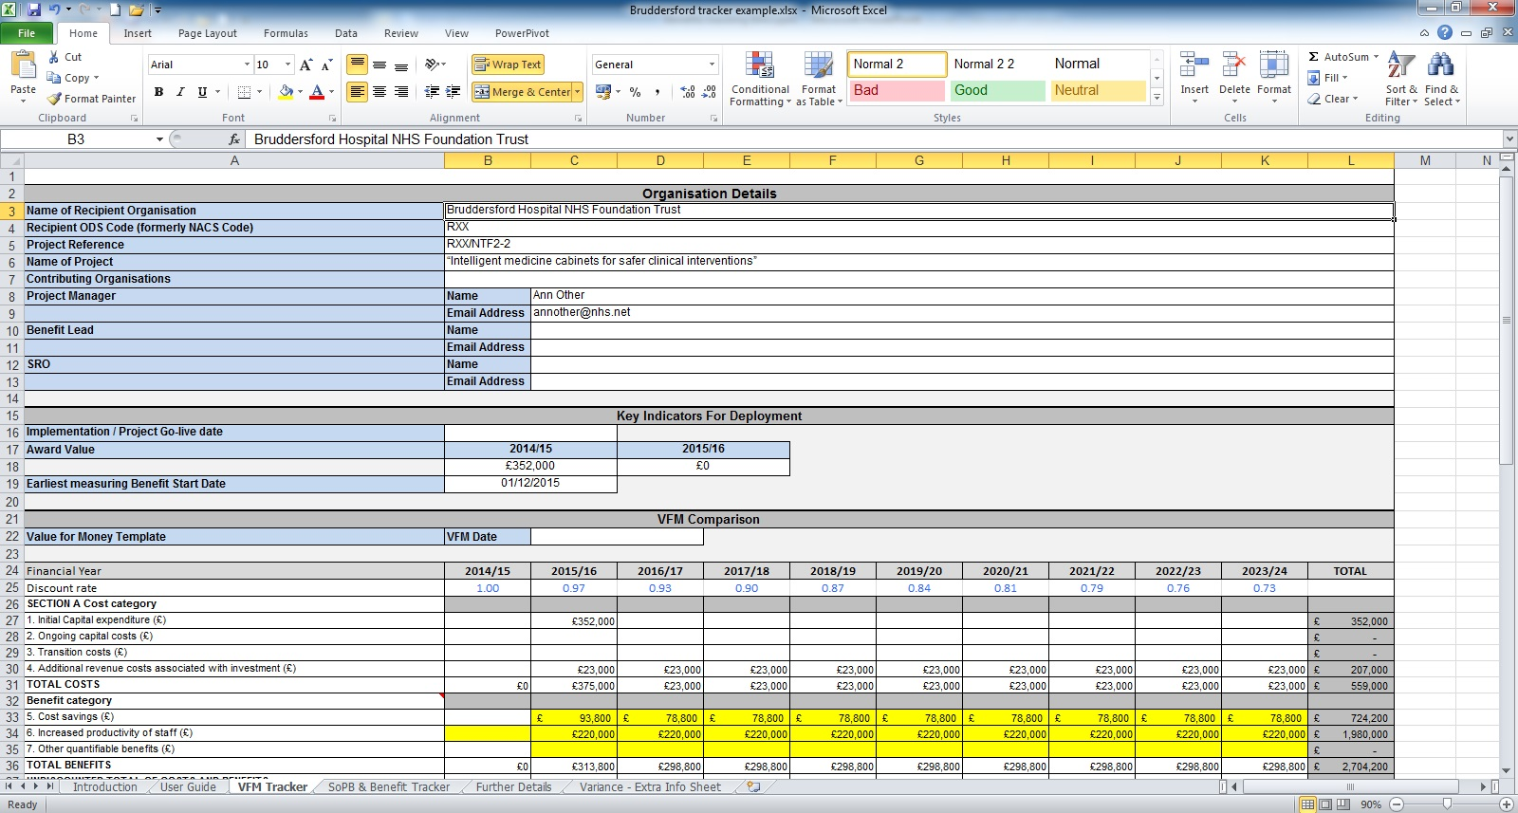
Notes:
Screenshot of the tracker. Show the spreadsheet.
Benefits to be tracked over 10 years.

Slide 5
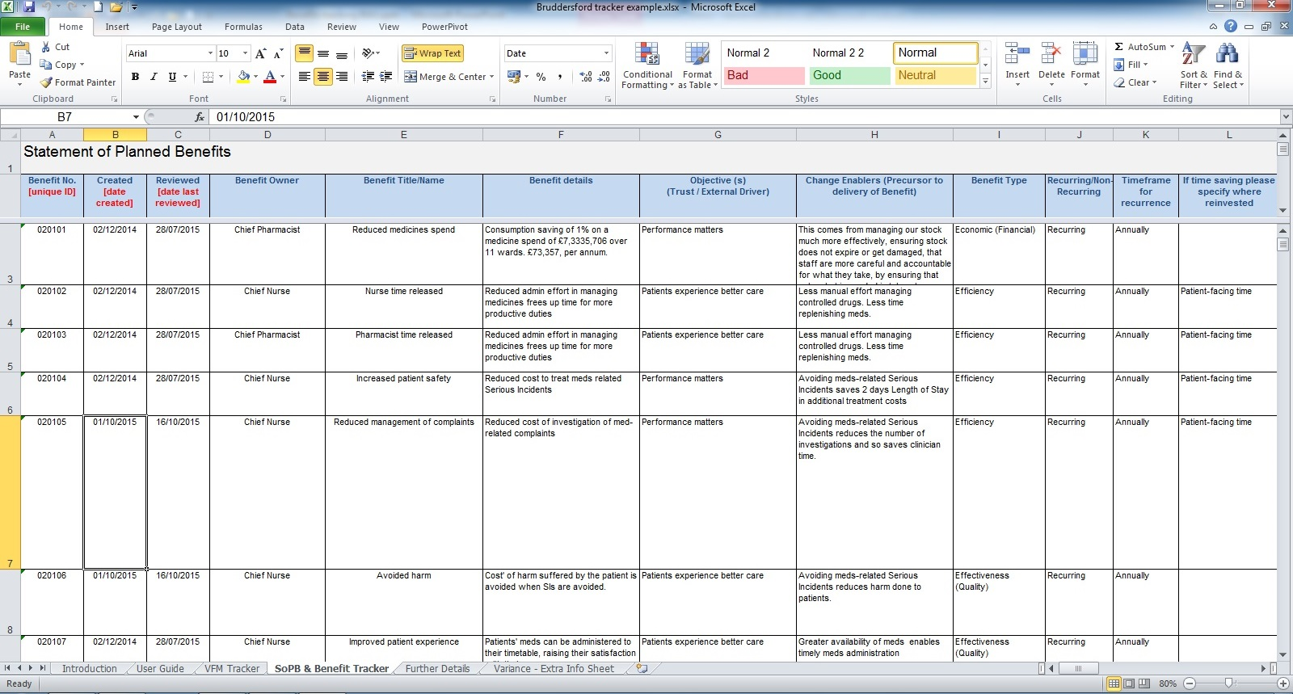
Notes:
The sort of benefit to be realised from the project.
Time released to other tasks. The original £100k got corrected for the wage rate but still kept the expected 667 hours / ward, still not a perfect benefit.
Patient safety and Patient experience, both converted to money values.
No more locksmith’s bills (the easiest to measure at first sight, scarily close to being the main reason for the project).

Slide 6
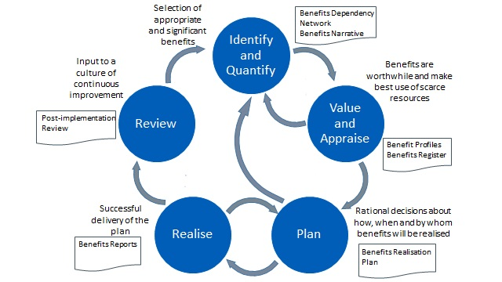
How it could be
Plan for BAU, a clean handover?
Use of existing KPIs, keep it cheap
Iterative process, use what you learn
Notes:
Old projects ended when the kit was switched on.
Present projects have Business Change Managers and end when the transition has been made to BAU.
Agile ones go on forever in incremental improvements. What about the incremental benefits? Agile BM is a subject for another day (possibly Napier BM group?)
We plan for transition in that the Project Board may become the Service Board. We miss the detail of how they will actually manage the service in the long run.
Handover – the Big Issue here
Project creates a new service that is fit for purpose. Its performance limits and capabilities are known and agreed by the business that takes it on. The business is then responsible for running the new service at this agreed performance.
So, what’s a better alternative than the 10 year benefits tracking?
Use existing measures where possible and appropriate. Don’t create a new empire of measurers.
The diagram, my take on the APMG five stages.
Assurance is the process of monitoring progress towards benefits realisation and taking corrective action to keep on target. Benefits assurance should take equal priority with the project’s technical quality assurance. Indeed, there is a strong argument for it to be higher.
When designing the measurement work packages, look for some commonality across the benefits. Seek to avoid un-necessary work by bundling the measures that use the same Key Performance Indicators (KPIs), are collected by the same person or occur at the same time. As I’ve already said, keep it cheap.
BM is an iterative process so use what you learn. In the Realise stage you run performance management reports, the ‘so far, so good’ stuff that keeps you on track. In the Review, these become the lessons learned, ‘what can we do next?’ sort of thing.

Slide 7
Hurdles
Duration of benefits
On-going ownership / accountability
  Who’s it really for? What do they actually want?
Time & effort
Quality control
Carrots & sticks
Notes:
Why isn’t this easy?
Duration of benefits, less concrete than depreciation of assets. Wear and tear reduces asset value. Dep’n is like putting money aside to replace the old kit. You can’t depreciate a benefit in the same way. They retain their value until supplanted by something better.
A benefit is a benefit while its owner says it is. You could say it gets measured as long as someone with sufficient clout wants it measured. When they’ve lost interest, stop. From an audit point of view, you might have to remind them of their responsibilities and why they ought to stay interested.
This brings me back to the handover. Two of the dumb questions for every project are “Who’s it really for? What do they actually want?” An internally funded project can hand over neatly to BAU. Once there are external stakeholders then we have to give them what they want. In a commercial world, again it’s relatively easy. You just pay back the bank loan, or hand over the dividend. In the public sector, your external investor wants evidence that they have spent public money wisely. That’s why we end up tracking benefits every quarter for ten years. We need to think this through properly and come up with a better way.
Time and effort, the big issue. The cost of measurement has to be outweighed by the potential loss if it didn’t happen. If you are just observing a well-oiled machine churning out the goods then the measurement cost is too high to justify. However, if everyone downs tools when your back is turned then it pays to keep watching them.
If tracking is a tick-box exercise then quality will be doubtful. The bosses have lost interest and the reports are just being produced by one side and filed by the other then they become an un-necessary expense.
Which brings me to carrots and sticks. How do we keep the right people interested? Tracking ought to provide input to future decisions. So what intrinsic and concrete motivations can we apply to keep tracking and management relevant and useful? Memoranda of Understanding look impressive but aren’t much use if they are not enforced. Sanctions are likely to hurt the wrong people, fine the Authority and it’s the citizens who feel the cuts. Find a way to price up the tracking exercise in the business case so the time and effort are justified with a worthwhile RoI of their own (easier said than done).

Slide 8
Benefits Measurement Plan
The Measurement Plan records and reports on the progress towards benefits realisation.
A benefits driven approach focuses on measuring and tracking the progress of benefits realised, rather than project activity.
A benefit cannot be claimed if there is no proof that it has occurred.
Notes:
If time allows, a formal method from BM. Measurement Plan developed from Cranfield.
A benefits driven approach focuses on measuring and tracking the progress of benefits realised, rather than project activity, to ensure that projects achieve what they set out to do. Benefits must be measured (or at the very least observed) if they are to be realised. The Benefits Measurement Plan will identify the measurement tasks to be carried out, when they should be able to demonstrate a benefit is being realised and when benefits reviews should be conducted.
This Measurement Plan maps onto the Prince2 process CS2 Assessing Progress and the role(s) of project assurance.
A benefit cannot be claimed if there is no proof that it has occurred. The Measurement Plan records and reports on the progress towards benefits realisation. It starts by collating all the measurement fields from the benefits profiles. These are then sorted into common categories and expanded with more detailed measurement requirements and activity.

Slide 9
Measurement Profile
Benefit Identifier
Benefit Owner
Predicted value
Delivery timescale
Measurement Dependency
Baseline measurement
Outcome Measures:
Outcome used as lead indicator (Y/N)?
Measurement Process
Trigger Event
Collection Frequency
Collection Timescale
Collector
Data Storage
Reports
Benefit Measures:
Measurement Process
Trigger Event
Collection Frequency
Collection Timescale
Collector
Data Storage
Reports
Notes:
Measurement Profile
This is a separate document from the Benefit Profile.
Benefit Identifier (unique ref no. or short description from BDN)
Benefit Owner
Predicted value
Delivery timescale
Measurement Dependency (pre-conditions for measurement, e.g. ethics committee approval)
Baseline measurement (if one needs to be made)
Outcome Measures:
Outcome used as lead indicator (Y/N)?
Measurement Process (the type of measurement to be carried out, e.g. system report, process review or stakeholder survey)
Trigger Event (what will determine when the measurement should begin, e.g. system go-live, start of new Financial Year)
Collection Frequency (how often data is to be collected)
Collection Timescale (how long the measurements should be made)
Collector (who will be responsible for collecting and storing the data)
Data Storage (how the results of the measurement will be collected and stored)
Reports (how reports are produced, who receives them and the actions they should take)
Benefit Measures:
Measurement Process (the type of measurement to be carried out, e.g. system report, process review or stakeholder survey)
Trigger Event (what will determine when the measurement should begin, e.g. system go-live, start of new Financial Year)
Collection Frequency (how often data is to be collected)
Collection Timescale (how long the measurements should be made)
Collector (who will be responsible for collecting and storing the data)
Data Storage (how the results of the measurement will be collected and stored
Reports (how reports are produced, who receives them and the actions they should take)

Slide 10
Appropriate Measures
Relevance
Causality
Cost of Measurement
    Andy Neely, Measuring Business Performance,1998
Notes:
Andy Neely (Measuring Business Performance, The Economist Books, 1998)
The chosen measure must be relevant to the situation.
It must have a reasonable degree of causality. The business changes you make must have some impact on the item being measured.
The cost of measurement in time and resources must be reasonable. There’s no point in re-investing all your savings into a measurement process.

Slide 11
Reasons for measurement
Check Position
Communicate Position
Confirm Priorities
Compel Progress
Notes:
Andy Neely has 4 CPs of measurement:
Check Position – see where you are
Communicate Position – tell the right people where you are
Confirm Priorities – make sure you are choosing the right things to do
Compel Progress – make sure people are actually doing them

Slide 12
Roles of measurement
Comply
Check
Challenge
Notes:
He also has 3 roles of measurement:
Comply – make sure you are meeting your legal and mandatory obligations
Check – look at the organisation’s state of health
Challenge – test your strategies

Slide 13
Potential for Further Benefits
Benefits Management is an iterative process
Post Project Review after a suitable bedding-in period of live service
Questions:
  What effects have we now got, relative to the previous situation?
  Are we getting the benefits?
  What further benefits can we now get?
  What further actions are necessary to get the potential benefits?
The output from the review is the input to the next round of benefits identification
Notes:
Remember that Benefits Management is an iterative process. See what is being delivered, review and adapt as circumstances dictate. Look to improve on what has gone before.
A benefits orientated post project review should be performed after a suitable bedding-in period of live service. The review will report on the benefits that were actually delivered compared with the proposed benefits in the realisation plan.
Questions that should be asked include:
What effects have we now got, relative to the previous situation?
Are we getting the benefits?
What further benefits can we now get?
What further actions are necessary to get the potential benefits?
The output from the review is a report on potential future benefits to be used as input to the next round of benefits identification.

Slide 14
Discussion

