Slide 1




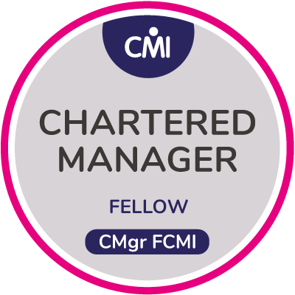

The Benefits Club
Not the sort you can join
“They’ll be using Benefits as a weapon next!”
Notes:
I overheard a throw-away remark at a CIO conference: “They’ll be using Benefits as a weapon next!” and it inspired me.
Times are hard and the competition is after your lunch, so bring out the BM Club. Today, I’m pitching Benefits Management in a world of competition and cost cutting. Times are hard, money is tight and the world isn’t as friendly as it once was. You’ve got to cope with this. Everyone else has to cope with it. And the way they cope is not going to be in your best interests. This applies whether you are their customer or their competitor, and whether they’re inside your organisation or not.
Today is about your benefits, selfish Benefits Management.
I’ll talk about BM as we’re all familiar with it. But I’m going to overlay it with some war-story analogies that I picked up years ago when I briefly worked in sales (Siebel Systems Inc. Target Account Selling c.2000). When your product is dull (and most products are), you need some glamour to motivate you. That’s why stereotypical salesMEN go for the ruthless competition, sales as Special Forces daydream. It’s what keeps Paintpall parks open.
Trigger Alert:
We are only talking analogies here, I’m not proposing you physically hurt anyone with your benefits. However, the following slides do contain metaphors, similes and imagined scenes of violence that may offend anyone under the age of 50, not brought up in a house full of Airfix kits and Commando comics.

Slide 2
Why this matters
“There is nothing in the world that some men cannot make a little worse and sell a little cheaper, and he who considers price only is that man’s lawful prey.”
  John Ruskin
Notes:
For all the talk about being benefits-led, there’s still a lot of this going round. It’s an argument that you still have to fight against when it comes to project selection.

Slide 3
Machiavelli’s Observation
…And one should bear in mind that there is nothing more difficult to execute, nor more dubious of success, nor more dangerous to administer than to introduce a new order of things; for he who introduces it has all those who profit from the old order as his enemies, and he has only lukewarm allies in all those who might profit from the new.
Notes:
3
When it comes to project implementation, there’s another thing to consider.
The Project Manager’s Excuse.
This used to get quoted by every project manager’s presentation. It’s old but it still gets rolled out occasionally.
What they don’t tell you is that Machiavelli had the answer.

Slide 4

Machiavelli’s Solution
Besides what has been said, people are fickle by nature; and it is simple to convince them of something but difficult to hold them in that conviction; and therefore, affairs should be managed in such a way that when they no longer believe, they can be made to believe by force.
Chap VI, The Prince - Niccolo Machiavelli (trans: Bondanella & Musa, OUP 1979)
Alternatively, it helps if that conviction has a sound and rational basis.
Benefits Management is good for this
Notes:
No-one ever mentions Machiavelli’s solution.
This is why you need a club.
These days you can’t bribe the corrupt and slaughter the rest. You need to be more subtle. If you want to hold people in their conviction, then it helps if that conviction has a sound and rational basis. Benefits is good for this.

Slide 5
Six dumb questions that deserve smart answers
What does ‘good’ look like?
What’s the point of this change?
Who is it really for?
What do they actually want?
How do we get this done?
What makes this option better than Plan B?
Notes:
You have to understand where you are. So, thinking about the end in mind, here’s a BM way to think about your projects.
At first glance, it all looks a bit naïve. The answers are going to be obvious, aren’t they? Probably not. We could be in Emperor’s new clothes territory here. No-one wants to be first to admit that all they see is a naked idiot. Or maybe he really is immaculately dressed but no-one can quite describe what his suit looks like.
Go get a BA to review your favourite project and answer these questions, one ppt slide each. What would the answers look like?
Naïve questions
1. What does ‘good’ look like here?
Before you start, know your key measures and how things stand now. Be able to tell if things are getting better and by how much. How do you know you are doing a better job this week than you did last week? All in a context of knowing what good looks like, what are the KPIs? What’s your business context – the market, your competitors?
2. What’s the point of this change? Sum up in two simple sentences what your project will deliver and why it’s a good idea. Remember, the reasons why we do stuff affect the way we do it.
Can you summarise it in a way that’s quickly and easily understood? Once it is easily understood, does it sound like a good idea?
3. Who is it really for? Who are the appropriate stakeholders? Who wants the change? Who controls how it will happen? Who gets the benefits?
4. What do they actually want? What do your stakeholders want? What do they think is valuable? What do you think is feasible?
5. How do we get this done? What resources (time, money, skill, etc.) can we use? What’s the organisation structure, governance and assurance that means things are done well?
6. What makes this option better than Plan B? What’s it worth? Why is this change the best option to take? Why is it the best use of your scarce resources?

Slide 6


Purpose of BM – Enterprise level
Fairness in a competitive world – investments are chosen on merit, when you need a club of your own
Raising the bar – better choices for better reasons
  Market research, don’t make what no-one wants
  Personal satisfaction in your work
  Confidence in the work around you, the best job won
Keeping us honest – maintaining the fairness between investments, the policeman’s truncheon
Notes:
Having set the scene, Let’s look at the purpose of BM at the top, the enterprise / organisation level.
First, fairness in a competitive world – investments are chosen on merit, not by who shouts loudest or whose turn it is next.
Raising the bar (your club) – better choices for better reasons, rational choices based on evidence and meeting sensible needs.
- Market research, don’t make what no-one wants
- Personal satisfaction in your work, You know you’re doing a good job
- Confidence in the work around you, the best job won, even when you lose to the competition, at least you know that you were beaten on merit.
Keeping us honest (the policeman’s truncheon) – maintaining the fairness between investments, assuring the on-going work is maintaining standards. The proposed benefits are proved to be genuine.

Slide 7
Objectives, of a sort
Deliver ‘Something’, there are no defined benefits and the outcomes are indicators of the ‘something’.
Deliver ‘Good’, the benefits are evidence or proxies of some intangible ‘good’.
Deliver the Shopping List. In this case the benefits and objective are the same thing.
Deliver Strategic Objectives, something big, important and probably intangible (not just a piece of kit).
Notes:
Every objective, however perverse, has a purpose that satisfies a stakeholder. There has to be something in it for someone. There are four crude types of objective
Objective 1 – Deliver ‘Something’, there are no defined benefits and the outcomes are indicators of the ‘something’. This could be appropriate when the project is to meet mandatory obligations or obey instructions from above. Or it could just be an example of poor objective setting. An example is eDischarge summaries from A&E, mandated in the NHS Standard Contract with no stated purpose.
Objective 2 – Deliver ‘Good’, the benefits are evidence or proxies of some intangible ‘good’. This is “Deliver the Vision” or “Deliver disruptive change”. Often, this is where we get lots of petty benefits that reward the players for taking part but don’t map to a coherent strategic objective.
Objective 3 –Deliver the Shopping List, in this case the benefits and objective are the same thing. This isn’t so much the General’s campaign map, more the Quartermasters’ requisitions for kit. For example, an SHA had 35 objectives, deliver Project 1, Project 2, etc.
Objective 4 – Deliver Strategic Objectives, something big, important and probably intangible (as opposed to kit and estate, provide the service, not build the clinic). The Benefits are contributions, evidence of action in support of the strategy.
By separating out the benefits from the strategy we affect the approach to objective setting, we’re determining the reasons why and so affecting how we do stuff.
Benefits as our club knocks our programme / project’s objectives into the right shape.
Benefits as the truncheon weeds out the bad objectives from the enterprise’s portfolio.

Slide 8
A benefits-led organisation
“Our goal is to improve health and social care in England by making better use of technology, data and information.”
  NHS Digital, Our Purpose
We achieve this through Benefits Management by:
Shared objectives
Stakeholder commitment to the numbers
A few big, genuine benefits
A feasible solution
Notes:
What does good look like? Here’s NHSD’s mission / vision. I quote this because NHSE didn’t have one when I looked.
Done well, Benefits Management provides a rational, consensus set of business decisions. The strength of Benefits Management is that it creates a compelling reason for the project sponsor / champion / stakeholders to act. A benefits-led project will have been chosen because it meets a valid business need with sound, agreed objectives. All the numbers in the business case will have been put there by the stakeholders with evidence to back them up and an owner committed to their delivery. As they are involved in delivery, it will be a manageable amount of change for a few big benefits
The links between the means, ways and ends (enabler to objective) are proved through the Benefits Map. There’s no implicit assumption along the lines of buy kit – get benefit. The cause – effect nets are visible and open to debate, and the solution is seen to be feasible.

Slide 9
Purpose of BM – Programme level
Optimisation
The purpose of the Benefits Management workstream is to optimise the contribution of the programme to the success of the enterprise.
It achieves this through the improvements it enables in efficient programme management, effective programme content and the selection of new programme initiatives.
Notes:
Purpose of programme level BM work - Optimisation
The purpose of the Benefits Management workstream is to optimise the contribution of the programme to the success of the enterprise. BM has benefits. If it doesn’t add value to your programme, then it’s not working right.
It achieves this through the improvements it enables in efficient programme management, effective programme content and the selection of new programme initiatives.
The visible outcomes from sound Benefits Management are:
Improved programme / project success
Successful business change management
Evidence of programme value
Use of appropriate resources
Building / enhancement of working relationships
Better selection of projects
Development of future initiatives

Slide 10

Handling competition - Offensive BM
Frontal
  Guard the flanks
Fight the FLAB
  Rational choice
Flanking
  Move the goal posts. Map the value they haven’t spotted
Fragment
  Break the job into the bits we can do and want to do
Notes:
Competitive Strategy
I expect we will have people here from service commissioners, providers and IT suppliers. Marketing and selling are things you all do to some degree. We all live in a competitive world and there’s stuff here that’s relevant even in the most right-on hipster collective, never mind the departments in a typical hospital.
Here’s a benefits slant on sales as warfare that I used in my previous (BT) life. I know this isn’t your sector but lets just go with the analogy for a bit. So, the Benefits Club, where can you use it?
Offensive BM, attacking BM, not rude BM.
Attack – Benefits as a rational argument to do your stuff.
Frontal
Your project is in a headlong charge, JFDI, no finesse. This is for the mandatory, cost effective stuff when they don’t care much about the benefits. If you are stuck on the sidelines, then keep an eye out for spoilers happening around you. Are there any similar competing projects that do have benefits? Do you have any currently unwanted benefits that you can pull out of your hat when reprioritisation strikes?
FLAB
The alternative to the benefits-led approach is most likely to be charismatic or visionary leadership, cynically summarised as Fantasy, Luck and Bull (FLAB). Pick a solution out of thin air, pray you’ll get away with it (or run before the chickens come home to roost) and flannel your way through in the meantime. E.G. Eden Project £56M on a Friday press release. The chances are, at least one of your competitors is trying this.
If you lack charisma, or possess, as Terry Pratchett described, charisn’tma then you need an objective with a sound purpose and benefits that are the right amount of the right stuff for the right people. If you don’t manage your benefits, you won’t get this.
Flanking
This means moving the goal posts, looking for new criteria on which the customer can decide. You have to look for the right issues and concentrate on the customer’s business value.
This is where BM comes into its own. The Benefits Map (Goal Model) is the ideal tool to determine what’s right and valuable for your client / sponsor.
The best way to use the map is in developing solutions is in partnership with the client, working through a series of iterations back and forth across the map until both sides have their optimum solution. However, it is still better than nothing if you have made it up from what you know and assume. Build up the right hand side, the objectives and benefits. It’s an excellent way to start a dialogue with your customer by asking them to give it a reality check.
Fragment
The whole opportunity may be too broad for us and we have to find the specific parts we are best placed to deliver. Draw the map from the right, see what features are needed to enable the business changes. Look for the features we can supply and concentrate on them. Consider partners to fill the gaps we can’t fill.

Slide 11
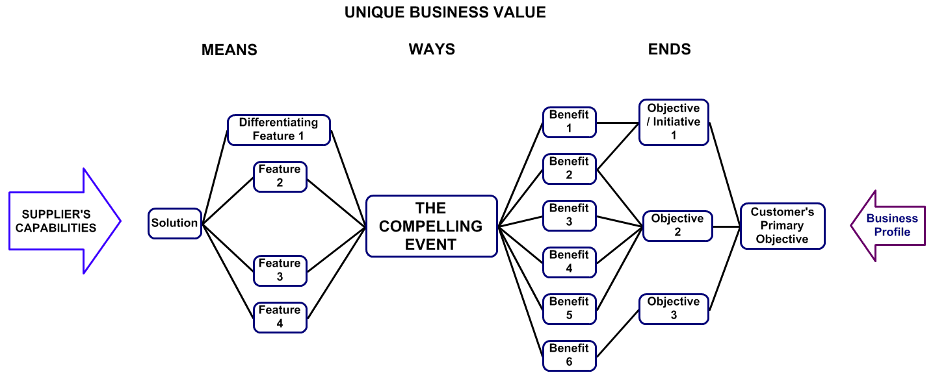
The Account Team’s Benefits Map
Notes:
This is Target Account Selling expressed in a benefits map. You have to know what your sponsor’s compelling event is (and they might not, themselves).
Make a solution that connects to what they want.

Slide 12


Defensive BM
Defend
  Relationship building, Benefits shows we’re the good guys
Develop
  Thought-leadership, Benefits shows we’re the smart guys
Notes:
You’re competing for scarce resources. Even the most non-commercial muesli-knitting social enterprise will have people inside and outside who want to eat your lunch.
Following on with the sales strategies:
Defend
Defence is about protecting existing relationships with your customer and keeping their contact with the competition to a minimum. One for the service providers and IT suppliers, after all, you are competing for work. The service commissioners and the researchers amongst you will be competing for funds. Think about this the next time government starts offering free money. This is where we need to look for win - win opportunities.
BM provides a good base on which to develop solutions with customers. Before work goes out to tender, we can be actively involved in defining the customer’s needs as we work with them to map solutions to objectives. This can take significant time and effort if done properly and the customer is unlikely to have the resources to duplicate this sort of exercise with our competitors. The required solution is going to have our flavour simply by our involvement in its definition. However, it will still be expressed in terms of customer benefits, meeting their objectives. It will be the solution they want to buy, not the one we want to sell. We should be at an advantage when the ITT is issued.
Develop
Maintaining and enhancing your presence with the customer involves leading their thoughts. You can give them something to keep their attention. A collaborative BM exercise is good for leading thoughts in high-level, blue-sky directions for the future. From a cynical point of view it can be used to delay a client’s decision by giving them a rigorous method to review their intentions. If you work through the process in a methodical manner there just may be time for us to come up with a competitive solution.

Slide 13
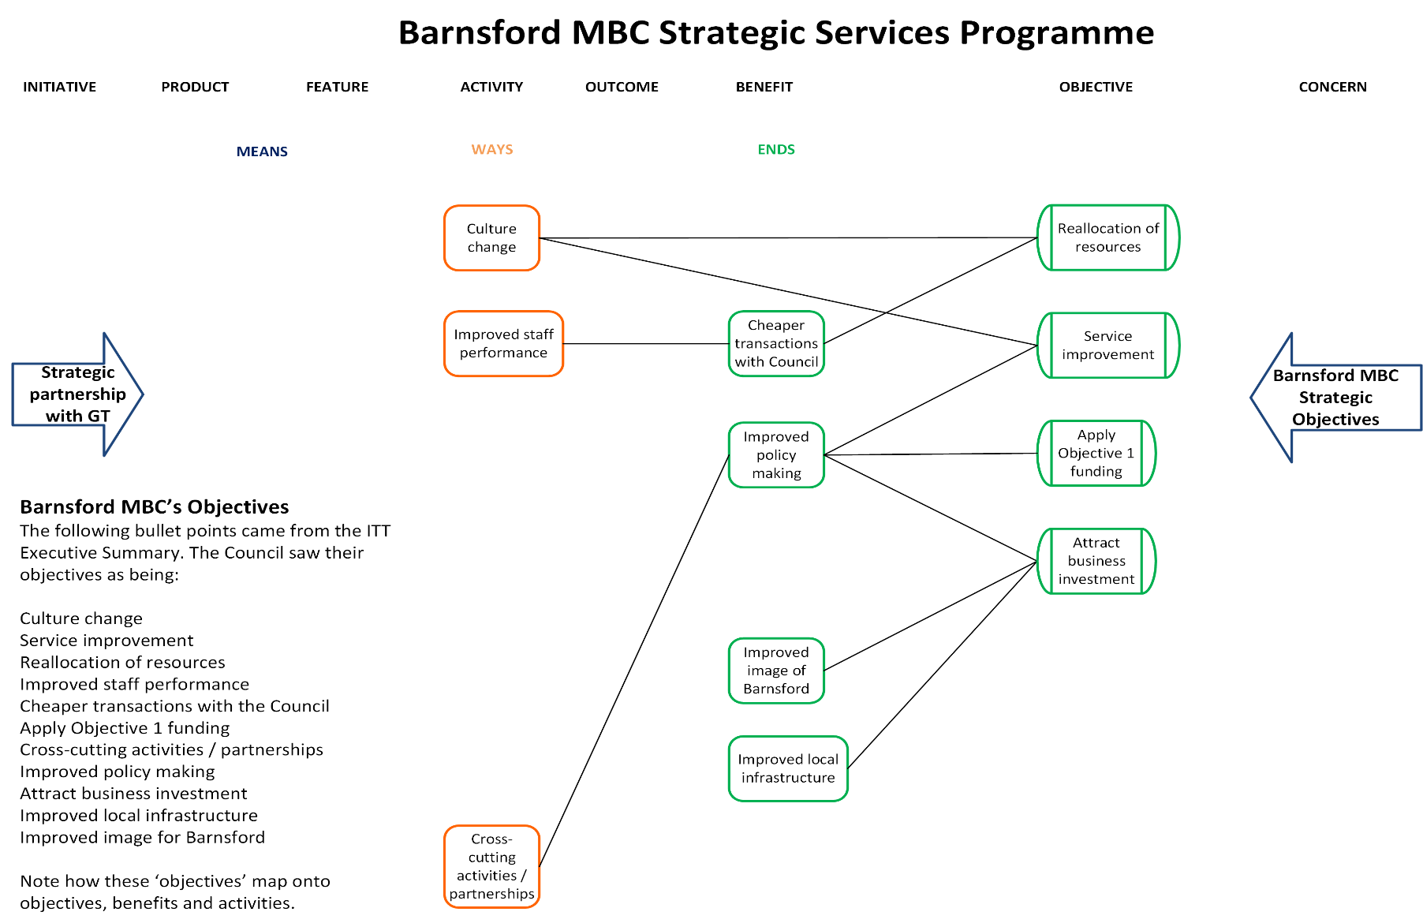
Notes:
An invitation to tender has its requirements in a list. They look much different in a map. The real objectives begin to stand out.

Slide 14
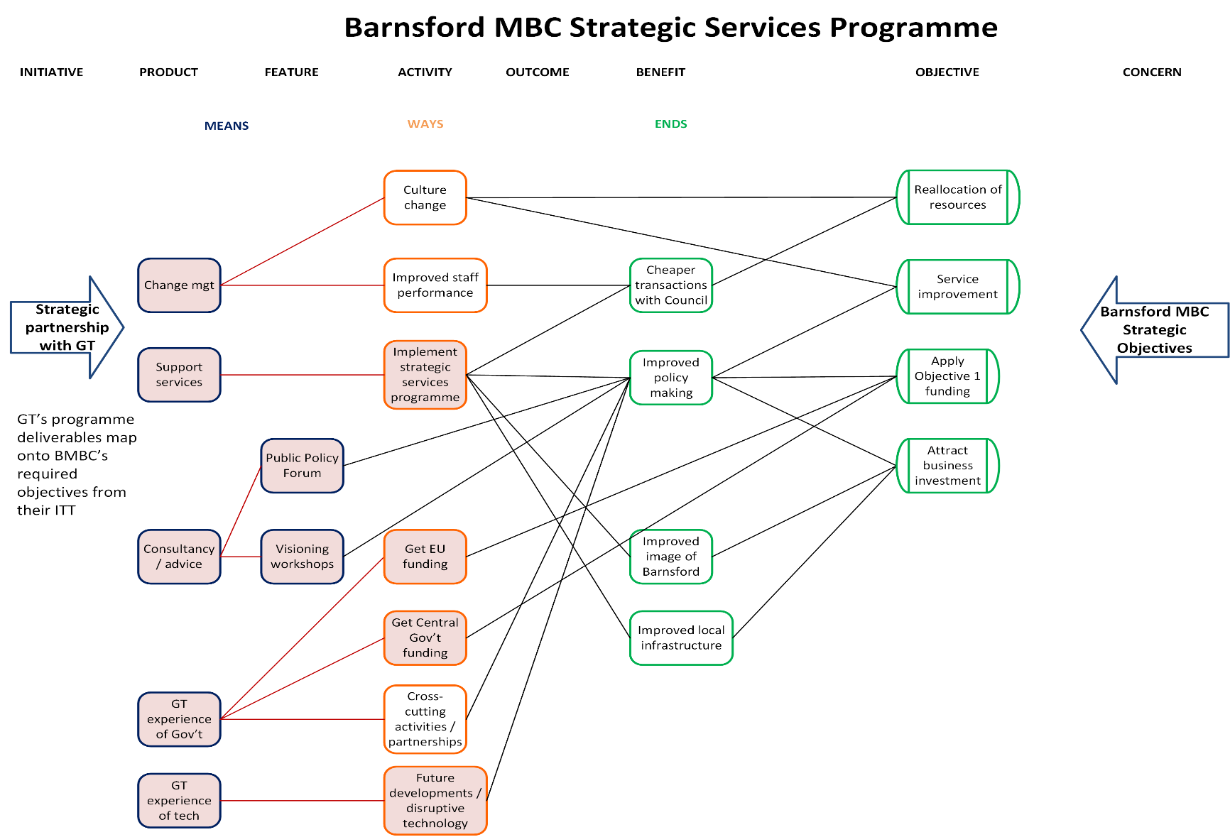
Notes:
And this is what the offered solution looks like. It fits like a jigsaw piece.

Slide 15

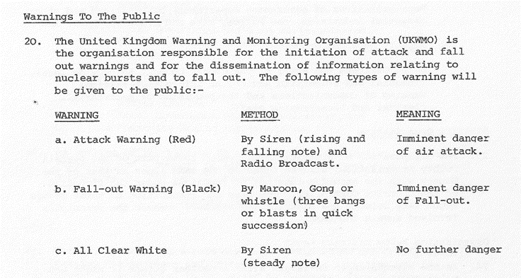
The Nuclear Option
“Go on, show me how your solution connects to my objectives.”
“Thank you and good night.”
Notes:
Benefits Management provides assurance tools.
Up front, before too much is spent, draw up the Benefits Map that shows the rational net of cause – effect between the proposed solution and the desired objectives. When the saleswoman is being a bit vague on how her whizzy piece of kit will meet your every need you can give her the flipchart pen and invite her to join the dots. If you don’t like the results, then she can leave.
In flight, once the sums obviously don’t add up then you pack up and go home. When it’s clear that you are not adding value but destroying it then you really have to stop what you’re doing.

Slide 16



Clearing up the misconceptions
Benefits Management is not really a club
“It’s not rocket science.” Well, actually…
It’s not new
I am not a sad old git with a clipboard
Benefits Management is not a Silver Bullet
Notes:
Finally, let’s clear up any misunderstandings. Just because everyone’s talking ‘benefits’ these days doesn’t mean everything’s sorted. Unless something changed radically in the past two years, NHS senior managers have a very poor awareness of BM and what it can do for them. I suspect other bodies are similar. You should go out and sell BM to your bosses. And I know that I should have done more about it when I had the chance.
1.) For all I’ve said previously about clubs and truncheons, BM is not a club unless we choose to use it as such. If you think you’re being beaten with a club labelled ‘Benefits’ then something is seriously wrong. If it’s because you aren’t delivering any then maybe the fault is yours and you need to look again at what you’re doing. However, your superiors can’t just invest thoughtlessly and then dump on you the responsibility of getting a return. Benefits Management starts up front, “Start with the end in Mind”. It’s iterative and collaborative. If you don’t have a common agreed understanding of the required benefits then you are missing a trick, to say the least.
2.) A common view of Benefits Management is that it’s not rocket science. True, but it’s nearer rocket engineering. It requires proper planning, meticulous effort, an understanding of the materials and careful tracking of performance if it’s to be done well. If you want it doing properly (and you really should) then it needs some effort and thought putting into it.
3.) It’s been going for years. Bits of the NHS were doing this stuff in the early 90’s. Cranfield put the academic spin on it 30 years ago. I came into the NHS (NPfIT) to do it in 2004. There’s only so long that we can use the excuse that it’s new and people are still learning. It may be short staffed but that’s more because it wasn’t taken seriously and resourced properly in the past.
4.) Your Benefits Managers are there to help you make good decisions. If all they are achieving for you is to go around counting trivia and interfering with people’s work, then you’re not using them properly.
5.) Benefits Management is not the latest in a series of disappointing silver bullets that fail to kill the monster for you. Silver bullets make bad solutions. Benefits Management is not a silver bullet. Therefore, Benefits Management may not be a bad solution.

Slide 17
“Benefits Management has its place”
There may be situations where, “The popular kids think it’s cool” is sufficient justification to invest.
However, the spending of public money to affect people’s lives isn’t one of them.
We come together as collective stewards of other people’s money to ensure that it is spent wisely and fairly.
Notes:
A phrase that I’ve heard more than once.
My view is that it’s always appropriate. It’s a more a question of how much of it is appropriate.

Slide 18
Benefits Management has its place
“What is becoming clear however is that we have found a robust, rational framework for setting objectives, managing projects, shaping communications and defining success that works for us. Furthermore, it is an approach which, once mastered, can be applied to almost any key business decision, giving us the benefit of foresight rather than hindsight.”
    Bob Sunley Yorkshire Ambulance Service (HSJ Good Management Oct 07)
Notes:
A reminder that BM works. Here’s a quote from the YAS testimonial piece.

Slide 19

The Benefits Club
©Keldale Business Services 2026

