Slide 1
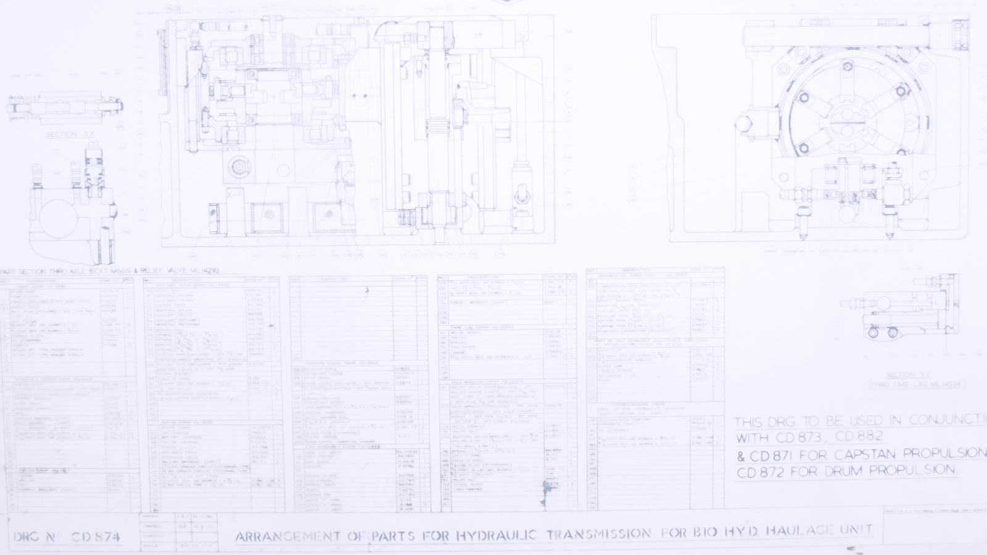
Bad BDNs
Where the diagram doesn’t go quite right

Slide 2
Thoughts to take away
You are not alone
You can do something about it
Notes:
My aim today is to give you some lessons to take away. Even if you are a well established BM practitioner, it’s nice to know that other people have hit the same snags that you have and that the snags are not insurmountable.
If you are new to BM then the bad news is that it isn’t always easy. The good news is that it isn’t always impossible.

Slide 3
Benefits
What’s a benefit?
How many iterations to get them
2 workshops for a weak set
12 workshops for a good set
More 2s than 12s
A benefit is a result that a stakeholder perceives to be of value
Notes:
The BIG issue, what constitutes a benefit.
A sweeping generalisation - everybody gets it wrong to begin with.
The simple definition we applied was: “A benefit is a result that a stakeholder perceives to be of value.”
People accept the definition but still come up with system features or outcomes when asked for benefits. There is great value in Post-it notes when constructing a benefits dependency network. It enables you to reassign the ‘benefits’ into their proper place.
How much effort should you put into benefits selection? Some teams held two workshops before producing their draft plans. The benefits were generally ill-defined and occasionally plain wrong, e.g. benefit = recruit 10 more staff. Another team ran 12 separate workshops amongst a wide set of stakeholder representatives and came up with a set of feasible, prioritised, measurable benefits. Unfortunately, they were the exception.

Slide 4
Squeezing old plans to fit
Lack of radical change
Poor grasp of strategic objectives
BM to validate / justify existing plans
Some degree of rationalisation
Notes:
Lessons from ISIP. The first set of plans didn’t deliver the radical transformational change that was hoped for. People were uncertain of ISIP’s survival. If it’s just a short-lived management fad then there’s no point in sweating too much over it.
The newness of the method hasn’t helped. Most people have treated their first plans as a learning exercise.
One area of confusion was the definition of objective, benefit and outcome. The same item could be phrased to fit any of the three categories so the significance of the differences wasn’t fully grasped. Applying SMART principle to the objectives encouraged people to narrow them down to tactical outcomes. Just because something should be measurable and timely doesn’t mean it should be a short-term cost saving. It’s like Nelson setting off for Trafalgar with the objective of:
Destroying the French fleet and removing Napoleon’s threat of invasion or
Using up his old gunpowder stock before it gets damp
This is vital to get right. We do too much without fully grasping the reasons why we are doing it. It opens up whole debates about governance and leadership.
Other teams simply used the method to validate or justify their existing plans. One programme came up with 23 plans and connected them to 13 benefits. The first draft of another plan had 35 objectives, all of the nature, implement project 1, project 2, etc.
There was some degree of rationalisation though. A great strength of the BDN is that it shows just how much change effort is going to be needed to deliver the selected benefits. The more benefits, the much more effort.

Slide 5
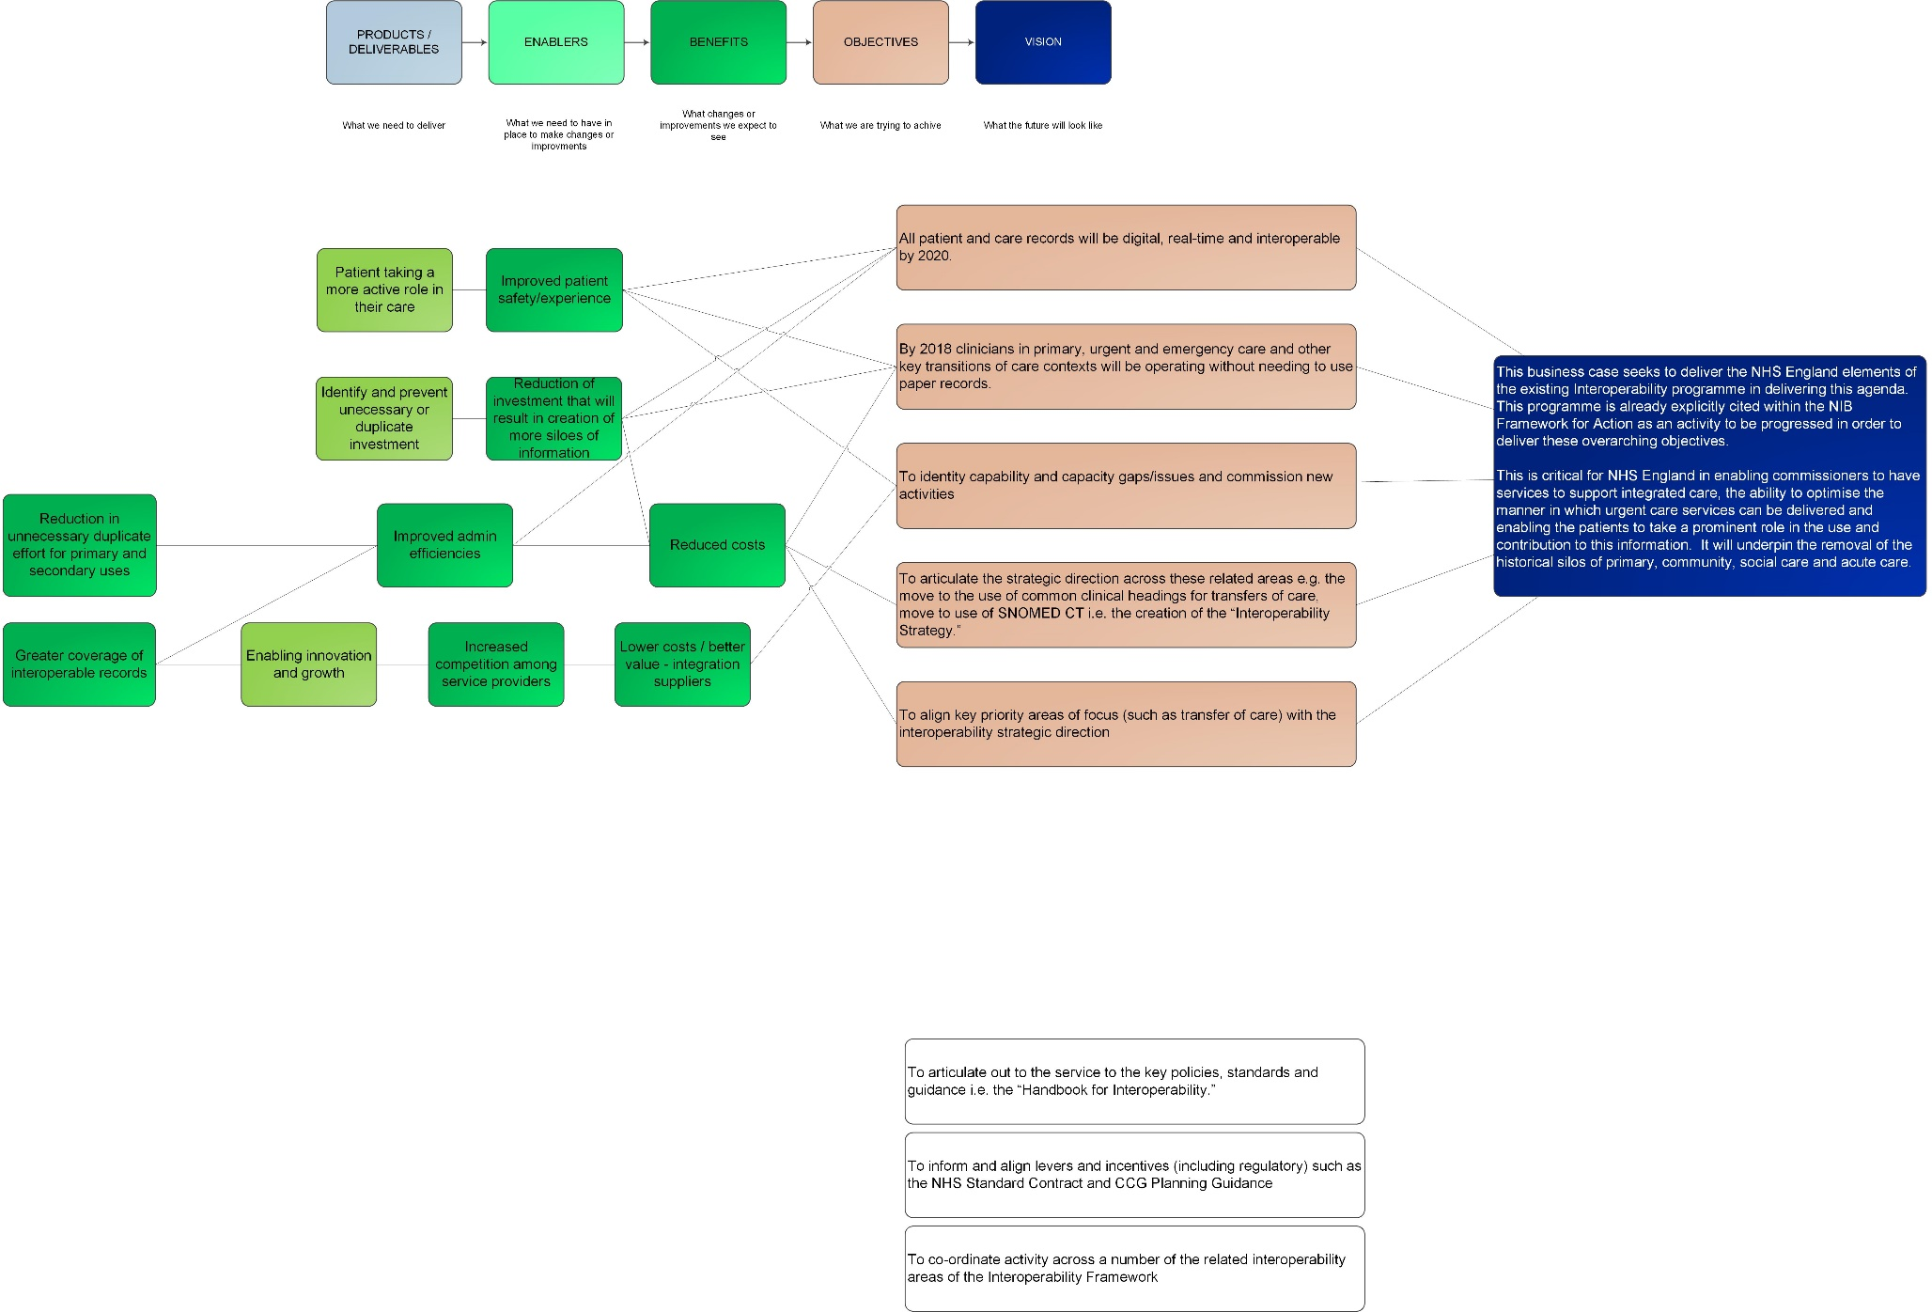
Cargo Cult Benefits Management
Notes:
A challenge that’s much nearer to home. It’s typical of the BDNs floating around NHSD and NHSE. They are being churned out by people who (through no fault of their own) don’t get it. The general quality of BM is not good.
This sort of diagram is either a waste of time because it is never used or harms its project because it is.
It’s an example of immature BM in practice.

Slide 6
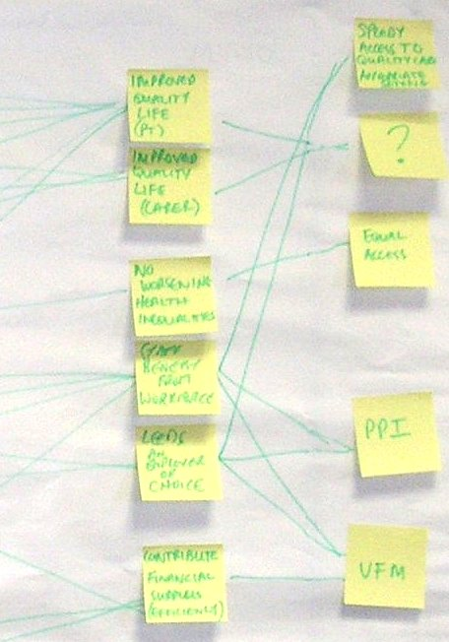
Missing Objective
The workshop selected Quality of Life benefits that could not connect with any of the Programme’s pre-stated Objectives

Slide 7
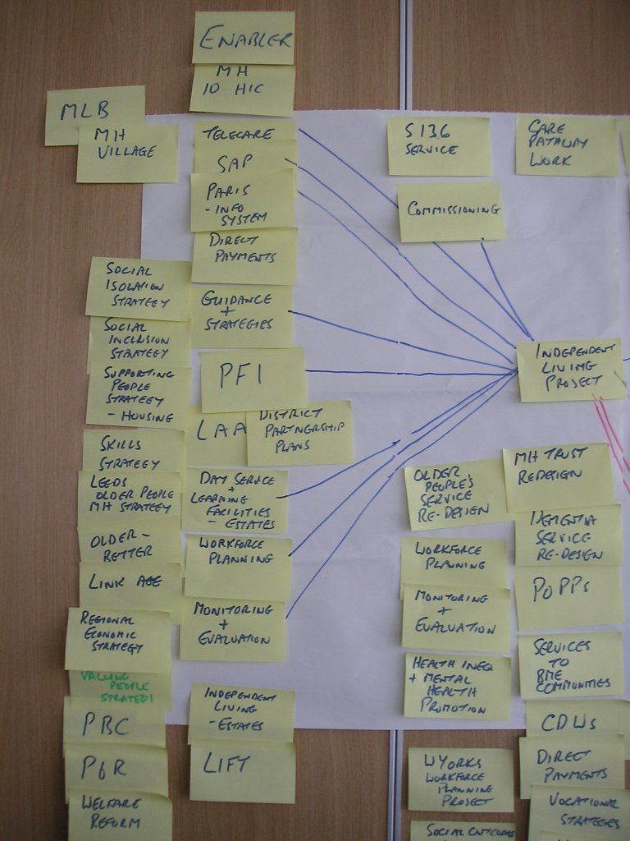
Poor Enablers
The many MH strategies were enablers without resources. They were really limiting factors. They told people how the job should be done but gave no tools to help do it

Slide 8
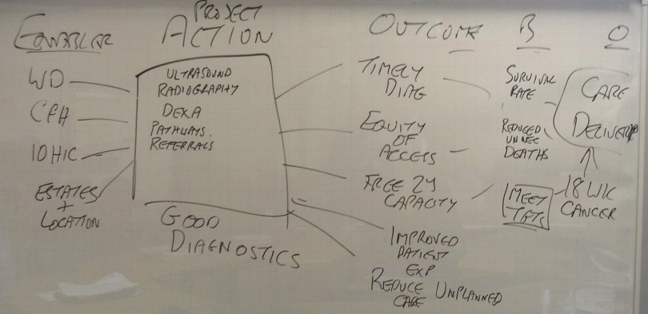
Lip service
This is the output of 30 mins management team discussion

Slide 9
Lip service
This is what the project manager brought to the next meeting

Slide 10
Cancer & Palliative Care Integrated Change Programme Benefits Dependency Network
Enablers
Projects
Outcomes
Benefits
Priority Objectives
Effective use of capacity
1. Commissioning & practice based commissioning
Cancer & palliative care NICE guidance implementation
Achievement of key waiting times
Improving access & choice
Increased diagnostic capacity
Increased number of diagnosed cancers referred via the USC route
2. Modernising information management & technology
Primary care service improvement initiatives
Delivering high quality managed care
Improved primary care engagement in cancer & palliative care agenda
Improvement in patient satisfaction
3. Workforce modernisation
Improved care pathways
Secondary & tertiary care service initiatives
Reduction of cancer mortality 20% by 2010
Year on year % reduction in incidence of cancer in identified areas of deprivation
4. High impact changes
Increased participation in screening, prevention and education programmes for target population
Partnership forum initiatives
Improving patient experience
5. Integrated care pathways
Achievement of prevention/ screening targets for specific target population
All patients better informed about choices
6. Estates & facilities modernisation
Prevention & screening initiatives
Consistent approach to management of cancer & palliative care in all GP practices
Improved communication along whole care pathway
Improving prevention & screening
Notes:
Here’s a good example of a BDN. This one comes from Wakefield’s ISIP (Integrated Service Improvement Programme) submission, March 06. It shows their Integrated Change Programme for Cancer and Palliative Care.

Slide 11
Primary Care Service Improvement Benefits Dependency Network
Enablers
Projects
Outcomes
Benefits
Priority Objectives
Effective use of capacity
1. Commissioning & practice based commissioning
Achievement of key waiting times
Improving access & choice
Increased diagnostic capacity
Increased number of diagnosed cancers referred via the USC route
2. Modernising information management & technology
Improved primary care engagement in cancer & palliative care agenda
Delivering high quality managed care
Primary care service improvement initiatives
Improvement in patient satisfaction
3. Workforce modernisation
Improved care pathways
Workstreams:
1. Primary care toolkit
2. End of life initiative (gold standards)
3. Prostate injection therapy
4. Breath testing
5. Mainstream primary care service improvement workforce
6. Cancer referral directory
Reduction of cancer mortality 20% by 2010
Year on year % reduction in incidence of cancer in identified areas of deprivation
4. High impact changes
Increased participation in screening, prevention and education programmes for target population
Improving patient experience
5. Integrated care pathways
Achievement of prevention/ screening targets for specific target population
All patients better informed about choices
6. Estates & facilities modernisation
Consistent approach to management of cancer & palliative care in all GP practices
Improved communication along whole care pathway
Improving prevention & screening
Notes:
This BDN is a sub-set of the previous one and concentrates on one project, the Primary Care Service Improvement Initiatives. There are six workstreams within this project. As far as the BDN is concerned, the cause-effect links come via the completed project, i.e. the end state where these primary care initiatives have taken place. The project to do this is separate from the BDN.
Note that the project’s benefits are a sub-set of the programme’s benefits. The purpose of the project is to support the programme.

Slide 12
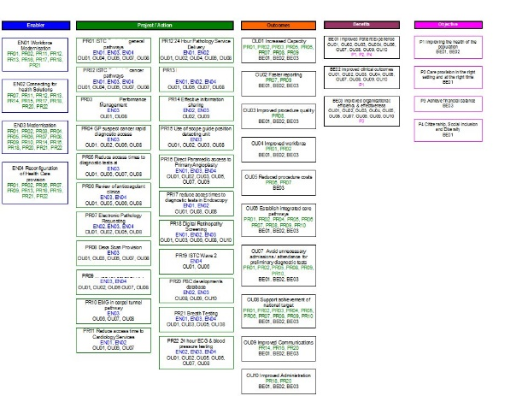
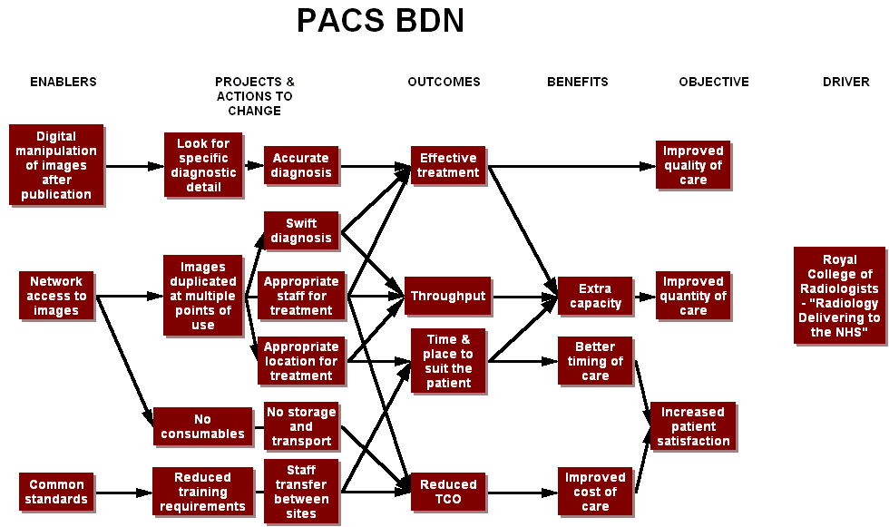
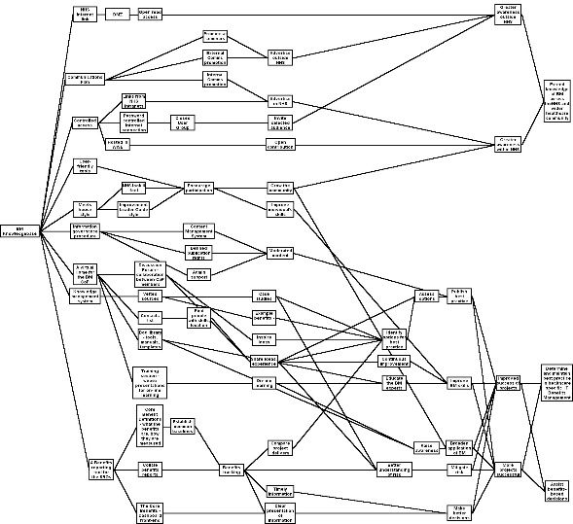
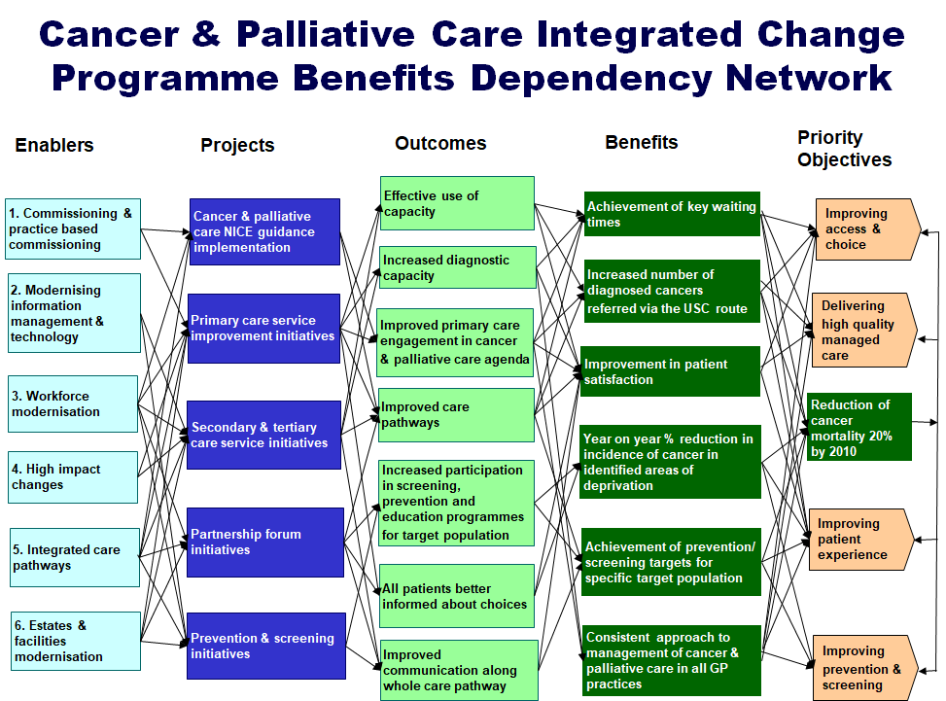
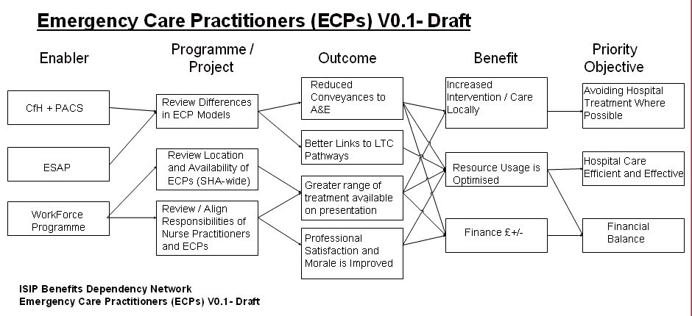
Dialects – eroding the standard
People adapted the tools to suit themselves
Five flavours of BDN within three months
Notes:
ISIP 2006, within three months people had adapted the tools and techniques. Some forms were discarded, others changed. We didn’t have one consistent BDN drawing tool. Some were drawn on PowerPoint slides, others using Visio, one on a spreadsheet.

Slide 13
Discussion

