Slide 1
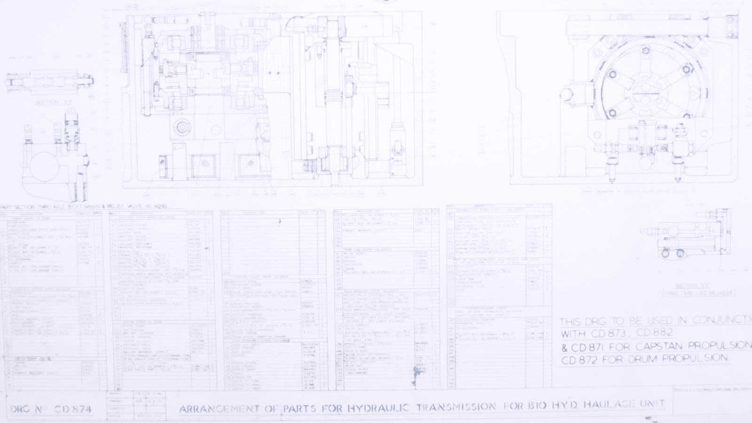
Benefits Mapping A Matter of Style
Form and Function

Slide 2
Ground Rules
I do not endorse any one model over the others
There are other models that we haven’t the time to consider here. They are just as valid
The models are one tool out of many that Benefits Managers can use
A model is not a guarantee of success, it depends on how well it is used
Notes:
This presentation is a compare and contrast exercise between a few of the better known Benefits Mapping models.
We do not endorse any one model over the others we consider
There are other models that we haven’t the capacity to consider here. They are just as valid
The models are one tool out of many that Benefits Managers can use
A model is not a guarantee of success, it depends on how well it is used
This is a ‘starter for ten’ to stimulate thought and discussion. It’s not the definitive instructions on how things must be done

Slide 3
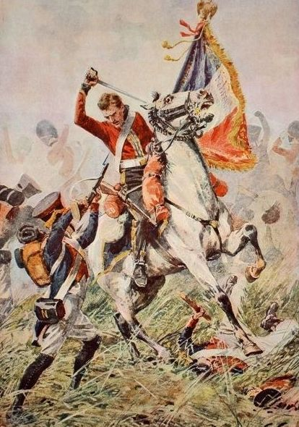
Start with the End in Mind
Why did Wellington fight at Waterloo?
A) Defeat Napoleon convincingly and remove France as a threat to European peace
B) Use up the old gunpowder before its sell-by date
C) A failed insurance scam to get a new horse
It’s not only what you do, it’s also why you choose to do it
Answer: A (if you didn’t pick A you are not taking this seriously)
Notes:
Why map stuff? Because we don’t always appreciate our Objectives. The purpose behind any course of action has a direct and significant effect on the way it is undertaken. The reasons why affect the ways we go about things. If Wellington had gone off to Waterloo simply with the intent of using up his budgeted stock of gunpowder then he would have fought a very different battle from the one that actually took place.
The same applies for any project, the ends affect the means and ways.
An objective is a result with a purpose. There has to be a ‘because…’ in it somewhere, even if it’s implicit. The objective is not ‘Build a shop’ but ‘Build a shop because it will be where we sell our products and make a profit. Otherwise, you could dump a box in the middle of a field and write ‘Shop’ on the side and still meet your objective.
The great thing about mapping is that it shows the rationale behind all this. It gets your ducks in a row, your carts behind your horses…

Slide 4
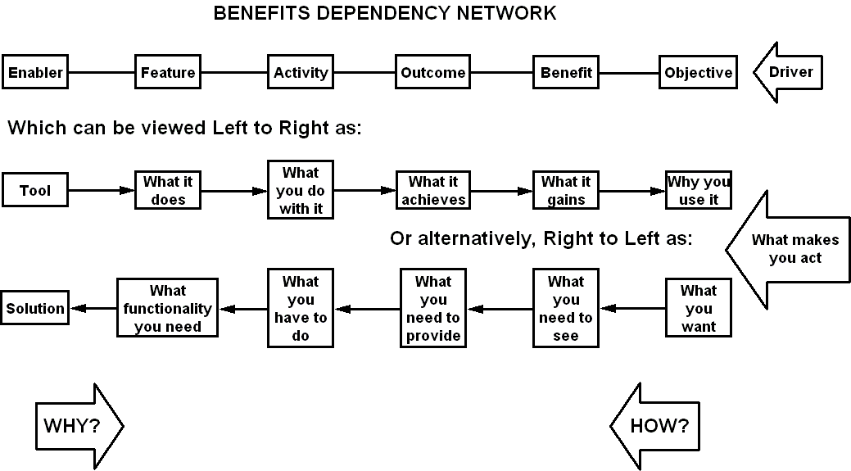
The Benefits Dependency Network
MEANS
WAYS
ENDS
Notes:
The benefits dependency network is one of the key elements of the benefits management method. It is a tool that shows the linkage from the solution, through business activities, outcomes and benefits to the organisation's overall drivers. It confirms that the system you intend to introduce will actually provide the results you are seeking.
Starting on the left, you ask ‘Why?’ to make the connections, ‘Why use this ICT tool?’
Starting from the right, ask ‘How?’ ‘How will I meet my objective?’
There’s a general flow from Means through Ways to Ends, what you use, what you do, what you get. Treat the labels more as a continuum than a rigid set of columns. This is a model of your actual situation so don’t try to force reality into the model, let the model resemble your reality.
How to build it
We need teamwork to make the most of this, the right people with the right knowledge and experience to build the diagrams objectively. A lot of the preliminary study can be done individually and the results passed around between colleagues. The diagram will be created in a group workshop though. It's better for everyone to talk and build the diagram with post-its on a wall than try to draw the thing on a PC. The agreed post-it diagram can then be copied onto a drawing application for further review before it is put into words for the proposition, plan, etc.

Slide 5
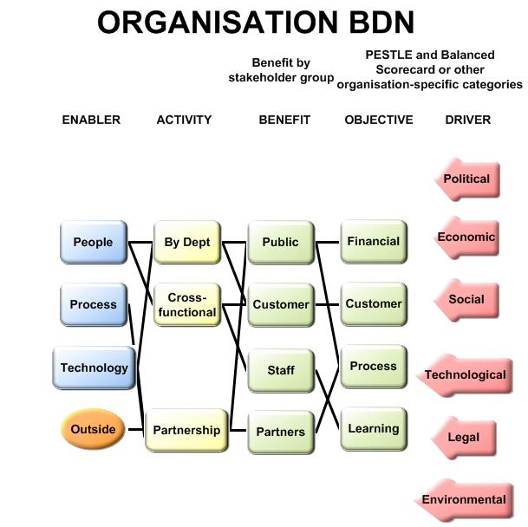
These are the areas to consider.
What people, processes and technology are in use?
Who are the stakeholders who get benefit?
What does the organisation want to achieve?
What business environment is it in?
Notes:
The Benefits Dependency Network (BDN) is one of the key tools in the Benefits / Value arena. It shows the chains of cause and effect between what you want, do and use. In this generic example the Drivers, the outside influences that make you act, fall into PESTLE categories. They don’t have to. It’s just a good way of analysing the context in which you have to operate.
Likewise, Objectives are split as per the Balanced Scorecard. Most objectives fit into quality of service, quantity of service, customer experience and finance.
Benefits are split by stakeholder. There is one stakeholder per benefit. If X is a benefit to customers and staff then X is two benefits. More likely, X isn’t a benefit at all but an enabler or outcome, something to be used to deliver benefits.
Activities may be in silos or multi-agent. They can be as simple as one step in a process or as complex as public-private partnerships.
Change managers split enablers into people, process, technology. Economists may use land, labour, capital, enterprise.
You don’t work in a vacuum so there’s bound to be some outside dependencies to consider as well.
Any function that isn’t linked to a benefit is obviously of doubtful value. Functions with many or vital links can be picked out for special attention.
These are all just tidy ways to help you break down your organisation in a logical manner. They are not mandatory but they do help.
Later we are going to build one of these. They are much more fun to play with than just look at.

Slide 6
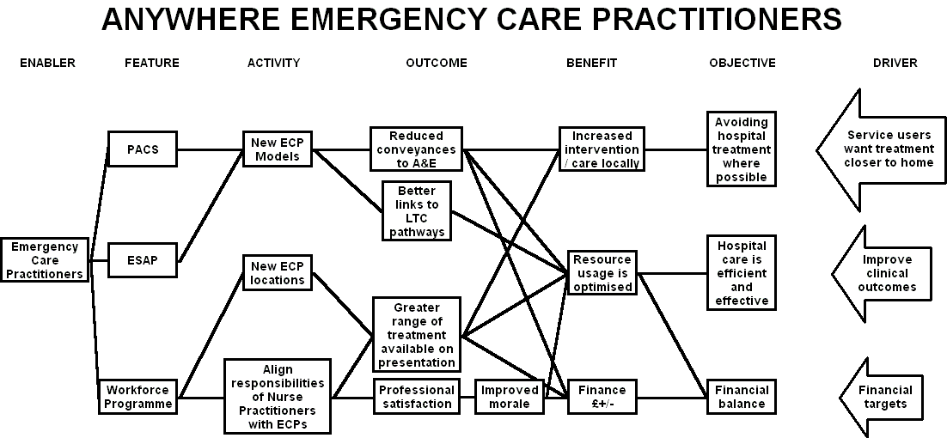
This is manageable
Notes:
Whatever model you choose, it’s purpose is to help you deliver a successful project. That is going to depend on how well you use it.
Here’s a hypothetical example, taken from an NHS transformational change programme, March 06.
The objectives are pretty generic and represent the high-level stakeholder groups of patients, policy makers and the organisation itself. All the connections are made. There are no dead-ends in the diagram so everything has a purpose and contributes to the objective to some extent. The diagram starts the discussion about the relative contributions and allows decisions to be made about priorities and allocating resources.
This is manageable, a feasible amount of activity delivers selected benefits that are directly connected to the organisation’s objectives.

Slide 7
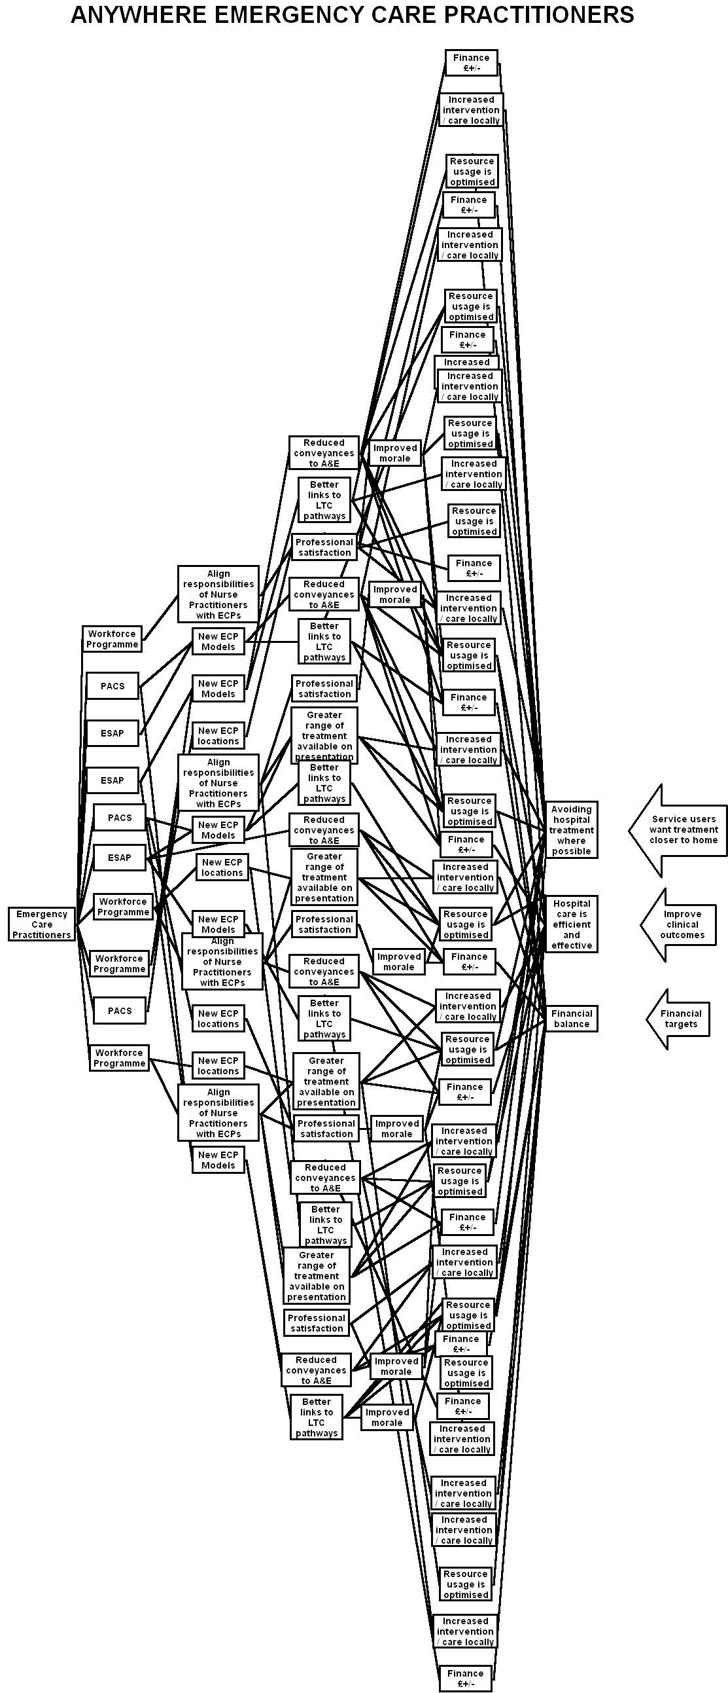
This is not
Notes:
Imagine that the programme had chosen 50 benefits instead of 3. Life gets much more complex here. Each box in the diagram will use resources. There will be a level of activity behind each one, some of it quite intensive. The more you choose, the more you have to spend and do.
There may be situations where this can be manageable. I’ll come to an example at the end of my talk (Ned’s).

Slide 8
Observations
Lack of radical change
SMART implies small - strategic objectives get de-scoped
BM to validate / justify existing plans
Inappropriate benefits
Mapping helps rationalisation
The amount of activity required to deliver each benefit
The validity of projects mapped to strategic objectives
Re-defined objectives
Iteration works
Notes:
Things we’ve seen in practice.
One area of confusion was the definition of objective, benefit and outcome. The same item could be phrased to fit any of the three categories so the significance of the differences wasn’t fully grasped. Applying SMART principle to the objectives encouraged people to narrow them down to tactical outcomes. Just because something should be measurable and timely doesn’t mean it should be a short-term cost saving.
This is vital to get right. We do too much without fully grasping the reasons why we are doing it. It opens up whole debates about governance and leadership and the purpose of projects.
Other teams simply used the method to validate or justify their existing plans. One programme came up with 23 plans and connected them to 13 benefits. The first draft of another plan had 35 objectives, all of the nature, implement project 1, project 2, etc.
Sometimes the benefits are inappropriate. There are some ‘usual suspects’ that crop up every time, no matter what the project is about, e.g. improve patient care. Sometimes a limiting factor is turned round into a benefit. A workshop on Junior Doctors’ working hours had a factor of no detriment to patient care. In two sentences this had become a benefit of improving patient care, an un-necessary potential burden on the project.
There was some degree of rationalisation though. A great strength of the map is that it shows just how much change effort is going to be needed to deliver the selected benefits. The more benefits, the much more effort.
It provided evidence to stop the projects which didn’t link into priority objectives and indeed one group had benefits which did not link into the objective, this was a very powerful message.
Iteration works, the third pass will look much better than the first one.

Slide 9


Models
Models reflect reality
Scale and detail appropriate to purpose
Notes:
Models reflect reality so adapt the model to reality, don’t squeeze reality to fit the model.
Appropriate scale and detail. These models do very different jobs. The same goes for BDNs. A simple PowerPoint slide is the balsa and rubber band job that convinces your Board that the project will fly. The Vulcan has sufficient in it to get airborne. The Corsair in the middle has the meticulous detail that some planners may want to see.

Slide 10
A benefits-led scenario
Feature - my car is painted ‘Police Car’ white
Outcome - people move over for me on the motorway so I get home for 6 pm
Benefit - I get to watch The Simpsons on TV
Notes:
A familiar slide – ‘My Car’
It shows the difference between features, outcomes and benefits. This is important to understand if we are to make sense of the diagrams that follow.

Slide 11
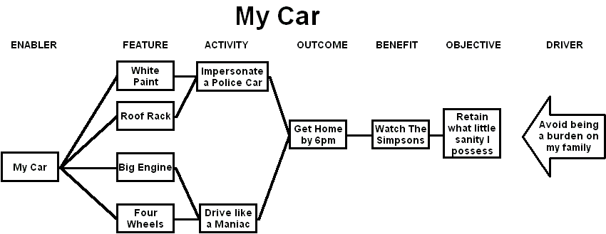
Mapping the Scenario
Notes:
This is why watching the Simpsons is a good thing, and what my car needs for me to meet my objective.

Slide 12
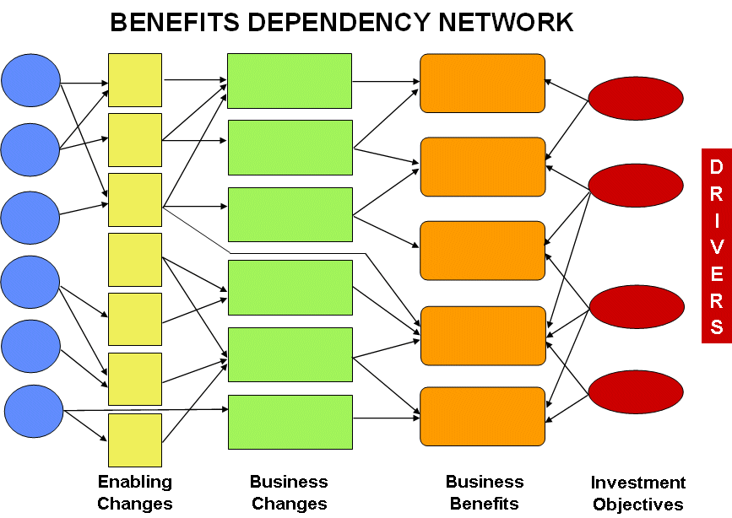
Cranfield Benefits Dependency Network
Notes:
Here’s our first model, one a lot of people will recognise.
The Cranfield University model was developed in the mid 90’s under Professor John Ward as a tool for managing the benefits of IT enabled business change. It’s most recent outing is in Benefits Management: How to Increase the Business Value of Your IT Projects by John Ward and Elizabeth Daniel.
Outline
Benefits dependency networks are essentially a graphical device for showing how technology features can enable business changes resulting in overall benefits to the business. They therefore show the linkages between technology effects and overall business objectives.
Benefits workshops are held in order to agree amongst the major stakeholders what the proposed benefits are, what measures are appropriate, and what the business responsibilities are for realising the benefits. Such workshops can also foster a high level of understanding as to the full scope of a project, and engender high levels of commitment to the project from those present.
Components
IS/IT Enablers
Enabling Changes
Business Changes
Business Benefits
Investment Objectives
Aims
The Benefits Dependency Network is a graphical depiction of the linkages between technology effects and overall business benefits.
Strengths
Once constructed, they can be used to identify appropriate business measures or observable effects for the benefits, and can be used as a basis for benefits realisation planning.
Other points
The network should be constructed from right to left, commencing with an understanding of the drivers acting on the organisation, agreement on the investment objectives and identification of the benefits that will result if the investment objectives are achieved.
There are two distinct types of change involved. Business changes are new ways of working that will go on after the project is closed. Enabling changes are the one-off changes created by the project that set up the business changes. For example, training staff in new skills is an enabling change. Applying those new skills is a business change.

Slide 13
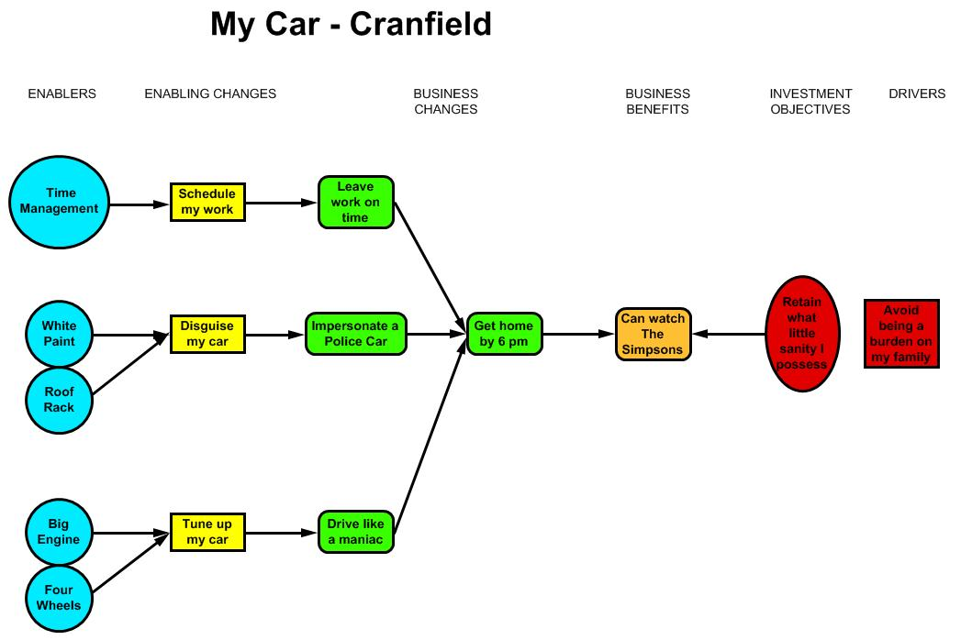
My Car - Cranfield
Notes:
My Car in the Cranfield style.

Slide 14
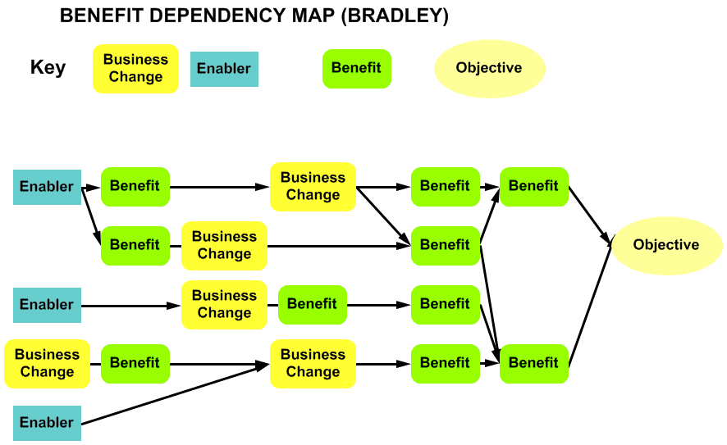
Gerald Bradley
Notes:
The next model is from Gerald Bradley’s book Benefits Realisation Management. It was developed by Gerald and is used by his consultancy firm Sigma.
Outline of Sigma’s Modelling Approach:
The approach for a single programme, which can be easily adapted for portfolios and projects, consists of three stages:
Building a Strategy Map of linked objectives:
By exploring the reason for change, both fixing problems and exploiting opportunities, a set of objectives (usually between 10 and 16) is determined. These are linked using ‘cause and effect’ relationships to create a Strategy Map, which is then used to identify 2 to 4 ‘bounding objectives to bound the programme.
Creating a Benefits Map for each ‘bounding objective:
For each of these bounding objectives a Benefits Map is created. This is developed by working from right to left from the objective, identifying, at each stage, a set of directly contributing benefits. The test for each set is that they are:
Collectively sufficient
Individually necessary
Mutually independent
Likely to lead to different kind of change needs
Transforming a Benefits Map into a Benefit Dependency Map:
At this stage the Benefits Map is just a carefully structured wish list. So the next step is to add to each Benefits Map (usually working from the left to right) all the enablers and business changes needed to deliver all the benefits. The resulting map is called a Benefit Dependency Map.
The above process is undertaken with the engagement of key stakeholders, ideally in workshops, using only logic and an understanding of the environment in which the organisation operates. Later, using a powerful ranking process, alongside a consideration of costs, risks, and avoidance of duplication, an effective prioritisation of options is achieved.

Slide 15
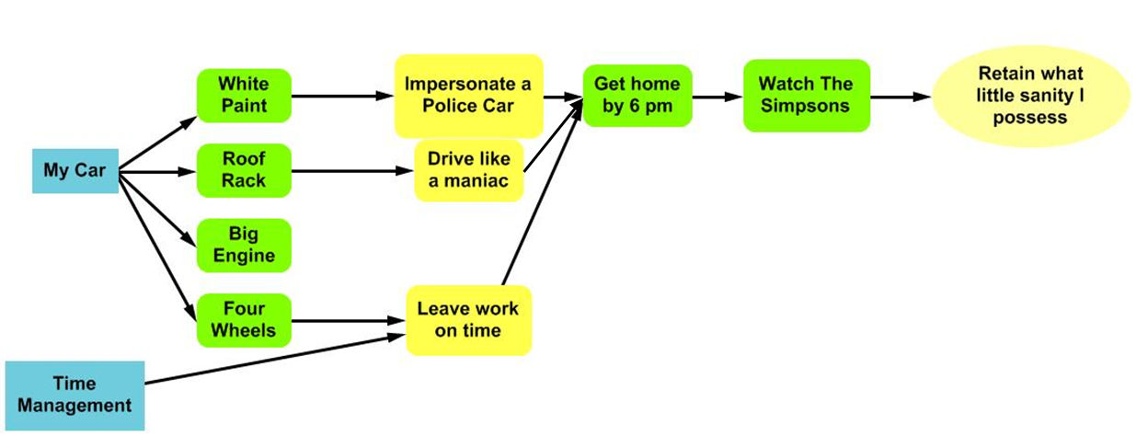
My Car - Bradley
Notes:
My Car in the Bradley style

Slide 16
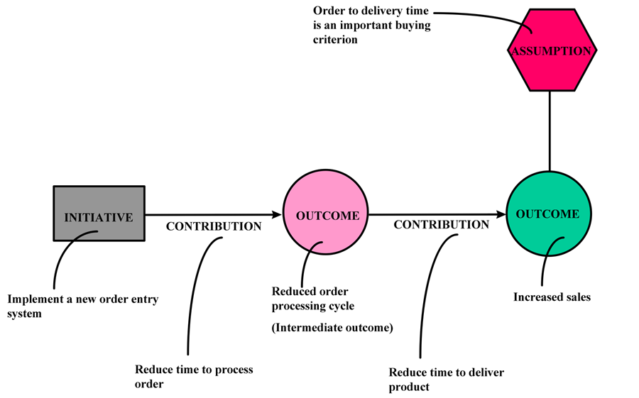
Fujitsu Results Chain
Notes:
The Results Chain™ , first published in The Information Paradox in 1998, was developed to support defining, evaluating, selecting and managing complete and comprehensive programmes of change - including, but not limited to, changes to the business model, process, people, technology, and organizational structure. The technique enables organizations to develop “road maps” that support understanding and proactive management of a programme throughout its full economic life cycle, such that expected, or often unanticipated, benefits are realized, and value is created and sustained. It is used to build simple yet rigorous models of the linkages among four core elements of a programme: outcomes, initiatives, contributions, and assumptions. Developing the Results Chain involves a number of facilitated workshops with the key stakeholders. Skilled facilitation is key here as, while the resulting “map” is very useful, what is more important is the process of discovery, understanding, consensus and buy-in that occurs during the development of the “map”.
Results Chain is a proprietary technique of Fujitsu Consulting, and the term and descriptions of the technique are provided here with permission of Fujitsu Consulting.

Slide 17
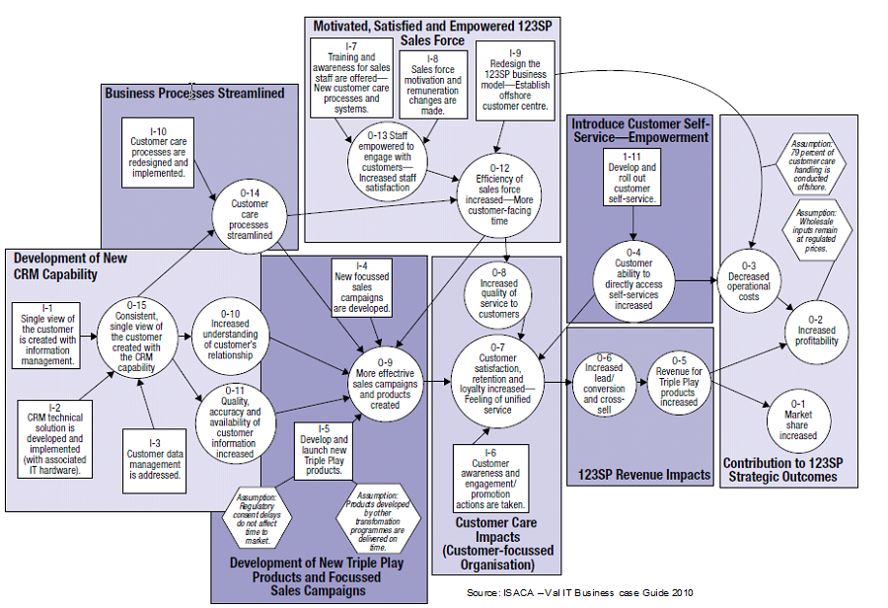
Example Results Chain
Notes:
Here’s an example to show the scale of a typical Results Chain.
Aims, typical uses and audiences
While the initial aim of the technique was to provide a “map” to support understanding and proactive management of a programme throughout its full economic life cycle, in practice, it’s application has been extended and adapted to include:
1. At a strategic level, to validate/clarify/communicate strategy and strategic objectives and outcomes;
2. At a portfolio level, to map programmes/projects to a strategic level outcome map; and to identify and evaluate different paths to desired outcomes;
3. At the business case stage (which could be initiated by a perceived opportunity or problem), to enable an informed decision based on balancing attractiveness with achievability by ensuring that there is a clear and shared understanding of:
a. The desired outcomes (both end and intermediate);
b. The full scope of change initiatives that are both necessary and sufficient to achieve the desired outcomes, including management of change itself;
c. Any assumptions that are being made about the external or internal environment, the outcomes, or the contribution of initiatives to those outcomes;
d. The relevant metrics that are required to both measure achievement of the outcomes (lag metrics), and to measure the expected contribution of initiatives and intermediate outcomes (lead metrics) to the end outcomes such that timely corrective action can be taken when things are not going to plan; and
e. The roles, responsibilities and accountabilities for both the contribution initiatives and achievement of outcomes.
4. At the Programme Management stage, to “manage the journey”, including getting early warning of when corrective actions, which could include termination, are required, and to assess/confirm the impact of those actions.
5. When a programme is in trouble, to determine if it can be “salvaged”, and the actions required to do so.
Depending on the use of the technique, audiences can in practice include the Board, Executive Management, LOB Management, as well as Programme Managers, Change Managers, Project Managers and their Teams, and other stakeholders impacted by programmes of change.

Slide 18
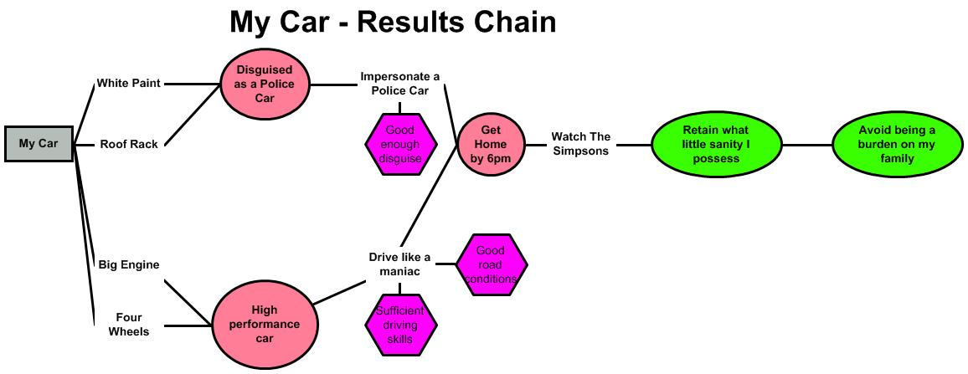
My Car - Results Chain
Notes:
Here’s the same scenario mapped in a Results Chain, a tool used by Fujitsu in the Southern Cluster of NPfIT in 2005.
Strengths
1. Simple - only four elements.
2. Comprehensive - includes: outcomes (what the ultimate objectives are and what intermediate outcomes these are dependent on); initiatives (the full scope of effort/change required to achieve the outcomes); assumptions (those things that come up and bite you which need to be surfaced, mitigated through further initiatives where possible, or monitored); and contributions (which facilitate the development of both lead and lag metrics).
3. Scalable - can be aggregated up (with all/some elements included), or “drilled” down.
4. Actionable - can be taken down to a sufficient level of detail to provide the foundation for both programme and change management plans, and can be used to assess, and guide corrective action when there are deviations from the expected plan.
Other points
1. John Thorp says that contrary to how the Results Chain may be described (i.e. earlier in this presentation), it is not a cause and effect model - it is a cognitive model that, through effective facilitation, makes explicit what each and all of the stakeholders implicitly believe will happen (all looking through different lenses and having different cognitive biases) - as such, as mentioned earlier, it is the process of developing the map, NOT THE MAP ITSELF, that facilitates gaining understanding of, consensus/buy-in and commitment to the outcomes and what has to be done to achieve them.
2. The comprehensiveness of the technique, and the ability to “drill” down can, without effective facilitation, lead to analysis paralysis resulting, in one famous instance I am aware of, in the “Results Chain that ate the world”.

Slide 19
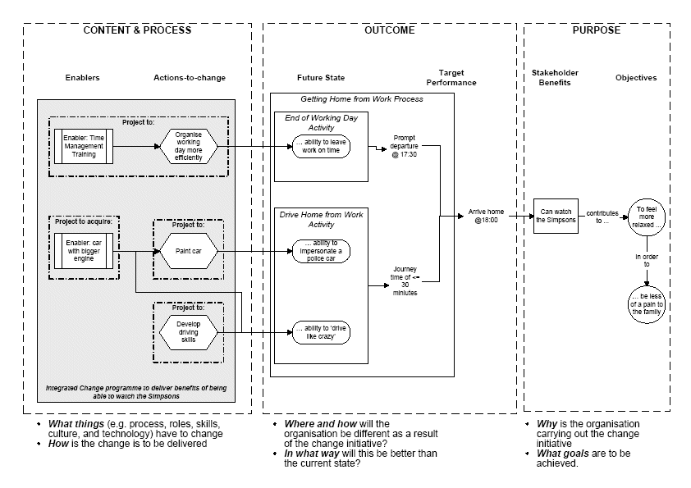
NPfIT BDN circa 2005
Notes:
MY Car courtesy of Roger Elvin, NPfIT 2005.

Slide 20
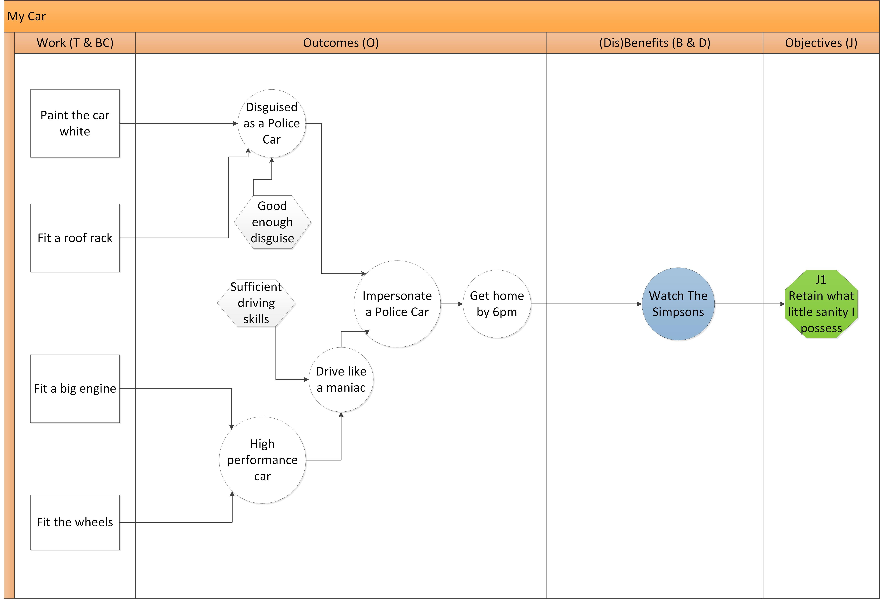
My Car - NHS Digital Modified Results Chain
Notes:
NHS Digital, evolved from NHS Connecting for Health, now use this as their house-style BDN.

Slide 21
Wovex Model Style
Notes:
This style is based on the MSP ‘Project Output to Strategic Objective Chain’.
It allows those familiar with MSP to use the concepts familiar to them but also add extra information, to improve context.
The objects on the left of the model are used to describe what will be done – called Programme objects. Any configuration of these can be used with these to represent plans, processes, solutions etc. that result in value adding Capabilities.
Those towards the right show how the Capabilities contribute value to Outcomes. These Outcomes become Benefits when measures are added.
Data can be added to these elements to not only document the model but analysis is possible. For example, costs added to the Programme objects can be calculated and used to understand the benefits that flow from them.
Only use the objects you need and your model can be as simple or complex as you require.

Slide 22
Wovex Model Style – An Example
Notes:
The modelling style allows the end to end cause-and-effect chain to be understood. To ensure not just benefits are focused on but also what contributes to their realisation.
For example, to ask:
‘What do you want?’ so Outcomes and Objectives can be identified
‘How will you know you’ve got it?’ so the Benefit Measures can be identified
‘What things do you need to have or be capable of?’ to identify the Capabilities and Outputs
‘’What do you need to do to get them and keep them?’ to identify the Programme objects
The modelling approach therefore allows ‘holistic benefits management’.
You can also ask questions on ‘What are the Risks to benefit achievement’, ‘are any Assumptions being made’, ‘what Requirements are being satisfied’, ‘what are Stakeholders interested in’ and ‘what Dependencies exist’?
By asking such questions and building the picture you can then provide and share answers with people: This is what we want, this is how we’ll know we’ve got it etc.
This allows stories and examples to be told to bring it to life and gain added support

Slide 23
My Car - Wovex
Good disguise
My family
White paint
Impersonate a Police Car
Get home by 6 pm
Retain what little sanity I possess
My Car
Roof rack
Watch The Simpsons
Drive like a maniac
Big engine
Me
Getting stopped
Four wheels
Notes:
The Wovex view of My Car

Slide 24
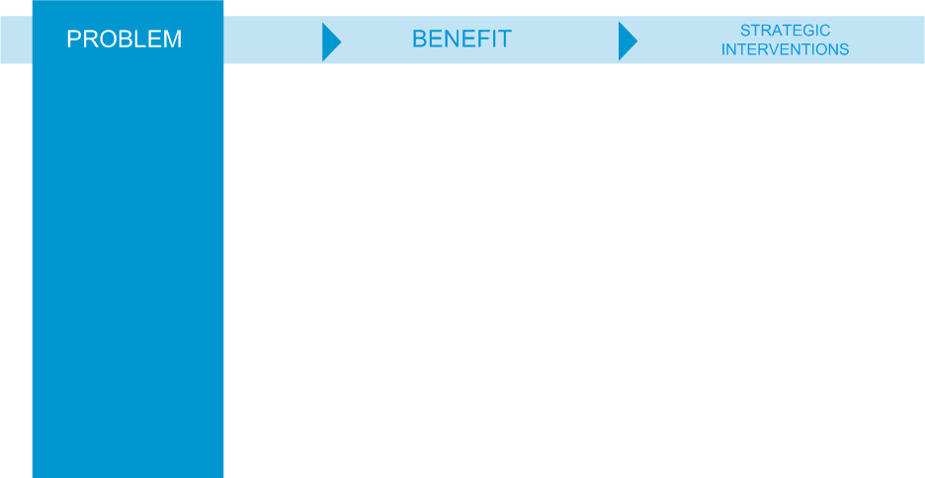
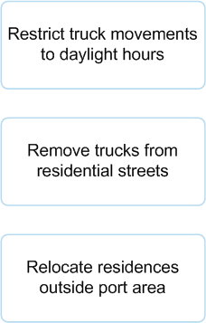
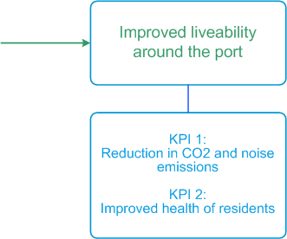

From Problem to Benefits and Strategic Response
Investment Logic Map
Notes:
The Department of Treasury & Finance (State Government of Victoria, Australia) developed this methodology as part of the Investment Management Standard around 2004. The Investment Logic Map starts from a problem statement. What problem needs to be addressed? What benefit is required to do this and what are its Key Performance Indicators? What has to be done (strategic interventions) to deliver the benefit and so fix the problem?
It is a single-page depiction of the logic that underpins an investment. It provides the core focus of an investment and is modified to reflect changes to the logic throughout its lifecycle.

Slide 25
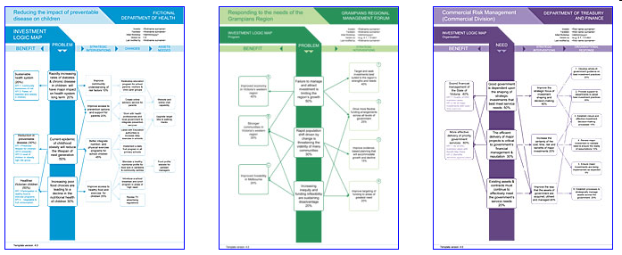
Investment Logic Map
A single-page depiction of the logic that underpins an investment. It provides the core focus of an investment and is modified to reflect changes to the logic throughout its lifecycle. There are three variations:
Initiative
(for single investments)
Program
(for a program of new investment)
Organisation
(for an entire organisation)
Notes:
There are three variations:
Initiative (for single investments)
Programme
Organisation

Slide 26
My Car - ILM
PROBLEM
BENEFIT
STRATEGIC RESPONSE
SOLUTION
CHANGES
ASSETS
White paint
I am a burden on my family
Retain what sanity I possess
Impersonate a Police Car
Roof rack
Watch The Simpsons
Home by 6 pm
Big engine
Drive like a maniac
Four wheels
Notes:
My Car in ILM

Slide 27
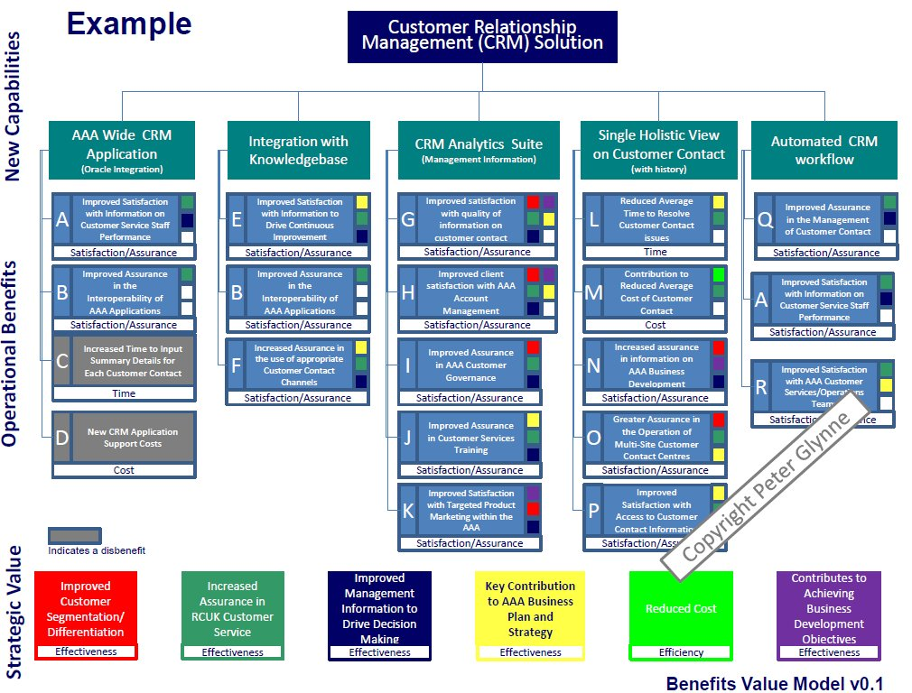
Benefits Value Model
Notes:
The Peter Glynne Benefits Value Model is an innovative, proven and tested approach to identifying, structuring and communicating benefits. It is a the first step and a key element of an end-to-end integrated approach to benefits driven change entitled “Benefits Made Clear”. It has been designed to be a powerful communications tool, clearly illustrating the relationship between new capabilities, operational benefits and strategic value. It avoids building a complex spiders web type model that other approaches to benefits mapping result in.
It is both a robust benefits and value identification tool, a structured way to engage stakeholders and a powerful way to communicate value to senior management .

Slide 28
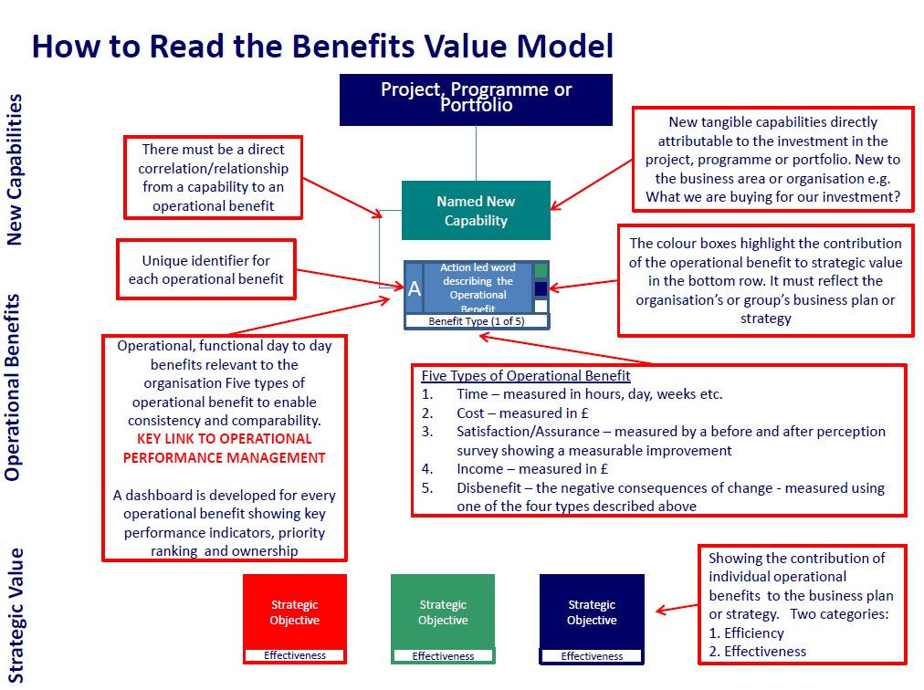
Notes:
KEY POINT: The approach is iterative over the lifecycle of the change journey: strategy, delivery and the embedding of change. It is a key element of a single integrated end-to-end approach to benefits realisation.

Slide 29
My Car – BVM
My Car
White paint
Roof rack
Big engine
Four wheels
A
Impersonate a Police Car
A
Impersonate a Police Car
B
Drive like a maniac
B
Drive like a maniac
Assurance
Assurance
Time
Time
C
Get home by 6 pm
C
Get home by 6 pm
C
Get home by 6 pm
C
Get home by 6 pm
Time
Time
Time
Time
D
Watch The Simpsons
D
Watch The Simpsons
D
Watch The Simpsons
D
Watch The Simpsons
Satisfaction
Satisfaction
Satisfaction
Satisfaction
Burden avoidance
Sanity retention
Best use of time
Effectiveness
Effectiveness
Effectiveness
Notes:
My Car as a Benefits Value Model

Slide 30

Outcome Relationship Model
Ned Newton, Atkins – presented to APM Benefits Summit June 2016
http://www.slideshare.net/assocpm/outcome-relationship-models-presentation-ned-newton-london-23-june-2016
A way to make this manageable?
Notes:
Mapping approaches within:
– benefits management
– International development, social change
– strategy creation
– value management
▪ Outcome Relationship Models (ORMs):
– Government programme ORMs Niteworks rainbow team: Atkins, BMT, Hi -Q Sigma, Rhead (Serco & independents )
– context, notation, layout
– ORM for a capability programme
– outcome analysis

Slide 31
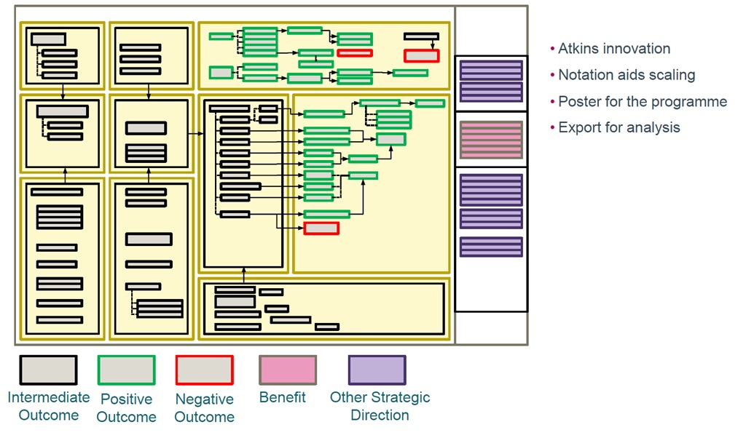
Outcome Relationship Model

Slide 32
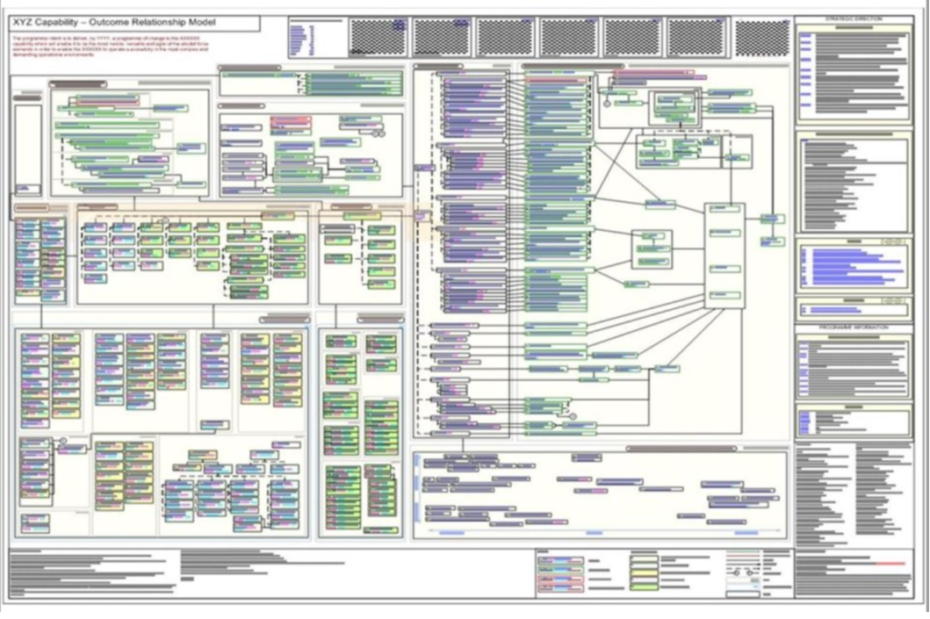
Notes:
This is manageable, for a given definition of manageable and the resources available to manage it. If you’re going to do this then you really have to take it seriously and maintain the effort.

Slide 33
Discussion

Slide 34
If time allows…

Slide 35
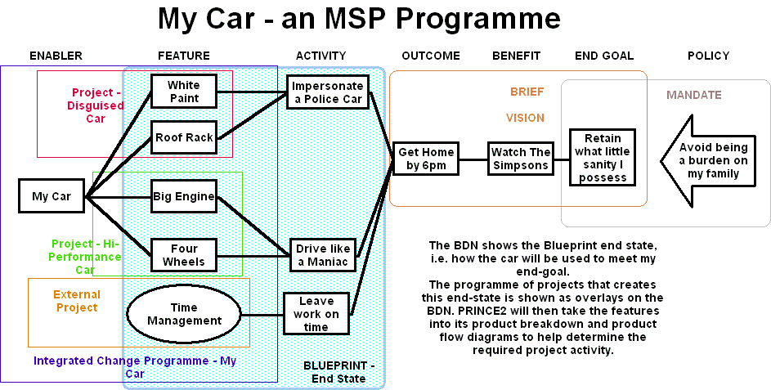
BDN as a Programme Summary
Notes:
My Car adapted to show how BDNs can be used in MSP.

Slide 36
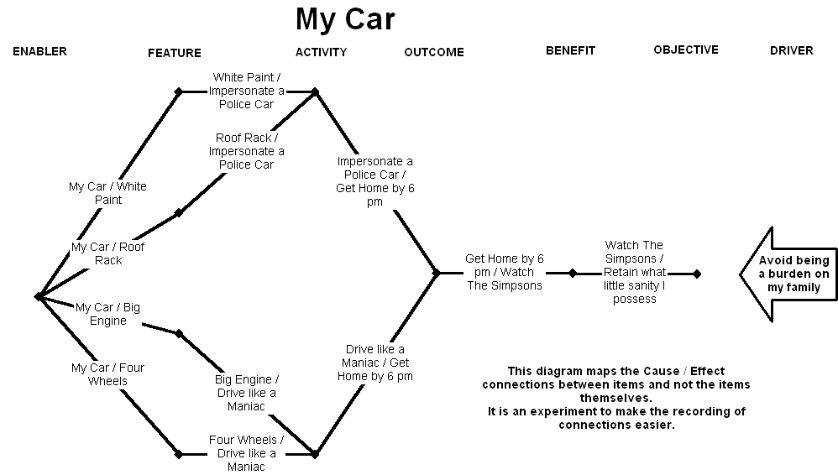
Bias in the Model
The resource boxes contain the words
The application links aren’t described
But the application is key
Notes:
The resource boxes contain the words
The application links aren’t described, except in John Thorp / Fujitsu model.
But the application is key. It’s not what you have but what you do with it that matters.
We can’t see these in the diagram so we concentrate on the resources themselves and forget what they are actually for, and therefore why they are important.

Slide 37
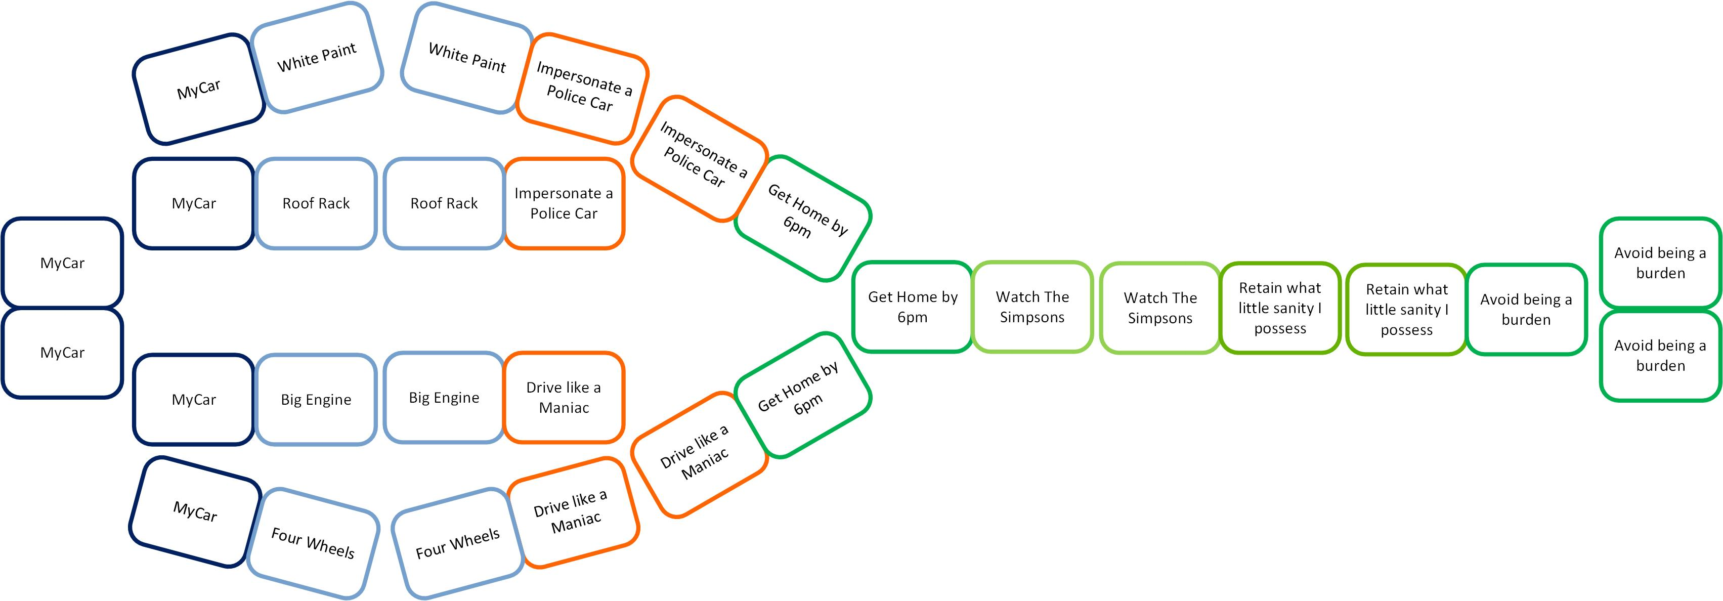
My Car – ‘So What?’ Dominoes
The domino shows what’s important
Start and end on a Double
Downside – it quickly becomes unwieldy
Notes:
This is an experimental concept (2012). All the diagrams so far are nodes and links between them. Because the node is a box full of words it draws our attention more than the thin line that makes the link between them. However, the crucial part of this sort of model is the link. The link answers the “So what?” question. I have a car, so what?
In this example we imagine the asset and its usefulness as a domino. Each domino has two parts, e.g. a 6 and a 3, so we get My Car : White Paint, White Paint : Impersonate a Police Car and so on.
Like dominoes, we start and end on a double and make chains by matching the ends. The plus point of this model is how it confirms the usefulness of each asset in the chain. The downside is that it quickly becomes hard to read beyond the most simple of projects.
There’s a design exercise to be done here someday to get the concepts into a legible and meaningful diagram.

