Slide 1
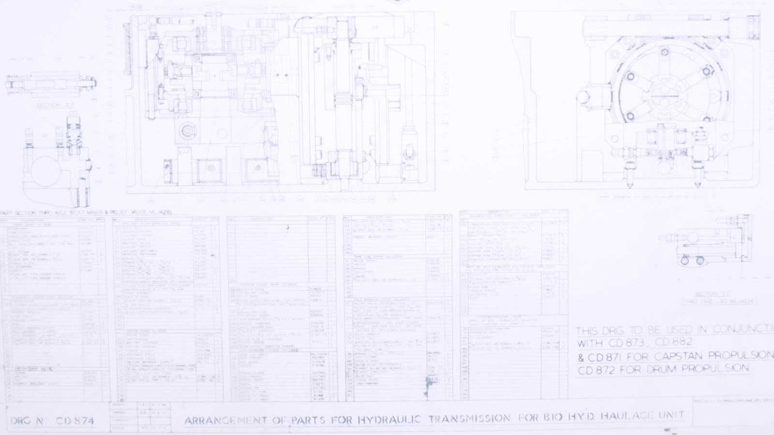
Agile Benefits Management
Round like a circle in a spiral, like a wheel within a wheel Never ending or beginning on an ever spinning reel…
The Windmills Of Your Mind: Legrand, Bergman & Bergman
© EMI Music Publishing

Slide 2
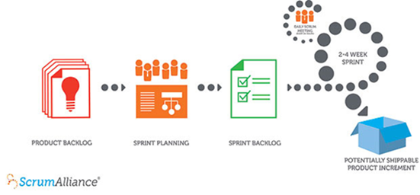
What’s the problem?
All the business books tell us that we live in an environment of uncertainty and that continuous and faster business change is a necessity.
How do we optimise continuous urgent change in an uncertain world?
Notes:
7
Scrum - The core of Agile project management. This is all about churning out working products in a continuous improvement production line of ideas to delivery to ideas again.
Agile BM is the approach that governs the ideas selected to feed this line.

Slide 3

A race with no finish line
Who will still be going by the time you get here?
The risks of chasing over the horizon
Corporate exhaustion
Cliff edge
Blind alley
Competitor’s ambush
Who knows what lies in the dead ground beyond this ridge?
Notes:
Continuous, urgent change
The risks of chasing over the horizon
Corporate exhaustion, you can’t keep running forever
Cliff edge, run straight into disaster
Blind alley, can’t see where the road leads so take the wrong option
Competitor’s ambush, you’re playing against other people who don’t want you to win so will deliberately set you up to fail

Slide 4
Tactical Bounds
1
2
Team 2 exploits their position
And repeat with Team 1 for the next objective
And the next…
1
Pause at the top
See what’s over the ridge
Exploit your position
Send Team 2 on to the next objective
Notes:
Moving in tactical bounds, one team at a time.
Understand the context
Choose Objective 1
Commit resources
Plan it
Achieve it
Exploit it
Establish a Firm Base
Use it as resources for the next bound
Choose Objective 2
And so on…

Slide 5
Tactical Bounds
Advance through a series of objectives
Understand the context
Choose Objective 1
Commit resources
Plan it
Achieve it
Exploit it
Establish a Firm Base
Use it as resources for the next bound
Confirm the context
Choose Objective 2
Commit resources
Plan it
Achieve it
Exploit it
Establish a Firm Base
Use it as resources for the next bound
Notes:
Understand the context
Choose Objective 1
Commit resources
Plan it
Achieve it
Exploit it
Establish a Firm Base
Use it as resources for the next bound
Confirm the context
Choose Objective 2
And so on…
Tactical Bounds give you the security to move forward. The firm base gives you the resources to use in your next venture. In Boston Box terms, it’s your Cash Cow that feeds the Problem Child to become a Star that turns into the next Cash Cow.
It also gives you somewhere to fall back to if Objective 2 fails. You don’t bet the firm on one throw of the dice.
Whether you split Team1 and Team 2 equally or have more than one team depends on your circumstances and preference. You may advance ‘one up and two in reserve’ for caution or ‘two up’ if there’s urgency and big prizes to be had.

Slide 6
Decision Cycle
Speed is of the essence
It’s not just a matter of choosing the right Objective
It’s also time you take to choose
Tools
Psychological
Practical
Notes:
Decision cycle:
The speed at which decisions are taken. Windows of opportunity, sense of urgency, lost chances. A good choice may fail because it was taken too late.
Use tools to help you choose good things fast.

Slide 7
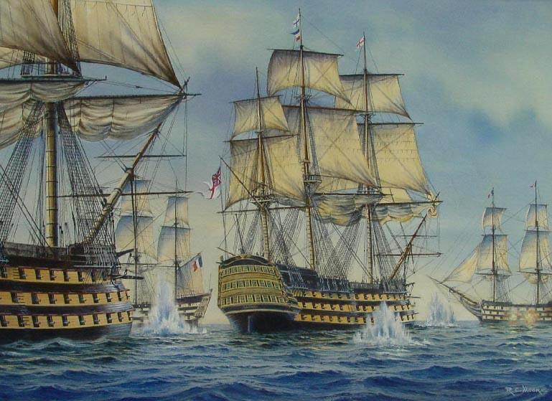
Start with the end in mind
Why did Nelson fight at Trafalgar?
A) Destroy the French fleet and remove the threat of invasion
B) Use up the old gunpowder before its sell-by date
C) Impress Lady Hamilton
It’s not only what you do, it’s also why you choose to do it
Answer: A (if you didn’t pick A you are not taking this seriously)
Notes:
Starting with the End in Mind
The purpose behind any course of action has a direct and significant effect on the way it is undertaken. The reasons why affect the ways we go about things. If Nelson had gone off to Trafalgar simply with the intent of using up his budgeted stock of gunpowder then he would have fought a very different battle from the one that actually took place.
The same applies for any project, the ends affect the means and ways.
Projects talk of acceptance criteria, the things that decide when the project has ended successfully, a sort of, “No-one goes home until…”
Define your acceptance criteria in terms of objectives and benefits before you start. Don’t install the kit and then wonder what to do with it. Too often, projects leave benefits realisation until it’s too late, i.e. at the end of the project. That’s why benefits should be managed from the start.
Some organisations demand a hard financial return.
Some want intangible improvements like satisfaction and image.
Usually, they want both. That’s when conflicting objectives throw a spanner in the works. That’s why clear objectives are crucial.

Slide 8
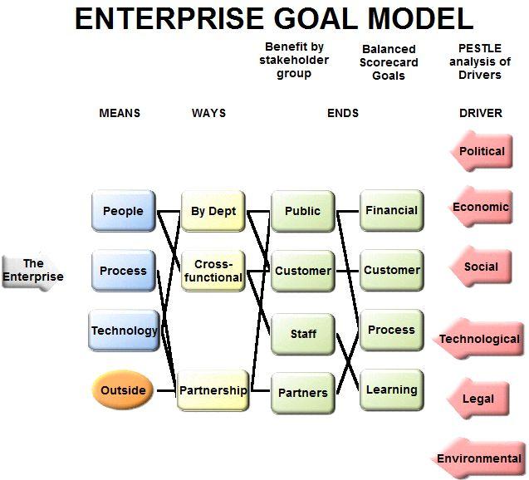
Benefits Dependency
Means – what you use
Ways – what you do
Ends – What you want
Notes:
Planning to realise the Goal through Means, Ways and Ends. A picture paints a thousand words. Mapping makes the links and dependencies clearer than tables in a business case.
The Benefits Map is one of the key tools in the Benefits / Value arena. It shows the chains of cause and effect between what you want, do and use. In this generic example the Drivers, the outside influences that make you act, fall into PESTLE categories. They don’t have to. It’s just a good way of analysing the context in which you have to operate.
Likewise, Objectives are split as per the Balanced Scorecard. Most objectives fit into quality of service, quantity of service, customer experience and finance.
Benefits are split by stakeholder. There is one stakeholder per benefit. If X is a benefit to customers and staff then X is two benefits. More likely, X isn’t a benefit at all but an enabler or outcome, something to be used to deliver benefits.
Ask ‘so what’ questions to decide where something fits in the chain.
People often confuse outcomes with objectives. “The new clinic is opened”. So what? You can do lots of things with it. It treats more people, better and quicker. Then the objectives are to do with clinical outcome and efficiency. The clinic is not an end in itself.
The distinction between benefits and objectives may not be so clear-cut. Sometimes the benefit is proof that the objective is being met, e.g. individual cost savings to meet an overall budget reduction. Sometimes the objective is to deliver benefits, e.g. raise average survival period for terminal patients by 6 months.
By thinking about the phraseology, we become clearer about what we are going to do and why it is important to us.
Activities may be in silos or multi-agent. They can be as simple as one step in a process or as complex as public-private partnerships.
Change managers split enablers into people, process, technology. Economists may use land, labour, capital, enterprise.
You don’t work in a vacuum so there’s bound to be some outside dependencies to consider as well.
These are all just tidy ways to help you break down your organisation in a logical manner. They are not mandatory, but they do help.

Slide 9
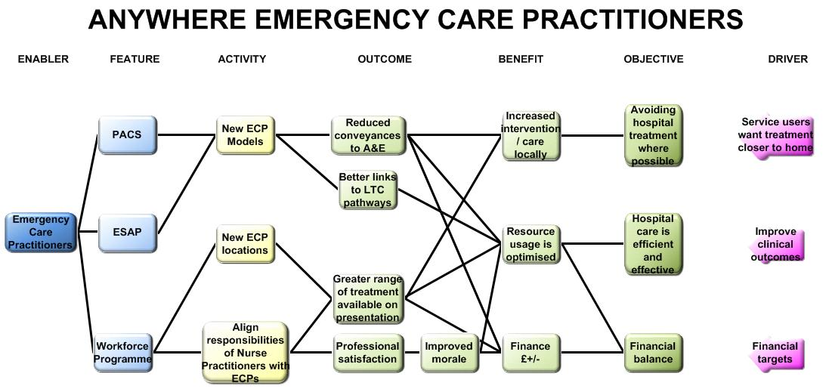
This is manageable
Notes:
Here’s a hypothetical example, reorganising ambulance services, emergency responders, ambulances parked in lay-bys, March 06.
The objectives are pretty generic and represent the high-level stakeholder groups of patients, policy makers and the organisation itself. All the connections are made. There are no dead-ends in the diagram, so everything has a purpose and contributes to the objective to some extent. The diagram starts the discussion about the relative contributions and allows decisions to be made about priorities and allocating resources.
This is manageable, a feasible amount of activity delivers selected benefits that are directly connected to the organisation’s objectives.

Slide 10
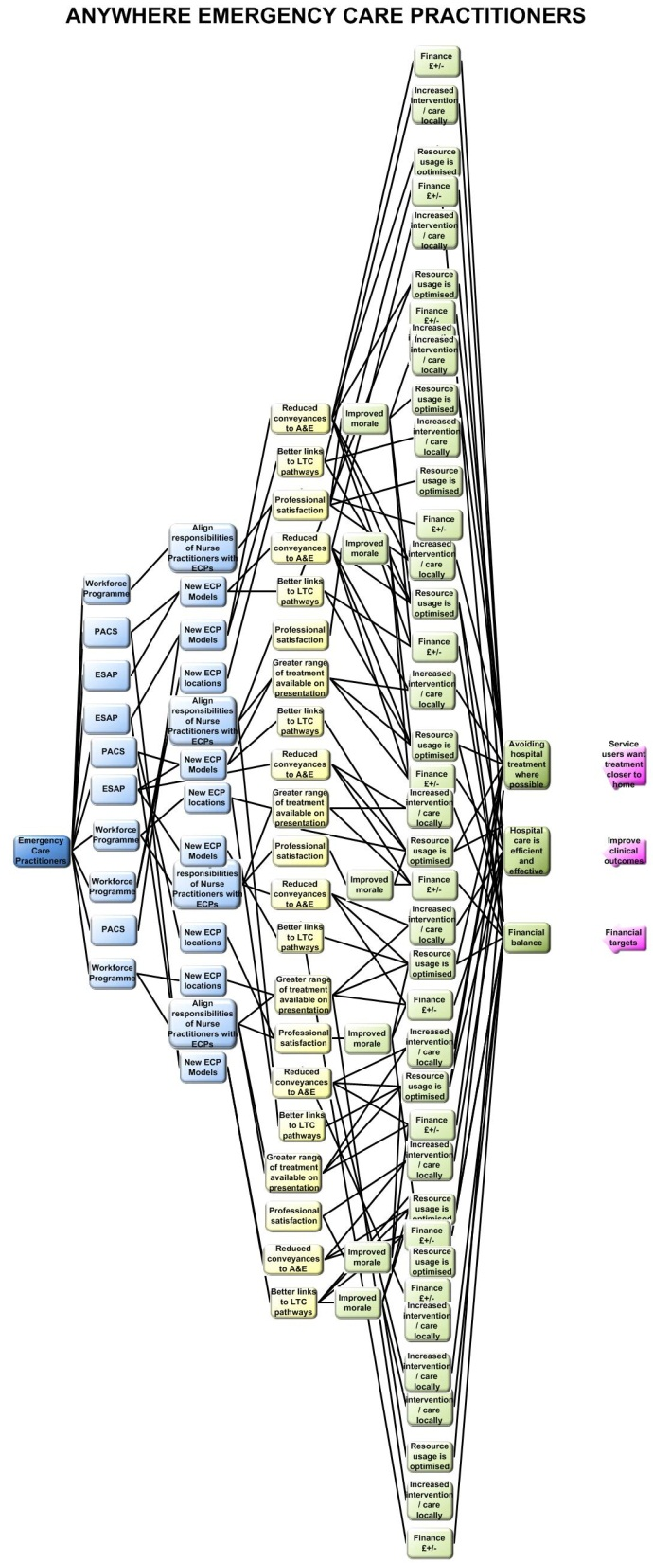
This is not
Notes:
Imagine that the programme had chosen 50 benefits instead of 3. Life gets much more complex here. Many business cases get drafted on the basis of quantity, not quality. The more benefits you put in, the more likely you are to be picked from the pack of competing business cases. Delivery is another matter though. Once you take the table of benefits out of the business case and map it you begin to see how impractical your project is.

Slide 11

Scrum
Notes:
The core of Agile project management. This is all about churning out working products in a continuous improvement production line of ideas to delivery to ideas again.
Agile BM is the approach that governs the ideas selected to feed this line.

Slide 12
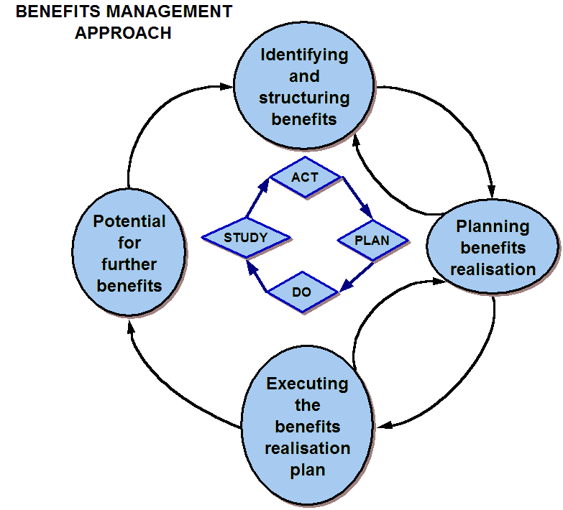
Making Stuff and
Using Stuff
Notes:
Scrum makes stuff. The business uses stuff.
Benefits and business change wrap around Scrum.
This BM approach maps onto the Deming Loop, PDSA cycle. Note that it starts with Act, not Plan. Make a decision, even if it’s only deciding to make a decision. The first few laps of the loop will be so quick that it doesn’t really matter where you jump in.
The benefits management approach is an iterative process with loops within the loop. It’s essential if the benefits are to be optimised that there is permission to step back and reconsider. Obviously, this has to occur within rigorous change control.
Remember, it’s an iterative process between stages as well as the whole process.

Slide 13
Sprint Ideas
The BDN sets the boundaries for the Sprint
Agile project management delivers the products and capability that fits the boundaries
New capability triggers the BM loop again. It’s a new Means so we look for a new End
Notes:
In the Sprint we work towards creating the products, the capability that serves our purpose. We make the Means that serves the Ends.
If new capability is discovered then we have to check that it’s useful. New Means may give us new Ends. So we test it for the benefits it could bring, select or discard it and move on.

Slide 14
Product Backlog
Benefit Ref No.
Benefit Title
Full description
Benefit Owner
Benefit Recipient
Related Prog Benefit
Value Type
Benefit Category
Objectives Supported
Enabler
Activity
Predicted / Target value
Probability of success (%)
Baseline Value
Delivery Timescale
Related Issues / risks
Benefit Measures:
What
Start date
Frequency
Who/how measured
Where it will be reported
Outcome Measures
What
Start date
Frequency
Who/how measured
Where it will be reported
Outcome used as lead indicator (Y/N)?
Assumptions / Comments
Date Accepted by Benefit Owner:
Date Approved by SRO:
Put rationality into MoSCoW
Use a Benefit Profile to capture requirements
Who’s it for?
What do they want to see happen?
How big a deal is it?
Fit the tool to reality, make it work in context
Ends from Ways from Means
Notes:
Scrum and Product Backlog has an assumption that the Product Owner has already done the analysis to select the best product increments to go in the Backlog. What have they used to make their MoSCoW selection? Where is their sense of proportion?
The Benefit Profile form has a lot of headings and can look intimidatingly methodical (or just plain boring) at first sight. It works well when everyone remembers that the tool should fit reality and we don’t force reality into the tool. It’s not so much the detailed list as the things that go into it. They are cultural and fit the enterprise in question.
The aim is to get the right thinking into the requirement, “I want these results (i.e. benefits) and I think this piece of functionality (product increment) will deliver them in the context in which I operate.” We phrase the requirement as Ends from Ways from Means, starting with the End in mind. This gets us away from the instant answer of, “I want this solution, the reasons are self-evident but hard to express”.
By describing each item in the Product Backlog using the same form and process, we can compare our options in a rational way by seeing their value relative to each other. The cultural context of the enterprise will have its own significant impact here. Some groups will go totally anal in the detail they complete. If that works for them, fine. Others will be fast and loose. Again, it’s whatever works. Where both types of group gain from the same process is that they’ve filled in the boxes in the form, in the right order, using a rational mindset and so have both raised the quality of the choices they make.

Slide 15
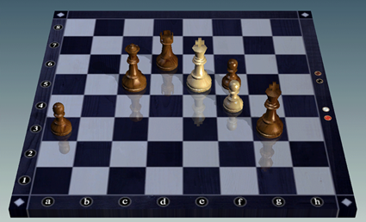
Scenario Planning
Options of what could happen and plans for our response
Pre-mortems on the projects, pretend that it all failed, why?
Treat it as an on-going chess game, each move changes the options for the next one

Slide 16
Things to watch
Preference for action over thinking keeps projects rattling along – but in the right direction?
Incubator test sites, thinking time – good for quick trials, need spare resources and must be able to drop things that won’t work
Fail and learn – don’t bet what you can’t afford to lose
Notes:
Preference for action, we’re back to the race without a finish analogy.
Incubators, great so long as you resource them properly and let them fail effectively if they have to. Know when to pull the plug and don’t blame the failures. Don’t even call them failures.
Effective failure means don’t bet the farm. No make or break gambles.

Slide 17
Discussion

